Slide 1
Firewall Issues BoF
5:00 Agenda bashing, find note-taker, sign-up sheets, IPR.
5:05 Introduction - Leon Gommans UvA
5:20 SOAP Routing Issues - Frank Siebenlist ANL
5:35 Securing Grid Services, Thijs Metsch Deutsche Aerospace
5:50 ESNET, PNNL and Fusion Grid, Michael Helm ESNet.
6:05 Grid-VPN RG BoF, Chan-Hyon Youn, co-chair Grid VPN RG BoF.
6:10 Charter discussion.
Co-Chairs:
Leon Gommans - lgommans@science.uva.nl
Inder Monga - imonga@nortel.com

Slide 2
Expressed Interest
GGF-12 Brussels: Sec Area meeting identified the need to start to work on “issues related to firewalls”.
Grid application level control is desired at both ends of a public network in case resources needs sharing.
Follow-up was done on Sec. Area mailing list and interest was shown. A charter discussion started.
Items brought up on list
  Make guide for firewall administrators
  This is a re-affirmation of a need
  Need well described requirement and market need
  Vendor participation is important
  Good for more rigorous IETF engagement
  Grid-Projects require special firewall configurations
  Pointers to relevant work in particular within HEP community

Slide 3
Examples of pointers to relevant work
GGF: Document GFD-37. Chapter 8 lists types of issues (performance, dynamic configuration, reliability, etc.) It points at IETF.
CERN: lcgdeploy.cvs.cern.ch/cgi-bin/lcgdeploy.cgi/lcg2/docs/lcg-port-table.pdf
Giving character of the problem by listing ports for LCG applications.
GLOBUS: http://www.globus.org/security/firewalls/
Von Welch: Globus Toolkit Firewall Requirements
EGEE: EGEE-JRA3-TEC-501422-Grid-Security-Incident-v-1.2 listing various types of grid security issues.
Research:
Theo Dimitrakos, Dave Chadwick: Policy-driven management of firewalls
UvA: Multi-domain network traversal based on wire speed security token handling in IP packets. Uses Generic AAA mechanisms to provision the token based switches equipment.
Other relevant area’s: Universal Plug and Play (UPnP),
Skype P2P VoIP using Midcom (e.g. STUN RFC 3489) to recognize a VoIP client is sitting behind firewall / nat.

Slide 4
Work done at IETF
Authenticated Firewall Traversal Working Group:
http://www.ietf.org/html.charters/aft-charter.html
Finished in 1996 with SOCKS RFCs 1928,1929 & 1961
GFD37 notes weak acceptance.
Middlebox Communication Working Group:
http://www.ietf.org/html.charters/midcom-charter.html
Nearly finished - RFCs 3303,3304,3489,3989 and 2 IDs.
Next Steps in Signaling (NSIS) Working Group:
http://www.ietf.org/html.charters/nsis-charter.html
Ongoing - june 05 present draft on FW/NAT signaling

Slide 5
Middlebox work
Are intermediate devices requiring application intelligence, in the area of:
Application specific policy based functions such as packet filtering, VPN tunneling, IDS etc.
NAT services providing routing transparency across IP address realms
Application level gateways examining/modifying content.
Definition Middlebox from RFC3303:
A Middlebox is a network intermediate device that implements one or more of the middlebox services. A Firewall middlebox is a middlebox implementing firewall service.
Traditional middleboxes embed application intelligence within the device to support specific application traversal. Middleboxes supporting the MIDCOM protocol will be able to externalize application intelligence into MIDCOM agents.

Slide 6
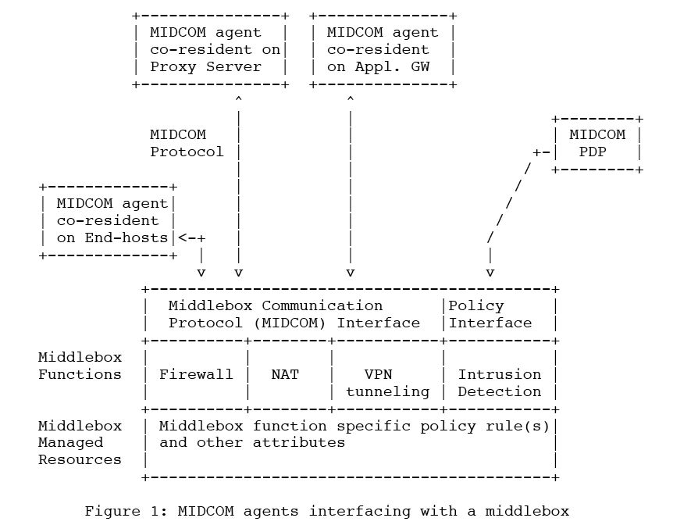
RFC 3303
RFC 3303 Middlebox communication architecture and framework.
Terminology: firewall, end-host, midcom agent, midcom pdp, midcom protocol, midcom session etc.
Architecture: identifies variety of midcom agents can interface with middlebox function

Slide 7
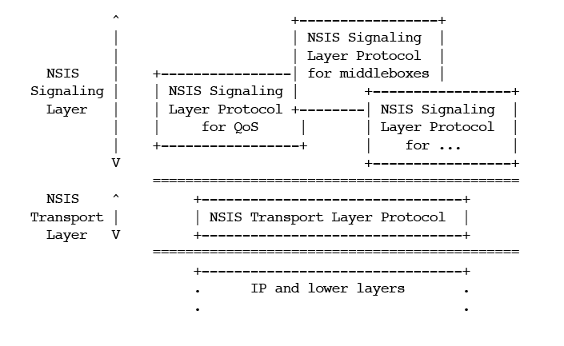
NSIS Signaling WG
Generalizes RSVP, a protocol for QoS style signaling.
RFC’s on requirements and drafts on framework, security and NSIS Signaling and Transport Protocols (NTLP/NSLP).
Work clearly recognizes that dynamic applications have issues when traversing Firewalls & NAT’s.
NSIS work however defers consideration of authorization.

Slide 8
Tasks to be done by FIG
  As seen for example by Ralph Niederberger,
  Forchungs Zentrum Julich, Germany:
  Checking which protocols, procedures, mechanisms are available already
  Evaluating, which of these can be used to reach the defined goals
  Definition of the new protocols, datastructures and security mechanisms
  (Implementing a prototype)
  Strategic objectives will be to define a standardized authorization mechanism accepted and implemented by firewall vendors into their systems so that grid enabled firewalls will become reality

Slide 9


Interactions GGF
Firewall/NAT
Solution developers
Solutions developers
are lifted out of
both GGF and IETF
communities

Slide 10
Interactions GGF
Firewall/NAT
Solution developers
Study interactions

Slide 11
Interactions GGF
Firewall/NAT
Solution developers
Grid Specific
Requirements
Definition
Requirements
Document

Slide 12
Interactions GGF
Firewall/NAT
Solution developers
Solution
(Protocol)
Development
Liaison
functions

Slide 13
Interactions GGF
Firewall/NAT
Solution developers
Offer
Interoperable
Grid Specific
Solutions
Uses
Solutions
Yield
Stakeholder Value

Slide 14
FIG Charter
Description of Work:
Grids increasingly require application driven transport privileges from the network. As such, the network is asked to make policy decisions on behalf of the various entities participating in an application's operation. A need has developed for Grid applications to communicate its requirements to the devices in the network that provide transport policy enforcement. Examples of such devices include firewalls, network address translators, and other gateway style devices.
This working group will focus its attention to issues that Grid applications experience when the need arises to control NAT/firewall functions. Some examples are highlighted in GFD.37. The work will not preclude extensibility to other categories of what the IETF refers to as “middle-boxes”.
This working group will concern itself with an environment that consists of:
- one or more NAT/Firewalls in the data path. NAT/Firewalls may be external network devices or they may be integral to a host. There may also be application/xml-soap level firewalls involved.
- a requesting Grid application
- an optional policy decision point in which a firewall acts as enforcement point deploying models such as described in GFD.38.
A requesting entity may be trusted or untrusted. In the case where it is trusted, the “middle box” will treat the request from the entity as authoritative. In the case where it is not trusted, the intermediate device will have to verify that it is authorized to complete the request. Authorization could originate from a separate, or a built in policy server. Policies can be created manually or automatically.
The working group will evaluate existing IETF models, architectures and protocols for their applicability to the set of issues identified in the Grid and will deliver a document(s) that will recommend possible solutions and modifications to current protocols, if any, to the attention of the IETF. The output will be actively promoted within the firewall vendor community.
The IETF work that will at least be considered is the output of the following groups:
- midcom - "middlebox" communication: http://www.ietf.org/html.charters/midcom-charter.html
- aft - Authenticated Firewall Traversal: http://www.ietf.org/html.charters/aft-charter.html
- nsis – Next Steps in Signaling: http://www.ietf.org/html.charters/nsis-charter.html
Input and participation from the vendor community is explicitly encouraged. Existing documents from the grid community will be used as starting point.

Slide 15
FIG Charter
Goals and Milestones:
Submit after GGF15 informational document(s) that will focus on
1) An inventory of the issues with use-cases when Grid jobs must
deal with firewall functions.
2) Subsequently technically describe and classify the issues
in document #1
3) Evaluating existing IETF protocols and firewall functions
for their suitability.
4) Recognize possible limitations of an identified firewall
function and/or protocol and produce a list of requirements
towards the IETF and interested firewall vendors.
5) Discuss and capture recommended approaches and solutions
addressing the grid-specific issues and distribute towards
the IETF and interested firewall vendors and capture
results of 3-5 in document #2
GGF13: Charter discussion and group volunteers
GGF14: First draft and Group discussions
GGF15: Second draft and Group discussions. First draft of
recommended approaches and solutions
December 2005: WG last-call and final submission of document #1.
GGF 16: Second draft and group discussions
May 2006: WG last-call and final submission of document #2.

