Slide 1
Combined BoF on:
Common Information Model based Grid Information Service (CIMGIS) and
Common Schemas for Interoperability (CSI)
GGF 5, Edinburgh, 22.7.2002

Slide 2
Agenda
Introduction, agenda bashing
  Peter Gietz, DAASI International (5 minutes)
Introduction to GLUE Schema and the CSI charter
  Jenny Schopf, Argonne National Laboratory (10 minutes)
Introduction to CIM
  Ellen Stokes, IBM (10 minutes)
CIM and OGSA
  Carl Kesselman, USC/Information Sciences Institute (10 minutes)
Implementing CIM
  Viktor Mihajlovski, IBM (10 minutes)
Proposed Charter
  Peter Gietz (10 minutes)
Discussion of the proposed charter(s)
  (35 minutes)

Slide 3
Charter Discussion
Questions:
  Shall there be a CIMGIS WG?
  Shall there be a combinded GLUE-CIM-activity?
  How does the GLUE schema fit in existing CIM classes?
  What should the focus of such a WG be?
  What documents should such a WG produce?
  What time frame should be defined?

Slide 4
CIM: What is it?
Common Information Model
A standard of the DMTF with lots of participation of big players like IBM, SUN, HP, Cisco
Designed to provide a common mechanism to describe data about entities for managing computers (and networks)
Follows the object oriented paradigm
Capable of defining anything

Slide 5
CIM and other technologies
Designed to be interoperable with other technologies
Can (e.g. via mappings) be used with, e.g.,
  Relational databases
  XML
  LDAP
Ideal means of interoperability
Thus it fulfills the same purpose GOS was designed to fulfill
Is discussed to be used in OGSA

Slide 6
www.daasi.de/wgs/CIMGIS

Slide 7
What does CIM define?
The metaschema
The Core Model
  Providing lego bricks for defining things
  a basic vocabulary for analyzing and describing managed systems
The Common Model
  CIM Definitions of entities in the computer world, such as system, device, application, network
  Agreed upon by all participants, usable by all
The Extension Model
  Possibility to define vendor specific stuff
  Not part of the standard
Infrastructure for transport and
conversion of information

Slide 8
What does the meta schema provide?
Classes
Properties
Methods
Associations
Triggers
Indications
Qualifiers

Slide 9
Classes
Describing objects, a type of thing
  Instances of classes: descirbing a special object, a thing
Classinheritance: A subclass inherits qualities of the superclass
A Class can have:
  Properties: Attributes of the Class
  Methods: functions connected with a Class

Slide 10
Properties
value used to denote a characteristic of a class
Sort of a pair of functions:
  one to set the property value
  one to return the property value.

Slide 11
Methods
An operation describing the behavior of a class
A method can have an override relationship with another method from a different class
  The domain of the overridden method must be a superclass of the domain of the overriding method

Slide 12
Special Class Association
Associations: defining relationships between Objects
  Properties of Associations are references pointing to the related classes
  Special Association is Aggregation having aggregation relationship as property

Slide 13
Special Class: Indication
An object created as a result of the occurrence of an event
Event is a status change noticed by a Trigger
Indication is related with zero or more triggers via an association
Triggers can create instances of the Indication

Slide 14
Qualifier
Metadata to characterize classes, properties, methods and other elements of the schema
qualifier has:
  a name
  a type
  a value of this type
  a scope
  a flavor
    EnableOverride, DisableOverride,
    ToSubclass and Restricted,
  a default value

Slide 15
MOF
The primary way of specifying schema in CIM is through the Managed Object Format (MOF)
A compiled language created by the DMTF and based on the Interface Definition Language (IDL)
Used to define static or dynamic classes and instances
C like syntax

Slide 16
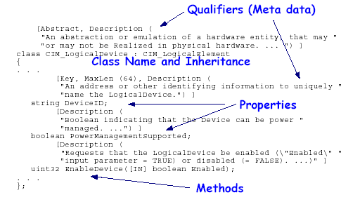
Example
Source: White Paper: Common Information Model (CIM) Core Model, Version 2.4, August 30, 2000

