Slide 1

Trusted Computing for
Grid Security
(Joint work with ChinaGrid)
Wenbo Mao
Principal Engineer
Hewlett-Packard Laboratories, Bristol
Bristol, United Kingdom
Presented to TC-BoF, SEC Area,
13th Global Grid Forum
Seoul, March 2005

Slide 2
What’s in this Presentation
Overview of Trusted Computing
TC Working Principle
TC for Grid Security

Slide 3
Trusted Computing Background
For a systematic fix of security problems with open platforms, while remaining in open-platform architecture
Preventing the release of critical data into undesired software environments.
Conformed platform/user security policies: even an administrator can’t override policies
Avoids the worst of crypto import/export regulations (block cipher, e.g., AES, is off-the-chip), hence ready deployment world wide.
Low cost (target: < $5 per platform).

Slide 4
History – From TCPA to TCG
Founded in 1999 as
Trusted Computing Platform Alliance (TCPA) by:
Compaq
HP
IBM
Intel
Microsoft
Renamed to Trusted Computing Group (TCG) in 2003
when TCPA reached 190+ member companies

Slide 5
The Trusted Computing Group
The Board
Technical Committee
Marketing Committee
TPM
Conformance
PC-specific
PDA
Mobile ‘phone
Servers
Infrastructure
Peripherals
HDD
Keyboard
Promoted by: AMD, HP, IBM, Intel, Microsoft, Sony, Sun

Slide 6
Trusted Platform Architecture
App1
App2
App3
.……
App n
protected
executables
encrypted
files
OS
TPM
Boot Processes
keys &
passwords
measurement & reporting

Slide 7
Deployment of Trusted Platforms
TPM
v1.1b
First generation platforms from
HP and IBM – available since 2004
This notebook machine has one
TPM
v1.2
Second generation platforms based on
new offerings (eg, measurement, attestation)
from AMD, Intel, MS – available 2006 ?
TPM (security chip) vendors
Atmel, Infineon, National Semiconductor

Slide 8
TCG Benefits
  TCG is designed so that platform identities and Integrity Metrics can be proven reliably to remote parties
  Secure storage of crypto keys in TPM
  X.509 to be widely deployed in the vast client environment
  Secure online discovery of platforms and services: confidence in the information about the software environment and identity of a remote party
  Protection against hacker scripts, by automatically preventing access to data if unauthorised programs are executed

Slide 9
What’s in this Presentation
Overview of Trusted Computing
TC Working Principle
TC for Grid Security

Slide 10
Trusted Platforms use Roots-of-Trust
A Root-of-Trust is a component that must behave as expected
A Trusted Platform Module (TPM) is a hardware based implementation of roots-of-trust (normally on a single chip, ``System-on-Chip’’)
The Trusted Computing Group has created specifications for V1.1 and V1.2 TPMs

Slide 11
How it Works….
TCG mechanisms for:
  Protected Storage and Execution
    Protect private and secret data
    Protected environment against malicious code subversion
  Platform Integrity Measurement and Storage
    Reliably measure software integrity property
    Securely store measured platform and s/w integrity
  Platform Status Attestation
    Report integrity properties to a remote challenging party
      Using crypto challenge-response mechanism and digital signature

Slide 12
Trusted Platform Module (TPM, Hardware): Protected (tamper-resist) Storage and Execution
Hash
Processor
NV-memory
Asymmetric
key generation
RNG
Memory
Power detection
Digital sign &
asymm crypto
Clock/Counter
Communications
I/O
MAC
PCR

Slide 13
TPM Crypto
Systems on the Chip:
SHA-1 hash, HMAC (hashed msg authentication code)
Random number generation (physical)
Asymmetric key generation (2048-bit RSA)
Asymmetric crypto encryption and signing(RSA PKCS#1v2)
Symmetric crypto is performed off-chip
(to achieve high performance and avoid exportation control)

Slide 14
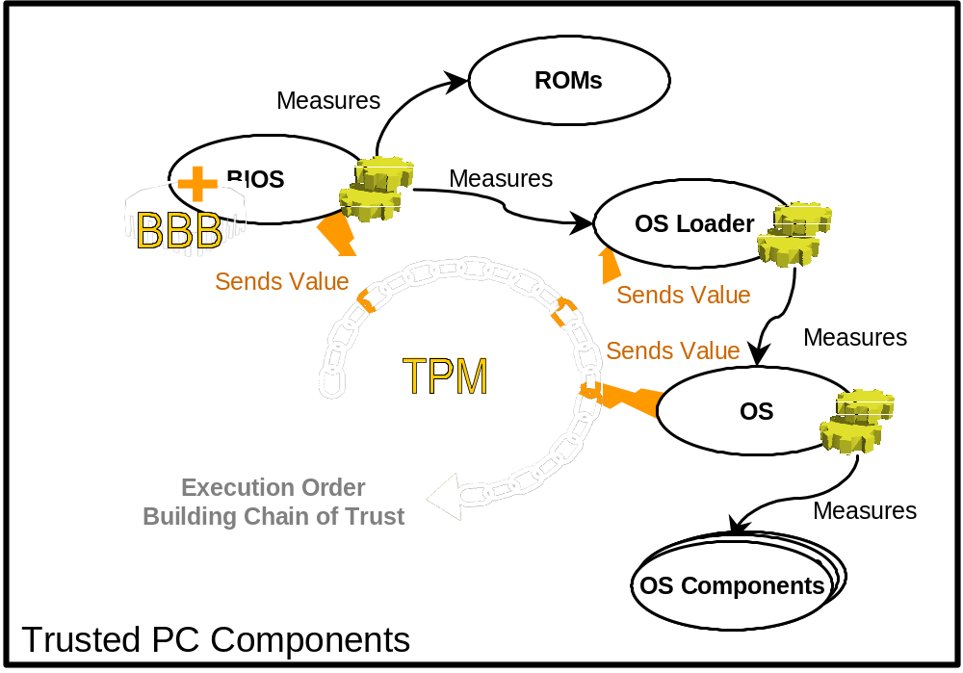
Core Root of Trust for Measurement (CRTM): Authenticated Boot

Slide 15
Integrity Measurement and Storage:
Platform Configuration Register (PCR)
An integrity measurement of an executable is a SHA-1 hash of 160-bit checksum (aka “crypto digest”)
The integrity measurement of executables is cumulatively stored in a PCR:
    PCR ← H( executable || PCR )
What can be measured and cumulatively stored (cannot be overwritten until reboot):
  BIOS, ROMs, MBR (static PCRs: no 0-4)
  OS loaders (static PCRs: no 5-7)
  Trusted OS’s (static PCRs: no 8-15)
  Trusted Applications (dynamic PCRs: no 21-22)

Slide 16
Platform Attestation: Reporting System Integrity Status to a Remote Party
Stored system integrity status can be reported to a remote party using crypto challenge-response mechanism and digital signature
TPM will use a user’s “attestation identity key (AIK)” to sign the system integrity report
  1 Alice → TPMForBob: RandomN, PCR3
  2 TPMForBob → Alice: Sign_{privateAIK}(RandomN, PCR3)
  3 Alice verify the signature using Bob’s publicAIK

Slide 17
What’s in this Presentation
Overview of Trusted Computing
TC Working Principle
TC for Grid Security

Slide 18
TCP for Grid Security “Offer I”:
Secure Key Storage
Tamper-resistant TPM is a natural place to store crypto keys, no need of using short-lived keys and “proxy certificates” with private key stored in file space
TPM of a client can be for multi users, each user can have a user key which can’t even be accessed by sys-admin
Secure key storage permits a longer lifetime for a certificate; it can be easier to achieve IPSec for Grid security at the node level, rather than being confined to “identity certificate” at the user level as in the case of the current GSI

Slide 19
TCP for Grid Security “Offer II”: group-oriented security from distributed FW
A conventional firewall is based on network topology: one-side is all trusted, the other side is assumed all enemies; but a Grid VO has no such network topology
Distributed firewall (Bellovin et al):
  With secure means for key storage by each IP node, IPSec can be in place
  IP packets can be filtered or accepted according to VO policy and IPSec signatures (in IPSec, each packet is signed)
With distributed firewall, a Grid VO forms a trust domain and achieves good group-oriented security

Slide 20
TCP for Grid Security “Offer III”:
Attestation of Secure Guest Environment
Secure Guest Computing:
A remote platform (eg, a Grid server) is attested by a guest such that it has the following virtualization & compartment behaviour:
    (1) a memory area is allocated to run a virtualized secure OS environment which cannot even be accessed by the platform owner (eg, system administrator);
    (2) a proprietary code of a guest is encrypted under a public key of the server where the matching private key is in the TPM; the encrypted code is sent to the TPM;
    (3) TPM decrypts and loads the proprietary code to run in the virtualized OS for the guest …
No conventional security mechanism can offer a solution to this typical Grid computing scenario. It is the innovation of remote platform attestation that plays the trick.

Slide 21
It’s time to work on “TC for Grid Security”
“Offer I” is available now (this machine has a TPM v1.1b)
  so “Offer I” is readily compatible with GSI
  node level certificate is ready for realizing IPSec
  user level certificate is ready for property-based credentials
“Offers II & III” address exactly fundamental limitations of GSI; the issue here is to augment GSI
  IPSec deployment will be sped up by TCP, hence distributed firewall should start consideration for GSI
  integrity attestation is with TCP v1.2 and beyond (available in 2006); virtualization work is now underway
Future: with Grid & TCP both having open-platform architecture, they can co-develop without major obstacle

Slide 22


