Slide 1

Security Requirements for ChinaGrid Applications
- What the current grid security solutions cannot do
Hai Jin
Huazhong University of Science and Technology Wuhan, China
hjin@hust.edu.cn

Slide 2
Outline
Introduction about ChinaGrid
Typical ChinaGrid applications
ChinaGrid security requirements
Open Issues of ChinaGrid Security

Slide 3
ChinaGrid in a Nutshell
China Education and Research Grid
Funded by Ministry of Education
As the pilot grid application supported by National 863 Hi-Tech R&D program
Based on CERNET (China Education and Research Network)
First Phase
  From 2003-2005
  12 key universities as initiative
  More than 6Tflops w/60TB
  20 key universities now

Slide 4
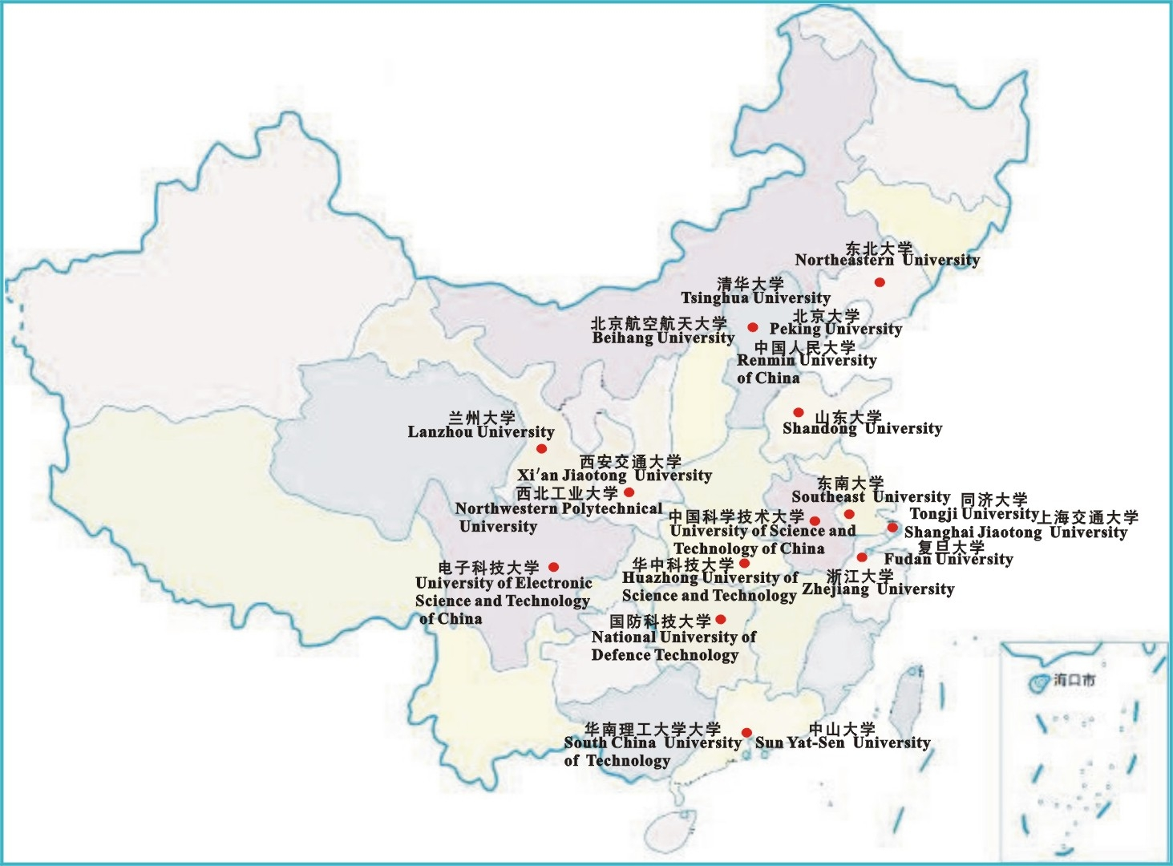
ChinaGrid (The First Phase)

Slide 5
Main Research Tasks
Campus grid platform
Common platform for ChinaGrid
Grid application platform and representative grid applications
  Image processing grid
  Bioinformatics grid
  Course on-line grid
  Computational fluid dynamic grid
  Large scale information processing grid

Slide 6
Campus Grids and their Computing Power and Storage Capacity
HUST：0.8Tflops, 5TB
THU：1.3Tflops, 20TB
PKU：0.5Tflops, 10TB
BUAA：0.5Tflops, 5TB
SCUT：0.9Tflops, 20TB
SJTU：0.3Tflops, 9TB
SEU：0.5Tflops, 5TB
XJTU：0.1Tflops, 2.5TB
NUDT：0.2Tflops, 5TB
NEU：0.8Tflops, 5TB
ZSU：1.0Tflops, 10TB
SDU：1.3Tflops, 18TB
NWPU：0.4Tflops, 2TB
ZJU：0.6Tflops, 3TB
FUDAN：1.8Tflops, 6TB
TONGJI：0.2Tflops, 1TB
USTC：1.2Tflops, 5TB
UESTC：0.3Tflops, 2TB
RUC：0.1Tflops, 0.5TB
LZU：0.3Tflops, 1TB
ChinaGrid：>13Tflops, 135TB

Slide 7
Layered Infrastructure of ChinaGrid
PKU
SJTU
XJTU
ZSU
NEU
HUST
SCUT
BUAA
NUDT
Remote
SEU
Image
education
Fluid
THU
processing
dynamics
SDU
grid
grid
grid
Massive
information
Bioinformatics
processing grid
grid
ChinaGrid Supporting Platform (CGSP)
High performance computing environment
(campus grid)

Slide 8
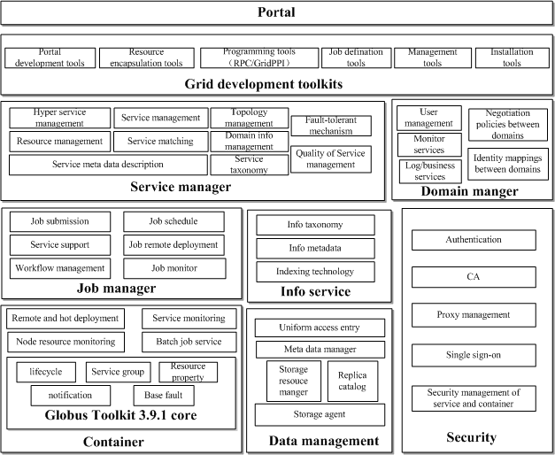
CGSP1.0 Architecture

Slide 9
Typical ChinaGrid Application
- Image Processing Grid
Grid
Interface
Portal and Application Interface
Application Middleware
Image resource
sharing
Image process programming environment
Typical application support
Application monitoring tool
Remote
visual
tools
Grid Infrastructure
Information service
Resource manager
Data manager
Grid security
Grid Resource
Clusters
Mainframes
Instruments
Databases

Slide 10
Workflow of Image Processing Grid Application - Remote Sensing
Remote Sensing
Original Image
Original Image Signal & Auxiliary Data Distill
Optical Original Image
Meta-data
Pre-Processing Layer
Image Radiation Validity & System Geometric Validity
Validity Image
Precise Check Image
Multi-Source & Physic Data
Data Processing Layer
Increment
Comeback
Transfer
Encoding
Single Breadth &Multiple-Spectrum Data
Info Abstract Layer
Automated Match
Histogram Statistic
Division
Classification
Description
Abstraction
Compound Data
Features, Identifier, Knowledge Data
Image Description & Inference
3D Model
Scenario Back
Identification
Knowledge Layer
Application:Resource Monitor, Modification Check,
Target Identify, Image Spelling, Map Navigation etc

Slide 11
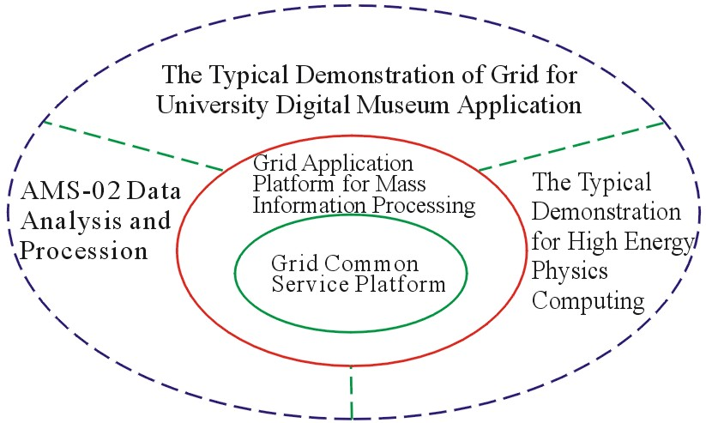
Typical ChinaGrid Application
- Massive Information Processing Grid

Slide 12
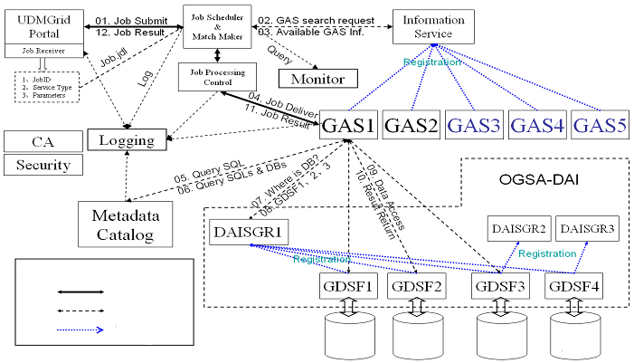
Workflow of Mass Information Processing Grid (UMDGrid)
Control Flow
Data Flow
Static Registry
BUAA
SDU
NJU
KMST

Slide 13
ChinaGrid Security Requirements (1)
Security requirements for ChinaGrid platform
  Interoperate with existing security infrastructures
  Adapt to domain autonomy
  Meet the security requirements of various applications
  Construct security architecture
  Trusted computing for platform legality

Slide 14
ChinaGrid Security Requirements (2)
Security requirements for image processing grid
  Basic security requirement (encryption transfer and authentication)
  Protect sensitive information produced by remote image processing
  Service (including key data, key software, key hardware) authorization requirement - for virtual human and remote sensing image processing grid
  User-profile based sensitive record authorization requirement (a decentralized trust management problem) - for medical image diagnosis grid
  Security requirement for virtual organization based collaboration processing (more general and abstract level)

Slide 15
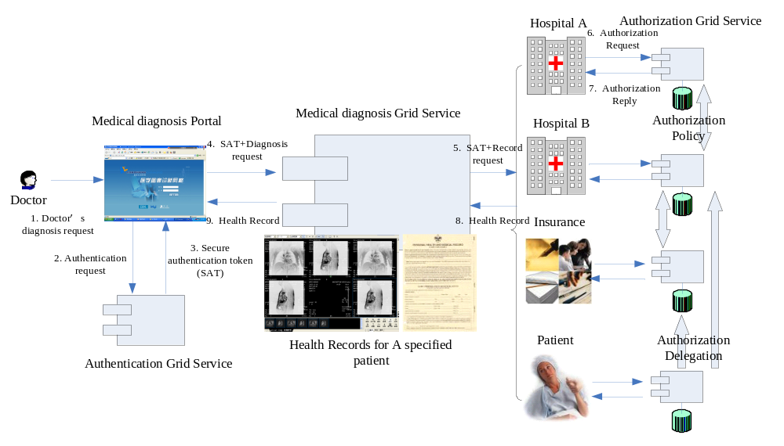
Scenario for Image Processing Grid (Medical Diagnosis)

Slide 16
ChinaGrid Security Requirements (3)
Security requirements for massive information processing grid
  Basic security requirement (encryption transfer and authentication)
  Database security operation requirement (to deal with federation of distributed information) - for UDMGrid and DPKDD Grid
  Data access authorization for different users in cooperative processing

Slide 17
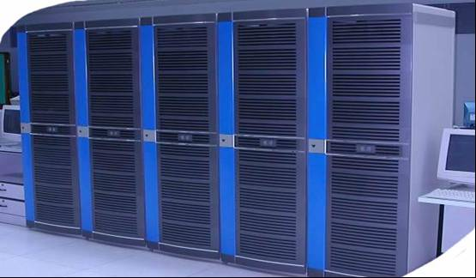









Scenario for Massive Information Processing Grid (University Digital Museum)
SDU
NJU
Database
Computing
Resource
Users
Users
Authentication
Authentication
Service
Service
Authorization
Authorization
Service
Service
Authorization
Admin
Delegation
Admin
BUAA
Mass Storage
Users
Authorization
Authentication
Authorization
Delegation
Service
Delegation
Authorization
Service
Admin

Slide 18
Open Issues for ChinaGrid Security (1)
Technical aspects
  Standard policy and assertion presentation
  Attribute based authorization and access control
  Autonomous authorization delegation
  Dynamic and flexible secure virtual organization collaboration
  Secure group communication (provide secure group communication mechanism for VO participants)

Slide 19
Open Issues for ChinaGrid Security (2)
Practical aspects
  Support Web Service/Grid Service
  Adopt standard draft and implement for policy and assertion (SAML, XACML)
  Conform to some security drafts, such as WS Security, Liberty Alliance
  Adopt ideas from some existing authorization infrastructure, such as PERMIS, AKENTI, CARDEA
  Adopt ideas from Single Sign-on (SSO) systems, such as Shibboleth and SourceID (for the SSO in a virtual organization)
  Adopt some ideas from decentralized trust management for Authorization Delegation

Slide 20
Open Issues for ChinaGrid Security (3)
Some aspects need to be further discussed
  Security policy negotiation and reconciliation inside the virtual organization (because of security policy conflict in VO)
  ChinaGrid security architecture
  Evaluation for ChinaGrid security technology and policy
  Trusted computing mechanism for ChinaGrid

