Slide 1
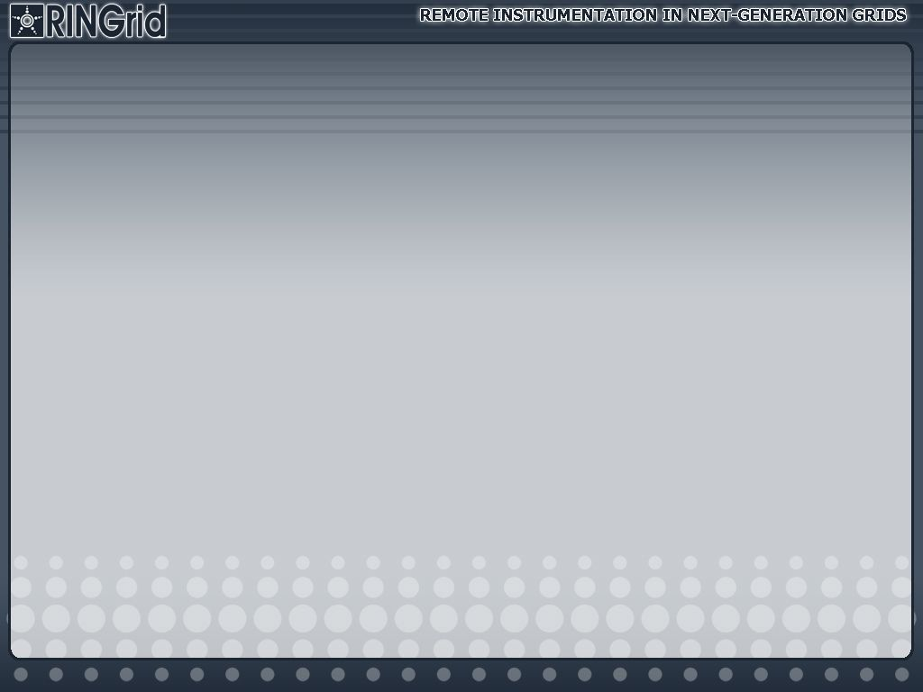

Instrumentation requirements for advanced e-Infrastructure
Norbert Meyer
Poznań Supercomputing and Networking Center
Notes:
Outline
Current state
Examples
Future activities – RINGRID, Express
Functional requirements
Integration of instrumentation and e-Infrastructure
Summary

Slide 2

Virtual Laboratory
http://vlab.psnc.pl/

Slide 3
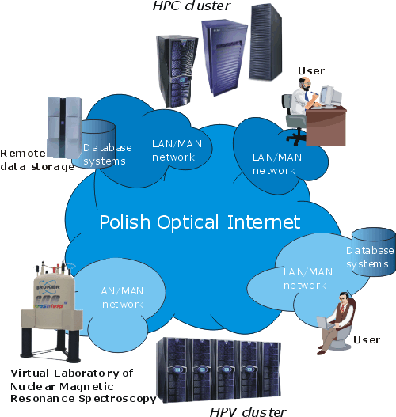
Virtual Laboratory overview
A distributed environment, providing its users with the following functionality:
Remote access to complex and expensive laboratory research equipment
User-customized Dynamic Measurement Scenarios
Digital Science Library
Data storage and management
Educational potential
Workgroup collaboration tools

Slide 4
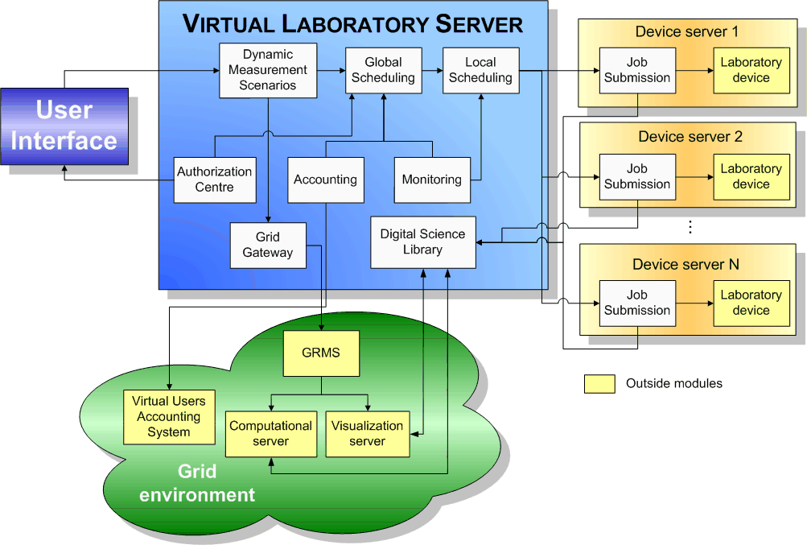
Vlab - Architecture
Notes:
Following the architecture overview, presented on previous slides, we can distinguish 4 main subcomponents of the VLAB:
the user interface – simply navigates the user throughout the entire environment
The VLAB server – introduces the functionality in grids
The grid environment – support and empowers the user to use the HPC/HPV
Devices – encapsulate the specialized facilities in heterogeneous environment and allows to see it like a simple grid resource

Slide 5
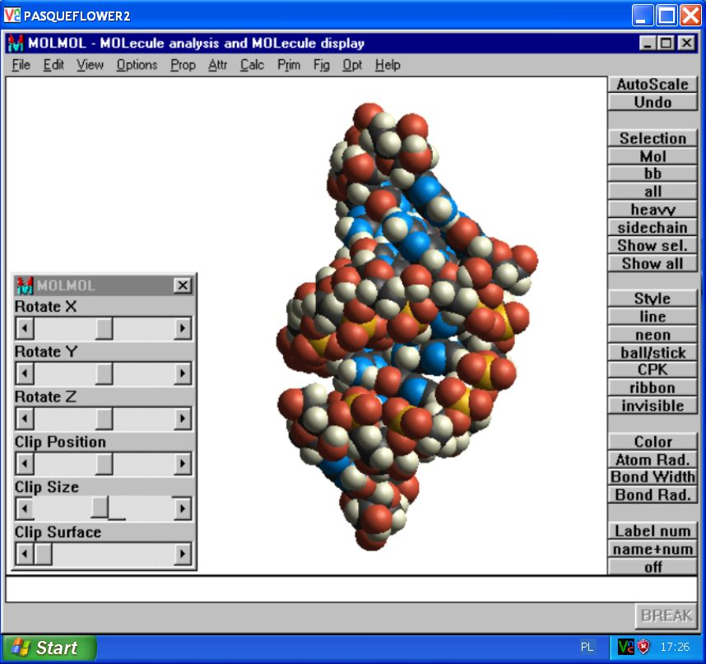
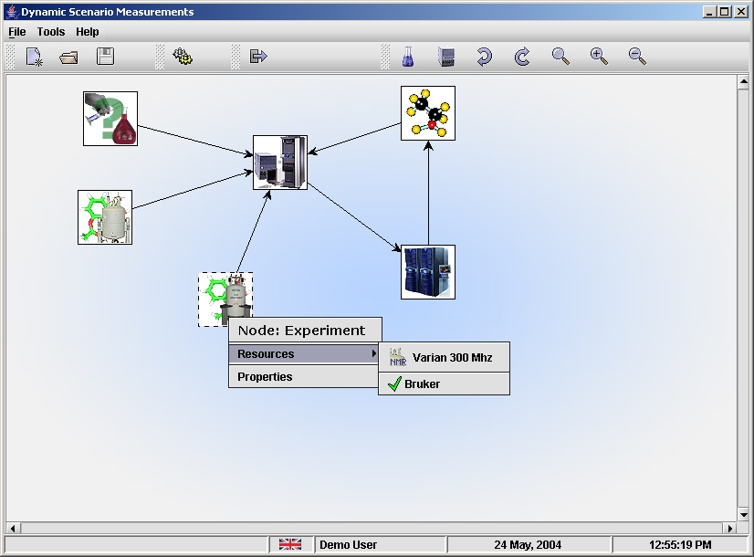
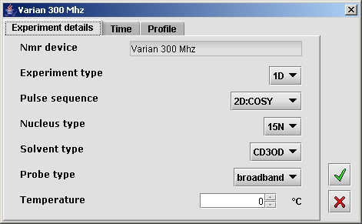
Scenario Submission Application
The user is welcome to create the measurement diagram using the Scenario Submission Application (SSA).
Scenario Submission Application

Slide 6
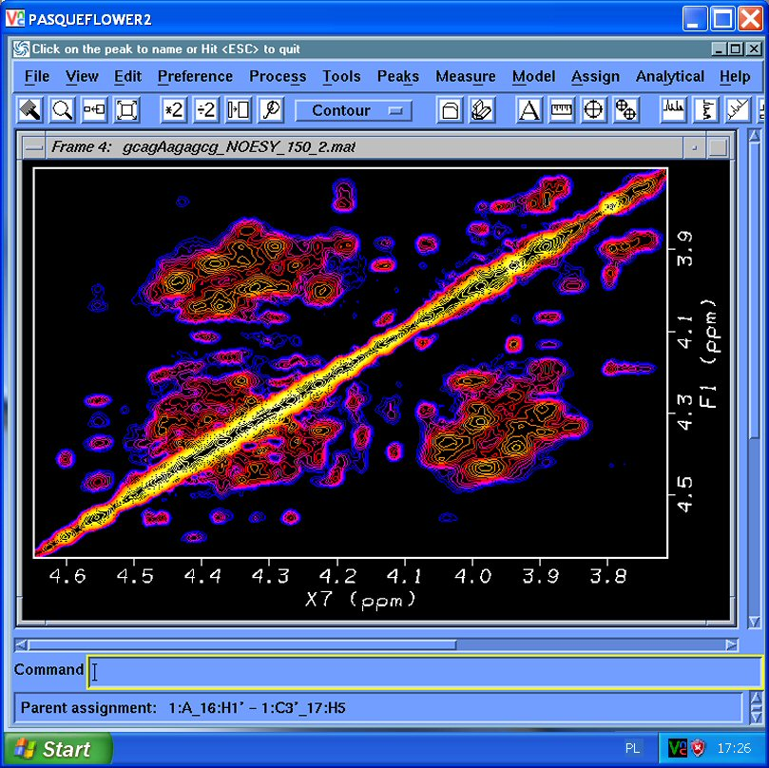
Visualization
Interactive access to visualization applications from the VLab portal

Slide 7
Conclusions (#1)
General framework
Integrates labour facilities with Grid environment
Testbed installation
Missing
  towards production infrastructure
  worldwide approach
    limited number of facilities
  sustainability
  enhanced architecture – vision of the future

Slide 8
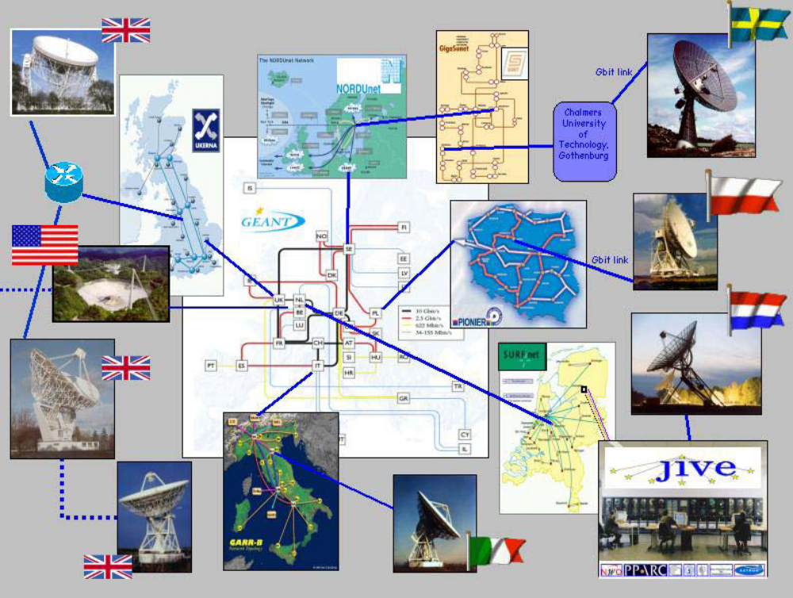

e-VLBI
pilot
VLBI is a technique, in which physically independent and widely separated radio telescopes observe the same region of sky simultaneously, in order to generate very high-resolution continuum and spectral-line images of cosmic radio sources

Slide 9
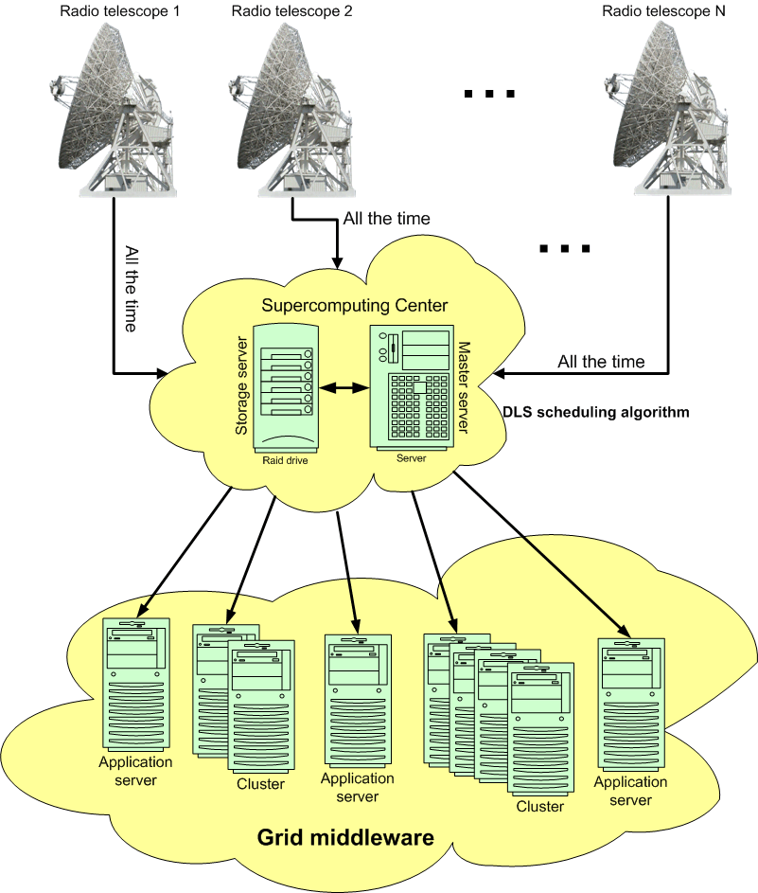
A Production Astronomy e-VLBI Infrastructure
VLBI approach:
Data are sent and correlated at the central point (JIVE – Joint Institute for VLBI in Europe)
e-VLBI:
The total flow of data into the central processor is approximately 10-100 Terabytes per single observation, after processing this is reduced to 10-100 Gbytes
Distributed correlation used in Expres project, supported by grid

Slide 10
RINGrid
Remote Instrumentation in Next-generation Grids
Specific Support Action
Contract no. 031891
18 months: from October 2006 – March 2008

Slide 11
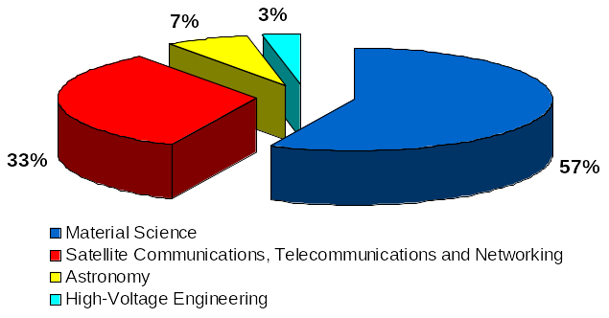
RINGrid
Objectives:
Identification of instruments and user communities, definition of requirements
Synergy between remote instrumentation and next-generation high-speed communications networks and grid infrastructures
Trend analysis and recommendations for designing next-generation remote instrumentation services
1st Phase:
Identified 30+ instruments
representatives and
requirements

Slide 12
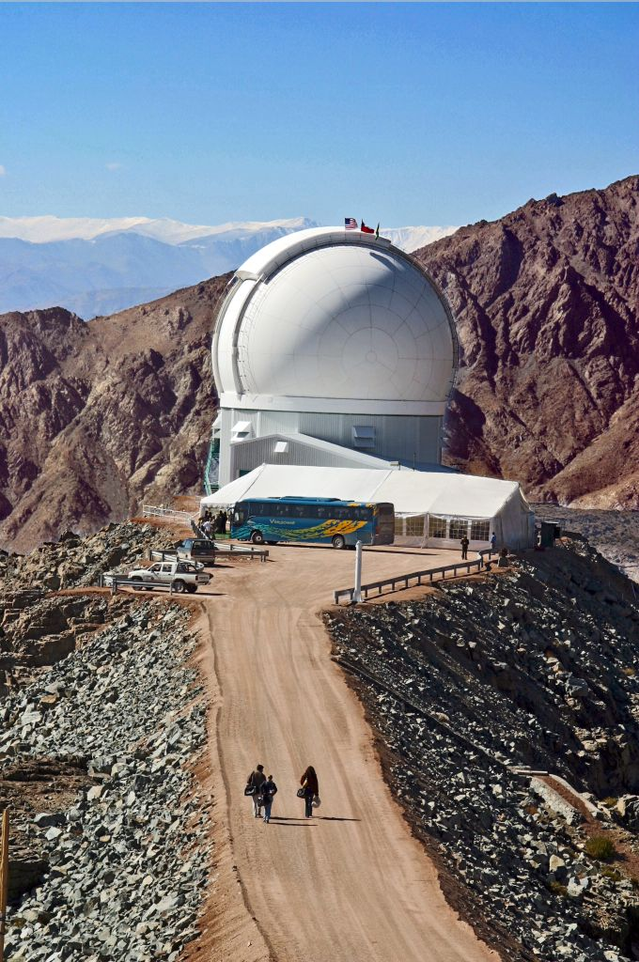
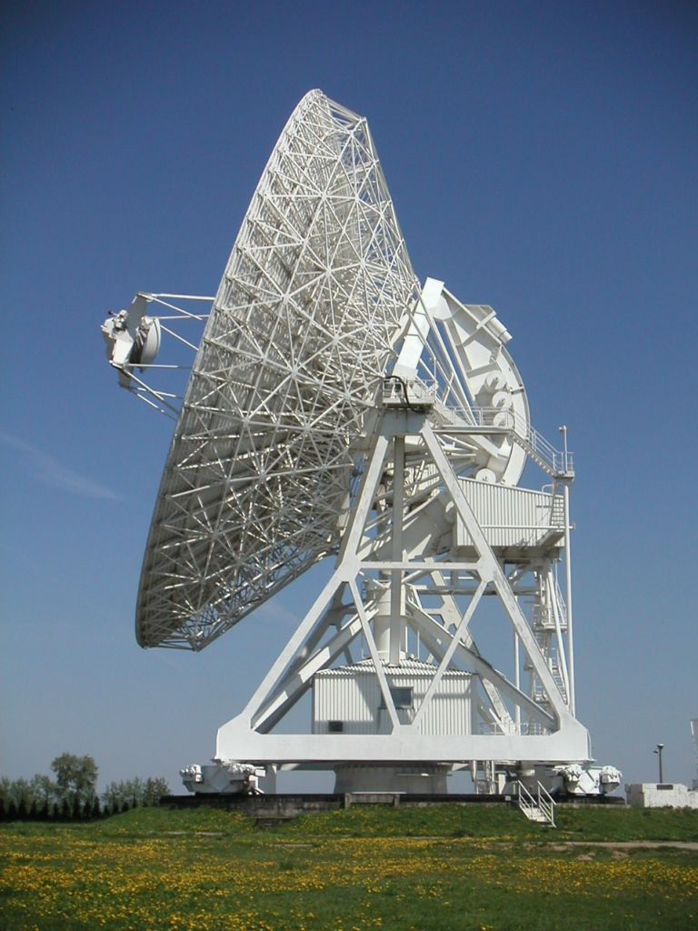
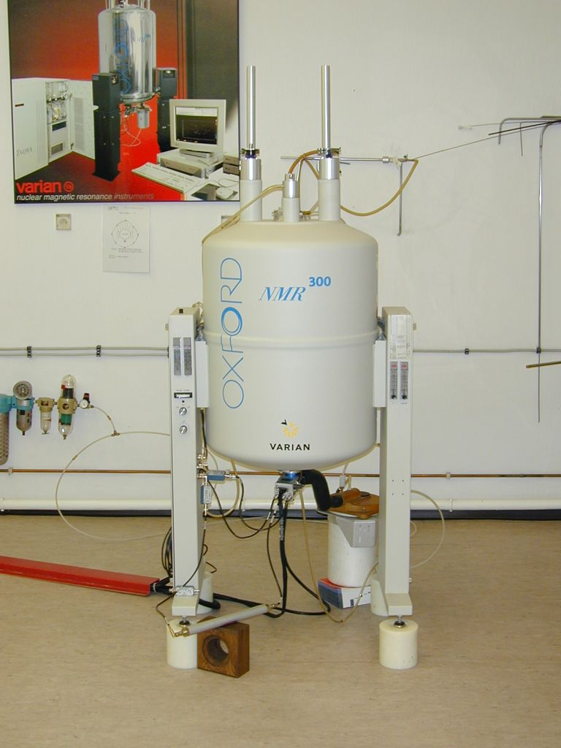
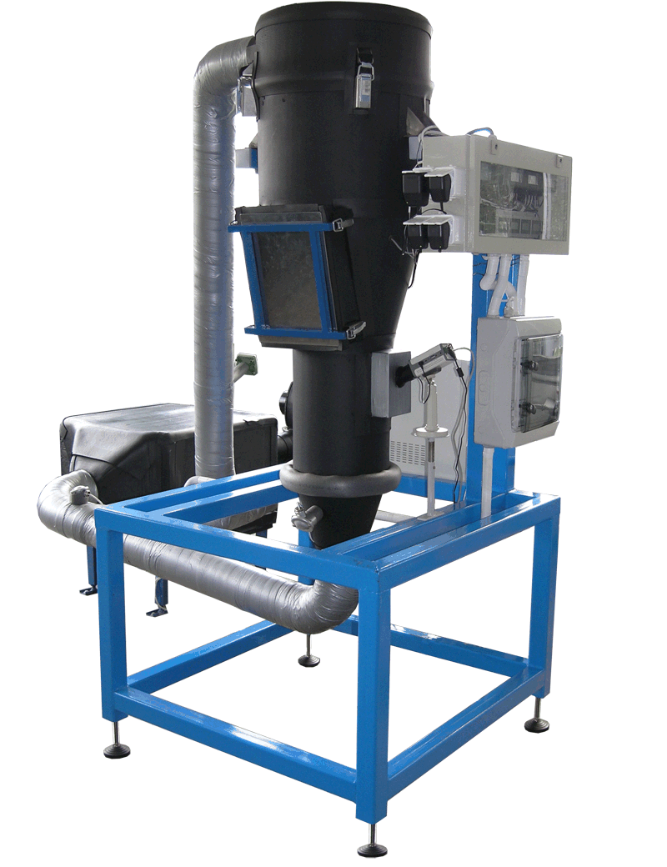
Identified Instrumentation
... from labour equipment to sensors
Material Science
  Synchrotron Light Source – 11 beam lines
  High Resolution Transmission Electron Microscope (HR-TEM)
  Field Emission Scanning Electron Microscope (FEG-SEM)
Optical Astronomy at LNA (www.lna.br)
  4.1 m optical telescope at Southern Astrophysical Research Telescope (SOAR)
Vibration spectroscopy
  BRUKER Tensor 37 FTIR
  Electron spectroscopy
  VARIAN Cary 100 UV-Vis
Chemistry
  Bruker AC – 250 P
  Laser Scan Microscope
  Zeiss LSM 410 Confocal Microscope
  Diffractometer
  Siemens D-5000( http://microlab.berkeley.edu/labmanual/chap8/8.44.html )
Satellite communications, telecommunication systems and networking measurement equipment
  Satellite network (mesh topology); 24 earth stations; audio and video multicasting
  Vector Signal Generator Agilent ESG E4438C (250 kHz – 6 GHz, IEEE 802.11b option)
Food processing, chemistry, other
  Gas Cromatograph Varian 38000
  Atomic Absorption Varian AA 800
  Varian Cary 1E UV-Visible Spectrophotometer
Radio Astronomy
  32m Radio Telescope in Piwnice, Poland

Slide 13
User requirements
Astronomy and Astrophysics:
To be able to effectively interact with the telescope operator.
To have additional information about sky conditions and other environmental information, to replace the act of walking outside to check conditions.
Ability for controlling telescope and/or instrument as if sitting in the control room.
Basically safety, reliability and low-cost maintenance needs
Telecommunications
High quality videoconferences capabilities
Dedicated broadband for specific purposes
Open source software (compatibility)

Slide 14
User requirements (cont.)
Material Science
Remote sample changing and positioning
Visualization of the obtained data (for some instruments)
Preparation and treatment of samples where the experiment is carried out
Use specific software to modelling different processes
Possibility for changing experimental conditions.
Possibility for preliminary training (including remote training)
Usage of friendly interface, easy to learn and use
Treatment of the samples
Provide information about technical parameters of instrumentation,
Contact with an operator during the measurement
To have same access efficiency as conventional (not remote) use.
Knowledge on the instrumentation type, its software and technical parameters in advance
Instruction of sample preparation

Slide 15

Conclusions (#2)
Framework ready to be used for deployment
Collaborative environment
Interactivity
Visualisation
Advanced resource reservation
AAA, business models
Service Level Agreement (SLA)
GRID .
INFRASTRUCTURE
Virtualisation of resources
Network buffers
Computational resources
NETWORKING
INFRASTRUCTURE
High bandwidth network
On-line access
Bandwidth used occasionally, e.g. on demand
QoS, jitter
Reliability
Sustainability
Security on technology level

Slide 16
RinGRID - further steps
Analysis of the scientific instrument requirements with respect to the present research network infrastructures
Analysis of the scientific instrument requirements with respect to the present state of the art of grid middleware and other grid- enabled software
Requirements definition of infrastructures for remote instrumentation systems
Analysis of future trends concerning network technologies that may be used to access remote instrumentation services and virtual research laboratories
Guidelines for the development of new software services enabling user-friendly interactions (e.g. access, control, monitor) with remote scientific devices
Recommendations for the development of virtual research laboratories to reduce access costs and expand accessibility to top-level instruments

Slide 17
Summary
Networking + Grid + Instrumentation
e-Infrastructure
Software framework ready for deployment
Ecosystem
stable, reliable
ready for deployment

Slide 18

Thank YOU !
Norbert Meyer
meyer@man.poznan.pl

