Slide 1
Challenges for Interactive Grids a point of view from Int.Eu.Grid project
Remote Instrumentation Services in Grid Environment RISGE BoF
Manchester 8th May 2007
Jesús Marco (CSIC)
Instituto de Física de Cantabria CSIC-University of Cantabria, SPAIN
Prepared with the help of Isabel Campos, Rafael Marco, David Rodriguez

Slide 2
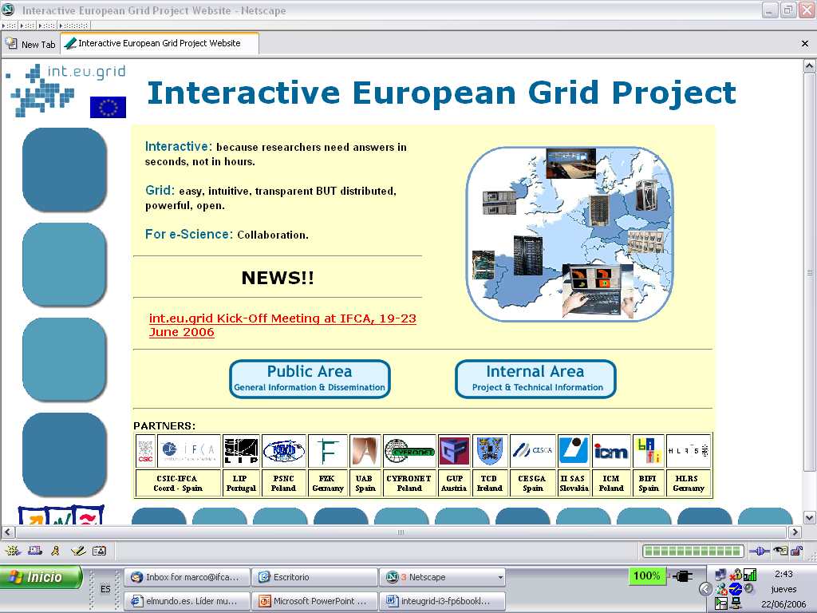

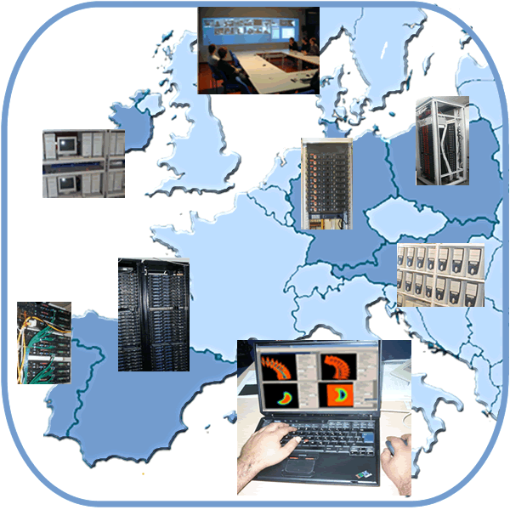
Interactive European Grid
(http://www.interactive-grid.eu)
Project acronym int.eu.grid
Contract number 031857
Instrument I3
Duration
2 years may ´06-april ´08
KEEPING EGEE INTEROPERABILITY!
“providing transparently
the researcher’s desktop
with the power of a supercomputer,
using distributed resources”
http://www.interactive-grid.eu
Coordinator: CSIC, Jesús Marco, IFCA, Santander, SPAIN [marco@ifca.unican.es]
User Friendly Access: Grid Interactive Desktop
Distributed Parallel (MPI) Interactive Computing & Storage at the Tera level

Slide 3
Key points
Established interest from research communities
  Fusion, medicine, environment, HEP, astrophysics
MPI & Interactivity support & integration
  MPI:
    Open MPI (incl. Infiniband support) & PACX-MPI
    Collaboration with EGEE
  Interactivity:
    GVid (& steering through Glogin)
    CrossBroker
    Integration in Migrating Desktop (user and developer friendly!!!)
Infrastructure deployment
  Resources: clusters & storage
Security
Network support
AccessGrid integration/availability/usage
Prepare for further dissemination to research communities

Slide 4

the challenges of int.eu.grid
From the Infrastructure point of view
  Operate a production level infrastructure 24/7
  Support Virtual Organizations at all levels
    Running the VO (user support)
From the middleware point of view
  Parallel Computing (MPI)
    Support intracluster Jobs with OpenMPI
    Support intercluster Jobs with PACX-MPI
  Advanced visualization tools allowing simulation steering
    GVid, glogin
  A Job scheduler that supports it all
  User friendly interface to the grid supporting all this features
    Integrating in the Migrating Desktop all the features
From the Applications point of view
  Analyze requirements of reference applications
  Ensure that middleware copes the reference applications demands
  Application Porting Support
  Promote collaborative environments like AccessGrid

Slide 5
Middleware Requirements
Provide computing resources
  MPI support
The job should be started inmediately on the user desktop
  Glide-in mechanism
  or… use an Interactive Session
The graphical interface should be forwarded to the user desktop
  Graphical interface to the grid → Migrating Desktop
  Supporting Visualization → GVid
The user should be able to steer the simulation
  Real Time steering → glogin

Slide 6
MPI Support on the Grid
Our solution, an intermediate layer:
mpi-start
RESOURCE BROKER
MPI-START
MPI
Implement.
Scheduler

Slide 7
Middleware for Visualization & Steering
Glogin
  Lightweight tool for support of interactivity on the grid
  Grid authenticated shell access “glogin host”
  No dedicated daemon needed such as sshd
  TCP Port Forwarding enables access to grid worker nodes with private IPs.
  X11 Forwarding
GVid
  Grid Video Service
  Visualization can be executed remotely on a grid resource
  Transmits the visualization output to the user desktop
  Communication of the interaction events back to the remote rendering machine
  Uses Glogin as bi-directional communication channel

Slide 8
Gvid and Glogin working together
USER
GRID
Steering &
Visualization
Application Plugin
MPI MASTER
Java Gvid Decoder
Gvid Encoder
Event Interception
Key, mouse
Event reception
GUI
Migrating Desktop
CE
Interactive
GSS
tunnel
glogin
RAS
glogin
https

Slide 9
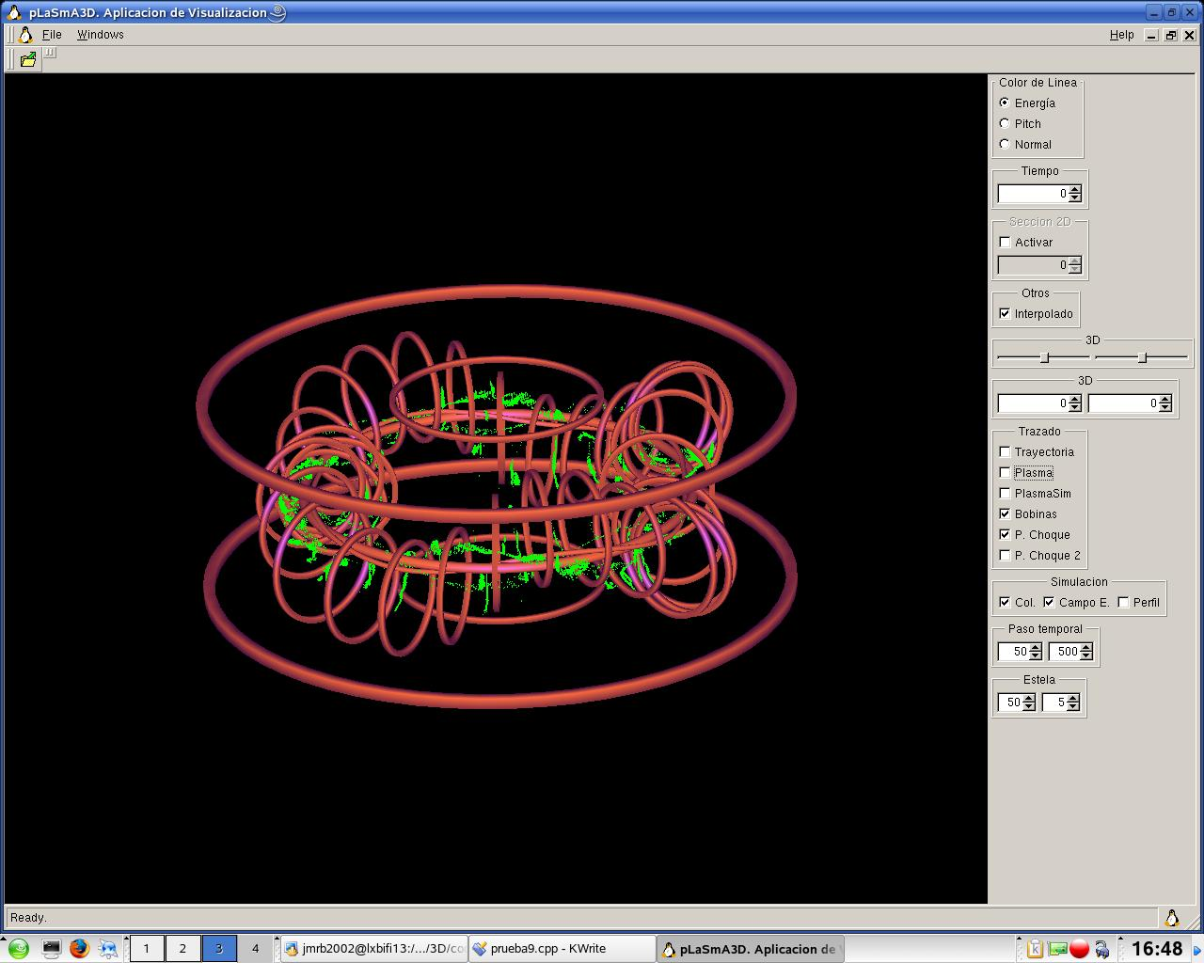
Interactive steering

Slide 10



Challenges and achievements…
Do we provide a “Complete” solution for the researcher offering more than what she/he can get from a workstation ?
  THE ANSWER IS…
    YES MPI + GVid + CrossGrid Broker MADE “TRANSPARENT” THROUGH MD
Do we offer our potential users a way to:
  Access an available, reliable, “standard” Infrastructure
    YES KEEP EGEE INTEROPERABILITY
  A flexible collaboration/participative model?
    HUMMM… maybe on the infrastructure side
      Offer “test” resources, allow new users to integrate their own resources
    BUT NOT flexible/dynamic enough to suit user needs
      VO support may require an specific compiler and 100 cpus for one week
In particular for support to instrumentation
  How to integrate an “instrument”
  Should we offer something similar to USB? (UGB® ?)
      That’s all, THANKS!

