Slide 1
NCBioGrid: Challenges in Grid Deployment and Application Enablement
Virinder Batra: IBM
Phil Emer: MCNC
Chuck Kesler: MCNC
Dr Alex Tropsha: UNC

Slide 2
Outline
Background
Project Goals and Challenges
Planning the Grid: Hardware and Software
The Grid Architecture
What we have done and What it means
Grid Application Vision
UNC QSAR Application
Summary of Lessons Learnt
Challenges in Making the Grid Operational

Slide 3
Background
North Carolina Genomics and Bioinformatics Consortium established in December 2000
Mission
  Provide a venue for Consortium members to share information and resources, plan strategic initiatives, and form alliances
Membership
  70+ Institutions (colleges and universities, federal research laboratories, biotechnology and biomedical businesses, information technology businesses, …)
Diverse Goals, Expertise and Resources
  Human health; animal models; agriculture and forestry; evolutionary biology; basic research; …

Slide 4
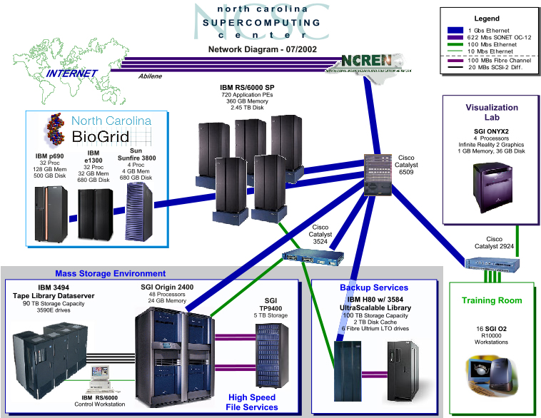
BioGRID and North Carolina Supercomputing Center

Slide 5
North Carolina Research & Educational Network
Abilene (OC-48)
Winston
Salem
Elizabeth
City
Boone
Greensboro
Rocky Mount
Asheville
RTP
Greenville
Cullowhee
Fayetteville
Charlotte
RTP rPoP
Pembroke
Morehead
City
NCCU
Wilmington
Duke
NCSU
NCREN3
High bandwidth (OC-3, OC-12, OC-48)
High reliability (multiple paths to rPoPs)
Very resilient (all new equipment)
Qwest
MCNC
NCSU
Centennial
Campus
UNC-CH

Slide 6
Project Goals
Build a production infrastructure that:
  Attracts Biotechnology Investment in the State of North Carolina
  Serves a diverse community of researchers and educators
  Provides a unified view to a growing set of distributed resources such as computational power, storage, data, and network
  Scales with number of users and resource requirements
  Embraces emerging technologies in distributed computing
Allow the scientist to concentrate on science
Allow the systems administrator to concentrate on IT
Enable and facilitate innovation in life sciences research
Built-in measurement capabilities for:
  Measuring success
  Capturing usage data
Notes:
Our goal is to build a production infrastructure for the state of North Carolina. Towards that end we have built a small testbed, in the Research Triangle Park (RTP). This Testbed will consist of grid nodes in the three major universities in RTP connected with the North Carolina SuperComputing Center (NCSC).
This small testbed will be representative of the final grid, in terms heterogeneity existence of multiple administrative domains in the grid. We intend to use the testbed to do smaller prototypes, and enable applications to use the grid. The lessons learned here can be used to build the larger production grid which will consist of nodes spread across the breadth and width of the state of North Carolina.
Currently, we have started to engage with researchers with compute and data intensive problems, to help these researchers in grid-enabling their applications. We expect papers published with results before and after grid-enabling will allow for the acceptance of grid technologies by more and more researchers.
**batra**

Slide 7
Challenges
Heterogenous compute, storage and data resources grown over the years
No unified approach to manage the set of distributed resources
Scientists need to spend a large amount of time on managing IT
Data Issues
  Many large genomic and other ..omic datasources
  Data sources change frequently
  Each researcher downloads own copy of these datasources.
    As these datasources grow exponentially in size, this mode of working cannot be sustained
    Constant version problems for data sources
  Data Integration Issues
Compute Power
  Spiky demand of Compute power
  Administration of Computing Resources non trivial

Slide 8
Challenges
Resources spread around multiple administrative domains
Security issues when using resources across administrative domains (Virtual Organizations)
  Multiple User Accounts
  Accounts needed for every user on every machine where resources are consumed by the user and in multiple domains
  Account and User Management Non trivial.. Becomes more complex with multiple security schemes
No mechanism for allowing policy based sharing of resources
  Compute Resources
  Data Resources
Set of Compute and Data Resources Dynamic
  Working Set of Resources changes constantly and manual intervention is required constantly to schedule jobs on this to use this dynamic set of resources

Slide 9
Project Structure
Two Phases (at least)
  Phase I – Project planning
    Build a test-bed for proof of concept
    Create a project plan specifying the requirements to build the production NCBioGrid
  Phase II – NCBioGrid Development
    Implement the plan developed in phase I
  Phase N – NCBioGrid version N

Slide 10
Planning the Grid
Hardware & Software
Objective was to build a representative grid testbed:
  Heterogenity of hardware vendors and operating systems
  Multiple administrative/security domains
  Multiple scheduling systems
  Individual machines as well as clusters of machines
Administrative objective was to get a operational testbed in 6 to 8 months
  Evaluated Globus Toolkit, and other commercial grid offerings from Avaki, Platform, United Devices, Entropia
  Decided to go with a commercial vendor
  Avaki grid implementation was chosen since our main concern was with ‘Data grid’

Slide 11
Conceptual Architecture

Slide 12



NC BioGrid Testbed (Phase 1a)
NCSC / RTP
NC State / Raleigh
IBM
LTO Library
IBM p690
Campus
Net
Gig-E
Client
Workstation
SunFire V880
FC Switch
Gig-E
UNC / Chapel Hill
FC
Campus
Net
Sun T3
SunFire 3800
NCREN
(OC-48)
Gig-E
Client
Workstation
IBM eServer 1300
IBM eServer 1300
Duke / Durham
10/100
Campus
Net
Development
& Staging
LAN
Gig-E
Client
Workstation
Client
Workstation
IBM eServer 1300

Slide 13
Important Decisions in Grid Implementation
Avaki chosen as the meta scheduler for the grid
Avaki grid software installed on all ‘grid machines’
Avaki data grid used to create the virtual file system across grid machines
Platform LSF the scheduler for UNC Chapel Hill cluster.
Sun SGE the scheduler for the Duke Univ cluster
Sun Solaris/Sunfire used for the NC State

Slide 14
What We Have Done
Install Avaki client code on “grid nodes”
  Determine which nodes should be grid nodes
Establish user accounts and associated policy
  Determine policy exceptions
Install datasets on native file systems and share them into the grid
  Build the grid file system structure
Install applications (NCBI BLAST) on native file systems and share them into the grid
  Register applications by platform architecture
Installed TurboBlast on the grid

Slide 15
North Carolina Bioinformatics Grid
Attributes
Single sign-on, security
Policy-based resource sharing
UNC-W
ECSU
Duke
NCSU
NCCU
Virtual Computers
ECU
NCArts
UNC-G
WSSU
UNC-CH
UNC-C
WCU
UNC-P
Virtual Databases
ASU
WFU
FSU
UNC-A
NCAT
Unified view of data and computers
  Computers and data appear to be local
Efficient access to large data sets
  Caching
  Replication

Slide 16
What It Means
The End User
  Can submit a job from an end system where neither the datasets nor the applications are installed.
  Does not have to know where those datasets and applications actually reside
  Can have the results stored on a local file system and can share that data according to individual policy
The IT Administrator
  Can install the datasets and applications once and thus manage a single copy
  Has the tools to implement policy across administrative domains

Slide 17
Grid Application Vision
Notes:
The grid application vision allows for a researcher to do all his/her work from a browser, by invoking a science portal url. This science portal url brings up the relevant portal screen (Websphere Portal Server). The Portal Server is is provisioned with portlets, which take user inputs for each workflow. The Websphere Workflow, allows for the workflow to execute where outputs from one part of the workflow are pipelined as inputs to another part of the workflow.
Each of the workflow pieces are implemented as individual webservices. Each webservice may be either a Java wrapper on a C executable or other programs which may in turn use DB2, Discovery Link or another File database on the Avaki data grid. Also each of these Java wrappers, may invoke an application registered to the compute grid, which may use any resources available to the compute grid..
In effect the use of a grid adds location transparency to the data, application and compute resource used to run the application.
We are using this application vision for the University Of North Carolina, Chapel Hill pilot.
The IBM Websphere Components are being used for the implementation of this grid application vision.
**batra**

Slide 18
Application Vision: Implementation
Use a Standards based Software Infrastructure for application using a compute and a datagrid
Creating an integrated workflow (using a standard workflow engine) to pipeline outputs from one application in the workflow to inputs of another application in the workflow
Allowing for a combination of synchronous and asynchronous applications in the workflow
  Compute grid applications typically are asynchronous
Using the IBM Life Sciences Framework to integrate grid and non-grid applications and workflows from a common browser based Graphical User Interface

Slide 19
Current Activities
The NC BioGrid is actively soliciting a ‘friendly user’ from each the following Universities
  UNC, Chapel Hill (QSAR Application)
  NC State University, Raleigh (Application Not Chosen Yet)
  Duke University, Durham (Application Not Chosen Yet)
Each of the ‘friendly users’ will be asked to
  Work with the grid infrastructure team and come up with a problem which grid technology can better solve. Typically this will be a procedure they do now which can be done faster by using by grid technology.
  These problems should be large enough that the speedup of the grid (vs. the usual desktop or lab machines) can be studied, but not so large as to interfere with testing the grid.
  Create a plan to use the BioGrid infrastructure to solve for the identified problem
  Share procedure workflow, so that the workflow can be used to develop web services for a BioPortal.
  Share performance metrics i.e. before and after using the BioGrid

Slide 20
UNC QSAR Application
Project Objectives
Web-enable UNC’s predictive QSAR modeling tools
  Distribute the work into a number of small workflows
  manage these smaller workflows in the context of global workflow
  allow the scientist to perform an start-to-end QSAR model development and validation from a browser.
Automate the QSAR model development and validation process
Deploy the QSAR modeling solution on the MCNC Biogrid.

Slide 21
QSAR Fundamentals
What is QSAR?
Quantitative Structure-Activity Relationship – a mathematical representation of a (linear or non-linear) relationship between a given property and structural attributes of chemicals.
P = f (X)
where
P: Target Property (pharmacological activity, ADME, Toxicity,
physicochemical property, etc.)
X: A set of Molecular Descriptors (molecular weight, # of hydrogen
bond donors/acceptors, # of rotatable bonds, graph and information-
theoretic indices, molecular orbital parameters, etc.)

Slide 22
Why QSAR?
Why Use QSAR models?
To minimize costly and time-consuming experiments,
thus accelerating selection of chemicals with a desired
property profile.
Typical applications:
  drug discovery
  agrochemical design
  environmental risk assessment
Users:
  pharmaceutical and biotech companies
  FDA, EPA
  Academic and industrial researchers

Slide 23
QSAR Input Table Example
(One table per target activity)
Structure
Activity
Molecular Descriptors
Comp.1
Value1
D1
D2
...
Dm
Comp.2
Value2
"
"
"
"
Comp.3
Value3
"
"
"
"
- - - - - - - - - - - - - -
Comp.N
ValueN
"
"
"
"
QSAR N X m matrix

Slide 24
QSAR: Model Generation
Empirical models are developed that relate descriptor values to the activity values using a combination of statistical techniques including
  Linear Multiple Regression
  K Nearest Neighbor (KNN)
  Partial Least Squares
  Principal Component Analysis
The Model Validation process requires the generation of large number of models

Slide 25
QSAR Model Validation
The input dataset is split multiple times into Training and Test Sets.
The model is created using a Training Set and is validated using the observed values in the Test Set.
The models are then ranked using statistical methods
The best models are then used to predict the activity of structures for which observed values are not available (external sets).

Slide 26
Computational Bottleneck

Slide 27
QSAR Model Generation – How Long?
Sample dataset: Antitumor Agents Inhibiting Tubulin Polymerization
  ≈ 300 Compounds
  10-12 Minutes Computation Time / kNN Model
  11,000 Models * 10 Minutes/Model =
  76.4 Days !
  On a Grid with 100 Processors →
  18 ⅓ Hours

Slide 28
Summary of Lessons Learnt..
One Size does not fill
  The requirements at each site drives what kind of grid is required
  Grids are built..and cannot be bought
Applications that need to be run on a grid determines which kind of grid needs to be built i.e.
  Compute Grid
  Data Grid
  PC Aggregation Grid
  Cluster Aggregation Grid
Prototyping is mandatory
  To try out representative scenarios
  To learn technologies and how to put it together
  To understand whether grid technology is best suited for the problem at hand

Slide 29
Summary of Lessons Learnt..
The basic grid software may take a relatively short time to install. But designing and configuring a grid takes a much longer. The following activities are non trivial:
  Determining Datasources
  Mapping grid identities with local identities
  Security considerations when setting up data grids
  Proxies for firewalls
  Domain mapping considerations
  Defining Queues, schedulers and Collection of Resources (Avaki)
  Performance Tuning
  Application Integration

Slide 30
Challenges in Making the Grid Operational
Security, Security, Security…
  Cross-authentication between AVAKI Data Grid and Globus Compute Grid
  Management of local accounts and mapping to grid identities
  Document operational procedures, Certificate Signing Policies, etc… for grid CA
  Grid middleware needs independent review for security vulnerabilities

Slide 31
Challenges in Making the Grid Operational..
Uncharted territory -- no one has all of the answers yet (or even all of the questions!)
Reconcile the needs of different customer bases (end-users, IT staff, management)
Prove that grid technologies are ready for prime-time -- and insure that user expectations are set properly
Ensure that user expectations are properly set
  With regard to stability and performance
  Not 24X7 yet!

Slide 32
Challenges in Making the Grid Operational..
Education -- insure that users can use the grid, user support staff can answer grid user questions, and IT personnel can keep the grid functioning
  FAQ’s
  Documentation
  Classroom Training
  Best Practices
Benchmarking -- need to understand and characterize how applications will perform on the grid in order to have:
  Predictable results when tuning performance
  Early identification of apps that will not perform well on the grid
  Grid Enabling of Applications or the lack there-of

Slide 33
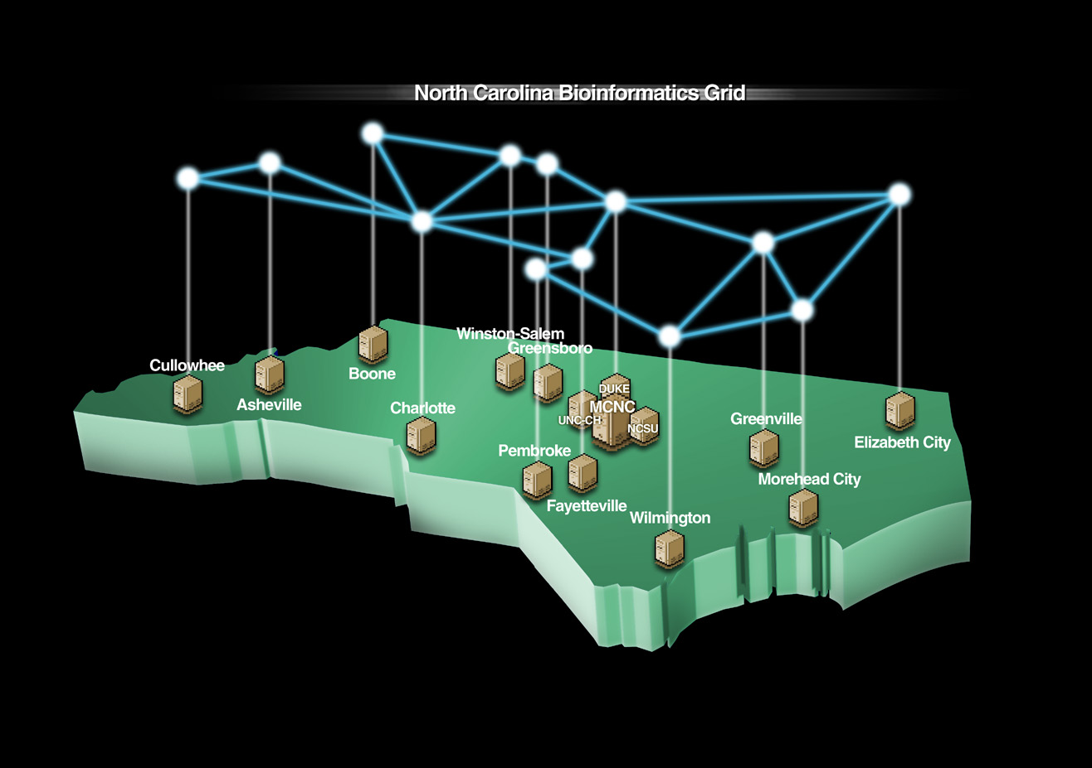

Slide 34
Contacts and References
Article Published in GridToday
  http://www.gridtoday.com/02/0916/100378.html
Website: www.ncbiogrid.org
Phil Emer
  phil.emer@ncsc.org
Chuck Kesler
  Chuck.kesler@ncsc.org
Dr Alex Tropsha
  tropsha@email.unc.edu
Virinder Batra
  Batra@us.ibm.com

