Slide 1
GGF 10
Grids : from life sciences to healthcare

Slide 2
Health + Grid = HealthGrid
eHealth
Health:
All levels of data & information, from molecule to population needed to ensure better prevention, diagnosis and treatment of the citizen.
Grid:
An environment, created through the sharing of resources, in which heterogeneous and dispersed data as well as applications can be accessed by different partners according to their authorisation, without loss of information.

Slide 3
Draft Ideas, September 2002
eHealth
HealthGRID
Patient
related data
Public Health
Association
Modelling
Computation
Databases
Patient
Public Health
Tissue, organ
Patient
Cell
Tissue, organ
Molecule
Cell
Molecule
INDIVIDUALISED HEALTHCARE
MOLECULAR MEDECINE
S. Nørager
Y. Paindaveine
DG-INFSO
Computational
recommandation

Slide 4
A recent example of the potential grid impact
eHealth
Last summer heat wave killed more than 10000 people in France
Mortality rate in excess of 10 to 50% in retirement homes and hospitals unnoticed for 2 weeks
A monitoring system could have raised the alarm much earlier
  Requirements : collect information from hospitals and/or funeral services on the number of casualties
  Internet can do it through a centralized web portal
  Grid added value : database federation (data left in hospitals, à la BIRN) + a grid service for mortality rate computation and monitoring
Grid technology allows to do it today…

Slide 5
The challenges of a life science grid
eScience
Technical challenges
  data and tools integration : address data heterogeneity and legacy of tools and standards
  provide the infrastructure to deploy biomedical applications in a grid environment
Human challenge : involve end users in the grid game
  Grids are still very much in development and therefore user-unfriendly
  Training and support to university hospitals, biology/medecine research centres
These challenges are addressed by FP5/FP6 grid projects and the FP6 grid infrastructures (EGEE, DEISA,…) to be deployed.

Slide 6
Allow every physician to access a reliable grid for his daily practice
New actors : hospitals, physicians, healthcare administrations, big pharmas, SMEs
Technical issues
Networking, User interface
Grid quality of services (stability, scalability, security,…)
Legal/ethical issues : obey the laws of the European countries with respect to personal data ownership and data transfer
eHealth
The challenges of an healthcare grid
Grid technology is not ready yet to address all these challenges, but
It is time to build bridges towards this vision

Slide 7
In silico drug discovery
Examples of HealthGRID applications
Goal : speed up the cycle for drug discovery
Challenge : bridge gaps in the translation of basic research through to drug development from the public to the private sector and in the feedback from the private sector of their results
The grid impact :
  high performance computing and data storage for massive docking
  Collaborative environment for searching new targets and sharing results while respecting privacy
Short term perspective : a grid for neglected disease
  Non profit drug discovery in a grid environment
Technical issues : security, data management

Slide 8
Multi-site therapy monitoring
Examples of HealthGRID applications
Goal : reduce time and cost to launch a drug on the market (100 million euros and 10 years)
Challenge : improve monitoring of multi-site clinical trials
The grid impact : moving away from a single centralized repository
Technical issues : security, data management

Slide 9
Intensity Modulated Radiation Therapy
Examples of HealthGRID applications
Goal : deliver a variable fluence (number of particles per unit square) using complex geometries adapted to the tumoral volume depending on the beam incidence
Challenge : necessity to simulate treatment through inverse dosimetry for each incidence of the beam and geometry of the multi-lames collimator and validate the dose delivered to the patient
  30 beams x 2 minutes = 1 hour for each iteration of treatment validation
The grid impact : parallel execution of the different beam configurations on a cluster
  Reduce time needed for treatment planning and increase number of patients
Technical issues : security, quality of service

Slide 10
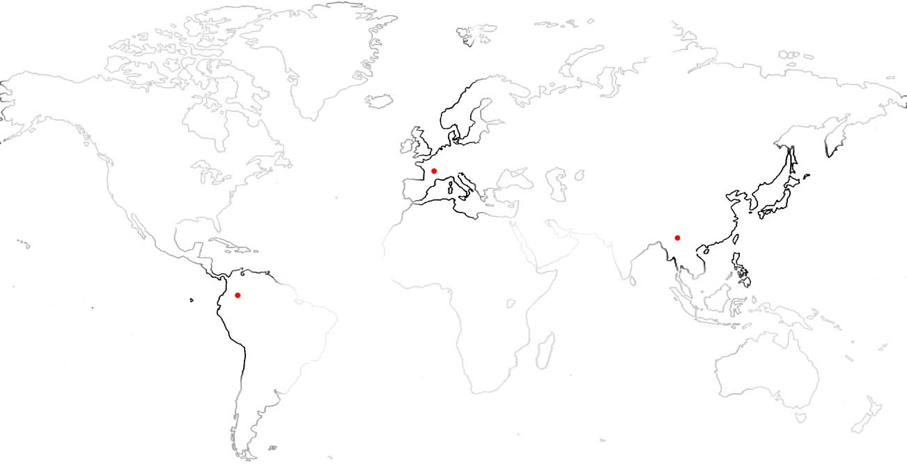
Grids for medical development
Examples of HealthGRID applications
Preparation and follow-up of medical missions in developing countries
Support to local medical centres in terms of second diagnosis, patient follow-up and e-learning
Clermont-Ferrand/Paris
Patient data
Request for
2nd diagnostic
Second diagnostic
Patient follow-up
Interactive e-learning
Video-conferences
Patient data
consultation
Chuxiong
Request for
second diagnosis
The grid impact :
Improved telemedecine services
Federation of patient databases
Interactive e-learning (high bandwidth network required)
Ibagué
Hand surgery
Medical centre
2 missions (Ibagué & Chuxiong) with the french NPO « Chaîne de l’Espoir » used as test cases

Slide 11
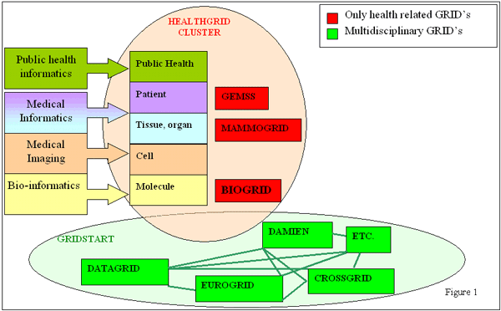
Some health related FP5 grid projects
in Europe
Perform a trial for the introduction of the Grid approach in the biotechnology industry
Biomolecular simulations
eScience
eHealth

Slide 12
MammoGrid –
European federated mammogram database implemented on a GRID infrastructure
eHealth
Main goals:
Epidemiology of breast cancer from a European perspective
  Open source architecture
Use of Grid in developing quality control techniques for breast cancer screening
Development of some CADe techniques
http://lotus5.vitamib.com/hnb/mammogrid/mammogrid.nsf/Web/Frame?openform

Slide 13

MammoGrid -
Federated System Solution
eHealth
Local
Analysis
Local
Analysis
University Database
Hospital Italy
Local
Query
Local
Query
Local
Analysis
Local
Query
Query
Result
GRID
Healthcare Institute
Clinician’s Workstations
Knowledge is stored alongside data
Active (meta-)objects manage various versions of data and algorithms
Small network bandwidth required
Massively distributed data
AND distributed analyses
Local
Analysis
Local
Query
Hospital UK
Shared meta-data
Analysis-specific data

Slide 14
MammoGrid -
Grid challenges: database
eHealth
Large federated databases
  Images and metadata
Ontologies and metadata
  Image formation parameters
  Image features
  Clinical information
  Demographic data
Effective data mining of a rapidly growing database
Allow for complex queries involving executables
Medical image analysis clients are not Grid experts!

Slide 15
MammoGrid
Grid challenges: communications
eHealth
Legal restrictions on access to data
  Clinicians, researchers, developers, Govt, …
Data resides in hospitals
  Firewall protected
Combining several databases
Secure file transfer
Large images to be transferred
Develop API for black box third party applications

Slide 16
DataGrid biomedical work package
eHealth
eScience
Critical for development
Mid-term requirement
Long-term requirement
Deploy biomedical applications on EDG testbed
Deploy grid nodes in biomedical laboratories
Express biomedical specific technical requirements
5. High priority jobs
  privileged users
6. Interactivity
  communication between user interface and CE’s
7. Parallelization
  MPI site-wide / grid-wide
8. Pipeline processing
  pipeline description language / scheduling
1. Large user community
  anonymous/group login
2. Data management
  data updates and data versioning
3. Security
  disk / network encryption
4. Limited response time
  fast queues

Slide 17
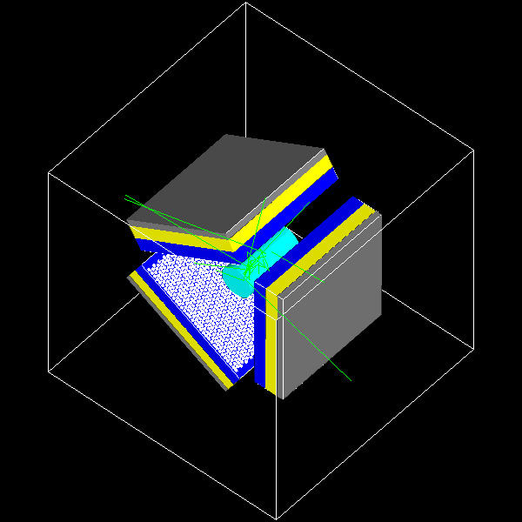
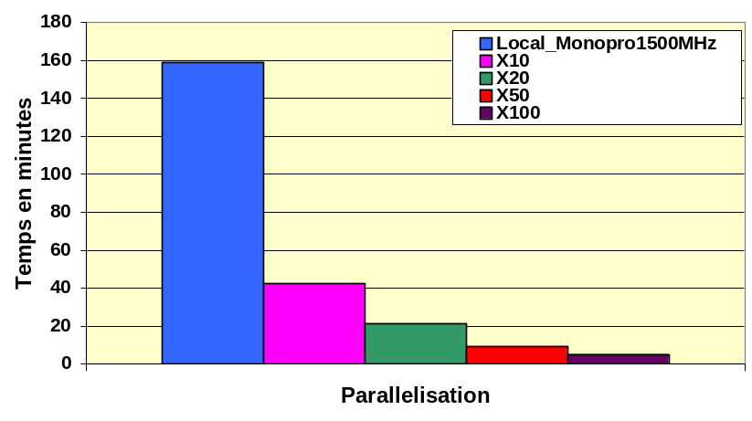
DataGrid : status of biomedical applications
eHealth
eScience
deployed
tested on EDG
under preparation
Bio-informatics
  Phylogenetics : BBE Lyon (T. Sylvestre)
  Search for primers : Centrale Paris (K. Kurata)
  Bio-informatics web portal : IBCP (C. Blanchet)
  Parasitology : LBP Clermont, Univ B. Pascal (N. Jacq)
  Data-mining on DNA chips : Karolinska (R. Médina, R. Martinez)
  Geometrical protein comparison : Univ. Padova (C. Ferrari)
Medical imaging
  MR image simulation : CREATIS (H. Benoit-Cattin)
  Medical data and metadata management : CREATIS (J. Montagnat)
  Mammographies analysis ERIC/Lyon 2 (S. Miguet, T. Tweed)
  Simulation platform for PET/SPECT based on Geant4 : GATE collaboration (L. Maigne)
GATE Monte-Carlo simulation
platform for nuclear medecine

Slide 18

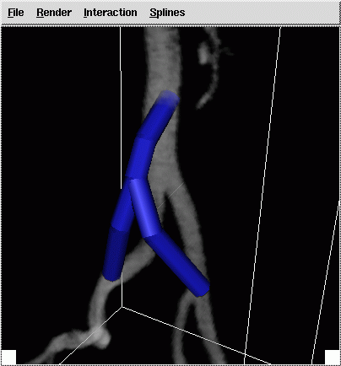
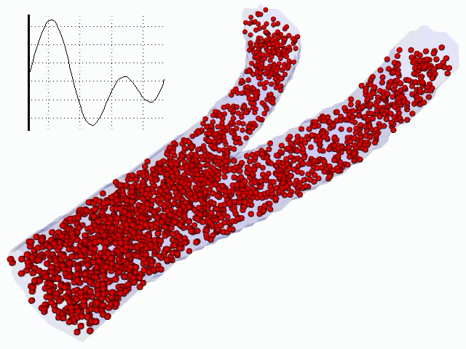
Simulated vascular reconstruction
eHealth
eScience
Goals
Supports the vascular surgeon in placement of bypasses and stents
Predicts blood flow before operation
  Geometry obtained from medical scans
  Add the proposed intervention
Method
Interactive Virtual Reality Environment to
  View scanned data
  Define proposed interventions
  View simulation results
Advanced fluid code to simulate flows
Grid for data access and computational resources
Notes:
The goal of this application is to support vascular surgeons in their pre-operative decision making for reconstructive interventions in the vascular system. Two common procedures are the placement of bypasses that divert blood around clogged arteries, and the placement of so-called stents that provide support for weakened arteries.
Both procedures influence blood flow, and both usually involve various alternatives. Besides obvious considerations such as accessibility, the attainable improvement in the blood flow must determine which alternative is best.
The CrossGrid biomedical application aims to support the surgeon in making this decision for a particular patient by predicting the blood flow, on the basis of the observed geometry of arteries, the proposed intervention, and other relevant data provided by the surgeon.

Slide 19
FP6 : the opportunities of a new paradigm
eHealth
From pilot to production grid infrastructures (EGEE,…) committed to provide to users communities
  Training
  User support
  Access to resources
Need for collaborations with NoE and grid projects in the eHealth area to deploy large scale applications
Feedback eHealth specific requirements to middleware developers
Research infrastructures
and testbeds
eHealth
Grids for complex
Problem solving

Slide 20

To widen the impact of the healthgrid cluster, the Healthgrid association
eHealth
To disseminate information on grids for health
  Summaries and links to health related grid projects
  Available tools (software platforms, middleware,…)
  Tutorials
  Conferences
To foster exchange between projects, end users and technology developers
  To avoid reinventing the wheel
  To improve the take-up of grid technology
To promote standards
  Involvement in GGF Life Science Research group
Open to any new member
  Contact point : Y. Legrè (legre@clermont.in2p3.fr)
  Web site : http://www.healthgrid.org

Slide 21
Healthgrid conferences
eHealth
Jointly organised by CERN, CNRS and EMBnet in collaboration with the eHealth unit DG-INFSO
Meeting point for actors of grids for health
  End users = healthcare professionals / providers + academic & industrial researchers and developers from bio-informatics and medical-informatics
  Grid applications developers
  Technology developers
First conference in Lyon (January 2003)
Next conference in Clermont-Ferrand (January 29-30 2004)

Slide 22

HealthGrid 2004
eHealth
January 29th - 30th 2004, Clermont-Ferrand, France
http://clermont2004.healthgrid.org
The aims of this conference are to reinforce and promote awareness of the possibilities and advantages linked to the deployment of GRID technologies in health. In this context "Health" does not involve only clinical practice but covers the whole range of information from molecular level (genetic and proteomic information) through cells and tissues, to the individual and finally the population level (social healthcare).

