Slide 1
CDL for BLAST based on Chris’s JSDL document*
Hiro Kishimoto
13 March, 2006
*: https://forge.gridforum.org/projects/ogsa-wg/document/jsdl_blast_instance/en/1

Slide 2
CLD document includes
Application binary installation
  If this application depends on specific libraries or other software, how to deploy them should be described by CDL
File system mount
  Or JM selects container already mounted
<jsdl-posix:Executable>/usr/local/bin/blastall</jsdl-posix:Executable>
<jsdl:FileSystem name="TMP">
<jsdl:FileSystemType>temporary</jsdl:FileSystemType>
<jsdl:Description> … </jsdl:Description>
<jsdl:DiskSpace>
<jsdl:LowerBoundedRange>10737418240.0</jsdl:LowerBoundedRange>
</jsdl:DiskSpace>
</jsdl:FileSystem>
<jsdl:FileSystem name="HOME">
<jsdl:FileSystemType>normal</jsdl:FileSystemType>
<jsdl:Description>Chris's home directory</jsdl:Description>
<jsdl:MountPoint>/home/csmith</jsdl:MountPoint>
</jsdl:FileSystem>

Slide 3
CLD document includes (2)
User creation
  Or JM selects container already has specified user
Stage / destage data file
  Or BES container does
<jsdl-posix:UserName>csmith</jsdl-posix:UserName>
<jsdl-posix:GroupName>bio</jsdl-posix:GroupName>
<jsdl:DataStaging>
<jsdl:FileName>blastqueries/sequences1.txt</jsdl:FileName>
<jsdl:FilesystemName>HOME</jsdl:FilesystemName>
<jsdl:CreationFlag>overwrite</jsdl:CreationFlag>
<jsdl:Source>
<jsdl:URI>file:/Users/csmith/blastqueries/sequences1.txt</jsdl:URI>
</jsdl:Source>
</jsdl:DataStaging>

Slide 4
CLD document includes
Set environment variables
  Or BES container sets when job is initiated
Set hard/soft limit
  Or BES container sets when job is initiated
Change working directory
  Or BES container does when job is initiated
<jsdl-posix:Environment name="PATH">/usr/bin:/usr/local/bin:/usr/local/bio/bin
</jsdl-posix:Environment>
<jsdl-posix:Environment name="TMPDIR" filesystemName="TMP"/>
<jsdl-posix:WallTimeLimit>60</jsdl-posix:WallTimeLimit>
<jsdl-posix:FileSizeLimit>1073741824</jsdl-posix:FileSizeLimit>
<jsdl-posix:CoreDumpLimit>0</jsdl-posix:CoreDumpLimit>
<jsdl-posix:WorkingDirectory filesystemName="HOME">blastqueries
</jsdl-posix:WorkingDirectory>

Slide 5
CDL document does not include
Job Identification
Application Name and version
  May be used to identify CDL document
Resource types
  Except FileSystem
Posix argument & stdin/stdout/stderr
  BES container

Slide 6
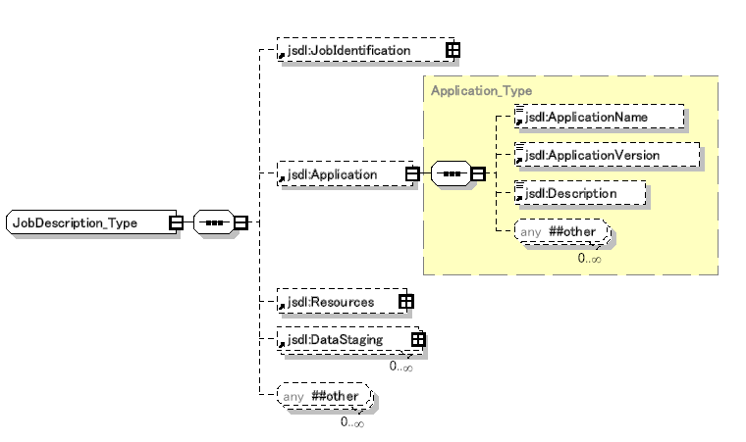
JobDescription
Included in CDL
maybe
Does not included
PosixApplication
See slide 5
See slide 6
Stage/destage
Data file

Slide 7
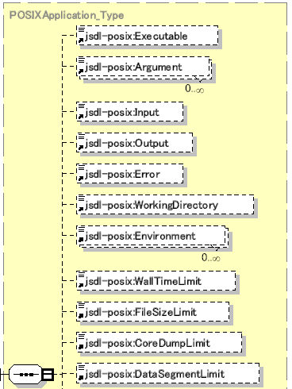
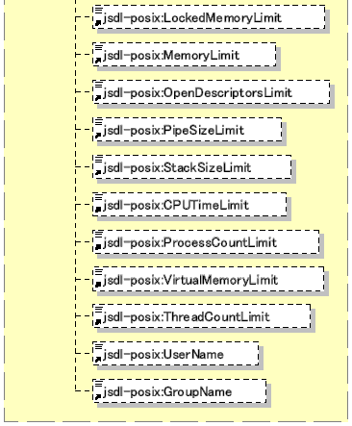
PosixApplication
Included in CDL
maybe
Application binary
Does not included
Working directory
Environment Variable
Hard/soft
limit
User & group

Slide 8
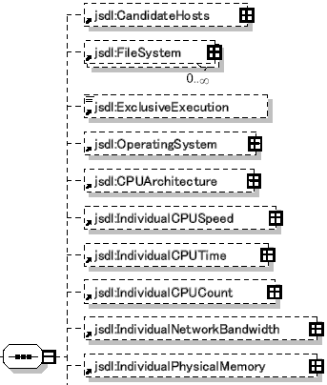
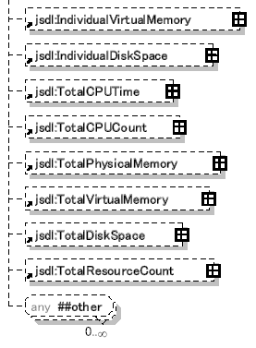
Resource
Included in CDL
maybe
File system mount
Does not included

