Slide 1
CDL for BLAST based on Chris’s JSDL document*
OGSA-WG
15 March, 2006
Basic Local Alignment Search Tool, or BLAST, is an algorithm for comparing biological sequences, such as the amino-acid sequences of different proteins or the DNA sequences. (wikipedia)
*: https://forge.gridforum.org/projects/ogsa-wg/document/jsdl_blast_instance/en/1

Slide 2
BLAST command
blastall -p blastn -d est -T T
-T [T/F]
-p Program Name [String]
Produce HTML output
Default = F
Input should be one of "blastp", "blastn", "blastx", "tblastn", or "tblastx".
-d Database [String]
Input could be one of "/db/ncbiblast/nr", "/db/ncbiblast/nt", "/db/ncbiblast/est" or user own database.
Question: Who sets up this est database?
http://www.rcc.uga.edu/applications/bioinformatics/ncbiblast2210/blastall.html

Slide 3
CDL document includes
Application binary installation
  If this application depends on specific libraries or other software, how to deploy them should be described by CDL
File system mount
<jsdl-posix:Executable>/usr/local/bin/blastall</jsdl-posix:Executable>
<jsdl:FileSystem name="TMP">
<jsdl:FileSystemType>temporary</jsdl:FileSystemType>
<jsdl:Description> … </jsdl:Description>
<jsdl:DiskSpace>
<jsdl:LowerBoundedRange>10737418240.0</jsdl:LowerBoundedRange>
</jsdl:DiskSpace>
</jsdl:FileSystem>
<jsdl:FileSystem name="HOME">
<jsdl:FileSystemType>normal</jsdl:FileSystemType>
<jsdl:Description>Chris's home directory</jsdl:Description>
<jsdl:MountPoint>/home/csmith</jsdl:MountPoint>
</jsdl:FileSystem>
  Alternative: JM selects container which already mounts these file systems

Slide 4
CDL document includes
Database setup
  BLAST needs NDA sequence database(s)
    Popular databases are nr, nt, and est
  Each database is large file in specific format and should be deployed before running job
<jsdl:Resources>
….
<blast:database>
<jsdl:FileName>db/ncbiblast/est</jsdl:FileName>
<jsdl:FilesystemName>DB</jsdl:FilesystemName>
</blast:database>
….
</jsdl:Resources>
Note by Chris Smith: There might be some more information needed depending on whether the database is already formatted, or if it's in FASTA format still. From the point of view of a provisioning engine, you might need to specify a command to run to format the FASTA file, or it might be a set of files that is the result of the formatting that need to be staged.

Slide 5
CDL document may include
Set environment variables
<jsdl-posix:Environment name="PATH">/usr/bin:/usr/local/bin:/usr/local/bio/bin
</jsdl-posix:Environment>
<jsdl-posix:Environment name="TMPDIR" filesystemName="TMP"/>
Alternative: BES container sets them when job is initiated

Slide 6
CDL document does not include
Job Identification
Application Name and version
  May be used to identify CDL document
Resource types
  Except FileSystem
Posix argument & stdin/stdout/stderr
  BES container does when job is initiated
Change working directory
  BES container does when job is initiated
Set hard/soft limit
  BES container does when job is initiated
User & Group
  JM selects container already has specified user
Stage / destage data file
  BES container does

Slide 7
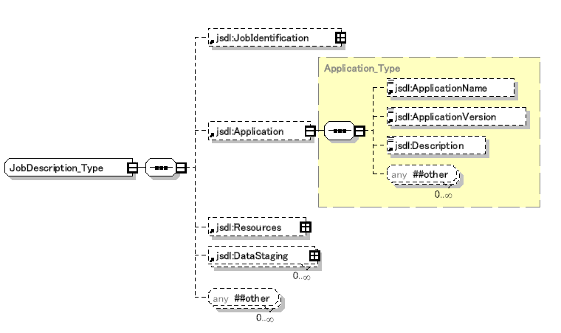
JSDL:JobDescription
Included in CDL
maybe
Does not included
PosixApplication
See slide 5
See slide 6
Stage/destage
Data file

Slide 8
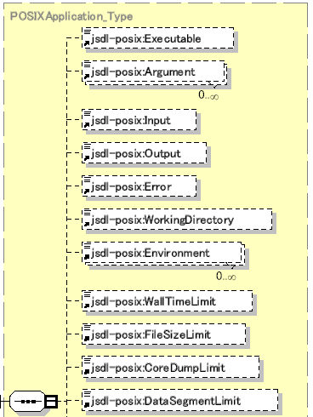
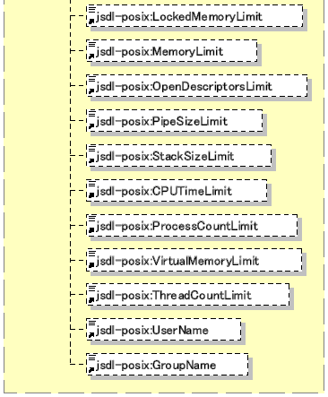
JSDL:PosixApplication
Included in CDL
maybe
Application binary
Does not included
Working directory
Environment Variable
Hard/soft
limit
User & group

Slide 9
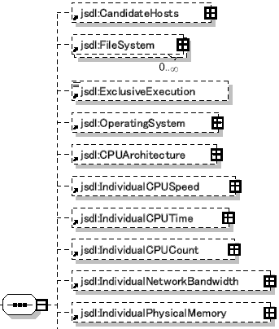
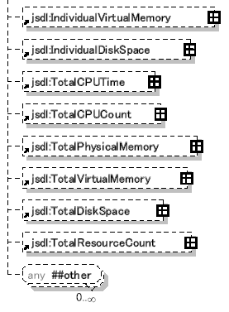
JSDL:Resource
Included in CDL
maybe
File system mount
Does not included

