Slide 1

SBLIM
CIM Instrumentation for Linux
Experiences and Outlook
Viktor Mihajlovski
Heidi Neumann
IBM Linux Technology Center

Slide 2
Web Based Enterprise Management
Encoding
Transport
CIM over HTTP
Modeling
CIM Specification
CIM Schema
Resource
Access
CIM
Instrumentation

Slide 3
Reasons for CIM Instrumentation
Data Modelling Aspects
  Rich inventory of Management Objects (Schema)
  Object Orientation facilitates Extensibility and QoS Distinctions
  Associations provide unprecedented flexibility
  Indication Model for advanced Management
Implementation Aspects
  Real interoperability through remote protocols
    standard: CIM (XML) over HTTP
    others to follow: ASN.1, WSDL
  Variety of Implementations
    CIMOMs: e.g. Pegasus, SNIA CIMOM, WBEM Services, OpenWBEM
    CMPI for broker-neutral providers
    Mappings to LDAP, SNMP
    Web Services, OGSA

Slide 4
Traditional CIMOM Environments
CIM
Client
Repository
(Data Model, Static Objects)
CIM over HTTP
CIM
Object
Manager
Dynamic Objects
(Instrumentation)
Provider
Provider
/dev/hda1 / ext3 1 1
/dev/hda2 /home ext3

Slide 5
SBLIM Components
Console Plugins
Managed System
Volumes
SRI
Packages
Kernel Settings
CIMOM (Any)
SRI Configuration
(XML)
NPI/CMPI
Managing
System
Services
FSVOL
RPM
Instrumentation
Plugins
Linux Resources

Slide 6
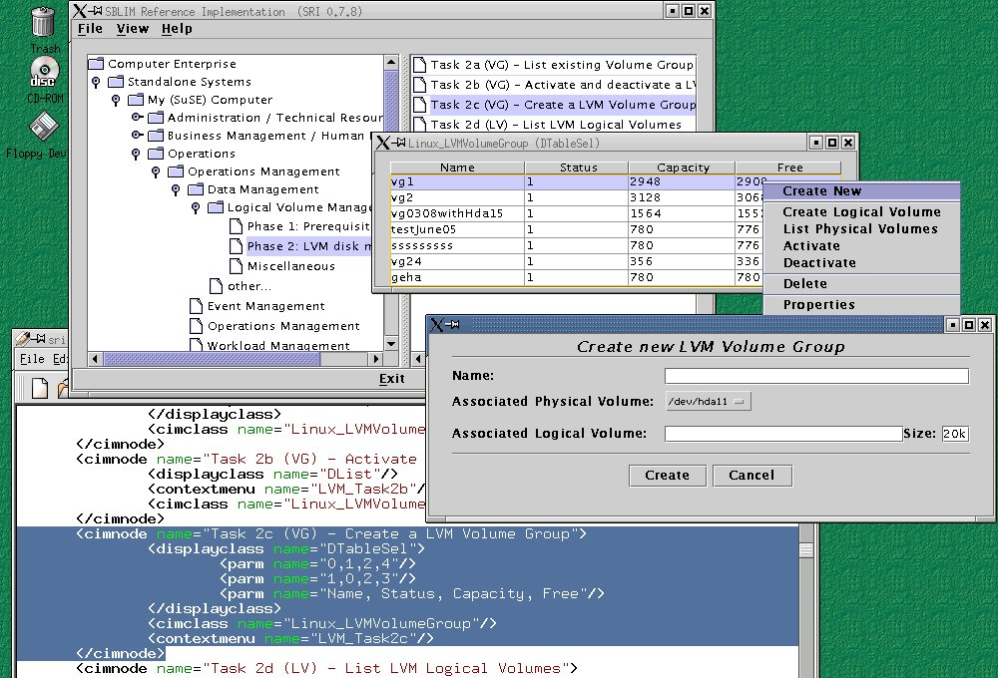
Example: Volume Management

Slide 7
SBLIM Features
Native Provider Interface
  CIMOM Independent
  Problem Oriented
  To be superseded by Open Group CMPI
Base Resource Instrumentation
  Computer, OS, Process
  File Systems, Logical Volumes
  Software Packages (RPM)
  Services
  Kernel Parameters
Reference Implementation
  XML Configurable
  Management Plugin Support
More details: http://oss.software.ibm.com/sblim

Slide 8
Cluster Model Proposal
Cluster
H
Management Node ( MN ) + Scheduler
ClusterResource CR1
ClusterResource CR2
Queue
x
Queue
y
Queue
z
_b
E
A
F
D
B
_a
Topology
Reflection in CIM
_c
_c
_f
_b
_c
C
_f
_e
_a
_f
G
_d
_d
_e
_f
CIM_ParticipatingResource
1
1
CIM_ParticipatingQueue
CIM_Dependency
CIM_Cluster
1
CIM_HostedClusterScheduler
CIM_Dependency
1
CIM_HostedClusterService
CIM_ParticipatingCS
*
CIM_Cluster
HostInResource
1..n
CIM_Cluster
SchedulerHost
1
CIM_Cluster
SchedulerQueue
*
CIM_ClusterResource
*
*
CIM_ClusterHost
*
1
CIM_ClusterScheduler
1
*
CIM_ClusterQueue
CIM_CollectionOfMSEs
CIM_Collected
MSEs
CIM_UnitaryComputerSystem
CIM_Dependency
CIM_ClusteringService
CIM_Dependency
CIM_JobDestination
*
CIM_ExecutionHost
*
1
1
CIM_Dependency
*
CIM_ClusterSchedulerJob
CIM_ClusterJobInResource
*
CIM_ClusterJob
*
CIM_Dependency
CIM_ClusterJobInQueue
CIM_Dependency
CIM_Job
*
CIM_JobDestinationJobs
cluster mgmt.
global view
Association
Aggregation
0..n
*

Slide 9
Background
Model defined in cooperation between IBM LTC and NCSA
Deficiencies in current CIM Schema to model a Cluster
  associations to reflect the relations in the Cluster
  definition of a class for the logical grouping concept of Hosts
  definition of a class to represent the Hosts ( global view )
  definition of a class to represent the Scheduler ( OpenPBS in NCSA environment )
Prototype implementation planned

