Slide 1

CMM-WG: Updates and
Gap Analysis Discussion
Fred Maciel
CMM-WG co-chair
© Global Grid Forum, 2003
All trademarks belong to their respective owners.

Slide 2
Outline
1. WG background and work
2. OGSA management glossary
3. OGSA management framework
4. WSDM updates and contents
5. OGSA gap analysis
6. Future Plans

Slide 3
What is the CMM-WG doing
Original work (base manageability functionality for OGSA) moved to OASIS WSDM TC
  Work being done in the WSDM TC
Now doing a gap analysis:
  What is missing on manageability in OGSA; what should be done (e.g., regarding resource models)
  Management framework and glossary for OGSA to support the gap analysis
  Collaborating closely with OGSA-WG
    Parts of the above being contributed to OGSA spec
  Still work in progress

Slide 4
Outline
1. WG background and work
2. OGSA management glossary
3. OGSA management framework
4. WSDM updates and contents
5. OGSA gap analysis
6. Future Plans

Slide 5
OGSA Management Glossary
Don’t divide “Grid” and “non-Grid”
Resource: all manageable entities
  Aligned with WSRF and WSDM
  Superset of usage for pooled resources (in which process, print job, VO as resources)
Resource Management: generic term for
  scheduling and brokering, deployment
  accounting and metering
  monitoring (performance, availability, etc.) and control
  problem determination, fault management
Resource Manager: manager that implements one or more resource management functionalities

Slide 6
Outline
1. WG background and work
2. OGSA management glossary
3. OGSA management framework
4. WSDM updates and contents
5. OGSA gap analysis
6. Future Plans

Slide 7
OGSA Management Framework (1)
OGSA has several functions (“services” in current OGSA spec), which extend to resources
Domain-specific functions
OGSA functions
OGSA
functions
level
Job
submission
Resource
usage
Deployment
Platform
functions
level
Resources
Resource
level

Slide 8
OGSA Management Framework (2)
Management in OGSA can be divided in 3 levels (aligned to current OGSA taxonomy)
Domain-specific functions
OGSA functions
OGSA
functions
level
Job
submission
Resource
usage
Deployment
Platform
functions
level
Resources
Resource
level

Slide 9
OGSA Management Framework (3)
Resource level: management of resources through native interfaces (SNMP, CIM, etc.)
Domain-specific functions
OGSA functions
OGSA
functions
level
Job
submission
Resource
usage
Deployment
Platform
functions
level
Resources
Resource
level

Slide 10
OGSA Management Framework (4)
Platform functions
  Shows resources as services (WSDM MUWS)
  Manageability for services implementing OGSA functions (WSDM MOWS)
Domain-specific functions
OGSA functions
OGSA
functions
level
Job
submission
Resource
usage
Deployment
Platform
functions
level
WSRF, WSDM
Resources
Resource
level

Slide 11
OGSA Management Framework (5)
OGSA functions level
  Functional interfaces of resource managers (management of the Grid)
  Manageability interfaces for each function (management of OGSA)
Domain-specific functions
OGSA functions
OGSA
functions
level
Job
submission
Resource
usage
Deployment
Platform
functions
level
Resources
Resource
level

Slide 12
Functional and Manageability Interfaces
Submit Job
Cancel Job
etc.
Functional
I/F
Job Submission Service
Manageability
I/F
Start / stop
Statistics
etc.

Slide 13
Outline
1. WG background and work
2. OGSA management glossary
3. OGSA management framework
4. WSDM updates and contents
5. OGSA gap analysis
6. Future Plans

Slide 14
What is WSDM? (What was CMM?)
OASIS Web Services Distributed Management TC
  Management using Web services (MUWS)
  Management of Web Services (MOWS)
Provides a uniform, WSRF-based way to access native manageability of various types of resources
A set of functionalities that are of broad and general use for management, e.g.:
  Metrics (collected values)
  Resource states
  Relationships among resources

Slide 15
WSDM Schedule
GGF9
October ‘03
March ‘04
May ‘04
August ‘04
CMM-WG
spec
You are
here
Unified
specs
WSDM spec
v0.5
v1.0
Demonstration
with prototypes
v0.5

Slide 16
WSDM MUWS v0.5 Functionality (1)
Identity
  Contents
    ResourceID (URI, opaque)
    Name (human consumption)
    Version
  WSDL definitions and XML schemas

Slide 17
WSDM MUWS v0.5 Functionality (2)
Metrics
  Specific type of object property. Represent collected values. Can be reset.
    Only metric in MUWS is CurrentTime
  Atrributes of a metric
    ResetAt
    LastUpdated
    ChangeType (Counter, Gauge)
    TimeScope (Interval, PointInTime, StartupInterval)
  WSDL definitions and XML schemas
    ResetAll operations

Slide 18
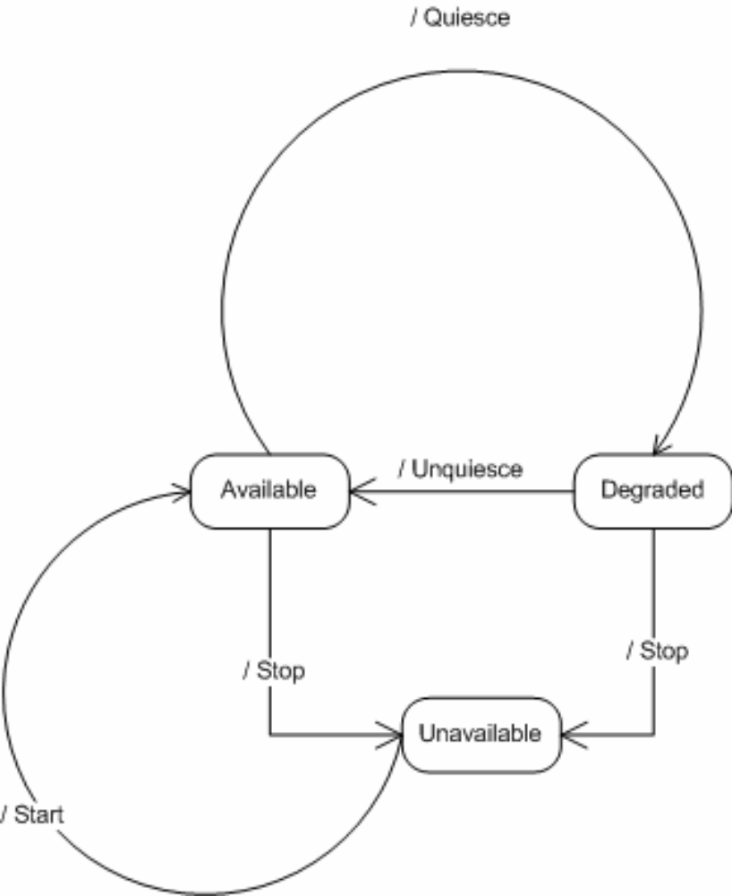
WSDM MUWS v0.5 Functionality (3)
Resource State
  Three top states
    Avalilable (“Green”)
    Degraded (“yellow”)
    Unavailable (“red”)
  Sub-states (v1.0)
    defined for each kind
    of resource
WSDL definitions and XML schemas
  start and stop operations

Slide 19
Expected WSDM MUWS v1.0 Functionality
Relationships between resources
Configuration and control
Change description
Events and notification

Slide 20
Outline
1. WG background and work
2. OGSA management glossary
3. OGSA management framework
4. WSDM updates and contents
5. OGSA gap analysis
6. Future Plans

Slide 21
What is the Gap Analysis?
Objectives
  Find what is missing on manageability in OGSA
  Find what should be done (e.g., regarding models)
Once targets are found:
  Prioritize
  Give work to other WGs, or spawn new WGs
Some useful references
  UK eScience gap analysis
  Data area doing their own gap analysis

Slide 22
OGSA Gap Analysis (Conceptual View)
2-dimensional array: functions vs. levels
Functions
Job submission
Deployment
Resource usage
Levels
Functional I/F
Manageability I/F
Operations
Service mgmt I/F
(WSDM MOWS)
Base manageability
(WSDM MUWS)
Models

Slide 23
Example: a registry function
Functions
Registry
Levels
Functional I/F
(Not resource management)
Manageability I/F
Monitoring of operation, performance
Service mgmt I/F
Create and destroy instances as needed (anything beyond WSDM MOWS?)
Base manageability
WSDM MUWS
Models
Model to support manageability I/F?

Slide 24
Status and Next Steps
Gaps so far
  Grid-specific events
  Manageability interfaces specific to each OGSA function not defined
  Academia-versus-industry gap
    academia has less interest in, and awareness of, manageability, standards, etc.
Next steps
  Fill in the “table”
    Moving target, given the OGSA re-factoring
  Detailed analysis of a few more critical services

Slide 25
Resource Information Models
Many models exist
  CIM, MIB (SNMP), JSR77 (JMX), etc.
  Resource descriptions contain implicit models:
    Brokering, scheduling, job submission (Globus RSL, Unicore Resource Schema, GLUE schema, etc.)
    Deployment
    Accounting, metering
Many models will be used simultaneously in a Grid
  Need to coordinate semantics
Analysis in preliminary state, looking forward to feedback on what needs to be done

Slide 26
Outline
1. WG background and work
2. OGSA management glossary
3. OGSA management framework
4. WSDM updates and contents
5. OGSA gap analysis
6. Future Plans

Slide 27
Future Plans (1)
WSDM
  Work continues at OASIS
Gap Analysis
  Get discussions deeper into OGSA-WG (working even more as an OGSA-WG “design team”)
  Finish the gap analysis document and submit it before GGF11 (in sync with OGSA-WG spec contents)
  Teleconferences on-demand (time chosen according to people’s availability)
  But, keep the WG status, and submit the document as a CMM-WG document

Slide 28
Future Plans (2)
Liaisons
  The “unwritten charter” of the CMM-WG
  Anything to do?
OASIS
Mgmt
Web
Services
SNIA
Storage Networking
W3C
Web Services Arch and Technologies
Industry-Wide
Mgmt
Model
Other Mgmt Stds Orgs
GGF
Resource Sharing and Provisioning (Model and Services)
DMTF
Model Unification and
Distributed Mgmt Infrastructure
Figure from GGF-DMTF work register

Slide 29
Questions?

Slide 30
Copyright Notice
Copyright (C) Global Grid Forum (2003). All Rights Reserved.
This document and translations of it may be copied and furnished to others, and derivative works that comment on or otherwise explain it or assist in its implementation may be prepared, copied, published and distributed, in whole or in part, without restriction of any kind, provided that the above copyright notice and this paragraph are included on all such copies and derivative works. However, this document itself may not be modified in any way, such as by removing the copyright notice or references to the GGF or other organizations, except as needed for the purpose of developing Grid Recommendations in which case the procedures for copyrights defined in the GGF Document process must be followed, or as required to translate it into languages other than English.
The limited permissions granted above are perpetual and will not be revoked by the GGF or its successors or assigns.
This document and the information contained herein is provided on an "AS IS" basis and THE GLOBAL GRID FORUM DISCLAIMS ALL WARRANTIES, EXPRESS OR IMPLIED, INCLUDING BUT NOT LIMITED TO ANY WARRANTY THAT THE USE OF THE INFORMATION HEREIN WILL NOT INFRINGE ANY RIGHTS OR ANY IMPLIED WARRANTIES OF MERCHANTABILITY OR FITNESS FOR A PARTICULAR PURPOSE.

Slide 31
Intellectual Property Rights and Notices
The GGF takes no position regarding the validity or scope of any intellectual property or other rights that might be claimed to pertain to the implementation or use of the technology described in this document or the extent to which any license under such rights might or might not be available; neither does it represent that it has made any effort to identify any such rights. Copies of claims of rights made available for publication and any assurances of licenses to be made available, or the result of an attempt made to obtain a general license or permission for the use of such proprietary rights by implementers or users of this specification can be obtained from the GGF Secretariat.
The GGF invites any interested party to bring to its attention any copyrights, patents or patent applications, or other proprietary rights which may cover technology that may be required to practice this recommendation. Please address the information to the GGF Executive Director.

