Slide 1


Early Experiences with OGSI-Agreement
Ming Xu, Principal Product Architect

Slide 2
Agenda
Community Scheduler Framework
Experiences in implementing Advance Reservation

Slide 3
What is CSF ?
Open-source Grid services for community scheduler
Support multiple meta-schedulers
Based on GT 3.0
Enterprise
Grid:
MultiCluster
Partner Grid
Solutions
Service Grid:
On Demand
Scheduler
Community Scheduler Framework (CSF)
Base on Globus Toolkit 3, OGSA core service,
OGSI-agreement, Open Source,
Part of Globus Toolkit,
Web Services enabled,
Gateway to 3rd party systems
LSF
Family
Off-line /
Batch
Symphony
On-line /
Service
Oriented
Condor
SGE
PBS
… others

Slide 4
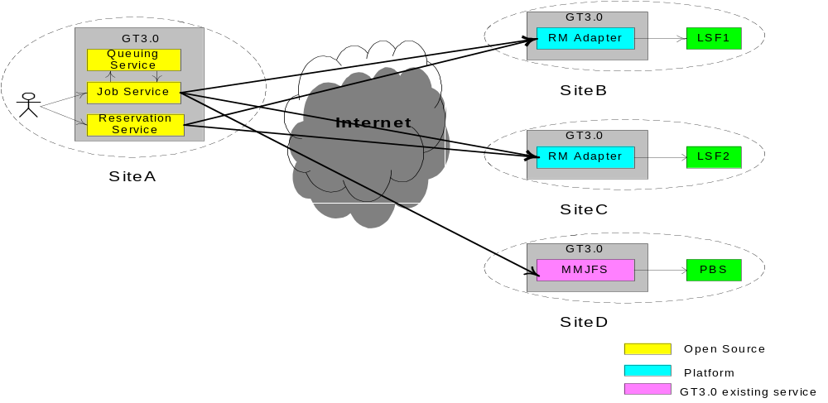

What’s in it for you
Interoperability of the RMs
Reliability/Scalability
Platform for more interesting work
  VO security and trust model
  Economy scheduler
  xSPs

Slide 5
What’s in it for meta-scheduler developers
Implement four call-back functions and plug-in!
Scheduler Modules
Scheduler framework API
Queueing Service
_{Resource}
_{Job Ctrl Actions}
Reservation Service
Job Service
Notes:
The scheduler is going to take on a new look.

Slide 6
How to get it
CSF is in Beta phase
http://www.platform.com/services/support/csf/beta.asp

Slide 7

Experiences

Slide 8
Reservation Service uses OGSI-Agreement
_{Reservation}
_{Adapter}
_{Reservation Agreement Exchange}
Work in progress to build Reservation
_{adaptor to other RMs}

Slide 9
What we implemented
Exposed an advance reservation as an Agreement Service
Defined the reservation agreement terms, currently to only use
  “all” agreement terms
  Wsp:Usage=“required” and Gsa:Negotiability=“fixed”
Negotiation is being explored in implementing LSF MultiCluster’s resource leasing feature on top of OGSI-Agreement

Slide 10

Implementation issues
Agreement states managed implicitly
Run-away reservations
  FactoryCallback:
  Temporary solution: handle failure in postCreate()
  Action: to be worked out with the Globus team
Stub class generation
  WSDL2Java does not support all xsd types, esp, “ref” keyword
  Leave that to the Apache team (?)
GT 3.0 issues: currently are being addressed
  File descriptors
  Memory usage: 600-800 jobs used 1GB ram
  DHCP, multi-homed hosts
Implementation trying to catch up with evolving standards
  Beta code reflect a snapshot of the earlier draft
  We are actively catching up !

Slide 11
Agreement terms for Advance Reservation
<metascheduler:agreement>
<wsp:All wsp:Usage="wsp:Required">
<metascheduler:ResReq gsa:Negotiability="gsa:Fixed">
<resReq>type==LINUX86</resReq>
</metascheduler:ResReq>
<metascheduler:hostTerm
gsa:Negotiability="gsa:Fixed">
<host>bf01</host>
</metascheduler:hostTerm>
<metascheduler:userTerm
gsa:Negotiability="gsa:Fixed">
<userName>jlam</userName>
</metascheduler:userTerm>
<metascheduler:cpuTerm gsa:Negotiability="gsa:Fixed">
<number>32</number>
</metascheduler:cpuTerm>
<metascheduler:startTime
gsa:Negotiability="gsa:Fixed">
<time>2003-08-29T17:00:00.000Z</time>
</metascheduler:startTime>
<metascheduler:endTime gsa:Negotiability="gsa:Fixed">
<time>2003-08-29T23:00:00.000Z</time>
</metascheduler:endTime>
</wsp:All>
</metascheduler:agreement>
_{CONT}

Slide 12
Reservation Service PortType
<gwsdl:portType name="ReservationPortType" extends="ogsi:GridService">
<operation name="modify">
<input message="tns:ModifyInputMessage"/>
<output message="tns:ModifyOutputMessage"/>
<fault name="ReservationFault" message="tns:ReservationFaultMessage"/>
</operation>
<operation name="cancel">
<input message="tns:CancelInputMessage"/>
<output message="tns:CancelOutputMessage"/>
<fault name="ReservationFault" message="tns:ReservationFaultMessage"/>
</operation>
<operation name="getStatus">
<input message="tns:GetStatusInputMessage"/>
<output message="tns:GetStatusOutputMessage"/>
<fault name="ReservationFault" message="tns:ReservationFaultMessage"/>
</operation>
<operation name="getRsvData">
<input message="tns:GetRsvDataInputMessage"/>
<output message="tns:GetRsvDataOutputMessage"/>
<fault name="ReservationFault" message="tns:ReservationFaultMessage"/> </operation>
</gwsdl:portType>
To be updated to extend AgreementPortyType
_{CONT}

Slide 13
Reservation Agreement Factory SDs
<ns3:supportedAgreement qname="ns4:createByAgreement" xmlns:ns3="http://www.platform.com/namespaces/2003/05/metascheduler/gsa" xmlns:ns4="http://www.platform.com/namespaces/2003/05/metascheduler/reservation" xmlns:xsi="http://www.w3.org/2001/XMLSchema-instance" xsi:type="ns3:SupportedAgreementType">
<ns3:term qname="ns5:hostsTerm" xmlns:ns5="http://com.platform.metascheduler/2003/05/rsl/metascheduler" xsi:type="ns3:SupportedTermType"/>
<ns3:term qname="ns6:cpuTerm" xmlns:ns6="http://com.platform.metascheduler/2003/05/rsl/metascheduler" xsi:type="ns3:SupportedTermType"/>
<ns3:term qname="ns7:userTerm" xmlns:ns7="http://com.platform.metascheduler/2003/05/rsl/metascheduler" xsi:type="ns3:SupportedTermType"/>
<ns3:term qname="ns8:startTime" xmlns:ns8="http://com.platform.metascheduler/2003/05/rsl/metascheduler" xsi:type="ns3:SupportedTermType"/>
<ns3:term qname="ns9:endTime" xmlns:ns9="http://com.platform.metascheduler/2003/05/rsl/metascheduler" xsi:type="ns3:SupportedTermType"/>
<ns3:term qname="ns10:reqReq" xmlns:ns10="http://com.platform.metascheduler/2003/05/rsl/metascheduler" xsi:type="ns3:SupportedTermType"/>
</ns3:supportedAgreement>

Slide 14
Reservation Agreement Service SD
Status as per Agreement:status
<ns3:status
Activity="gsa:Inactive"
Negotiation="wsp:Observed"
Satisfaction="gsa:Satisfied"
xmlns:ns3="http://www.platform.com/namespaces/2003/05/metascheduler/gsa"
xmlns:xsi="http://www.w3.org/2001/XMLSchema-instance" xsi:type="ns3:StatusType"/>
Agreement as per Agreement:agreement
<ns3:agreement xmlns:ns3="http://www.platform.com/namespaces/2003/05/metascheduler/gsa" xmlns:xsi="http://www.w3.org/2001/XMLSchema-instance" xsi:type="ns3:AgreementType">
<ns3:all Preference="0" Usage="wsp:Required" xmlns:ns4="http://schemas.xmlsoap.org/ws/2002/12/policy" xsi:type="ns4:Compositor">

Slide 15
Reservation Agreement Service SD (cont)
<ns4:TextEncoding xsi:nil="true"/>
<ns4:Language xsi:nil="true"/>
<ns4:SpecVersion xsi:nil="true"/>
<ns4:MessagePredicate xsi:nil="true"/>
<ns5:hostsTerm xmlns:ns5="http://com.platform.metascheduler/2003/05/rsl/metascheduler" xsi:type="ns5:HostsTermType">
<ns5:host>bf01 dev04</ns5:host>
</ns5:hostsTerm>
<ns6:cpuTerm xmlns:ns6="http://com.platform.metascheduler/2003/05/rsl/metascheduler" xsi:type="ns6:CpuTermType">
<ns6:number>32</ns6:number>
</ns6:cpuTerm>
<ns7:userTerm xmlns:ns7="http://com.platform.metascheduler/2003/05/rsl/metascheduler" xsi:type="ns7:UserTermType">
<ns7:user>jlam</ns7:user>
</ns7:userTerm>

Slide 16
Reservation Agreement Service SD (cont)
</ns7:userTerm>
<ns8:startTime xmlns:ns8="http://com.platform.metascheduler/2003/05/rsl/metascheduler" xsi:type="ns8:TimeTermType">
<ns8:time>2003-08-29T17:00:00.000Z</ns8:time>
</ns8:startTime>
<ns9:endTime xmlns:ns9="http://com.platform.metascheduler/2003/05/rsl/metascheduler" xsi:type="ns9:TimeTermType">
<ns9:time>2003-08-29T23:00:00.000Z</ns9:time>
</ns9:endTime>
<ns10:reqReq xmlns:ns10="http://com.platform.metascheduler/2003/05/rsl/metascheduler" xsi:type="ns10:ResReqTermType">
<ns10:resReq>type==LINUX86</ns10:resReq>
</ns10:reqReq>
</ns3:all>
<ns3:id xsi:nil="true"/>
<ns3:language xsi:nil="true"/>
<ns3:messagePredicate xsi:nil="true"/>
<ns3:name xsi:nil="true"/>

Slide 17
Reservation Agreement Service SD (cont)
<ns3:policyReference xsi:nil="true"/>
<ns3:specVersion xsi:nil="true"/>
<ns3:targetNamespace xsi:nil="true"/>
<ns3:textEncoding xsi:nil="true"/>
</ns3:agreement>

Slide 18
What’s next
Standardize OGSI-Agreement job terms and reservation terms
Change PortType to extend AgreementPortType
Work with Globus to address the identified implementation issues

