Slide 1
GGF Community Function
GGF15/GridWorld F2F
October 2, 2005

Slide 2
AGENDA
Break-Out #1
  Introductions
  Progress/Success To-Date
  Objectives for Today
  Community Structure and Operating Model
  Draft Report-Out #1
Break-Out #2
  Assess/Apply feedback from joint session
  Proposed Community Areas, Activities, Assignments and Timeline
  Draft Report-Out #2

Slide 3
Progress/Success To-Date
We organized and held a successful Community program at GGF14
We have designed and expect a successful Community program at GGF15
Community programs have a few stable groups (health, applications) that actively meet; at GGF14
  PE, HASS, CAOps, Telco, Apps, GCE
  LSG held workshop outside GGF
But major effort is “ad-hoc” meetings and tutorials which can be considered as “dynamic community groups”
Don’t think we did very well in getting back some scared-away research groups
Under-resourced in surveys, web-pages, etc.

Slide 4
GGF Management Steering Committee and Direct Staff
Mark Linesch
GGF Chair
Steve Crumb
Robert Fogel
Vice-Chair Operations
David Snelling
Vice-Chair Community
Executive Director
Vice-Chair Standards
GGF, Inc.
Kevin Drew
Jennifer Ehling
Webmaster
Administrator
Julie Wulf-Knoerzer
Manager, Community
Ann Collins
Joel Replogle
Director of Events
Manager of Standards

Slide 5
GGF Management Steering Committee
Mark Linesch
GGF Chair
Focus
Robert Fogel
David Snelling
Steve Crumb
Community
Standards
Operations
Functions
Establishing overall direction, priorities, objectives and measures, ensuring operational over-site for activities and deliverables
Chairing and participating in council and GGF management meetings, creating a collaborative, productive and accountable environment
Facilitating, championing and/or managing special projects critical to longer term success
Providing insight and expertise to GGF strategy, policy and operational issues
Representing GGF in public forums, events, press and analyst engagements
Special Projects
Grid Forum Program Committee (GFPC)
GGF Use Case Project
Grid Forum Interoperability Committee (GFPC)*
GGF Standards Roadmap and Process
GGF Document Series*
GGF Sponsorship Program
GGF Marketing Program
GGF Events Program
IT/Process Projects*
* In the “idea and project incubation stage”
Notes:
ns

Slide 6
GGF Support Staff
GGF Direct Staff: 4 FTE, 2 Part TIme
Steve Crumb
Kevin Drew
Webmaster
(part-time)
Jennifer Ehling
Administrator
(part-time)
GGF Executive Director
Vice Chair, Operations
Focus
Julie Wulf-Knoerzer
Ann Collins
Joel Replogel
Community
Events
Standards
Functions
Community support and facilitation
Major meeting facilitation (CC, GFAC, MSC)
GGF project-based leadership, support and/or collaboration
Event business, operations & partnership management
Major meeting facilitation (ESC, GGF/IDG)
GGF project-based leadership, support and/or collaboration
Standards support and facilitation
Major meeting facilitation (SC, GFSG Policy)
GGF project-based leadership, support and/or collaboration
Special Projects
GGF Event Survey
GGF Satisfaction Survey*
GGF Event Summary
Group Session Scheduling
IT Project/Process Support*
* In the “idea and project incubation stage”
Notes:
ns

Slide 7
Introductions
Robert Fogel | Intel | vc communities
Julie Wulf-Knoerzer | GGF | Manager, Community
Satoshi Matsuoka | Tokyo Inst. of Technology | research apps
Thilo Kielmann | Free University of Amsterdam | research apps
Craig Lee | the Aerospace corporation | industrial apps
Bob Cohen | Economic Strategy Institute | industrial apps
Ken Klingenstein | Internet2 (US) | grid operations
Charlie Catlett | Argonne National Lab | grid operations
DeRoure, David | Univ of Southhampton, UK | tech innovators
Dennis Gannon | Univ Indiana, US | tech innovators
Wolfgang Gentzsch | MCNC, D-Grid and RENCI | major grid projects
Victor Alesandrini | IDRIS (Fr) | major grid projects
Geoffrey Fox | Univ Indiana, US | community affairs
Alan Blatecky | Univ. of NC | Ad at-large
Hai Jin | Huazhong Univ, Wuhan, China | major grid projects – China
Notes:
Hai Jin changed to Major Grid Projects (this is a new position – “Liaison to China”

Slide 8
Objectives for our Face-to-Face Today
Agree-on a set of crisp objectives that we can articulate to GGF members at-large
Agree-on Community structure and operating model to act on objectives
Establish prioritized list of projects/activities that tie back to the objectives and comprehend cut line, resources and timing
Assign owners for each project/activity
Actually, the most important objective for today is to stimulate dialogue, exchange of ideas and participation, then apply the results to shape the GGF Community in support of GGF as “leading the pervasive adoption of grid computing for research and industry”

Slide 9
Community Directive
Building an international community for the exchange of ideas, experiences, requirements, best practices
GGF Mission
Leading the pervasive adoption of grid computing for research and industry

Slide 10
The GGF Value Creation and Delivery Process
End User
&
Technology
Community
“MAKE END USERS SUCCESSFUL”
“MAKE STANDARDS RELEVANT”
Solutions
and
Building Blocks
Use Cases,
Requirements
and Prototypes
Deliver
Value
Create
Value
Vendor
and
Open Source
Communities
Standards
Groups/Orgs
Architectures and Specifications
Flow of Tangibles
“MAKE STANDARDS COST EFFECTIVE TO APPLY”
Interaction

Slide 11
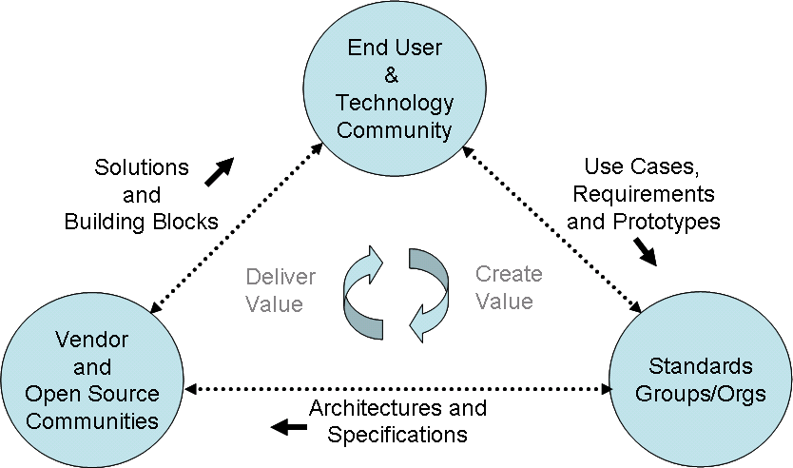
Community Objectives
Identify and prioritize use cases, requirements and prototypes then represent them in the standards process
Enable end users apply solutions and building blocks for successful Grid deployment
Ensure that standards are cost effective and easy to apply, then facilitate their adoption

Slide 12
Community Structure & Operating Model
Community
Advisors Board
(GCAB
Ideas & Suggestions
Grid Community
At-Large
Capture
Ideas & Suggestions
Solicit
Feedback
Prioritize/Filter/Shape
into Activities
Community Council
Queue/Provision/Distribute
Activities
Execute
Activity
Execute
Activity
Execute
Activity
Execute
Activity
Activity
AD/Lead/Team
Activity
AD/Lead/Team
Activity
AD/Lead/Team
Activity
AD/Lead/Team
Area
Area

Slide 13
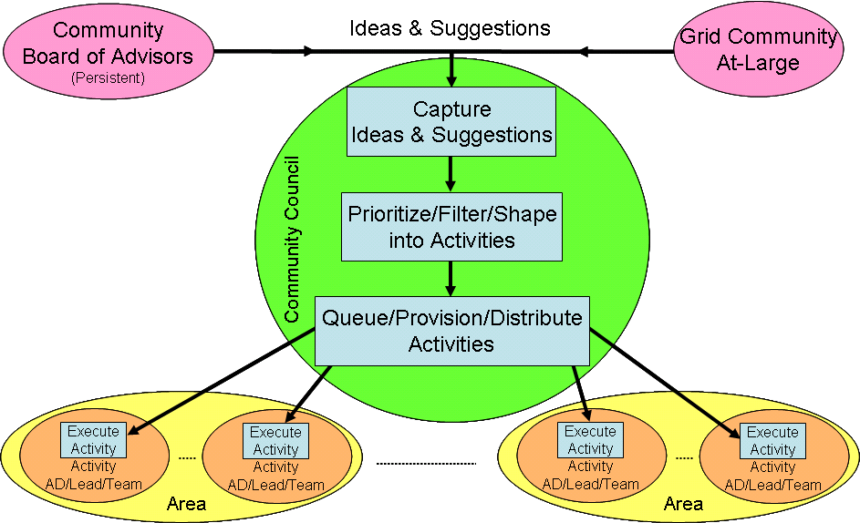
Community Board of Advisors
Potentially large, persistent group representing thought leadership and key participants in the community at large
Members would not necessarily hold official GGF positions, e.g. GSFG members
Small time commitment since responsibilities would mainly be to review and suggest ideas to influence the community structure, operation, activities, etc.
No formal meetings except possibly at major GGF events, i.e. interaction is primarily via e-mail
By default members would include ADs
Should there be a Chair?
Member suggestions? (e.g. key vendors, nontraditional Grid folks, thought leaders)
Notes:
*Added ‘Should there be a Chair’
*Deleted next slide and added “Member suggestions” (Catlett, Foster, DataSynapse for starting discussion)

Slide 14
Community Council
Consists of all the ADs
Responsible for taking suggestions/ideas and turning them into discrete, measurable, executable activities
Bi-Weekly telecon
Use Grid Forge as the archive (for now)
Notes:
*Weekly changed to Bi-Weekly

Slide 15
Areas and Activities
Areas are defined by the sum of its activities, i.e. just a way of grouping related activities NOT a management hierarchy
Each activity has a specific set of objectives, metrics, execution plan/timeline
Each activity has a team, team lead and an associated AD
Activities may need to network to ensure efficiency, e.g. between events and recruiting
Examples of activities
  GGF16
  Community survey
Notes:
*Provided 2 examples of activities
OUTSTANDING:
*Elaborate on 3 boxes in terms of process of transforming an idea into an activity.

Slide 16
AGENDA
Break-Out #1
  Introductions
  Progress/Success To-Date
  Objectives for Today
  Community Structure and Operating Model
  Draft Report-Out #1
Break-Out #2
  Assess/Apply feedback from joint session
  Proposed Community Areas, Activities, Assignments and Timeline
  Draft Report-Out #2

Slide 17
Community Areas
Outreach, Events and Meetings
  Delivering content for major GGF events (3 per year)
    Establish BKM across all events
    Make accessible to the Grid community at-large (inc. nontraditional Grid people/orgs)
    Tie event to regional group/franchise
  Industry events (E.g. Oracle World, BEA World, Grid World Japan, Grid World China, analysts events, etc.)
  Use as recruiting vehicle
Community Groups/Regions/Franchises
  Major Grid projects (E.g. TeraGrid, UK eScience)
  Emerging geographies, e.g. China
  Nurturing environment for community participation and experiment with new ways to nurture communities
Publications and Documentation
  Use cases and requirements
  Reference-able documentation to appeal to academics
  BKMs
Prototypes
Notes:
*Publications and documentation
-We should seek assistance from the GCAB to assist in this

Slide 18
Community Activities (committed for 2006)
Develop and deliver content for GGF16 (Athens)
Develop and deliver content for GGF17 (Tokyo)
Develop and deliver content for GGF18 (Boston)
Develop GGF event survey to increase attendance and augment value delivered via GGF events
GGF Community satisfaction survey to increase participation, and augment value delivered by of GGF
Champion information exchange between GGF and the community through GGF interop BOFs and workshops

Slide 19
Community Activities (existing, 1 of 2)
Enable active participation & growth for existing Research communities
Pro-actively explore, develop, and establish new Industry communities
Increase community-oriented focus at GGF events
  Ensure meetings are well attended and productive for target communities
Publish community-driven requirements & best practices

Slide 20
Community Activities (existing, 2 of 2)
Seek out and work with leaders important to the community
Publish by mid year ’05 a GGF Community Participation Guide outlining the value (Why) and the mechanisms (How) to participate in GGF communities
Each community area publishes a Community Charter Document outlining charter and rational, expectations and processes; activities and deliverables
Proposals are written to EC, NSF, DoE and other sources for CCGT and other fundable activities

Slide 21
Community Activities (existing, 2 of 2)
Establish 3 active industrial grid user communities with GGF by YE05
Publish by YE05 Requirement Documents from 2 research and 2 industry application communities on topics related to grid technology specifications and standards
By mid 2006 have at least two communities committed to executing a usability test of OGSA standards based on available implementations
Develop GGF membership model, database and survey mechanisms in place and operational by YE05

Slide 22
Community Activities (proposed, 1 of 3)
Establish smaller and more frequent regional (i.e. GGF franchised) community meetings via self-sufficient regional chapters in key geographies
  E.g. 2 times per year in the US
Create GGF Community presence at non-GGF industry events
  E.g. Oracle Open World, Grid World Japan, BEA World, Analysts events
Develop specific GGF Community groups around Financial, Pharma, Telcom, QCD, Life Sciences, CFD, Automotive, Oil&Gas, Astrophysics, Weather, Hydrodynamics, etc.
  Each Group produces a “voice of the Community” (VOC) document to capture it’s unique requirements and use cases
  The VOCs not only Identify and prioritize use cases, prototypes and requirements; but, are also used to represent use cases, prototypes and requirements in the formation of stds
  Help End Users apply solutions and building blocks, i.e. use Grids.
Establish specific GGF Community groups associated with major Grid projects
  E.g. NCOIC/W2COG, TeraGrid, UK eScience, EGEE (European particle physics), OSG (Open Science Grid) for USA, Bring back OGCE (Open Grid Computing environments), MSI’s (Minority Serving Institutions)
Develop and deliver tutorials and seminars at Grid events
Setup summer schools as delivery vehicles

Slide 23
Community Activities (proposed, 2 of 3)
Establish groups around specific functional areas to develop best practices and to better understand end user requirements and use cases
  E.g. Data Management, Virtualization, licensing, Ontologies, Semantic Web, DRM, Orchestration, Management, Utility Computing, Datacenter, security, data management, apps management, etc.
Capture/mine GGF success stories and references to help measure GGF value, as well as to help educate end users
Manage docs for publication which are reference-able by GGF
Develop GGF case studies and white papers
Develop best know methods (BKMs) and blueprints to help end users use Grid technology
Work with vendor community to create composite architectures
Develop glossary/taxonomy
Make GGF web site more oriented to the Community function
Publish Community News Letter
Create vendors and open source database (yellow pages)
Notes:
*Added “referencable documentation” – great interest among research to have published papers.

Slide 24
Community Activities (proposed, 3 of 3)
Event add-ons such as workshops, BoF’s at HPDC, GGxx SCxx
Roadmaps of entire Grid space (i.e. not just OGSA)
Bring-in Globus and similar communities

Slide 25
Top 5 Major Objectives
Implement Community Operational Model by Feb 2006
Unique Value Proposition (what unique value can GGF offer in general and where are we lacking? Cross-cutting)
  Make conscious decisions about what we do and don’t do
  Place where multiple grid people can meet in an open forum (The Grid Watercooler)
  Use Case Repository
  Surveys
  Standards
Events (on-going)
  GGFxx Community Program Content (GGF16, GGF17/GridWorld Japan, GGF18/GridWorld Boston)
  Plugfest
  Non-GGFxx Events
Establish bi-directional communication into and with Standards and Operations
  Pilot: Major Grid Projects Priorities (repeatable process)…note: Not based on OGSA Roadmap
  Participation and ‘sign-off’ in GGFxx event structure
Communities (Understand needs, learn what it takes to make that group successful and plug-in to the rest of GGF)
  Call for Activities (and Activity Leaders) – on-going efforts rather than just one event
  Major Grid Projects
    Assemble the major international deployed grid projects
  Vertical groups (pharma, life sciences, finance, manufacturing, telco, energy, oil/gas)
    Business value and impact
  Vendor group (tbd)

Slide 26
Project Timeline (needs refinement)
Implement Community Operational Model by Feb 2006
GGF16
  Engage GRNET to integrate regional track
  Engage GCAB, GFSG, etc., (emphasis European contacts) for distribution of CFP and potential keynote solicitation
  Collaborate with Operations council on promotion of Community Program
  Involvement from GridCoord and other European projects?
  Determine program committee
  Events Survey
  Vendor BoF

Slide 27
Community Function Groups (prior to GGF15)
Research Applications (Area Director: Satoshi Matsuoka)
  Application Developers and Users (APPS-RG)
  Astronomy Applications (Astro-RG)
  Humanities, Arts, and Social Science (HASS-RG)
  Life Sciences Grid (LSG-RG)
  Particle and Nuclear Physics Applications (PNPA-RG)
  Preservation Environments(PE-RG)
Industry Applications (Area Director: Craig Lee)
  Enterprise Grids Requirements (EGR-RG)
  Telecomm Community Group (Telco-CG)
Grid Operations (Area Director: Ken Klingenstein)
  CA Ops (CAOPs-WG)
  Production Grid Services (PGS-RG)
Technology Innovators (Area Director: David DeRoure)
  Advanced Collaborative Environments (ACE-RG)
  Appliance Aggregation (APPAGG-RG)
  Grid Computing Environments (GCE-RG)
  User Program Development Tools for the Grid (UPDT-RG)
  Semantic Grid (SEM-RG)
  Workflow Management (WFM-RG)
Community Affairs (Area Director: Geoffrey Fox)
  GGF Process-WG
  Grid Benchmarking (GB-RG)
Major Grid Projects (Area Directors: Charlie Catlett and Alan Blatecky)
Notes:
*I am not sure if this is the correct spot for this?

Slide 28
Assignments
Robert Fogel | Intel | vc communities
Satoshi Matsuoka | Tokyo Inst. of Technology
Thilo Kielmann | Free University of Amsterdam
Craig Lee | the Aerospace corporation
Bob Cohen | Bway
Ken Klingenstein | Internet2 (US)
Charlie Catlett | Argonne National Lab
DeRoure, David | Univ of Southhampton, UK
Dennis Gannon | Univ Indiana, US
Wolfgang Gentzsch | MCNC
Allesandrini | IDRIS (Fr)
Geoffry Fox | Univ Indiana, US
Hai Jin | Huazhong Univ, Wuhan, China
Notes:
*At meeting – we will map activities to specific areas/individuals

Slide 29
Timeline/Roadmap
GGF15
2005
2006
2007
Q4
Q2
Q3
Q4

Slide 30
Community Activities (existing objectives, 2 of 2)
Publish and communicate GGF information to enable community members to productively participate and contribute to GGF communities
  Seek out and work with leaders in important communities
  Publish by mid year ’05 a GGF Community Participation Guide outlining the value (Why) and the mechanisms (How) to participate in GGF communities
  Each community area publishes a Community Charter Document outlining charter and rational, expectations and processes; activities and deliverables
Develop and execute a community oriented focus for GGF events ensuring meetings are well attended and productive for target communities
  Community-oriented tracks are developed and established during GGF14 and GGF15
  Community surveys indicate increased satisfaction with GGF events and increased participation at GGF events
  Proposals are written to EC, NSF, DoE and other sources for CCGT and other fundable activities

Slide 31
Community Activities (existing objectives, 2 of 2)
Proactively explore, develop, and establish new Industry grid communities
  Establish 3 active industrial grid user communities with GGF by YE05
Document and publish community-driven application requirement profiles, usability criteria and benchmarks
  Publish by YE05 Requirement Documents from 2 research and 2 industry application communities on topics related to grid technology specifications and standards
  By mid 2006 have at least two communities committed to executing a usability test of OGSA standards based on available implementations
Develop GGF membership database and community survey model
  GGF membership model, database and survey mechanisms in place and operational by YE05

Slide 32
Transformation Landscape
Community and Sponsors
Value Proposition:
our unique promise of value to the customer
Value Delivery System:
Use Cases & Requirements
Specifications & Standards
Products & Solutions
Time & Money
how we utilize resources to delivery value and obtain credit from sponsors and our community
Value & Brand Credit
Architectures & Best Practices
Reference Designs
how we make, manage value through the chain (e.g. Standards, Community, Operations)
Community
Standards
Operations
Leadership Framework
Strategy
Structure and processes
Metrics, results and rewards
Values and behavior
how we manage & make decisions

Slide 33
2005 Objectives
Community
Enable active participation & growth for existing Research communities
Pro-actively explore, develop, and establish new Industry communities
Increase community-oriented focus at GGF events
Publish community-driven requirements & best practices
Community Satisfaction
Standards
Publish GGF Standards Roadmap
Publish OGSA v 1.5 Architecture and Profiles
Standards Adoption
Publish, or support the publication of, important Grid specifications
Manage liaisons with standards organizations critical to grid adoption
Operations Efficiency
Operations
Marketing plan that communicates the value of GGF and ongoing contributions
Events plan resulting in increased GGF event satisfaction & financial return
Sponsorship plan resulting in increased sponsor satisfaction and revenue
Revise GGF website while improving GGF document publishing infrastructure
Notes:
Role with BCS Value Creation
Understand current BCS deals
? With BCS
BCS focus?
Same ?
Who gets revenue for x-IGS deals?
Delivery
How to do ?

Slide 34
GGF Structure
Grid Forum Steering Group (GFSG) provides day-to-day management for accomplishing the mission of GGF.
Steering Group (GFSG)
Advisory Committee
(GFAC)
Provides long term strategic advice to GGF Chair and Steering Group
Editor
GGF Non-Profit Corp.
(GGF-Corp)
Legal and financial business entity supporting the mission of GGF
Chair
Community
Standards
Operations
Vice Chair
Vice Chair
Vice Chair
AD
AD
AD
AD
AD
AD
AD
AD
AD
AD
AD
AD
Area
Area
Area
Area
Area
Area
AD
= Area Director
= Group
Groups, Areas & Functions: GGF groups are organized into areas and associated with key functions such as Community, Standards and Operations

Slide 35
The type of organization we aspire to be
Strategy
“right questions, right answers”
Collaboration
“ no broken glass or dead bodies”
Fun
“ freedom to innovate & make a difference”
Execution
“lead, deliver and leverage”

Slide 36
Current Integrating Mechanisms
Standards Con-call | Chair: Dave Snelling Facilitator: Joel Replogel | Bi-weekly, Same week as Community
Community Con-call | Chair: Robert F Facilitator: Julie Wulf-Knoerzer | Bi-weekly , Same week as Standards
GFSG Policy Con-call | Chair: Mark Linesch Facilitator: Joel Replogel | Bi-weekly, Alternate to Stds and Community
MSC Con-call | Chair: Mark Linesch Facilitator: Julie Wulf-Knoerzer | Bi-weekly
ESC Con-call | Chair: Ann Collins Facilitator: Ann Collins | Bi-weekly
GFSG f2f at GGF Events | Chair: Mark Linesch Facilitator: Julie Wulf-Knoerzer | By Event
GFAC f2f at GGF Events | Chair: Bill Feiereisen/Tony Hey Facilitator: Julie Wulf-Knoerzer | By Event
GFSG 3-day offsite | Chair: Mark Linesch Facilitator: TBD | Annual

Slide 37
Creative backlog of projects
Grid Forum Program Committee (GFPC)
GFSG Charter/Dashboard
GGF Use Case Series
GGF Document Series
Grid Forum Interoperability Committee (GFIC)
GGF Roadmap Process and Interoperability Campaign
Sponsorship/Members
GFAC/BOD
Interoperability testing
GGF Satisfaction Survey

