Slide 1
Cees de Laat
Control Models
University of Amsterdam

Slide 2
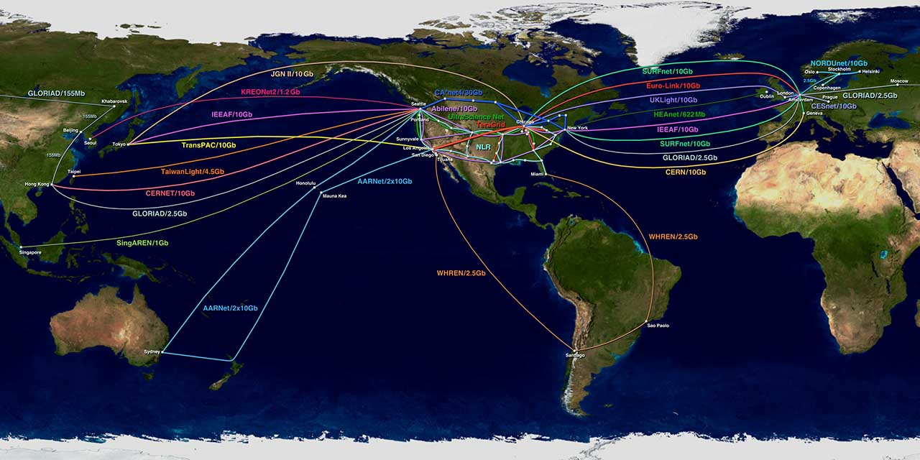
The Playing Field
Visualization courtesy of Bob Patterson, NCSA.

Slide 3
How low can you go?
Application
Endpoint A
Local
Ethernet
MEMS
15454
6500
HDXc
Application
Endpoint B
Regional
dark
fiber
POS
Trans-Oceanic
Router
Ethernet
SONET
DWDMFiber
StarLight
GLIF
StarPlane
NetherLight

Slide 4
Optical Exchange as Black Box
Web Services
TeraByte
Email
Service
Ref gridnets paper by Freek Dijkstra et al,,
see my homepage

Slide 5
Service Matrix
To From | WDM (multiple λ) | Single λ, any bitstream | SONET/ SDH | 1 Gb/s Ethernet | LAN PHY Ethernet | WAN PHY Ethernet | VLAN tagged Ethernet | IP over Ethernet
WDM (multiple λ) | cross-connect multicast, regenerate, multicast | WDM demux | WDM demux* | WDM demux * | WDM demux * | WDM demux * | WDM demux * | WDM demux *
Single λ, any bitstream | WDM mux | cross-connect multicast, regenerate, multicast | N/A * | N/A * | N/A * | N/A * | N/A * | N/A *
SONET/SDH | WDM mux | N/A * | SONET switch, + | TDM demux * | TDM demux⁶ | SONET switch | TDM demux * | TDM demux *
1 Gb/s Ethernet | WDM mux | N/A * | TDM mux | aggregate, Ethernet conversion + | aggregate, eth. convert | aggregate, Ethernet conversion | aggregate, VLAN encap | L3 entry *
LAN PHY Ethernet | WDM mux | N/A* | TDM mux⁶ | aggregate, Ethernet conversion | aggregate, Ethernet conversion + | Ethernet conversion | aggregate, VLAN encap | L3 entry *
WAN PHY Ethernet | WDM mux | N/A * | SONET switch | aggregate, Ethernet conversion | Ethernet conversion | aggregate, Ethernet conversion + | aggregate, VLAN encap | L3 entry *
VLAN tagged Ethernet | WDM mux | N/A * | TDM mux | aggregate, VLAN decap | aggregate, VLAN decap | aggregate, VLAN decap | Aggregate, VLAN decap & encap + | N/A
IP over Ethernet | WDM mux | N/A * | TDM mux | L3 exit * | L3 exit * | L3 exit * | N/A | Store & forward, L3 entry/exit+

Slide 6
ISO Telecommunications Management
Networks (TMN) reference model
Legal Ownership
Economic Ownership
Business Management Level
Business agreements between Carrier Networks and Open Exchanges.
Service Management Level
Manage a 99.9995 % available network connectivity.
Administrative Ownership
Network Management Level
Create optimal route
Element Management Level
Network Operator
Manageable network elements
Network Elements
Optical switches
TMN is based on the OSI management framework and uses an object-oriented approach, with managed information in network resources modeled as attributes in managed objects. TMN is defined in ITU-T M.3000 series recommendations
feb 2005 GLIF Workshop LG, FD, BvO, CdL

Slide 7
Ownership of resources
Legal Owner:
  Organization that legally owns a resource.
  A legal owner may sell the right to economically use the resource.
Economic Owner:
  Acquires economic resource usage right a from legal resource owner.
  A contract details terms by which a resource may be used.
  Economic owners may outsource resource management to an Administrative Owner by means of a service level agreement.
Administrative Owner:
  Technically implements the terms of a service level agreement
  Signals requests to other AO’s and handles responses.
  Collects accounting information.
Relationship between owners:
  Legal, economic and administrative owners may or may not be independent organizations.
  Economic owners may acquire resources from different legal owners.
  Administrative owners may serve different economic owners.
  Economic owners may establish contracts with other economic owners to create more elaborate services. Technical details are delegated and implemented by Administrative Owners.
feb 2005 GLIF Workshop LG, FD, BvO, CdL

Slide 8
Contract
Optical Network Stakeholders
Contract
VO
Economic
Link
Owner
VO
Economic
Link
Owner
Global Carrier
Legal Link Owner
Optical
Exchange
Optical
Exchange
NRN
NRN
Internet
Exchange
Internet
Exchange
VO
Members
VO
Members
Global Best Effort
INTERNET
Problem
In order to enable a dynamic, cost effective VO business operation, Economic Link Owners Red and Blue need to create and have the ability to implement link usage contracts with VO’s leading to the creation of Optical Private Network (OPN) between VO members.
feb 2005 GLIF Workshop LG, FD, BvO, CdL

Slide 9
Role definitions
Legal Link Owner (LLO): Sells the right to use a link to an ELO’s
Economic Link Owner (ELO): Acquires the right to use a link and creates agreements with Economic VO’s about the usage of its links.ELO’s will terminate a link at an optical exchange based on a contract with an EPO.
Administrative Link Owner (ALO): Translates the ELO defined business rules governing link access to technical rules that are subsequently pushed to the APO for enforcement (optical link fibers have no electronic control).
Legal Port Owner (LPO): Owns optical switch-ports. Usage rights are sold to EPO’s. Multiple LPO’s may be present within an Optical Exchange.
Economic Port Owner (EPO): Acquires the usage right from one or more LPO’s for one or more ports on the Optical Exchange. EPO’s establishes contracts to allow peering with own or other EPO ports on behalf of ELO’s.
Administrative Port Owner (APO): an entity that accepts peering policies from ALO’s. Peering policies are based on the agreements between ELO and a VO. Creates connections with own ports or other ports from different APO’s based on requests with credentials from VO’s members or its proxy .
feb 2005 GLIF Workshop LG, FD, BvO, CdL

Slide 10
Optical Exchange Stakeholders
Open Optical Exchange
Legal Port Owner
Administrative Link Owner (ALO)
Economic Port Owner
Administrative Port Owner (APO) APO = ALO
Administrative
Link Owner (ALO)
Administrative Link Owner (ALO)
Legal Port Owner
Economic Port Owner
Administrative Port Owner (APO)
APO ≠ ALO
Administrative Link Owner (ALO)
Not so Open Optical Exchange
feb 2005 GLIF Workshop LG, FD, BvO, CdL

Slide 11
Open issues
Open versus closed
What about if policy == yes always
Housing neutral or not neutral
Different business models of operating exchanges

