Slide 1
Overlap of Concepts between GGF DAIS Specs and the DMTF CIM Schema
CIM System/Devices, Application, User/Security and Database Models
October 8, 2003
Author:
Andrea Westerinen
DMTF VP of Technology
andreaw@cisco.com

Slide 2
Agenda
GGF DAIS Scenarios and DMTF CIM
System/Devices Model for Storage and Files
Application Model for Deployment and Runtime
Database Model
User and Security Model
Next Steps

Slide 3
Complementary WG Charters
GGF DAIS Charter:
  “… Promote standards for the development of grid database services, focusing principally on providing consistent access to existing, autonomously managed databases”
DMTF CIM Database WG Charter:
  “… Define the information model that characterizes the common properties and services performed by a database. This includes both the inventory (static database properties, parameter settings, resource limits, features available/used) and behavioral (event, state, rules, and methods) attributes.”

Slide 4
DAIS Scenarios and CIM
Discovering a database
  Instance of a CIM_DatabaseSystem (a subclass of CIM_ApplicationSystem) with supporting CIM_DatabaseServices
Provisioning a database system
  Result of a “create database” -> An instance of CIM_CommonDatabase
  Tables are not currently modeled but are a future activity of the Database WG

Slide 5
DAIS Scenarios and CIM
Locating a suitable database system and defining the necessary tables
  Locate database by checking associated CIM_CommonDatabaseStatistics
Starting up and shutting down a system
  Use the RequestStateChange method on CIM_EnabledLogicalElement that is inherited by all systems and services

Slide 6
But there is more ….

Slide 7
Other DAIS Concepts in CIM
Product information in CIM_Product class
Software features in CIM_SoftwareFeature class
  SoftwareFeatures related to Products
Capabilities as subclasses of the abstract CIM_Capabilities class
Concepts of state and status inherited from CIM_ManagedElement and CIM_EnabledLogicalElement

Slide 8
Other DAIS Concepts in CIM
Concept of CIM_OrganizationalEntity (orgs, org units and user contacts) in the CIM User and Security Model
Also modeled, CIM_Credentials, CIM_Identity (i.e., a security principal) and RBAC (via CIM_Privilege, CIM_Role and policy)

Slide 9
Agenda
DAIS Scenarios and CIM
System/Devices Model for Storage and Files
Application Model for Deployment and Runtime
Database Model
User and Security Model
Next Steps

Slide 10
Storage Aspects Addressed by CIM
Application
File/record layer
Database
(dbms)
File system
(FS)
Services
Block layer
Host
Discovery, monitoring
Resource mgmt, configuration
Security, billing
Redundancy mgmt (backup, …)
High availability (fail-over, …)
Network
Capacity planning
Block
aggregation
Device
Storage devices (disks, …)

Slide 11
Storage and File Concepts
CIM_StorageExtent is the high level class representing any storage
CIM_StorageVolume describes storage that is presented to an OS (for ex, by a hardware RAID cabinet), or to a File System (for ex, by a software volume manager)
StorageVolumes can be based on (assembled from) lower level StorageExtents

Slide 12
Storage and File Concepts
CIM_FileSystem and CIM_LogicalFile define the base file system concepts
FileSystems reside on storage, as indicated by the CIM_ResidesOnExtent association
LogicalFiles are located in FileSystems and are of various types – Directory, Data, Device (describing devices accessed via a byte stream I/O model), FIFOPipe, or SymbolicLink
File sharing and import (across systems) also described

Slide 13
Agenda
DAIS Scenarios and CIM
System/Devices Model for Storage and Files
Application Model for Deployment and Runtime
Database Model
User and Security Model
Next Steps

Slide 14
Applications Model Overview
Sub-Models:
  Application Lifecycle Model (Deployment)
  Application Runtime Model
  J2EE Application Server Model
  Management and State
  Metrics

Slide 15
Application Model Overview
Execution Service
Unit of Acquisition
Application Model
Application
System
Product
Service
Core Model
Collect Features into Business System
Software
Feature
ProductSoftwareFeature
ApplicationSystemSoftwareFeature
SoftwareFeatureSoftwareElements
Unit of Component Management
Software
Element
Unit of Deployment

Slide 16
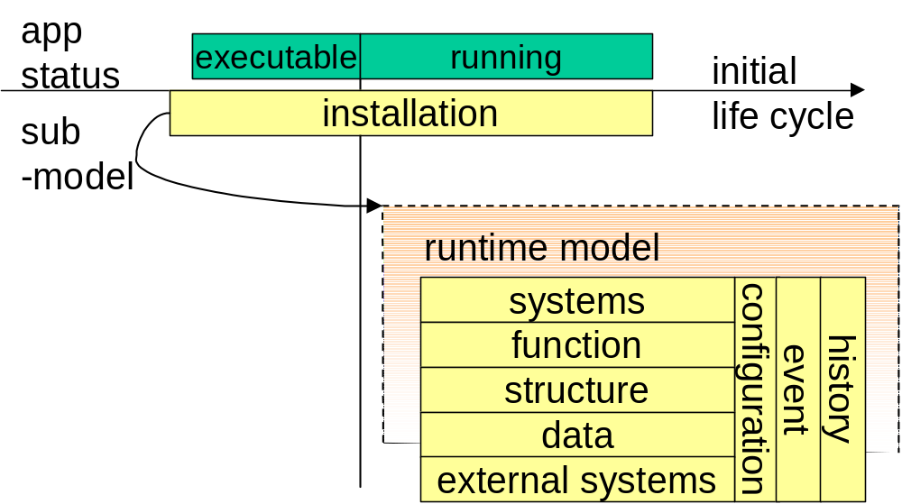
Breaking Down the Model: Runtime Sub-Models

Slide 17
Mapping the Runtime into CIM
Overview,
Monitoring
Runtime Model
External System
inter-
acts
with
System
Configuration
Event
History
Statistics, Summary,
Aggre- gations
System, Service,
Resource, SWF/SWE
Application
System
applies
consists of
provides
Perfor-mance
metrics
Status
Errors
Structure
Function
imple-
ments
Resource
Setting
Indication
Metrics, Statistics
SW
Feature/
SW
Element
Application
Service
determines dataflow
performs
Metrics per individual action
Data
UoW
(Action)
emits
Analysis
stores behavior
of the past
CIM Class Representing a Managed Object
Principal Management Object Class
Support Object Class
Sub-Model

Slide 18
Modeling FCAPS Aspects of Applications
Fault
  Indications
  Error and status properties (counter, information)
  Log-entries, traces, etc.
Performance
  Base metrics (IO, timebound metrics, etc.)
  UoW
  Metric properties
  Statistics
Configuration
  Persistent configuration information: configuration, settings
  Control: methods
  Current configuration: object properties, support classes, associations

Slide 19
Agenda
DAIS Scenarios and CIM
System/Devices Model for Storage and Files
Application Model for Deployment and Runtime
Database Model
User and Security Model
Next Steps

Slide 20
Database Model Overview
3 Level Model for a
database environment:
- Database system software
- Common database entity
- Database services
- Entities that
perform tasks
for the database, such as
coordinating user access
Database
Users
Database
System
Database
Services
DBA
Common
Database
Database
Files
Config
Params
Database
Files
Database
Storage

Slide 21
Current Database WG Activities
Work with the Application WG to refine application runtime to better address database environment
Database clustering
Extend concepts from other models to cover Database Users, Listeners, and other relevant database management entities
Define inter-model relationships needed to support capabilities such as provisioning and inventory management

Slide 22
Agenda
DAIS Scenarios and CIM
System/Devices Model for Storage and Files
Application Model for Deployment and Runtime
Database Model
User and Security Model
Next Steps

Slide 23
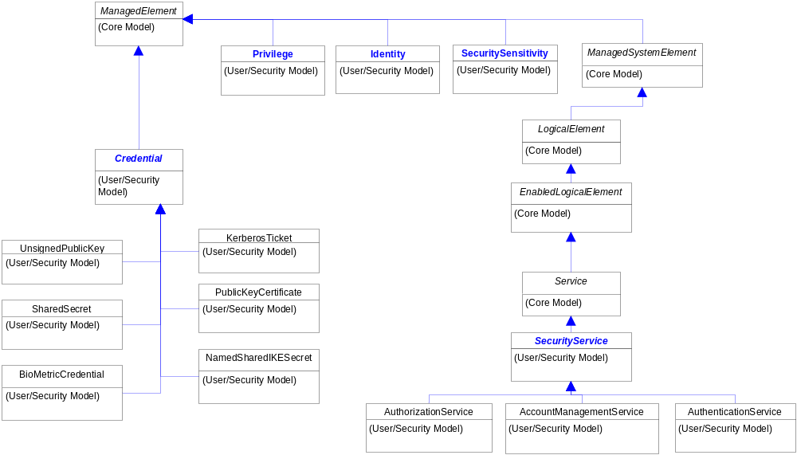
User/Security Model Overview

Slide 24
CIM_Credential
Defines materials, information, or other data which is used to prove something, such as establishing identity
Types of Credentials:
  Shared Secret
  Kerberos Ticket
  Public Key (Self-issued, CA)
  Biometrics
  …
Authentication “Service” validates Credential

Slide 25
CIM_Identity
Represents a security principal
Entity “behind” an Identity can be user, organizational, services, systems, … (AssignedIdentity)
  Entity may have multiple Identities
Within a given security context:
  Identity has a level of trust (SecuritySensitivity)
  Whether an Identity is currently authenticated must be established and removed (CurrentlyAuthenticated boolean) by the security infrastructure

Slide 26
Identity (Continued)
Conditions which must be met in order for an Identity to be authenticated are defined using “policy”
  Allow different alternatives/combinations of Credentials to establish Identity
  For ex, birth certificate and driver’s licence OR passport
Identity object may not be authenticated, but instance valid for audit/accounting

Slide 27
CIM_Privilege and CIM_Role
Privilege:
  Types of activities which are granted or denied (PrivilegeGranted boolean)
  “General” activities – Create, Delete, Detect, Read, Write, Execute
  Any Privileges not specifically granted MUST be denied
  An explicit deny takes precedence over any granted Privileges
Role:
  Collection of privileges and/or other roles
  Allowing definition of role hierarchies

Slide 28
Agenda
DAIS Scenarios and CIM
System/Devices Model for Storage and Files
Application Model for Deployment and Runtime
Database Model
Next Steps

Slide 29
Next Steps
Define mapping of DAIS concepts to CIM
Where specific mappings exist, reuse the CIM classes
Where mappings do not exist, extend the models
  Model development is on-going and driven by the needs of DMTF members and partners

