Slide 1

Data Access Service Specification:
RDF(S) Ontology Access Draft
Access Services for RDF(S) Data Resources
Miguel Esteban Gutiérrez
Ontology Engineering Group
Dpto. Inteligencia Artificial
Facultad de Informática
Universidad Politécnica de Madrid

Slide 2
OGF IPR Policies Apply
“I acknowledge that participation in this meeting is subject to the OGF Intellectual Property Policy.”
Intellectual Property Notices Note Well: All statements related to the activities of the OGF and addressed to the OGF are subject to all provisions of Appendix B of GFD-C.1, which grants to the OGF and its participants certain licenses and rights in such statements. Such statements include verbal statements in OGF meetings, as well as written and electronic communications made at any time or place, which are addressed to:
    the OGF plenary session,
    any OGF working group or portion thereof,
    the OGF Board of Directors, the GFSG, or any member thereof on behalf of the OGF,
    the ADCOM, or any member thereof on behalf of the ADCOM,
    any OGF mailing list, including any group list, or any other list functioning under OGF auspices,
    the OGF Editor or the document authoring and review process
Statements made outside of a OGF meeting, mailing list or other function, that are clearly not intended to be input to an OGF activity, group or function, are not subject to these provisions.
Excerpt from Appendix B of GFD-C.1: ”Where the OGF knows of rights, or claimed rights, the OGF secretariat shall attempt to obtain from the claimant of such rights, a written assurance that upon approval by the GFSG of the relevant OGF document(s), any party will be able to obtain the right to implement, use and distribute the technology or works when implementing, using or distributing technology based upon the specific specification(s) under openly specified, reasonable, non-discriminatory terms. The working group or research group proposing the use of the technology with respect to which the proprietary rights are claimed may assist the OGF secretariat in this effort. The results of this procedure shall not affect advancement of document, except that the GFSG may defer approval where a delay may facilitate the obtaining of such assurances. The results will, however, be recorded by the OGF Secretariat, and made available. The GFSG may also direct that a summary of the results be included in any GFD published containing the specification.”
OGF Intellectual Property Policies are adapted from the IETF Intellectual Property Policies that support the Internet Standards Process.
Notes:
IPR Notices Note Well for OGF meetings

Slide 3
Full Copyright Notice
Copyright (C) Open Grid Forum (2006-2007). All Rights Reserved.
This document and translations of it may be copied and furnished to others, and derivative works that comment on or otherwise explain it or assist in its implementation may be prepared, copied, published and distributed, in whole or in part, without restriction of any kind, provided that the above copyright notice and this paragraph are included on all such copies and derivative works.
The limited permissions granted above are perpetual and will not be revoked by the OGF or its successors or assignees.
Notes:
OGF Full Copyright Notice if necessary

Slide 4
Outline
Introduction
Overview
Current status
Outstanding issues
Future work
Conclusions

Slide 5
Outline
Introduction
  Scope
  Goals & Objectives
Overview
Current status
Outstanding issues
Future work
Conclusions

Slide 6
Introduction
Scope
The WS-DAI-RDF(S) Ontology specification extends the interfaces defined in WS-DAI, to allow access to and provide descriptions of RDF(S) data resources.
RDF(S) data resources are assumed to contain data defined using the RDF(S) model defined in [RDF Concepts, RDF Schema].
This data is accessed using a set of ontology handling primitives based on the RDF(S) model.

Slide 7
Introduction
Goal & Objectives
Goal:
“To provide access to RDF(S) data sources in a grid fashion, without constraining what the user could manually do (specially when serializing a local RDF/XML file), and facilitating common tasks, providing a highly flexible and adaptable access mechanism that hides technicalities of RDF(S) to the user, whilst transparently exploits its full semantics”
Objectives:
  Full RDF(S) coverage
  R+W capabilities
  Granular data access
  Resource centric API
Notes:
The main goal is to provide an RDF(S) mechanism that does not restrict what the user could manually do by hand, but helping him hiding the technical details he would have to know (i.e. the details of the RDF/XML syntax), and let him decide how he wants to deal with RDF(S) data sources and configure the access mechanisms so they fit his needs.
The objectives are covering the both RDF and RDF Schema, so that means including the reasoning capabilities. Also providing the means for both reading and writing contents (that means going beyond SPARQL and the SPARQL protocol, that just provide retrieval capabilities). And we want to provide these functionalities in a granular fashion, following a resource centric approach.

Slide 8
Outline
Introduction
Overview
  Concepts
  Data Resources
  Interfaces
  Profiles
Current status
Outstanding issues
Future work
Conclusions
Notes:
Now I’ll review some conceptual details about the realization.

Slide 9
Overview
Concepts
Merging RDF(S) and WS-DAI Concepts
Object
Object
B
E
Predicate
Object
B
E
Predicate
F
B
E
Predicate
A
C
F
p
s
Subject
A
C
F
.
.
.
t
A
q
C
.
.
.
Subject
D
G
Subject
.
.
.
r
D
n
G
Resource
D
M
Literal
Repository Data Resource
RDF Resource
Data Resource
RepositoryCollection
Data Resource
Notes:
RDF(S) is about asserting information about entities, which are call Resources. In RDF(S) everything is a resource.
The assertions we can do are called triples, which are composed by a subject resource, an object (target) resource (or literal values), and a predicate (also a resource) that indicates the relationship that holds between the subject and predicate.
We can do multiple assertions about a resource, and the set of assertions we do about a given resource are managed in the realizations by RDF resource data resources.
But in an RDF(S) data source we can have assertions about multiple resources (represented by their own RDF data resources. These bunch of assertions about RDF resources are managed together by Repository data resources.
Multiple repositories are managed in RepositoryCollection data resources.

Slide 10

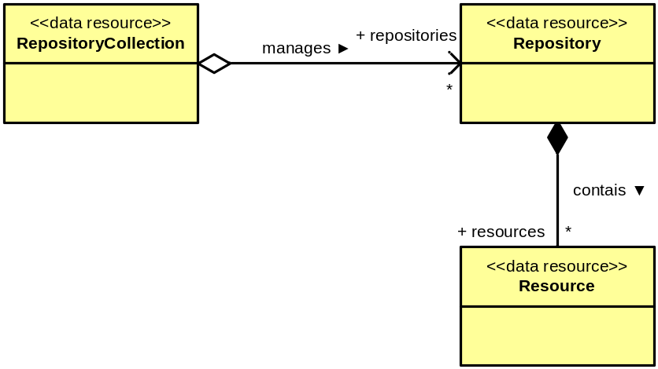
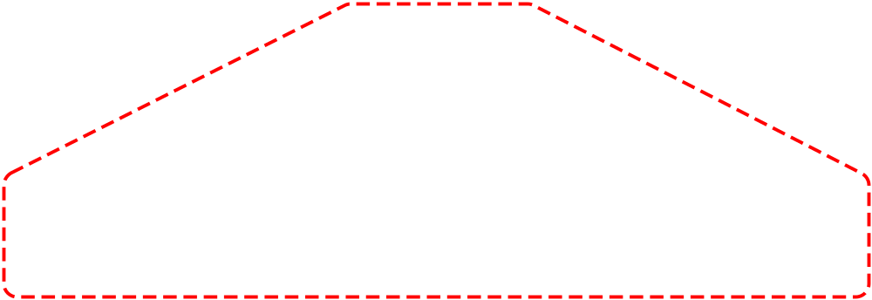

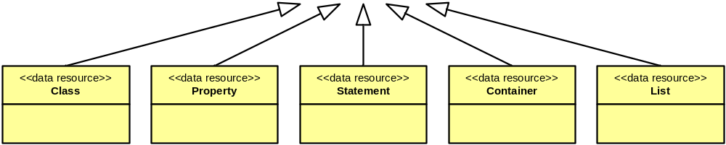
Overview
Data Resources
Types & Organization
Convenience abstractions
Class placeholders
Class placeholder
Notes:
Given the already identified RDF(S) data resources, we can differentiate between convenience abstractions and RDF(S) class placeholders. Convenience abstractions allow as organizing, addressing and targeting RDF(S) data. RDF(S) class placeholders allow us focusing on specific aspects of a certain piece of RDF(S) data, and exploit the RDF(S) semantics associated to it. As there are different types of built-in RDF(S) classes, there are different types of associated RDF(S) data resources that represent instances of these classes.

Slide 11
Overview
Concepts, revisited
RDF Resource lifecycle
Creation:
  Explicit: a triple is created with the resource as subject.
  Implicit: a triple is created with the resource as predicate or object.
(Property value) Attachtment:
  Explicit: adding a new triple which uses an already existing resource as subject.
  Implicit: adding a triple which uses an existing resource as predicate or object, and due to RDF(S) entailment rules, new property values are automatically attached.
(Property value) Detachment:
  Explicit: removing a triple which has the resource as subject.
  Implicit: removing a triple that has the resource as predicate or object, and as a result inferred property values are lost (no longer explicit).
Removal:
  No triples using the resource exist.
Notes:
The RDF(S) built-in vocabulary is always implicit in the Repository data resources and cannot be removed, but extended. Extensions are taken into account for allowing implicit resource definition, but base vocabulary is not taken into consideration.
For example, removing a rdfs:range relationship between resources A and B, implies that if B is not explicitly defined as an RDFS class, it will no longer be an RDFS class after the removal of the relationship. Thus, the explicit detachment of the rdfs:ranges property provokes the detachment of the rdfs:type rdfs:Class from resource B, which was implicit. As a consequence, if B is not used anywhere else, it will no longer exist, as built-in vocabulary is not taken into account for resource implicit definition.

Slide 12
Overview
Data Resources
Lifecycle example scenario
“A”.remove (“C”, “t”, “F”)
B
B
E
p
p
s
F
A
q
C
t
F
A
q
C
t
.
.
.
r
r
n
t
D
M
A
B

Slide 13
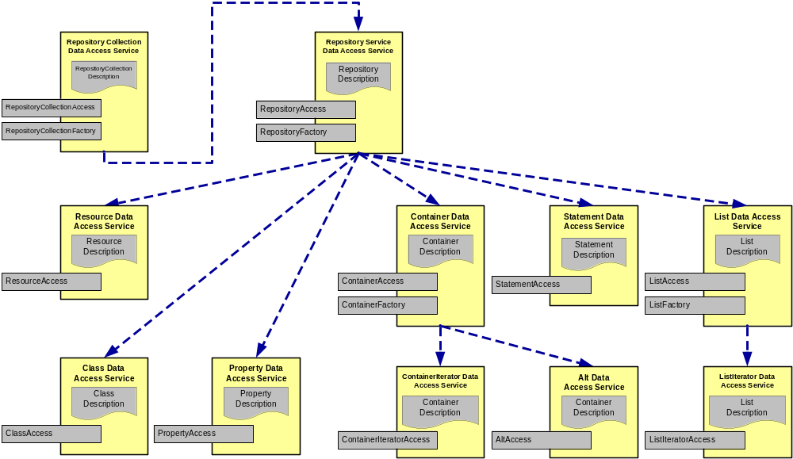


Overview
Interfaces
Organization
Primitive interfaces
Utility interfaces
Notes:
Primitive interfaces: include operations that provide straight-forward basic data creation, retrieval and removal for a given resource.
Utility interfaces: include complex operations for a given data resource, which provide added value functionalities that enhance the access capabilities for the data resource.
The enhancements provided by the utility interfaces are [conseguidos] by hidding some aspects and making some assumptions (often structural) that affect the usage (update, removal and retrieval) of the data stored in a data resource. It is desirable to be able to configure (adapt) these behaviours so they can fit the user requirements. (behaviour can be tailored, the system adapts, it is flexible).
Message definition:
Direct data access:
Retrieval of directly associated information (RDF(S) data)
Creation of new RDF(S) data (including attachments)
Deletion of existing RDF(S) data (including detachments)
Indirect data access:
Delegation of access to services that provide specialized access to a subset of associated information.

Slide 14
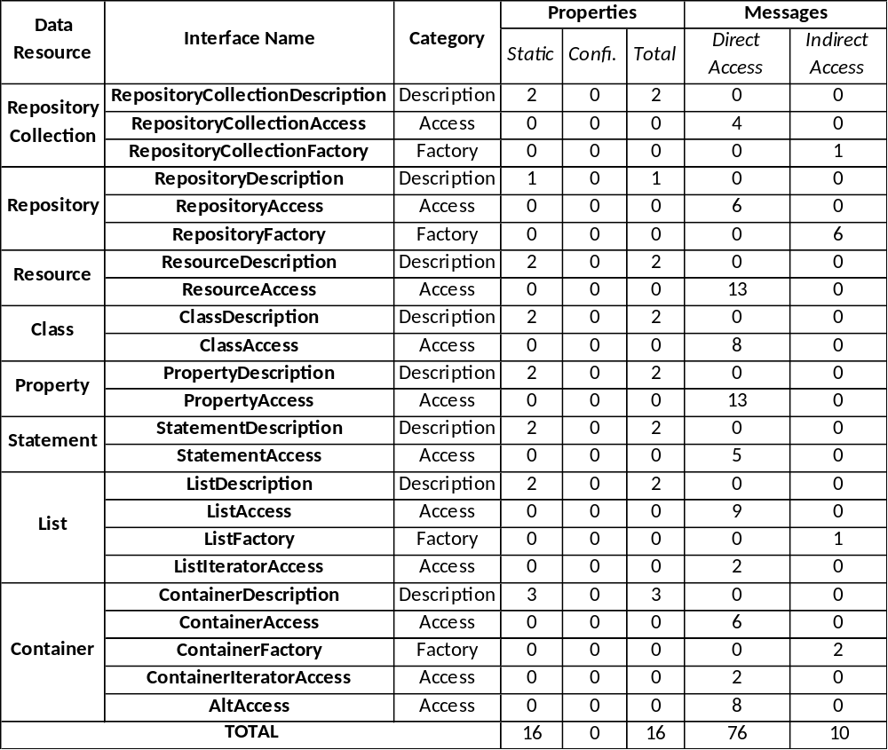
Overview
Interfaces
Summary

Slide 15
Overview
Profiles
WS-DAI-RDF(S)
Ontology Realization
StatementAccess
ContainerAccess
ContainerFactory
ContainerIterator
AltAccess
ListAccess
ListFactory
ListIterator
Statement
Container
List
Profile 2:
Full RDF(S) Support
ClassAccess
PropertyAccess
Profile 1:
RDF Schema Support
Class
Property
Profile 0:
Basic RDF Support
RepositoryCollectionAccess
RepositoryCollectionFactory
RepositoryAccess
RepositoryFactory
ResourceAccess
RepositoryCollection
Repository
Resource

Slide 16
Outline
Introduction
Overview
Current status
  Profile 0
  Profile 1
  Profile 2
Outstanding issues
Future work
Conclusions

Slide 17
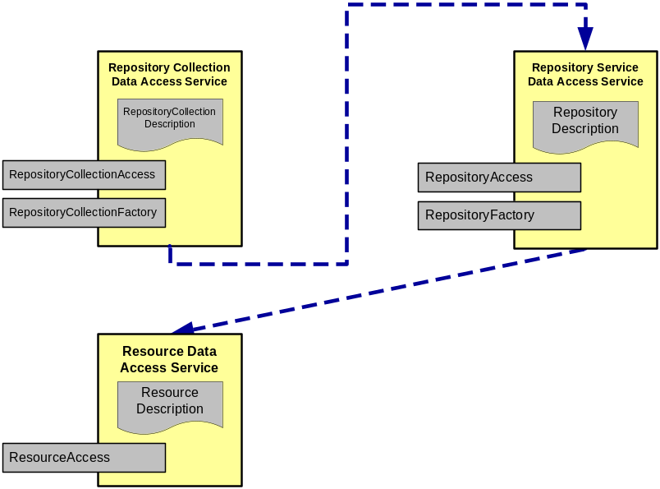
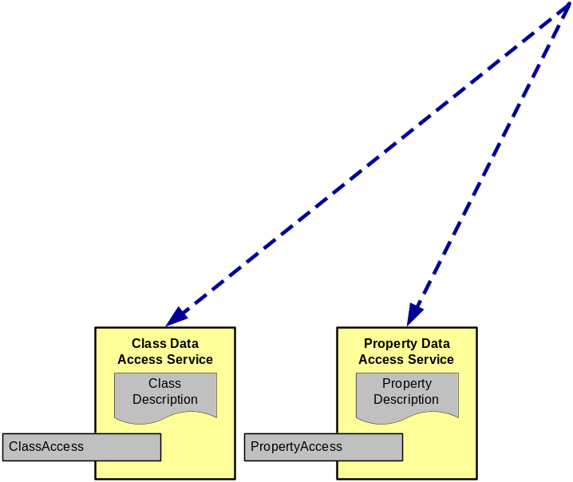
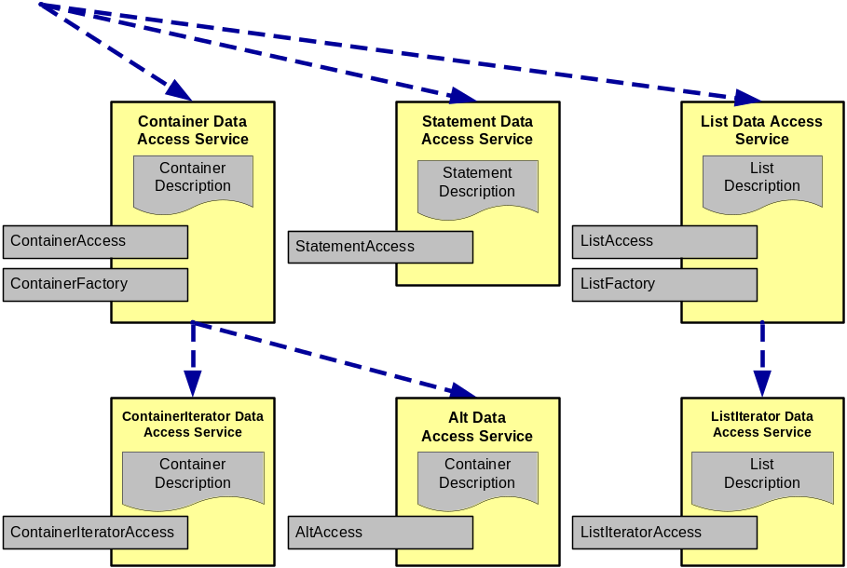
Current Status
Profile 0

Slide 18
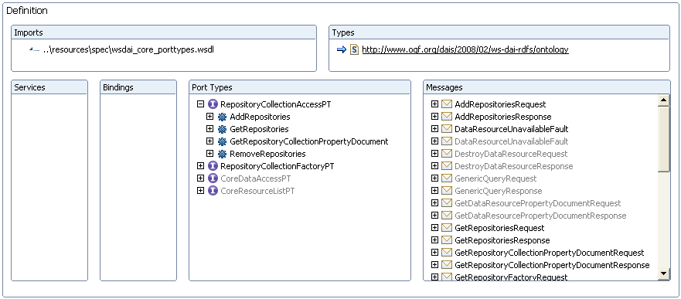
Current Status
Profile 0
RepositoryCollectionAccess

Slide 19
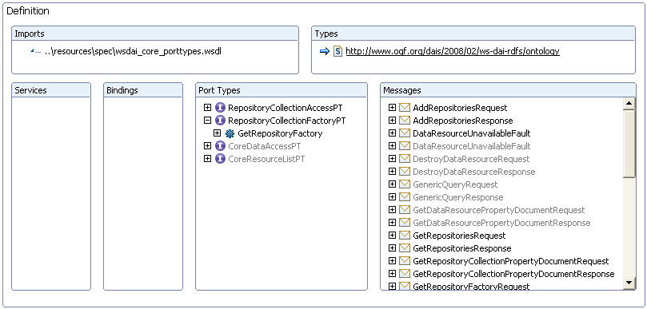
Current Status
Profile 0
RepositoryCollectionFactory

Slide 20
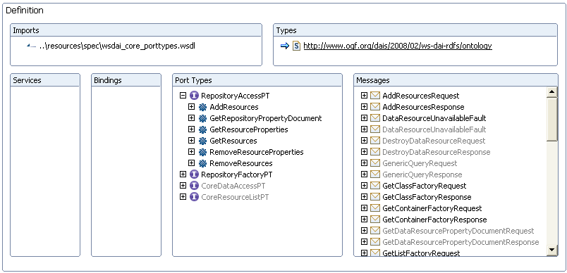
Current Status
Profile 0
RepositoryAccess

Slide 21
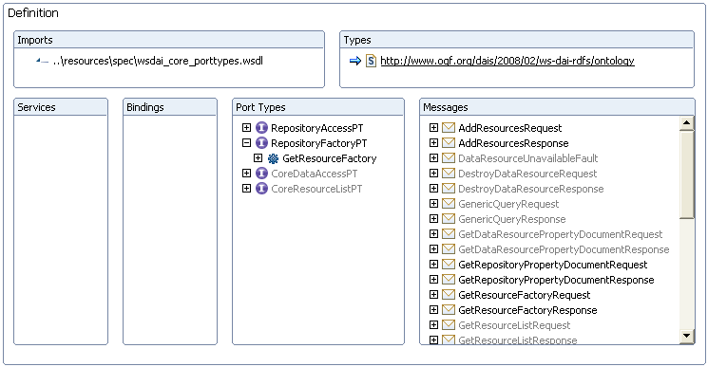
Current Status
Profile 0
RepositoryFactory

Slide 22
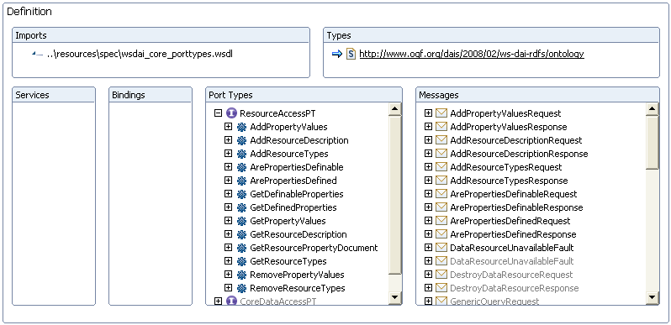
Current Status
Profile 0
ResourceAccess

Slide 23
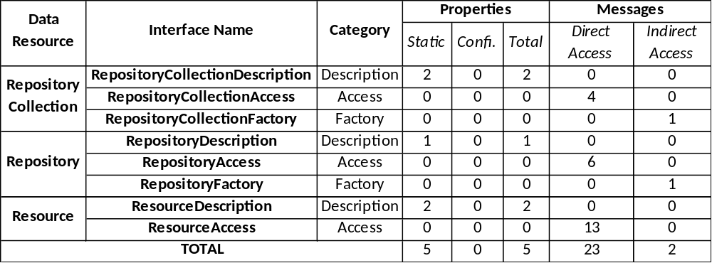
Current Status
Profile 0
Summary

Slide 24
Current Status
Profile 1

Slide 25
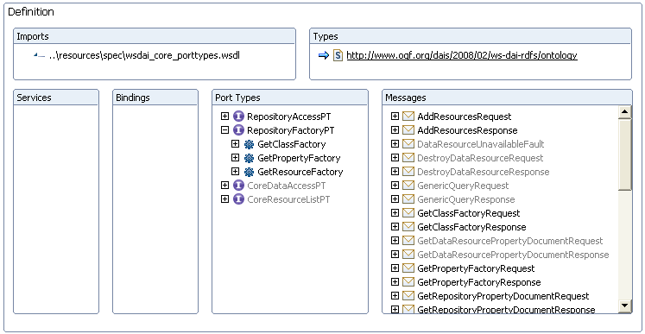
Current Status
Profile 1
RepositoryFactory update

Slide 26
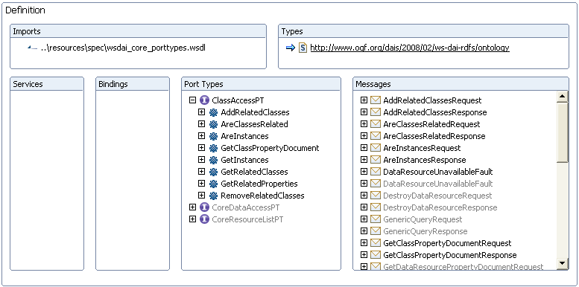
Current Status
Profile 1
ClassAccess

Slide 27
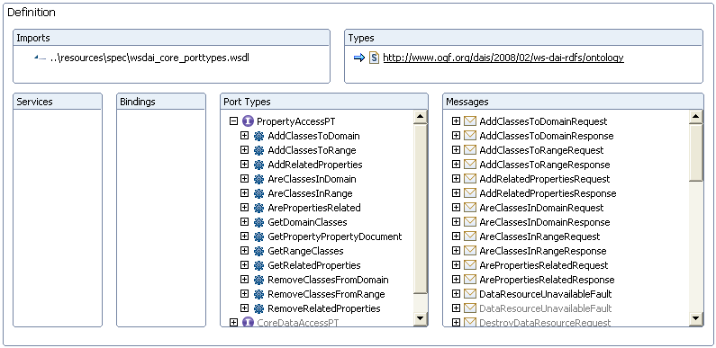
Current Status
Profile 1
PropertyAccess

Slide 28
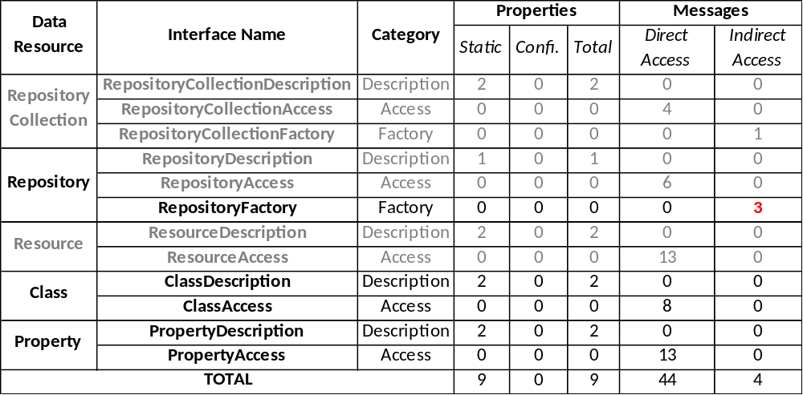
Current Status
Profile 0
Summary
21
2

Slide 29
Current Status
Profile 1

Slide 30
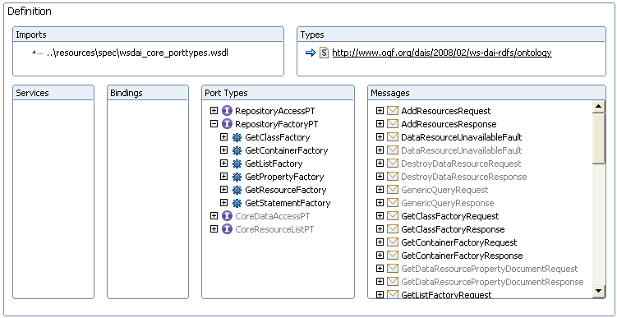
Current Status
Profile 2
RepositoryFactory update

Slide 31
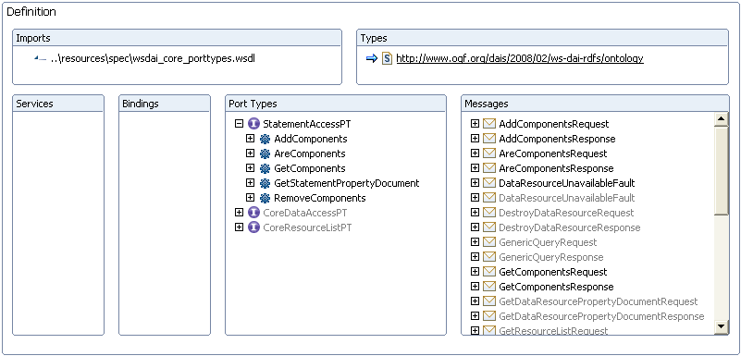
Current Status
Profile 2
StatementAccess

Slide 32
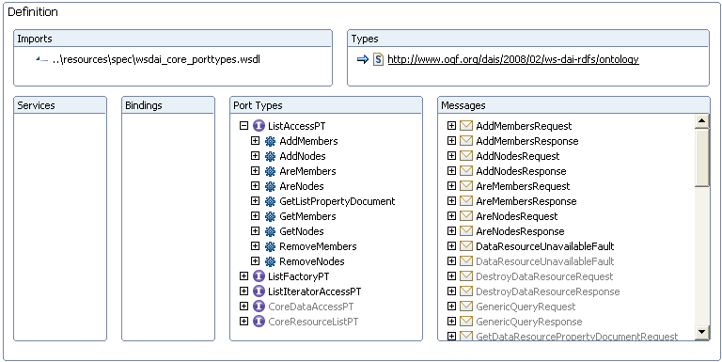
Current Status
Profile 2
ListAccess

Slide 33
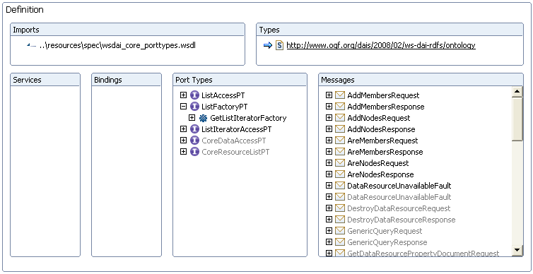
Current Status
Profile 2
ListFactory

Slide 34
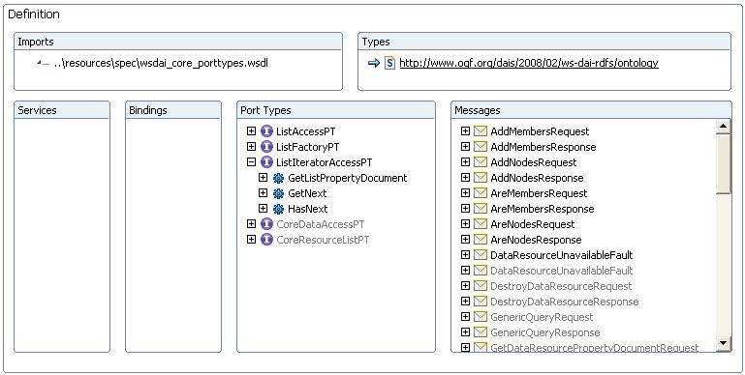
Current Status
Profile 2
ListIteratorAccess

Slide 35
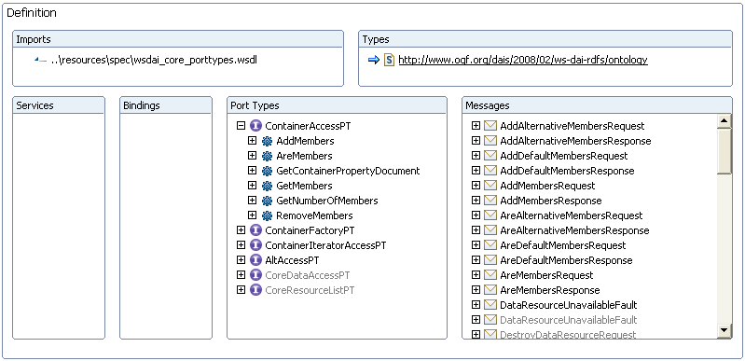
Current Status
Profile 2
ContainerAccess

Slide 36
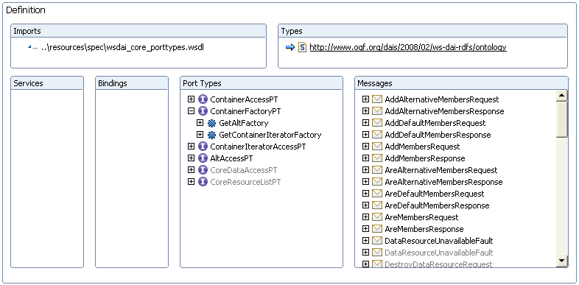
Current Status
Profile 2
ContainerFactory

Slide 37
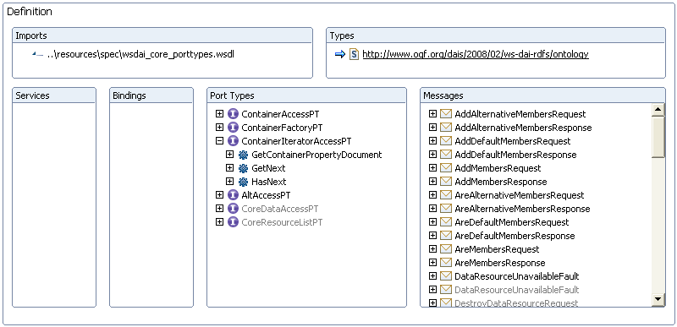
Current Status
Profile 2
ContainerIteratorAccess

Slide 38
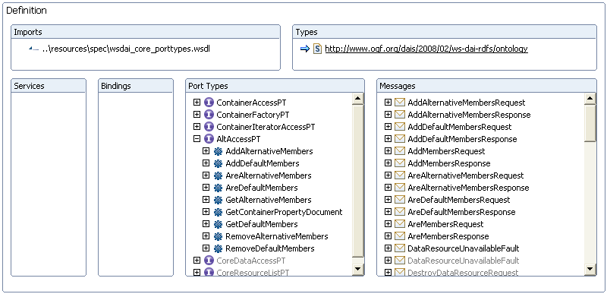
Current Status
Profile 2
AltAccess

Slide 39
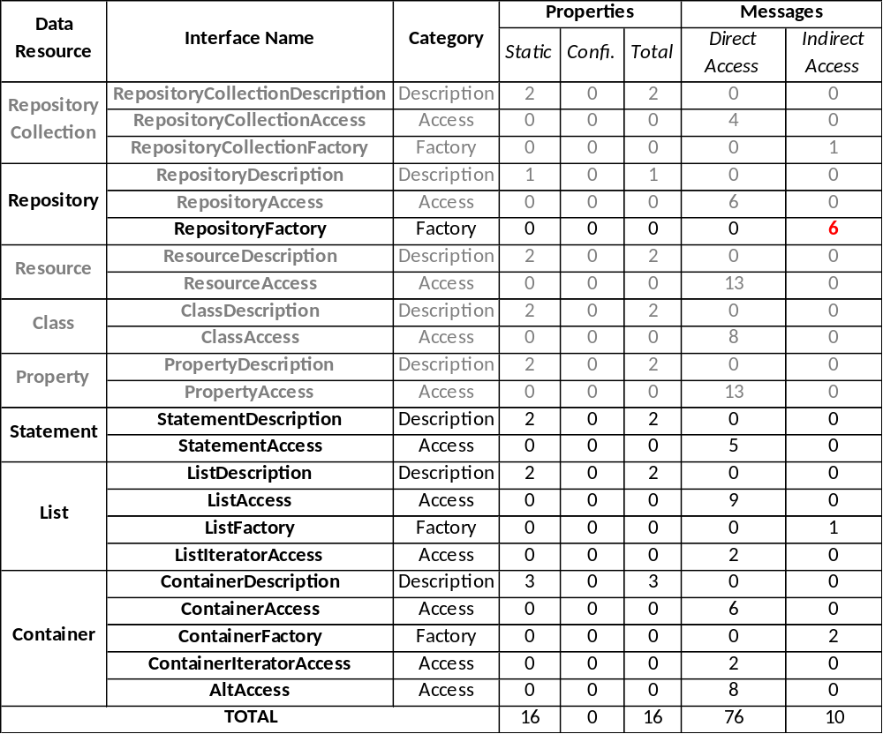
Current Status
Profile 2
Summary
32
6

Slide 40
Outline
Introduction
Overview
Current status
Outstanding issues
Future work
Conclusions

Slide 41
Outstanding issues
WS-DAI-RDF(S) related:
  Not fully aligned with the glossary.
WS-DAI-RDF(S) Ontology specific
  List + Container serialization vs. abstract model modification paradox.
  RDF(S) data resources lifecycle still obscure in the document.
  Missing configurable properties.

Slide 42
Outline
Introduction
Overview
Current status
Outstanding issues
Future work
Conclusions

Slide 43

Future work
Include missing configurable properties.
Make clear the data resources lifecycle:
  Introduction.
  Messages.
Update the introduction of the document.
Review the terminology used & align it with the glossary.
Update from the paper

Slide 44
Outline
Introduction
Overview
Current status
Outstanding issues
Future work
Conclusions

Slide 45
Conclusions
Profile based approach followed to favour community adoption.
Specification almost completed:
  Interfaces cleaned
  Messages normalized (inputs + outputs + faults)
An stable version to release has been finally reached.

Slide 46

Thanks for your attention, questions?

