Slide 1
Database Access and Integration Services Working Group
Norman Paton
University of Manchester

Slide 2
Outline
Requirements.
Key concepts/functionality.
Architecture/Model.
Services/portTypes.
Relation with invited groups.

Slide 3
Requirements
To provide service interfaces to data resources.
  Relational databases.
  XML repositories.
  Files.
To support higher-level data integration services:
  Comprehensive metadata.
  Flexible data delivery.

Slide 4
Key concepts
Service-oriented treatment of structured data access:
  Specification defines collection of Grid Service Interfaces.
  Generic: Grid Data Service Specification:
    Top level port-types of OGSA Data Services proposal.
  Specific: Realisations for specific kinds of service:
    Relational.
    XML.
Data Service port-types:
  Data Description: schema of relational database.
  Data Access: evaluate an SQL Query.
  Data Factory: virtualise a query result as a data service.
  Data Management: not database administration; role mapping.

Slide 5
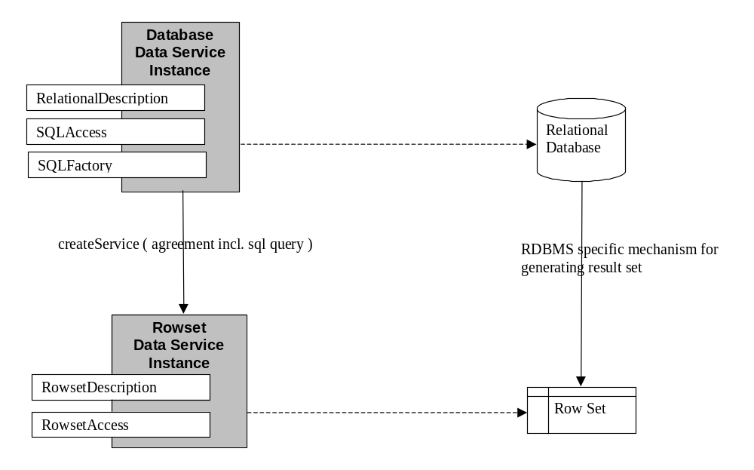
Architecture/Model

Slide 6
Proposed Services/portTypes (1)
Grid Service
OGSI Interfaces
Factory
Agreement
Agreement Provider
WS-Agreement Interfaces
Data Description
Data Access
Data Management
Data Factory
DAIS Grid Data Service Interfaces
Extensions for: Relational Database, Relational Result Set, XML Collection.

Slide 7
Proposed Services/portTypes (2)
Related specification on the table:
  Grid Data Distribution service.
  Generic data movement service.
Functionalities:
  Data producers can publish data.
  Data of interest can be subscribed to.
  Data propagation determines how data is conveyed to consumers.
  Data consumption determines how data is consumed.
Relationship to Grid Data Service Specification:
  Delivering data to/from data access services is important.
  Knowing where to stop in data access specification has been an issue.

Slide 8
Relation with invited groups
OREP-WG (Overlap; Service Provider)
  May want to replicate data from/to databases.
  Share need to manage and convey data sets.
  Joint session: Monday 2-5:30.
PA-RG (Service Provider):
  Databases are an archiving technology.
  Metadata catalogues managed by databases.
GFS-WG (Overlap):
  DAIS framework can accommodate certain forms of file access (Wednesday 12-1 DAIS Session).

