Slide 1

Proposal for Data Management
in GridRPC
GRAAL Research Team, INRIA, France

Slide 2
Outline
Data Management Model:
  Model
  Examples
  Use cases
Data Management Proposals…
… and one more:
  Operations
  Examples
  Semantic and errors

Slide 3
Basic GridRPC Model
Access to services
Basic use:
grpc_initialize
grpc_function_handle_default
or
  grpc_function_handle_init
  grpc_call
  grpc_finalize
API limited to services
Data ?
Registry
handle
register
lookup
Client
call
Service
results

Slide 4
Data in GridRPC
Justifications:
Large to huge data
Avoid useless transfers
Data location
But … not always useful
call
Client
Server
Data
Storage

Slide 5
Extended GridRPC Model
Data access
Data location:
  External Data
  Internal Data
API extended to data management
No modification
Registry
handle
register
lookup
Client
call
Service
results
Data management API
Data
Storage

Slide 6
Data management in basic GridRPC platforms
call
call
Client
Server
Client
Server
Standard GridRPC
External In data
call
call
Client
Server
Client
Server
results
A
B
B=F(A)
C=G(B)
Intermediate data
External out data

Slide 7
Data management extension for GridRPC platforms
call
call
Client
Server
Client
Server
Standard GridRPC
Direct use of external In data
call
call
Client
Server
Client
Server
return
A
B
B=F(A)
C=G(B)
Data persistence
Direct transfer to external storage

Slide 8
Is that useful ?
Use cases:
DEM computation:
  DEM computation
  + 3D rendering or + antenna positioning
Molecular Physics Simulation:
  Kinetic monte carlo simulation of atom deposition on substrate
  Povray visualization
Dividing cube:
  ISO surface extraction
  Image reconstruction
  Vizualization
Scilab// – Diet:
  Interactive access to servers (matlab-like)

Slide 9
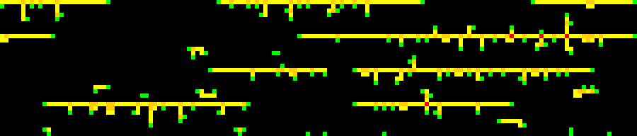
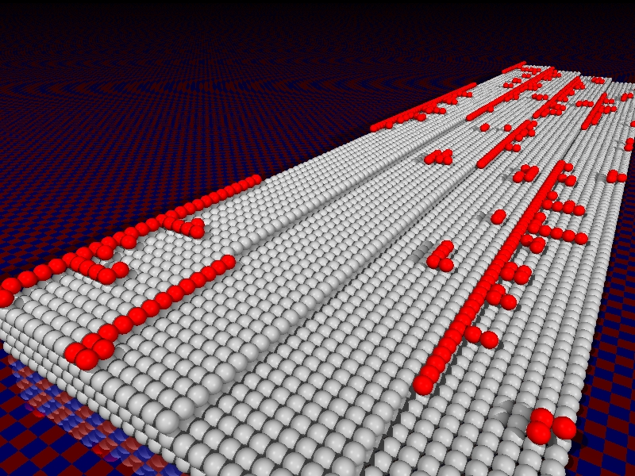
Molecular Physics Simulation
call ( KMC )
2D image
KMC
Server
Client
call ( povray )
povray
Server
3D image

Slide 10
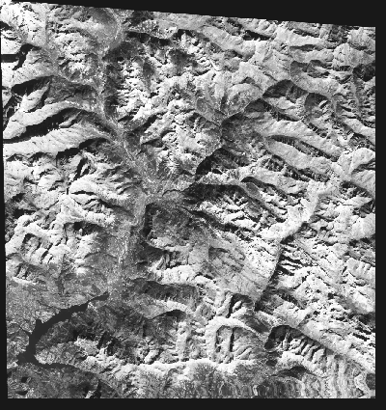
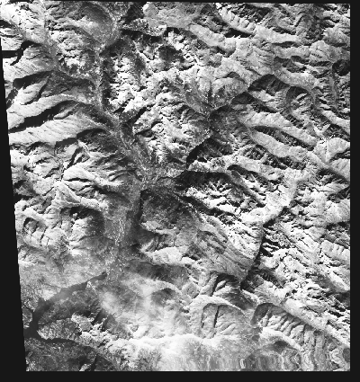

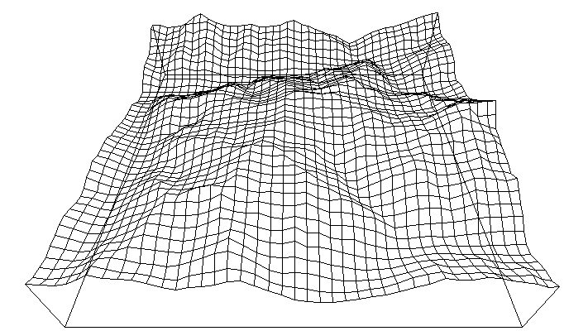
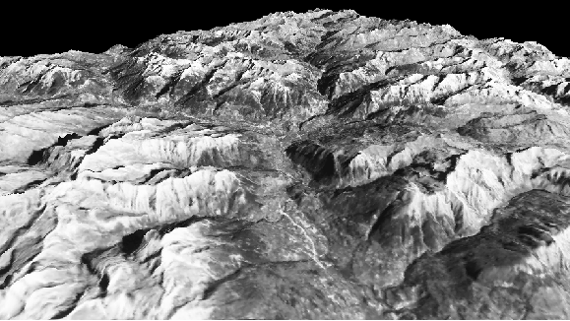
DEM example
Compute Digital Elevation Model from a pair of satellite views
Construct images and animations from DEM
Compute optimal placement of antenna in an area
Stereo-vision

Slide 11
Data Management
Specifying the way data are handled in a GridRPC call is mandatory
  Useless data transfers
  Data identification
  Data persistence
GridRPC API extensions:
  Data handle
  Data location (or transfers):
    from : data handle initialisation
    to : data handle binding
  Direct interaction with data storage:
    upload : read
    download : write

Slide 12
GGF 10, Graal proposal
grpc_data_handle_t
Persistence policy flag
Main functions:
  Handle management: grpc_new_data_handle / grpc_free_data_handle
  Persistence flag: grpc_set_persistence_flag
  Data management: grpc_new_data / grpc_get_data /grpc_free_data
  Sessions: grpc_read_data_handle / grpc_write_data_handle
Issues:
  Too explicit data handle
  Persistence flag
  Too much functions
  External data considerations

Slide 13
C. Lee’s proposal
No persistence flags
External data
Operations:
  create ( dh, srv )
  read/write
  inspect
  delete
Open issue:
  Persistence
  Unknown server in case
grpc_function_handle_default

Slide 14
New proposal
Different types of data :
  Internal data
  External data
Persistent data: bind dh to persistence location
Direct transfers from/to storage
Limited number of functions
Data handles:
  reference to data
  Contains data location
    grpc://myServer:port/myDataPath
    Data identifier

Slide 15
Data management functions
Initialization: grpc_data_handle_init ( dh , data )
  From internal data
  From external data
Bind data: grpc_data_handle_bind ( dh, location )
  Set data location after computation:
    External storage : grpc://myServer/pathToDataStorage
    Specific server : svA
    GridRPC platform : GRPC_DATA_MGT_DEFAULT
Transfers from/to storage:
  grpc_data_read ( dh, data )
  grpc_data_write ( dh, location )
Misc:
  grpc_data_delete ( dh )
  grpc_data_handle_inspect( dh )

Slide 16
Example : standard call
call
double *A;
grpc_function_handle_t fh;
grpc_initialize();
grpc_function_handle_default ( &fh, “F” );
grpc_call ( fh, A);
grpc_finalize();
Client
Server
A
A
OR
Standard GridRPC
double *A;
grpc_data_handle dhA;
grpc_function_handle_t fh;
grpc_initialize();
grpc_data_handle_init(&dhA, A);
grpc_function_handle_default ( &fh, “F” );
grpc_call ( fh, dhA);
grpc_finalize();

Slide 17
Example 2 : data persistence
call
Data persistency
Client
Server
Return dhB
A
B
B=F(A)
C=G(B)
double *A, *B, *C;
grpc_data_handle dhB;
grpc_function_handle_t fhF, fhG;
grpc_initialize();
grpc_data_handle_bind(&dhB, GRPC_DATA_MGT_DEF);
grpc_function_handle_default ( &fhF, “F” );
grpc_function_handle_default ( &fhG, “G” );
grpc_call ( fhF, A, dhB);
grpc_call ( fhG, dhB, C);
grpc_finalize();

Slide 18
Example 3 : external in data
call( fh, dhA)
Client
Server
A
Direct use of external In data
double *A;
grpc_data_handle dhA;
grpc_function_handle_t fh;
grpc_initialize();
grpc_data_handle_init(&dhA, “grpc://server/data”);
grpc_function_handle_default ( &fh, “F” );
grpc_call ( fh, dhA);
grpc_finalize();

Slide 19
Example 4 : storage of out data
call( fh, A, dhB)
Client
Server
A
B
Direct transfer to external storage
double *A, *B;
grpc_data_handle dhB;
grpc_function_handle_t fh;
grpc_initialize();
grpc_data_handle_bind(&dhB, “ftp://server”);
grpc_function_handle_default ( &fh, “F” );
grpc_call ( fh, A, dhB);
grpc_finalize();

Slide 20
Client-storage transfers
Client
grpc_data_write
Server
A
Send data to storage
double *A;
grpc_data_handle dhA;
grpc_initialize();
grpc_data_handle_init(&dhA, A);
grpc_data_handle_write(&dhA, “gprc://server”);
grpc_finalize();

Slide 21
Client-storage transfers
Client
grpc_data_read
Server
A
Get data from storage
double *A;
grpc_data_handle dhA;
grpc_initialize();
grpc_data_handle_init(&dhA, “gprc://server/data);
grpc_data_handle_read(dhA, A);
grpc_finalize();

Slide 22
DEM computation example
call(fhF,A,B,dhC)
Client
DEM
Server
using grpc_function_handle_init
return dhC
A,B
C
call(fhF,dhC)
return D
C=DEM(A,B)
Visu
Server
D=Visu(C)
file *A, *B, *C;
grpc_data_handle dhC;
grpc_function_handle_t fhF, fhG;
grpc_initialize();
grpc_data_handle_bind(&dhC, “gprc://demServer”);
grpc_function_handle_init ( &fhF, “demServer” );
grpc_function_handle_init ( &fhG, “visuServer” );
grpc_call ( fhF, A, B, dhC);
grpc_call ( fhG, dhC, D);
grpc_finalize();

Slide 23
DEM computation example
call(fhF,A,B,dhC)
Client
DEM
Server
using grpc_function_handle_default
return dhC
A,B
C
call(fhF,dhC)
return D
C=DEM(A,B)
Visu
Server
D=Visu(C)
file *A, *B, *C;
grpc_data_handle dhB;
grpc_function_handle_t fhF, fhG;
grpc_initialize();
grpc_data_handle_bind(&dhB, GRPC_DATA_MGT_DEF);
grpc_function_handle_default ( &fhF, “DEM” );
grpc_function_handle_default ( &fhG, “Visu” );
grpc_call ( fhF, A, B, &dhC);
grpc_call ( fhG, dhC, D);
grpc_finalize();

Slide 24
Operations semantic
grpc_data_handle_init ( dh, data ):
  Initialize the data handle with a data
  Data could be local or identified in storage ( A or grpc://server/data )
grpc_data_handle_bind ( dh, location ):
  Set the location of the data after grpc_call
  Unbound data will not be stored on server
  Will only be used for persistent data or output data save to storage after call
grpc_data_read ( dh, data ):
  Load data identified by dh into data
grpc_data_write ( dh, location ):
  Write data to the server+path identified by location
grpc_data_delete ( dh ):
  Free the data (storage) referenced by the dh
grpc_data_handle_inspect ( dh ):
  Information on the referenced data (valid ?)
Errors:
  Using uninitialized dh as input data
  Reading, writing, inspecting, deleting with uninitialized dh

Slide 25
Conclusion
Benefits:
Data transfers
Intermediate results
Cover all issues ?
Open issues:
Data Lifecycle : when to destroy data, multiple copies

Slide 26
