Slide 1
CIM-based Grid Schema
Working Group
(CGS-WG)
GGF6
Session 2

Slide 2
GGF6 Agenda
Session 1 – 2:00-3:30PM Tuesday 10/15 (Gleacher 400)
  Review of group charter and goals (25 mins)
  Brief CIM Modeling Tutorial (45 mins)
  Session 2 Planning (20 Mins)
CGS/DAMED/NM joint meeting
2:00-3:30PM Wednesday (Sheraton Ohio)
Session 2 – 8:00-9:30AM Thursday 10/17 (Sheraton 1)
  Document/Mapping discussions

Slide 3
CGS WG 2nd Session Planning
Strawman JSIM document (http://www.isi.edu/~flon/cgs-wg/jsim.doc)
  Please download and review prior to session.
Process for updating/enhancing the document.
Discussion and plan for delivering MOF, XML, LDAP versions of the schema.

Slide 4
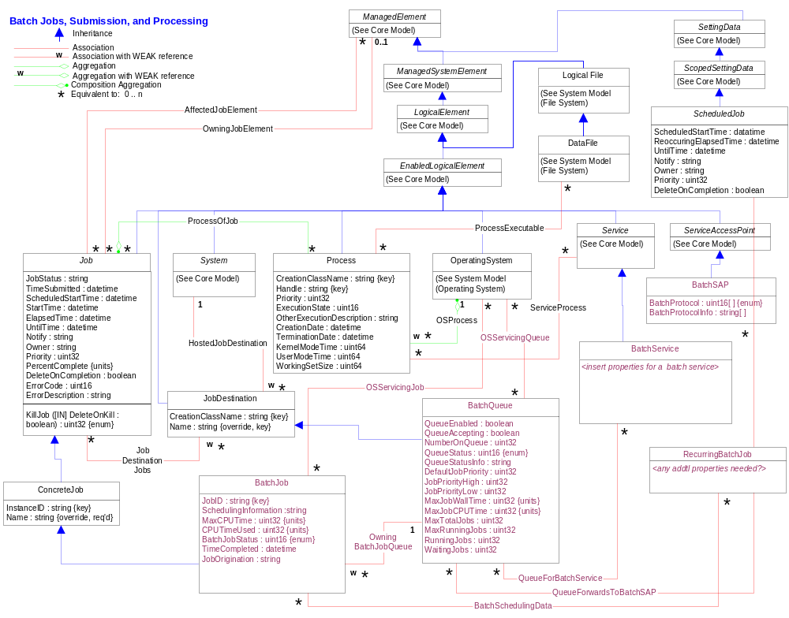

Slide 5
JSIM Document Issues
In the UML diagram, the link type between ScheduledJob and JobData must be changed from association to inheritance. Maybe it would also make sense to add a section where changes to the document are listed. In order to facilitate the comparison between the LTC/NCSA model and this proposal I've compiled the following list of classes in the models
Equivalent Classes (w/o associations)
ClusterQueue | BatchQueue
ClusterJob | BatchJob
ClusterScheduler | BatchService
Classes only in JSIM proposal BatchSAP RecurringBatchJob | Classes only in LTC/NCSA model Cluster ClusterResource ClusterHost
There's one system hosting the BatchService, which is maintaining the BatchQueues and is scheduling the BatchJobs to run on some other systems. If you exchange the class names according to the list above, the same is true for the LTC/NCSA model. In order to make such semantic information available to readers, it would help to add some use case scenarios. We should reuse (and extend) the use cases the NPi work group has developed so far.
I am not so sure whether we can get away without defining resources (meaning groups of candidate execution hosts) to get the complete picture. They need not to be fully fleshed out, but could exist as abstract classes. Further, I like and support the approach to have a separate class for recurring/planned Jobs.

Slide 6
JSIM Document Issues
Job dependencies?
Jobs are not necessarily just a job, but rather a work flow (do we need to model this?) i.e. traditional batch job vs. grid job

