Slide 1
Execution Planning Service (EPS) Specification
OGSA Resource Selection Services (RSS) Working Group
Donal Fellows, University of Manchester
GGF17, Tokyo
May 10-12, 2006

Slide 2
GGF Intellectual Property Policy
All statements related to the activities of the GGF and addressed to the GGF are subject to all provisions of Appendix B of GFD-C.1, which grants to the GGF and its participants certain licenses and rights in such statements. Such statements include verbal statements in GGF meetings, as well as written and electronic communications made at any time or place, which are addressed to any GGF working group or portion thereof,
Where the GFSG knows of rights, or claimed rights, the GGF secretariat shall attempt to obtain from the claimant of such rights, a written assurance that upon approval by the GFSG of the relevant GGF document(s), any party will be able to obtain the right to implement, use and distribute the technology or works when implementing, using or distributing technology based upon the specific specification(s) under openly specified, reasonable, non-discriminatory terms. The working group or research group proposing the use of the technology with respect to which the proprietary rights are claimed may assist the GGF secretariat in this effort. The results of this procedure shall not affect advancement of document, except that the GFSG may defer approval where a delay may facilitate the obtaining of such assurances. The results will, however, be recorded by the GGF Secretariat, and made available. The GFSG may also direct that a summary of the results be included in any GFD published containing the specification.

Slide 3
Previous Decisions
RSS Services Do Not Commit
  Reservation out of scope
  Any WS-Agreements must be templates
RSS is not Developing Workflows
  No common workflow spec yet so atomic jobs only
RSS does not say How to Generate Candidates
  Up to service implementors
  So connection to Information Services out of scope
RSS Services Should be Composable
  Enables inter-VO cool stuff!
RSS Services Should Allow Large Responses
  Consider candidates from the whole of EGEE

Slide 4
More Previous Decisions
Candidate Set Generator is Abstract Concept
  Converts Request into Ordered Set of Candidates
  CSG does not Specify Request or Candidate Documents
  CSG does Specify Basic Candidate Ordering Language
    May support others; should publish which are supported
Execution Planning Service is Specialization of CSG for Working with Job Planning
  Request Document is JSDL
  Candidate Document is Extensible Tuple
    JSDL Job, EPR of BES container, Quality-of-Service descriptor

Slide 5
Core CSG Interface
Only One Operation
  Get Candidates:
  Input Document * Candidate Order
  -> Ordered List of Candidates
Failures
  “I do not understand the Input Document”
  “I do not understand the Candidate Order”
  “I do not want to talk to you”
No Failures for Nothing Matched
  Just an empty set

Slide 6
Candidate Ordering Language
Simple Recursive Language
Everything in Language is a Term
  Semantically, Terms Evaluate to Floating Point Numbers
  Most Terms Provide Basic Math Operations
Select Term does XPath Searches
  Candidate Document as Context
  Converting Dates to Numbers
  Operators for Converting Sets of Numbers to One Value

Slide 7
Order Language Example
<Sum>
<Select operator=“total”>
<Path> //*:QoS/*:Price[@*:Currency=“urn:JPY”] </Path>
</Select>
<Product>
<Constant> 42 </Constant>
<!-- Convert at ¥42 per second -->
<Select operator=“first” timeBase=“now”>
<Path> //*:QoS/*:StartTime/*:AnyAtOrAfter </Path>
</Select>
</Product>
</Sum>
“Score = Price + 42×TimeToStart ”

Slide 8
EPS Candidates
JSDL Document
  May be Specialized or Rewritten
  May include Tokens to Initiate Claim of Reservations
Execution Service EPR
  Somewhere to send the JSDL document
  Does not need to be uniquely identifiable or renewable
Quality of Service Description
  Cost (fixed amounts, must specify currency)
  Execution Schedule
    Start Time or Start Delay
    End Time or Execution Wall-Time
Extensibility for Anything Else
  e.g. CDDLM Deployment Descriptor

Slide 9
A Concrete EPS Specification
WS-RF or WS-Transfer/Management or REST?
  Should be Implementable on any
    Core Interface is Stateless
    Efficient Implementations may use state
  WS-Enumeration is Good Fit
  But Choose WS-RF
    Author knows it better!
State Model Implements Control State and Partial Transfers
Two Port-Types
  Execution Planning Service
  Execution Planning Service Result

Slide 10
EPS in WS-RF
One Operation: GetExecutionPlans
  Input: Standard EPS Input Document
    Also some extra optional decorations
  Output: Either Immediate Candidate or EPR of EPS Result resource
Empty Result Does Produce Fault
State Model (need not be writable)
  Set of supported Candidate Ordering Languages
  Maximum number of Execution Plans per transfer
  Default lifespan of EPS Result resource
EPS does not need to Support Lifetime of Itself

Slide 11
EPS Result in WS-RF
One (Non-Lifetime) Operation: GetMorePlans
  Input: Max Plans to Transfer This Time
  Output: List of Execution Plans
Faults are Subset of EPS Faults
State Model
  WS-ResourceLifetime properties must be supported
    Should refuse to set very long/infinite lifetimes
  Count of plans transferred so far
  Whether there are more plans to transfer
  Maximum number of plans per transfer

Slide 12
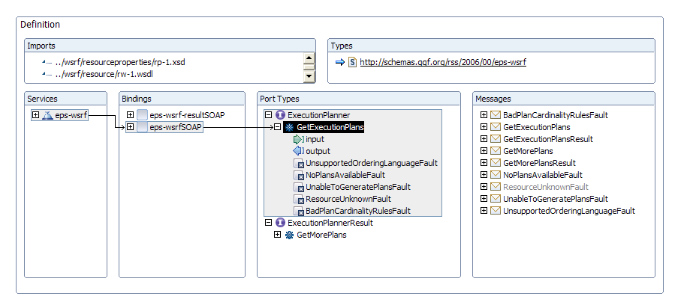
EPS-WSRF Definition

Slide 13
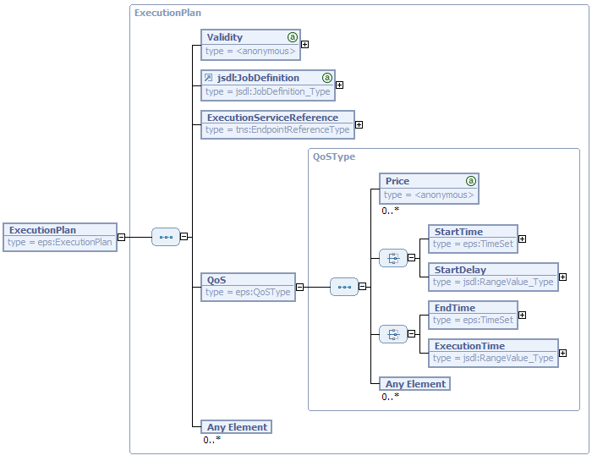
Execution Plan Definition

Slide 14
How It Fits Together
Candidate
Set Generator
Uses
COL
Argument Specialize
Execution
Planning Serv.
Interopable
Instance
Binding
Specialize
Binding
Specialize
WS-RF
EPS
WS-Transfer
EPS
REST
EPS
Simple
COL
Implement These!

Slide 15
Next Steps
Finalize EPS
  Any other QoS elements?
  Any JSDL decorations?
  Security
    Especially any comments on authorization and delegation
Write up Specification
  First draft already up, but incomplete and very rough!
  Draft schemas (nearly) done

Slide 16
Issues
A “Don’t mess with Texas” option
Is mandating a simple COL necessary?
  Not needed for some simple scenarios, want option to not implement any
  Prior art on ordering languages, in different contexts?
Security is important, needs non-trivial statements
  Goal: whether ultimate end user will be able to actually execute the job using the candidate plan
Results paging (rewind, etc.)

