Slide 1
Firewalls Issues at German Aerospace Center
Simulation and Software Technology (SISTEC)
Thijs Metsch, thijs.metsch@dlr.de
GGF-Meeting, June 29, 2005

Slide 2


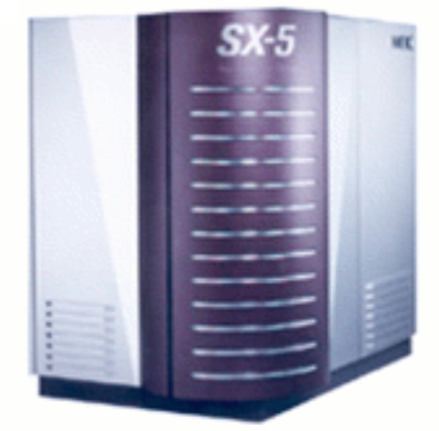
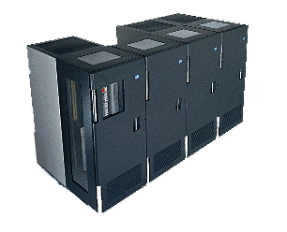
Creation of VOs
Virtual Organization
Firewall
Internet
Firewall
Grid A
Located in Bonn
Grid B
Located in Cologne

Slide 3
Closer Look at the Borders
High performance clusters are placed in the DMZ
Clients and
applications are located here
Firewall
Firewall
Internet
Division‘s
local network
Demilitarized zone
External partners (and applications)

Slide 4
Firewall Issues within this Configuration
Several firewalls have to be passed
Some resources are located in the DMZ
Clients and applications are located on both sides
  Creation of VOs
Local site security policies
  Firewalls cannot be opened
  Strict control of incoming and outgoing data traffic
  Use of VPN is obligatory
  “A lot of politics have to be dealed with…”

Slide 5
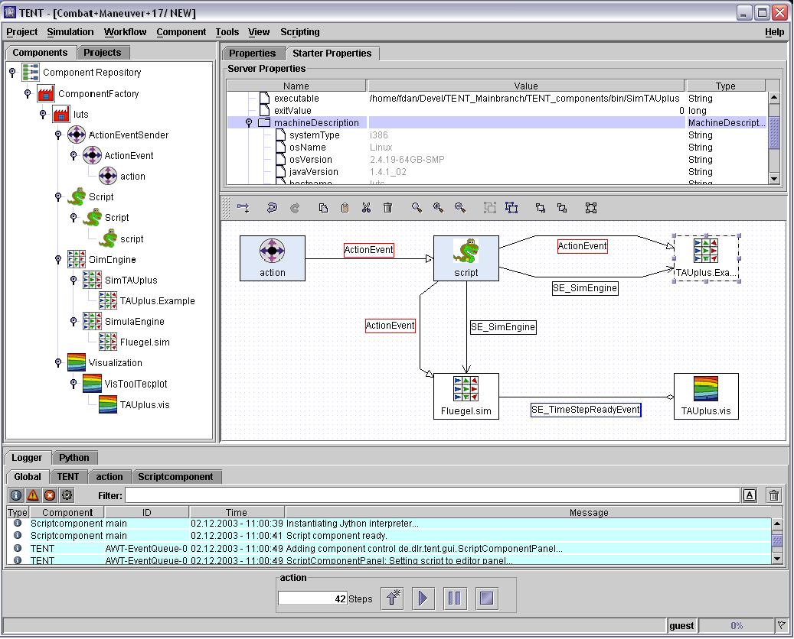
Case Studie – Workflow Management
Components of the workflow are mapped on Grid resources

Slide 6
Firewall Issues for Workflow Management
Needed functionalities for workflow management
  Access to resources of the Grid (authentication)
  Non blocking data transfers (GridFTP)
  Execution of CFD-Codes on Grid resources (MPI)
  Ad hoc service based communications & data transfers
Firewalls have to deal with:
  Need of several IP ports
  Data transfers (possibly encrypted)
  Session initiation
  Automatic VPN initialization

