Slide 1


Information Modeling of Grid Resources: the OGF GLUE WG Approach
DMTF Symposium - Portland, 17 July 2007
Sergio Andreozzi
INFN-CNAF, Bologna, Italy
sergio.andreozzi@cnaf.infn.it

Slide 2

Agenda
Context and Problem Description
GLUE 1.X
  2002-2006
GLUE 2
  since 2007 in the context of OGF
GLUE and CIM

Slide 3
Context and Problem Description

Slide 4






Grid as a multi-institutional infrastructure
Intra-site resource
Inter-site
seamless collaboration
Virtual organization
local credential
Grid-level credential

Slide 5
Problem Statement
How do we describe resources shared in Grid systems in order to enable:
  Resource awareness
  Resource discoverability
  Resource requirements expression
  Resource basic monitoring

Slide 6

Use Case 1
I want to run my job on an execution environment characterized by:
  OS
    Linux, Distribution X, version Y
  CPU Archicture
    IA64
  Available software packages:
    S1, S2

Slide 7
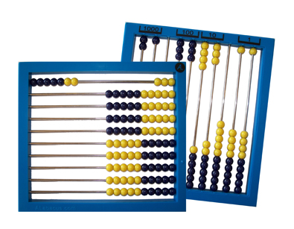
Use Case 2
I want to know
  how many job slots are used by members of the VO A
  what is the global available storage space for the users of VO B

Slide 8
Modeling Guidelines
Generalization
  capture common aspects for different entities providing the same functionality
    e.g.: uniform view over different batch services
Abstraction given by the Grid paradigm
  Virtual pool of resources
  Grid-related user attributes (e.g., VO, groups, roles)
Main focus on discovery for brokering, monitoring and inventory
  concerns those attributes that are meaningful for locate resources on the basis of a set of preferences/constraints

Slide 9
GLUE 1.X
2002-2006
“GLUE Schema activity before OGF”

Slide 10
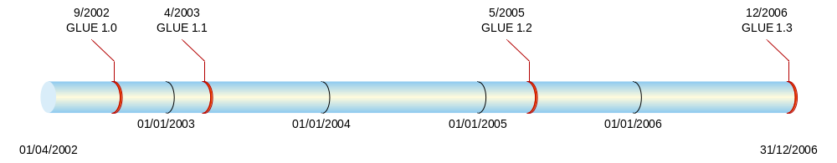
GLUE Schema
Collaborative effort focusing on interoperability started by the EU DataTAG and US iVDGL Grid projects
Initial Contributors: DataGrid, Globus, PPDG, GriPhyn, NorduGrid
Goal:
  a common description for Grid resources designed to support discovery and selection via Grid information Service
Current projects supporting this activity:
  EGEE, OMII-Europe, KnowArc, TERAGRID; APACGRID, NAREGI, UNICORE, NGS, OSG, APACGrid, …

Slide 11



GLUE Schema
Conceptual Model described by UML Class Diagrams
Mapping for several concrete data models
GLUE Schema
(Relational)
R-GMA
DataGrid Schema
(LDAP)
GLUE Schema 1.X
(UML)
GLUE Schema
(XML)
GT MDS 4
Globus Schema
(LDAP)
GLUE Schema
(LDAP)
GT MDS 2
GLUE Schema
(OldClassAd)

Slide 12
Adoption
Used in production Grid infrastructures
  Mainly EGEE Grid and OSG Grid
Main Focus
  Grid-wide scheduling
  Resource Inventory
  Basic Monitoring
Other Grid infrastructure have a partial adoption

Slide 13
GLUE 1.X - concepts
Core
  Site, Service, Element
Computing
  Cluster/SubCluster/Host
  Computing Element
Storage
  Storage Element
  Storage Area
  Access/Control Protocol

Slide 14
GLUE 2
Since 2007 in the context of OGF

Slide 15
OGF GLUE WG
New OGF Working Group approved at OGF 19 (Jan 2007)
Focus:
  facilitate interoperability between Grid infrastructures via common information models and reference implementation for describing Grid resources in response to use cases
Goal:
  define a use case document collecting use cases from different Grid projects/infrastructures
  define a conceptual model defining the abstract schema GLUE 2.0 satisfying the collected use cases.
  develop reference implementations

Slide 16
Relationship to other OGF WGs
BES
JSDL
SAGA
Used to describe
exposed resources
Used to express
requirements in
Common service descripton
for discovery API
GLUE
Used to describe
exposed resources
Should fit into the picture
GSM
OGSA Res.Mgt.
Should fit into the picture
Reference Model
SAGA:Simple Access Grid API
JSDL: Job Submission Description Language
GSM:Grid Storage Management
BES: Basic Execution Service

Slide 17
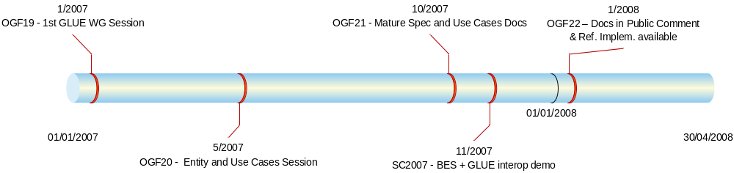
Tentative Timeline

Slide 18
GLUE 2
Main Entities

Slide 19
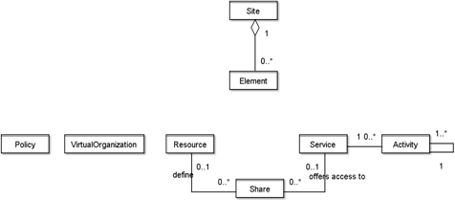
GLUE::Main Entities
Can change in the near future

Slide 20
GLUE::Site
Administrative domain grouping resources and services managed by the same set of person
the administrative site can span different physical locations
the location attributes in this entity are meant to be used for the core location

Slide 21
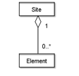
GLUE::Element
It groups concepts that participate in the creation of an entity useful in a Grid environment.
The element is autonomous and can be composed by services and the exposed resources.

Slide 22
GLUE::Resource
An entity that is useful in a Grid environment and offered through service(s)
A resource may contain aggregated information

Slide 23
GLUE::Service
An abstracted, logical view of actual software components having a well-defined interface and offering one or more functionalities;
it does have network endpoint(s); it abstracts some functionality

Slide 24

GLUE::Share
A utilization target for a set of resources defined by policies and characterized by status information

Slide 25
GLUE::Activity
An activity is a unit of work managed by a service;
An activity can have relationships to other activities being managed by different services, therefore it shares a common context.

Slide 26
GLUE::Virtual Organization
A virtual organization (VO) comprises a set of individuals and/or institutions having direct access to computers, software, data, and other resources for collaborative problem-solving or other purposes.
Resources utilized by a VO are expected to be provisioned via SLA’s . The VO can exhibit the internal structure in terms of groups of individuals and/or institutions and their roles

Slide 27
GLUE::Policy
Statements, rules or assertions that specify the correct or expected behavior of an entity
Relevant specialization are important to express authorization aspects to services/resources/shares

Slide 28
GLUE 2
Computing Entity

Slide 29
Computing Entities
The computing power is typically offered by cluster systems
  They can offer different types of machines (i.e., execution environments)
Requests are typically staged into queues for efficient system usage and fair share among clients
By playing with queues and authorization policies, it is possible to implement different level of services (e.g., guaranteed share, priorities)

Slide 30
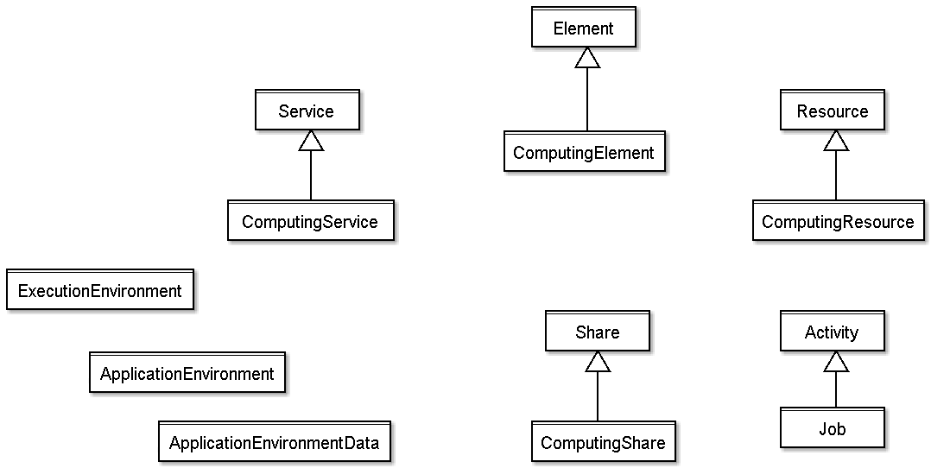
Involved Concepts and Inheritance

Slide 31
GLUE::Computing Element
It groups the concepts that participate in the creation of an entity providing computational activity in a Grid environment.
It considers computing services and the exposed computing resources where services and related resources have many to many relations

Slide 32
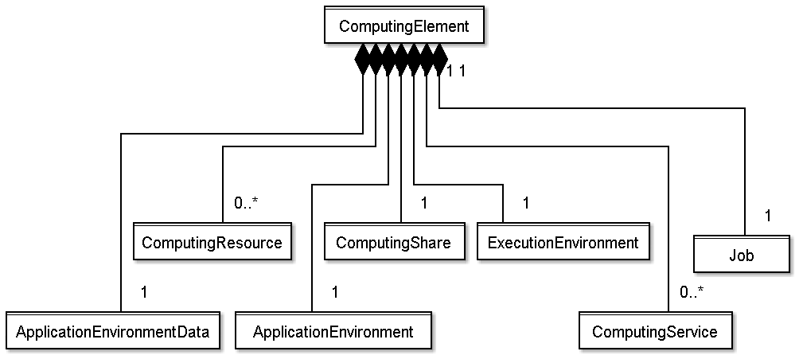
Computing Element as Concepts Container
Useful to refer all the concepts related to a computing
entity instance with a persistent and unique ID

Slide 33
GLUE::ComputingResource
Grouping concept for a set of different types of execution environments; the aggregation is defined by the common management scope (e.g., a local resource management system like a batch system defines an aggregation scope);
The OS can be the simplest case of LRMS.
The Computing Resource may contain aggregated status information

Slide 34
GLUE::ExecutionEnvironment
A description of hardware and software characteristics that defines the environments available to and requestable by a Grid job when submitted to a Computing Service;
the description also includes information about the total/available/used instances of the execution environment

Slide 35
GLUE::ApplicationEnvironment
Description of the application software environment available within one or more execution environments

Slide 36
GLUE::ComputingService
Specialization of service for creating, monitoring, and controlling computational activities called jobs

Slide 37
GLUE::ComputingShare
A utilization target for a set of computing resources defined by policies and characterized by status information
  a typical implementation of a share is a batch queue with the associated policies and status information
  the same share can be implemented using different batch system configuration/strategies
  in complex batch systems, it is possible to define different set of policies for the same batch queue, this will imply a share for each set of policies

Slide 38
GLUE::Job
An activity managed by a computing service

Slide 39
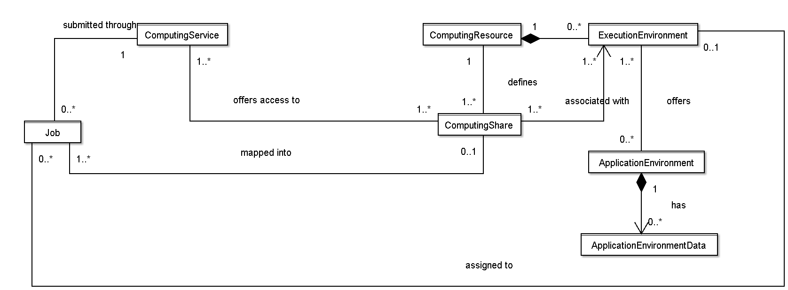
Computing Entity Relationships

Slide 40
GLUE 2
Storage Entity

Slide 41
Status
The status of the GLUE 2 specification for Storage entities is in an early stage
In order to provide an idea about the involved concepts, we sketch the GLUE 1.3 model

Slide 42
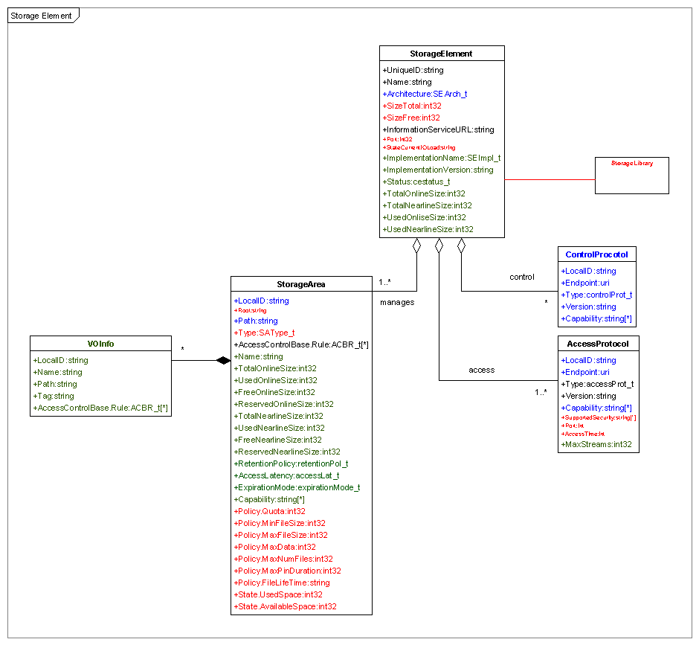
GLUE13::Storage Element
Storage Element:
Abstraction for a storage resource
Group of services, protocols and data sources

Slide 43
GLUE 1.3 Storage Element concepts
Storage Area:
  portion of storage extent to which a uniform set of policies applies
Access Protocol
  Protocol available to access/transport files in/from storage areas
Control Protocol
  Protocol available for the control and/or management of the storage resource

Slide 44
GLUE and CIM
A possible marriage?

Slide 45
Why not yet a CIM-based GLUE?
Modeling
  Perceived high complexity of CIM
    Difficult to extend for non-expert
    Difficult to use the CIM-based models for sharing knowledge among Grid experts that are non knowledgeable of CIM
Implementing
  Several implementations exist
    Issues of choosing among them
  High learning curve for writing both MOF and providers

Slide 46
Why not yet a CIM-based GLUE?
  Current panorama in Grid
    There are CIM extensions for Grid not having real implementation and support from real Grid infrastructure
    There are info model implementations non CIM-compliant
  People prefer
    simpler modeling
    hand-made mapping to different concrete data models
    implementation with scripting-based providers for rapid prototyping

Slide 47
Can We Fill the Gap?
Current work on GLUE 2 is a fresh-new work with no backwards-compatibility constraints
There is a 6-month timeframe to try GLUE and CIM marriage
For a success:
  Ability to talk to users that provide use cases
  Ability to talk to developers that know the details of the various Grid components and tell them how to write providers
  Ability to exchange GLUE concepts among CIM-nonexperts

Slide 48
Contribution to OGF GLUE WG
The OMII-Europe project is funding three persons (me plus two other colleagues)
  to contribute to GLUE 2
  to write info providers for OGSA-BES implementations of gLite and UNICORE
We are investigating the adoption of CIM and OpenPegasus right in this period
Important for the success is to enstablish the right relationships for a positive experience

Slide 49
Conclusion
Common Models of Grid resources are a key aspect for their integration and usage
The OGF GLUE WG is working on a re-design and itnegration of existing models in order to provide the community with use-cases driven info model
Reference implementations will be used by services exposing resources and by Grid Information Service
GLUE can enter the CIM world if we manage to enstablish the right relationships and keep in mind the inherent knowledge barriers

Slide 50
References
OGF GLUE WG Website
http://forge.ogf.org/sf/projects/glue-wg
Documents
  GLUE 2 - Specification
  GLUE 2 - Use Cases
  http://forge.ogf.org/sf/docman/do/listDocuments/projects.glue-wg/docman.root.drafts
GLUE Schema Specification v.1.3
  http://glueschema.forge.cnaf.infn.it/ (pre-OGF website)

