Slide 1
GLOBALGRIDFORUM.ORG
DRMAA in OGSA
DRMAA-WG Cochairs
John Tollefsrud [j.t@sun.com], Sun Microsystems
Hrabri Rajic [hrabri.rajic@intel.com], Intel
GGF9
Chicago, IL USA
Oct, 2003

Slide 2
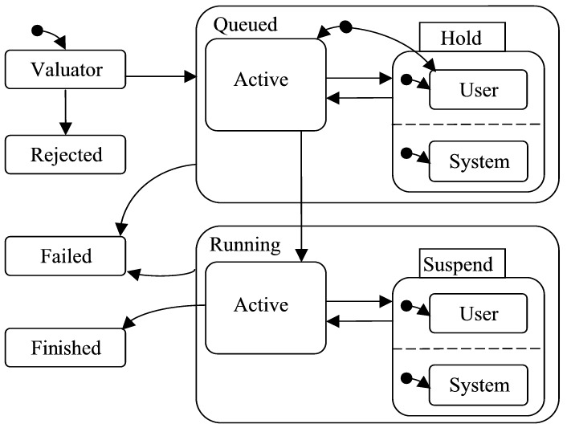
DRMAA Overview
What is DRMAA
  API spec
    submit, control & monitor, and query status of jobs.
  DRMAA v1.0 targets current DRM systems
  Designed for ISV applications, efficient parametric execution of tasks
  Current status
    Doc in final review
Activities connected with v1.0 spec
  C binding ( doc announced at GGF 8 )
  Java binding ( doc announced at GGF 9 )
  (G)WSDL binding ( just started )
DRMAA state
transition diagram

Slide 3
DRMAA & OGSA
Integration Proposition | Value Proposition | Supporting Deliverable
DRMAA Apps MAY integrate with OGSA | Maximum app portability across various distributed computing architectures | DRMAA OGSI client mapping document
DRMAA as an OGSA RM Adapter | RM investment leveraged for OGSA | DRMAA for OGSA document
OGSI
Client
Program
Execution

Slide 4
DRMAA Application Portability
APP
APP
DRMAA
DRMAA
DRMAA
RM at deployment
DRM
OGSA
Local
Service
Single
Machine
Local Netw Sys’s
Round Robin
Clusters
P2P
Service
Oriented
Grid

