Slide 1

Global
Grid
Forum
Promoting and Standardizing Grid Computing
EGA Discussion
November 2004
Notes:
This slide deck has been created to provide several key components of enterprise customer segment presentations.
It is not meant to be delivered as a synchronous, self-contained presentation.

Slide 2
Today’s Discussion
Grid: the next phase of distributed computing
GGF: promoting and standardizing grid computing
OGSA: the industry blueprint for standards-based grid computing

Slide 3

Grid: the next phase of distributed computing

Slide 4
Industry Perspectives
Overlapping concepts and terminology…
GRID
COMPUTING
DISTRIBUTED
COMPUTING
UTILITY
COMPUTING
Adaptive
On-Demand
Real-time Enterprise
Organic IT
But, common and compelling themes
Improve linkage between business and IT
Respond quickly to changing opportunities and threats
Lower costs through automation and improved utilization

Slide 5
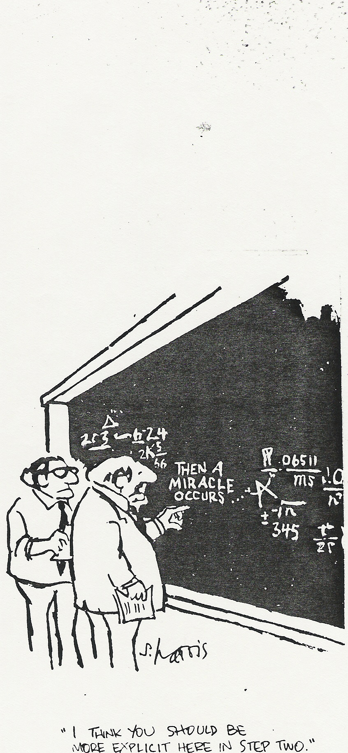
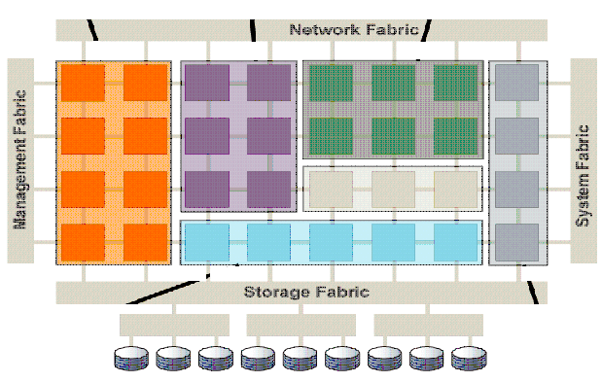
Industry Journey
To Shared …
Network Fabric
Management Fabric
System Fabric
From Silos …
Storage Fabric
Eng
Mfg
Mfg
Sales
Sales
…
…
IT
IT
Business
Business
Business
Business
Business
Business
Business
Business
Business
Process /
Business
Process /
Process /
Process /
Process /
Process /
Process /
Process /
Process /
Applications
Process /
Applications
Applications
Applications
Applications
Applications
Applications
Applications
Applications
Applications
Infra
Infra
-
-
Infra
Infra
-
-
Infra
Infra
-
Infra
-
-
Infra
-
structure
structure
structure
structure
structure
Infra
structure
Infra
-
structure
-
structure
structure
structure
Management Tools & Processes

Slide 6
The Path Toward Pervasive Adoption
HP
Adaptive Enterprise
Products & Solutions
Platform Computing
IBM
On-Demand
Oracle 10g
Microsoft
DSI
Sun
N1
Data Synapse
Avaki
Globus
UNICORE
Condor
Reference Designs
Reference Designs
Apache
Open Grid Services Architecture
(OGSA)
Web Services Distributed Management (WS-DM)
WSDL
Architectures & Standards
HTTP
Service Oriented Architecture
Web Services Resource Framework
(WSRF)
Soap
Grid FTP
XML
Life Sciences
Pharmaceutical
Mfg.
Use Cases & Best Practices
Physical Science
Computer Science
Oil & Gas
Finance
Telco

Slide 7

GGF: promoting and standardizing grid computing

Slide 8
What is GGF?
Standards: Open process for development of agreements and specifications
  Grid “Recommendations” process - modeled after Internet Standards Process (IETF, RFC 2026)
  Persistent, reviewed document series - similar to RFC series
Community: Forum for information exchange and collaboration
  Best practices spanning research, design, deployment and use of grid computing
  3 GGF events each year – next event, GGF13 in Korea, March

Slide 9
GGF Structure
GGF Corp
Board of Directors
Steering Group (GFSG)
GGF Management
Document Series Review
Advisory Committee (GFAC)
Chair
Exec Director
AL
AL
AL
AL
AL
AD
AD
Editor
Marketing
AD
AD
AD
AD
AD
AD
AD
Events
AD
AD
AD
Sponsorship
Area
Area
Area
Finance/Legal
Area
Area
Area
Operations
= working group
= research group
Holds non-exclusive copyright for document series and owns GGF and related service marks.

Slide 10
GGF Operating Philosophy
“Practice forest management”
Collaborate with a
variety of standards organizations working on underlying and related technologies.
Innovation
Execution
“Let a 1,000 Flowers Bloom”

Slide 11

OGSA: the industry blueprint for standards-based grid computing
Context Services
Data Services
Content Services
Execution Mgmt Services
Information Services
Resource Mgmt Services
Self-Mgmt Services
Security Services

Slide 12
IPR and Presentation Status
This Presentation is under GGF Copyright Rules
However,
  the content is subject to change and some parts have not yet been ratified by the WG.
Therefore,
  Please do not redistribute this presentation.
OGSA GridForge Site:
    www.gridforum.org/projects/ogsa-wg

Slide 13
OGSA Aims and Perspective
Goals
  Interoperable solutions to Grid based applications
    Grid definitions sidebar
  Addressing loosely coupled distributed computing
Philosophy
  Standardization at the Architectural level
    Similar to profiling.
    Developed before and/or during standards development
  Use existing standards and technology where possible
Grid: Distributed computing across multiple
administrative domains.
Includes cluster computing and distributed
management as subtypes.

Slide 14
OGSA Process
Use Case Driven
  21 Detailed Use Cases (~ 6 pages each)
    Tier 1 Available at: http://www.ggf.org/documents/GWD-I-E/GFD-I.029.pdf
Distributed Specification and Standardization
  Identify and/or develop open and accessible standard specifications
    Active current work in GGF, OASIS, W3C, and DMTF.
“Design Team” Working Model
  Facilitate cross fertilization within and outside GGF.
  Focus mind share (the most valuable commodity)
    e.g. DAIS-WG and OGSA-Data Design Team
Iterative Refinement
  Abstract service evolving to concrete specifications
Documents:
  OGSA: Use Cases, Informal Specification, GGF Recommendation

Slide 15
OGSA Design Philosophy
Service Oriented Architecture
  Interface Extension (WSDL 2.0 ‘extends’ attribute)
  Resources as First Class Entities
    Expressed as WSRF-Resource Properties
  Data type extensibility and introspection
  Dynamic service/resource creation and destruction
Component Based
  Elements of the Architecture are pluggable
Customizable
  Support for dynamic, domain specific content, ...
  Within the same standardized framework

Slide 16
Architecture Overview
GRID
COMPUTING
DISTRIBUTED
COMPUTING
UTILITY
COMPUTING
Use Cases &
Applications
Distributed query processing
Data Centre
Collaboration
Persistent Archive
ASP
Multi Media
VO Management
OGSA Self Mgmt
OGSA-EMS
DAIS
Core Services
Information
WSDM
Discovery
GGF-UR
WS-Base Notification
Naming
Privacy
Trust
GFD-C.16
WSRF-RP
WSRF-LT
Data Model
WSRF-RAP
WS-Security
SAML/XACML
X.509
Base Profile
WS-Addressing
HTTP(S)/SOAP
WSDL
CIM-XML/JSIM
Data Transport
GRID Computing, Distributed Computing and Utility Computing
are different views of the same important problem domain.

Slide 17
OGSA Use Cases – Examples:
Severe Storm Prediction and Tracking
  Crisis Management and loss containment
Online Media and Entertainment
  Production, sales, and online delivery
Distributed Query Processing
  Heterogeneous DBMS
Persistent Archives
  Digital Libraries, Government, Law, Medicine, ...
Distributed Learning
  Staff training to Higher education.
Application Steering
  Drug discovery, Decision support, ...

Slide 18
Use Cases:
Grid Application Service Provision
“Middleware is about bringing applications to users.”
  - A. Geiger, T-Systems
Multi-party Interactions:
  User, Application Service Locator, Application Service Provider, Application Creator, Resource Provider
Key Requirements:
  Discovery
    Locate resources, SLA Terms, ...
  Deployment
    Install application is line with SLA (e.g. security, performance, cost, ...)
  Metering and Monitoring
  SLA Management and Accounting
    SLA Negotiation, violation detection, and compensation, billing, ...
  Other:
    Security enforcement, Orchestration, Notification, Legacy support, ...

Slide 19
Use Cases:
Grid Based Commercial Data Centre
The Japanese Government is spending 26 M$ to develop open source infrastructure for GCDCs.
“Customers” of GCDCs:
  Centre Administrators:
    Manageability & Automation, Location Transparency, ...
  IT Systems Integrator:
    Complexity reduction, Meeting availability targets, ...
  IT business Activity Manager:
    Focus on the business proposition to end users, not operations.
Heterogeneous Platforms
  GCDC provisioning without lock-in.
  Provision to supplier’s strengths.

Slide 20
Requirements 1
State Reference and Management
Standards, More Standards, Open Standards
Dynamism
  Resource Virtualization
  Common Management Infrastructures
  Discovery and Query
  [Creation | Destruction] of [short | long] lived [services | resources].
  Soft state garbage collection
    Distributed reference counting and explicit destruction are untenable
Distribution, management, and logging of events
  Monitoring and archival of Grid information (events)
  Provenance and auditing of systems, services and, applications

Slide 21
Requirements 2
Quality of Service Assurance
  Detection of violation, enforcement, & compensation.
Support for Data Sources and Content
  Access, Consistency, Persistency, Integration, and Location Transparency
Security
  Authentication and Authorization (Separated!)
  Integration with heterogeneous legacy infrastructure
  Perimeter protection and internal isolation
  Delegation and policy exchange
  Intrusion detection and containment

Slide 22
Requirements 3
Execution Management
  Jobs, Services, Operations support, ...
Total Cost of Ownership Reduction
Scalability
Availability
Ease of Use
  Users and Providers
Extensibility
Supply-Side Optimization

Slide 23
Core Services Build Out
Extends
Uses
Discovery
Self Mgmt.
OGSA-EMS
VO Mgmt
DAIS
Information
WSDM
OGSA Base

Slide 24
OGSA Base Profile
SAML/XACML
OGSA Base
GFD.16
CIM/JSIM
Trust
Data Model
Privacy
GGF-UR
Transport
WS-Security
Naming
WSRF-LT
WS-BaseNt
WSRF-RP
WSRF-RAP
WS-Addressing
Extends
Uses
Fabric: WSDL 1.0, SOAP/HTTPS, X.509

Slide 25
Status Legend
Standard
  Existing, adopted specification from a recognized Standards Development Organization.
Evolving
  Emerging specifications with reference implementations and standardization in process
Gap
  Identified architectural component with no existing specifications complete, but work is in progress somewhere.
Hole
  Identified architectural component without apparent activity.

Slide 26
OGSA Base Profile - 1
Facility | Status | Current Specification | Comments
Service Description | Standard | WSDL 1.0 | Move to WSDL 2.0 in later versions of OGSA, primarily for ‘extends’ support.
Addressing | Evolving | WS-Addressing 08/04 | Firewall traversal, Scalability, Support for resources with reference data structure (EPR). Standardization started in W3C. Last call planned for January 05.
Resource Access | Evolving | WSRF-RAP (Embodiment 1) | Stable now. Committee Draft expected April 05.
Control Channel | Standard | HTTP(S)/SOAP 1.2 | Data volume assumed small. Lightweight (performant) implementations required. Some use cases may require reliable delivery, e.g. WS-Reliability.
Data Transport | Hole |  | Use HTTP(S)/SOAP 1.2 with attachments, which fails to meet current performance requirements. Future options: MTOM, GridFTP, ...

Slide 27
OGSA Base Profile - 2
Facility | Status | Current Specification | Comments
Notification | Evolving | WS-BaseNotification 06/04 | Seeking unification with WS-Eventing due to significant overlap. Some functionality depends on WSRF-RP. Brokered Notification and Topics to follow later in OGSA. Committee Draft expected April 05.
State and Properties | Evolving | WSRF-RP 06/04 | Super-set of WS-Transfer. Committee Draft expected April 05.
Lifetime | Evolving | WSRF-LT 06/04 | Committee Draft expected April 05.
Naming | Gap |  | Evaluation in progress in OGSA-WG and a new WG to form in early 2005, if required.
Resource Model (Storage & Compute) | Evolving | CIM-XML + JSIM | The models are stable, but the XML schema is under development.
Resource Model (Data) | Gap |  | The CGS-WG is developing an extension to CIM for databases and other data sources.

Slide 28
OGSA Base Profile - 3
Facility | Status | Current Specification | Comments
Authentication | Standard | WSS-SOAP-Mess-Sec 1.0, X.509, GFD-C.16 | Authentication is not conflated with authorization or delegation in OGSA. Authentication services and identity mapping are future developments in OGSA.
Authorization | Standard | SAML, XACML (PIP, PAP, PDP, PEP) | Initially, authorization is a local issue. By basing description and distribution on standards OGSA facilitates migration to dynamic, distributed authorization.
Accounting/Audit | Gap | GGF/UR | Current focus is on “jobs”; we need service level accounting and audit. Extensions to CIM and JSIM, and “Grid Economies” GGF/GESA-WG.
Confidentiality | Standard | WSS-SOAP-Sec | Negotiated, lightweight protocols will be developed in coming versions of OGSA.
Privacy | Hole |  | The focus here is on the individual person.
Trust | Gap |  | There are proprietary and open specifications that start to address this area, e.g. WS-Trust, WS-Federation, WS-Delegation.

Slide 29
OGSA Core Services Profile
Facility | Status | Current Specification | Comments
Discovery | Gap |  | UDDI is generally thought to be too static. Registry and discovery services built on WSRF-SG seem likely, but no activity yet.
Data Access (Files and Databases) | Evolving | DAIS | OGSA-DAI project will encompass files as well as databases and will feed specifications into DAIS.
Generic Management | Evolving | WS-DM 0.5 | WSDM acts as a basis for all other management functions in OGSA. Move to V1.0 in early 2005.
Execution Management | Gap |  | OGSA-EMS Design Team expects to form a WG in 2005, working with the GRAAP and JSDL WGs.
Self Management | Gap |  | Foundation infrastructure for self managed systems. Design team creation on hold. Related activity in CCDLM-WG.
VO Management | Hole |  | Build on WSDM and authentication and authorization specifications. No working group activity yet.
Information | Hole |  | Infrastructure for information distribution, storage, and monitoring.

Slide 30
Focus on Security: Baseline
PKI Based Infrastructure
  X.509 + PKI, see models in GFD.16
Authenticated Connections
  Client authenticated HTTPS.
WS-Security Based Payload Protection
  WSS-Sec, 2004/01
Authorization, Roles, and Access Privileges
  Locally (site) managed
  SAML and XACML Basis
  Credential mapping provided by implementations.

Slide 31
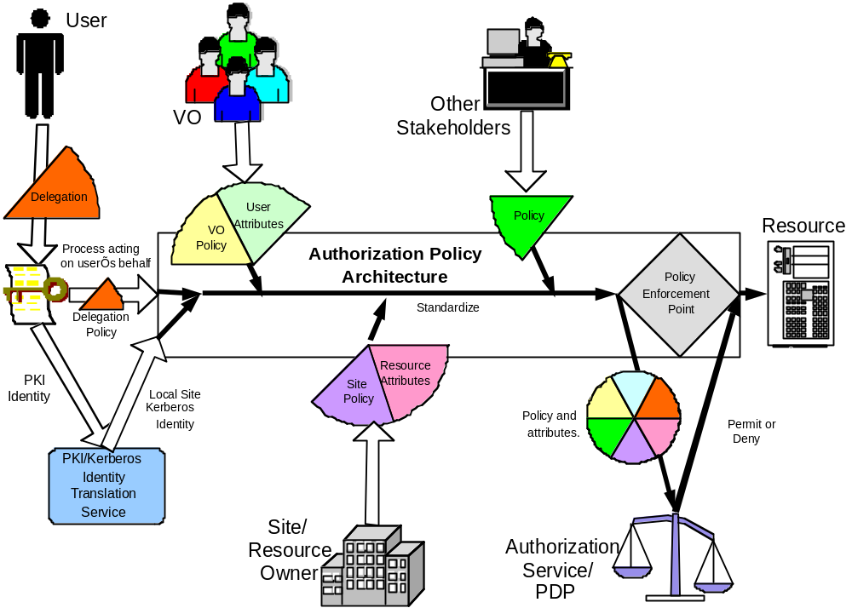
Focus on Security: Long Term
Security Function Points
  Policy Enforcement
  Policy Decision
  Policy Information
  Policy Administration
Grid Specifics
  Cross Organizational
  Rights Delegation
  Dynamic Management
Trust Framework Required
  “Parallel Grid”
  Codification of Trust
  Manageable

Slide 32
Security: Interim Approaches
Globus
  Grid Security Infrastructure
  Time Expiring Proxy Certificates
    Authorization by “impersonation” of original user
Unicore
  Explicit Trust Delegation
  Trusted Agents
    Authorization based explicitly declared trust in the agent
    Identity from user’s public certificate
GRIA
  Business Process Driven Authorization
  Authorization established as part of the workflow
    Application and business process instance dependant

Slide 33
Architecture: Status
GRID
COMPUTING
DISTRIBUTED
COMPUTING
UTILITY
COMPUTING
Use Cases &
Applications
Distributed query processing
Data Centre
Collaboration
Persistent Archive
ASP
Multi Media
VO Management
OGSA Self Mgmt
OGSA-EMS
DAIS
Core Services
Information
WSDM
Discovery
GGF-UR
WS-BaseNotification
Naming
Privacy
Trust
GFD-C.16
WSRF-RP
WSRF-LT
Data Model
WSRF-RAP
WS-Security
SAML/XACML
X.509
Base Profile
WS-Addressing
HTTP(S)/SOAP
WSDL
CIM-XML/JSIM
Data Transport
Hole
Gap
Evolving
Standard

Slide 34
Summary
Opportunity to make significant progress on industry standard grid computing
  Enterprises are adopting grid computing – require standards and a rich vendor ecosystem
Growing consensus on architecture concepts – OGSA provides a blueprint
  Service-oriented architectures enable broad industry support
Significant progress has been achieved but much remains
  Magnitude and scope of the work is greater than any one standards organization – requires collaboration

Slide 35
Q & A

