Slide 1
Network Services Use Cases
GHPN Research Group
Peter Clarke, University College London
Tiziana Ferrari (Editor), INFN CNAF
Gigi Karmous-Edwards, MCNC Institute
Peter Kunzst, CERN
Mark J. Leese, Daresbury Laboratory
Paul Mealor, University College London
Inder Monga, Nortel Networks Labs
Volker Sander, Forschungszentrum Jülich

Slide 2
Motivation for Grid Network Services draft-ggf-ghpn-netservices-0
Elevate Network Resources to 1st-class Grid-managed Resource
  akin to CPU, Storage
Motivation for Network Services Use Cases
draft-ggf-ghpn-netservices-usecase-1
Harvest user and application requirements from real-life stories
  Leading to a necessary & sufficient set of Grid interfaces and Abstractions
Make Grid Network Services “as simple as possible, but not simpler”

Slide 3
Our Use Cases
Draw upon OO tradition
Template reflects the OGSA experience
They are of the black-box kind
  From a user’s story, we take the WHAT, not the HOW
We expect to report qualitative and quantitative aspects to the story

Slide 4
Areas and Use Cases
Two areas:
  Path oriented use cases
      Visualization session
      Remote parallelized visualization
      High throughput file transport with a deadline
      HEP replica management
      High Energy Physics replication of re-processed data from a central point to several data centres
  Knowledge-based use cases
      Service optimization
      Administrative setup of schedules of measurements
      Passively monitored data

Slide 5
Path-oriented use cases

Slide 6
Visualization Use Case
Visualization components of many Grid Applications driving network requirements
  Remote Visualization, Tele-immersion, Collaborative Visualization, Tele-operation, distributed simulation analysis
A generic end-to-end Visualization session has multiple workflow components that can be localized/distributed geographically
The Grid Resource Broker for this use-case could need access to one or more of the following netservices (complete list in the document):
  Network Capability Discovery Service
    Can a high-bandwidth visualization session be supported between selected sites?.
  Network Resource Allocation Service
    Can the resources be reserved to provide consistent service for the duration (full-day)?
  Network SLA Monitoring Service
    How do I know if the network is keeping its end of the Agreement?
  Network Advanced Reservation Service
    Can I schedule a collaborative session for next month among the five sites along with the sensor farm
Raw
Data
Data
Processing
Display
Processing
Interactive
Components
NETWORK
NETWORK
NETWORK

Slide 7
Remote parallelized visualization
Parallelization in three areas:
  server-side functions
  client side functions
  object rendering
Large data set was divided over multiple remote servers for more efficient computation and I/O
Each server update across the network should maintain the requested QoS
  very low network jitter
  very low network latency
  very high network bandwidth for the transfer of large data sets;
  near-real-time
The volume of data crossing the network between each remote server and the client display varies substantially depending on the end user’s maneuvering of the single displayed object on the display wall.
High bandwidth connections will be required to ensure near-real-time rendering of the displayed object .
Dedicated end-to-end connections between servers and displays are ideal for reducing jitter and latency.

Slide 8
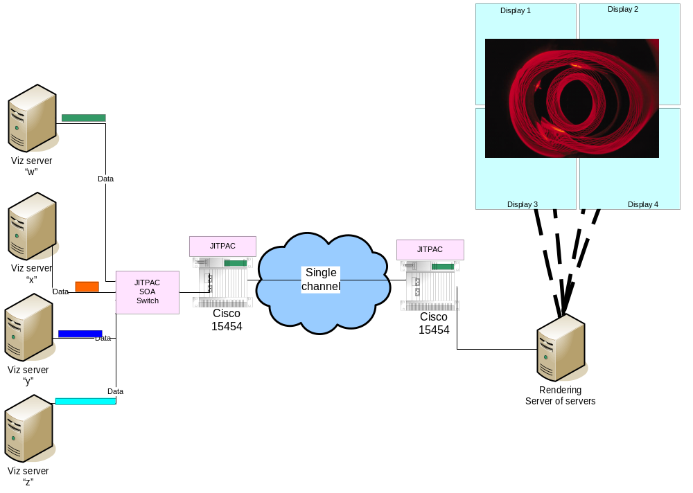
Remote parallelized visualization (cont)

Slide 9
High Throughput File Transport with a Deadline
Determining a schedule for computation in distributed Grid environments can often be simplified by assuring the availability of the data at a particular time
  Guaranteed Bandwidth
  Rate might be negotiable and varying
  Available Bandwidth should effectively used by Pre-Staging mechanisms
Two types of customers:
  A resource management service such as a community scheduler that dynamically maps workflows to resources.
  End-users that negotiate a particular time frame for the remote execution of their program. An example would be visualization and steering application that is served by a supercomputer application.

Slide 10
HEP replica management (1):
Job submission through a RB
Workflow:
  Submit job; RB chooses CE; CE runs job; job retrieves replicas from SEs; job saves output to SE
Bandwidth predictions
  On two separate occasions
    When choosing a CE
    When retrieving files once the job has started
  Both require complicated queries
    Need the cost for (each available CE) x (each available replica)
Bandwidth allocation?
  When transfers cannot be prompt enough?

Slide 11
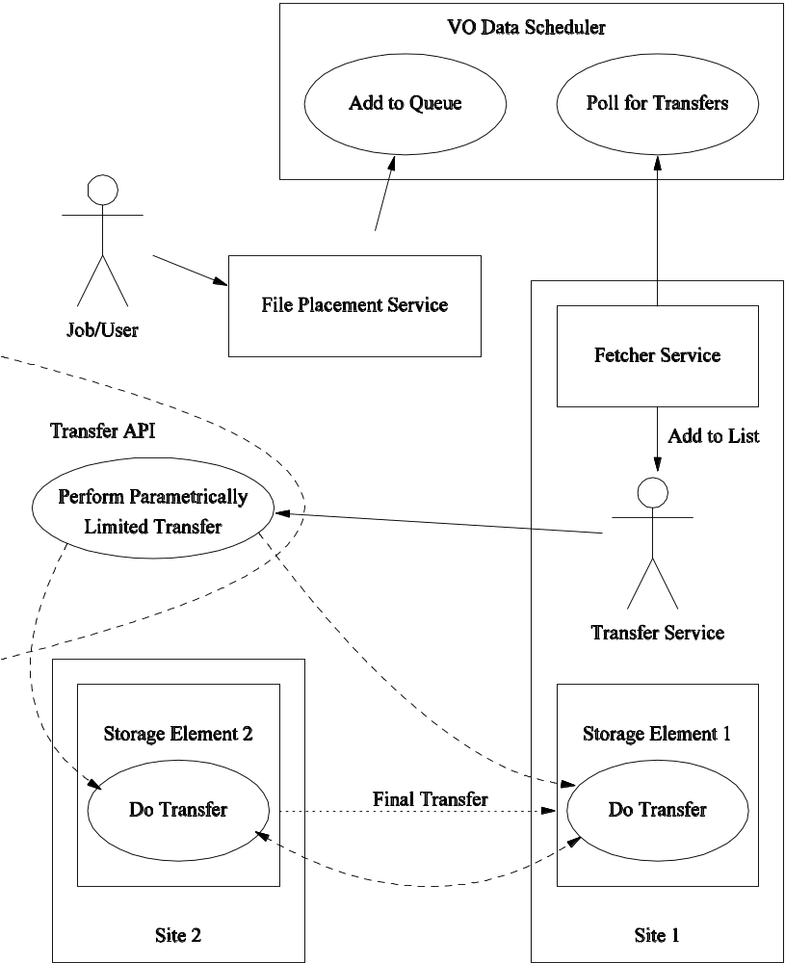
HEP replica management (2):
Data distribution from CERN in EGEE
Huge amounts of data from detectors
  Streamed to HDD at CERN
  Tier 1 sites retrieve as many files as they are interested in
  Data stored to tape at CERN (retrieving this data is tedious)
Few tier 1 sites
  Bandwidth might be booked once for all transfers
Transfers are constrained by:
  VO policy (administered by VO Data Scheduler and VO File Placement Service)
  Site policy (administered by Site Transfer Service)
Transfer mechanism: GridFTP?

Slide 12
HEP replica management (3):
Data reprocessing
Raw data from LHC processed to other forms regularly
  Reprocessing must be done more quickly than data is produced
  Processing happens at geographically remote sites
Raw data transferred to computation sites
  From where ever is convenient
    All tier 1 sites have some raw data
  Loads of it, and time-constrained – requires bandwidth allocation?
  Middleware might check network state to decide
Processed data replicated to all tier 1 sites
  Loads of it, and time-constrained

Slide 13
Knowledge-based use cases

Slide 14
Service optimization
Optimise many Grid interactions with networks
  By estimating the cost of using the networks
  Different applications need different cost models
Scenarios
  Grid Job scheduling
    Place jobs so that use of the network is minimised
  Replica input/output by jobs
    Retrieve or output to the fastest replica
  Data replication
    Minimise network use
Implemented in EDG
  DataGrid Deliverable 7.4
Issues
  Heavy use – cost for every replica required for every job

Slide 15
Administrative setup of schedules of measurements
Temporary measurement schedules
  For problem analysis
    Must be able to change, extend and shorten a schedule
  To examine the results of changes
    Streaming results
Permanent measurement schedules
  Monitoring for signs of changes/problems
    Long-term measurements between two known nodes
    Along generally known paths
    Notification on big changes required?
  To ensure middleware gets the information it needs
    Long-term measurements between two sites or CE/SE pairs
    Some manual configuration easier than automatic
    Allow network services to avoid doubling-up measurements

Slide 16
Passively monitored data
Lots of sources
  Instrumented file-transfer software, Routers, Middleware
Useful for
  Resource brokering
    No need for intrusive measurements
    Not as dependable as active, maybe
  Monitoring for changes/problems
    Background monitoring program notifies user in the event of changes
  Characterisation of file-transfer use
    Just need summaries, but which ones?
Issues
  Data must be anonymised
  Might get lots of raw data, and so only store summaries

Slide 17
Future Work
Elicit more real-life stories from Users
Polish/strengthen the guidelines for new use cases
Enlist new groups inside GGF (e.g., OGSA) and outside GGF
Switch emphasis from WHAT to HOW
  draft-ggf-ghpn-netservices-xxx is about HOW

