Slide 1


RISGE-RG use case
Telecommunication measurement instrumentation on the eInfrastructure
Evaluating the effects of noise and fading over a video transmission performed on a wireless channel
RISGE-RG
Luca Berruti, Franco Davoli
CNIT, University of Genoa Research Unit

Slide 2

OGF IPR Policies Apply
“I acknowledge that participation in this meeting is subject to the OGF Intellectual Property Policy.”
Intellectual Property Notices Note Well: All statements related to the activities of the OGF and addressed to the OGF are subject to all provisions of Appendix B of GFD-C.1, which grants to the OGF and its participants certain licenses and rights in such statements. Such statements include verbal statements in OGF meetings, as well as written and electronic communications made at any time or place, which are addressed to:
    the OGF plenary session,
    any OGF working group or portion thereof,
    the OGF Board of Directors, the GFSG, or any member thereof on behalf of the OGF,
    the ADCOM, or any member thereof on behalf of the ADCOM,
    any OGF mailing list, including any group list, or any other list functioning under OGF auspices,
    the OGF Editor or the document authoring and review process
Statements made outside of a OGF meeting, mailing list or other function, that are clearly not intended to be input to an OGF activity, group or function, are not subject to these provisions.
Excerpt from Appendix B of GFD-C.1: ”Where the OGF knows of rights, or claimed rights, the OGF secretariat shall attempt to obtain from the claimant of such rights, a written assurance that upon approval by the GFSG of the relevant OGF document(s), any party will be able to obtain the right to implement, use and distribute the technology or works when implementing, using or distributing technology based upon the specific specification(s) under openly specified, reasonable, non-discriminatory terms. The working group or research group proposing the use of the technology with respect to which the proprietary rights are claimed may assist the OGF secretariat in this effort. The results of this procedure shall not affect advancement of document, except that the GFSG may defer approval where a delay may facilitate the obtaining of such assurances. The results will, however, be recorded by the OGF Secretariat, and made available. The GFSG may also direct that a summary of the results be included in any GFD published containing the specification.”
OGF Intellectual Property Policies are adapted from the IETF Intellectual Property Policies that support the Internet Standards Process.

Slide 3
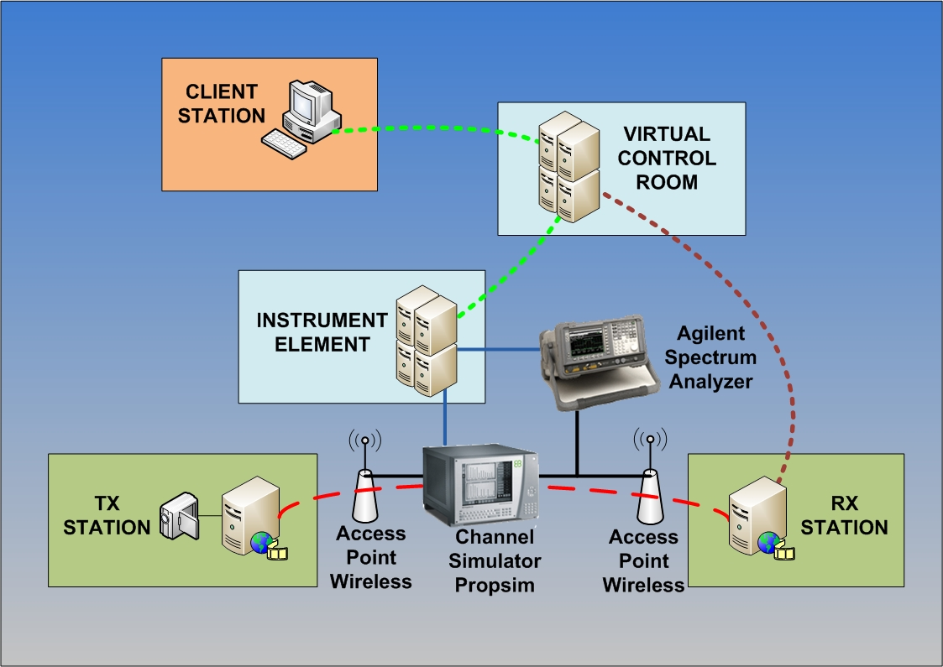
Use case evaluating noise and fading over a wireless channel
The experiment aims at evaluating the effects of noise and fading over a video transmission performed on a wireless channel.

Slide 4
Customers
Primary Actor:
  The Engineer who has to perform measurements over a wireless channel.
Secondary actors:
  The owner of the equipment
  Observer of the video data (scientist, public, student)‏
  Operator (on-site at instruments' station)

Slide 5
Scenarios
Preconditions:
Video received at the receiver without channel simulator
Minimal guarantee:
Packet loss and missing video frames when generating fading and additive noise.
Success guarantee:
Poor video quality observed at the receiver in the presence of heavy fading and/or noise levels.

Slide 6
Scenarios
Observations, full experiments, response actions
  Logging in to the client that transmits video
  Setup video transmitter
  Logging in to the client that receives video
  Setup video receiver
  Connect the wireless Access Point output at the transmitter end to the input of the channel simulator (Elektrobit PropSim C2) [must be performed by operator, unless already in place]
  Connect the output of the channel simulator to the input of the wireless Access Point at the receiver end [must be performed by operator, unless already in place]
  By using a directional coupler, connect the output of the channel simulator to the input of the Spectrum Analyzer (Agilent E4404B) [must be performed by operator, unless already in place]
  Turn on channel simulator, spectrum analyzer and access points

Slide 7
Scenarios (2)
Observations, full experiments, response actions
  Start video transmission
  Start the receiver
  Choose a fading profile, switch on and configure the channel simulator
  Set noise level in the channel simulator
  Observe the effects of fading and noise on the decoded video stream [needs VNC or other tool to transfer the decoded video stream to the remote location (without video compression)]
  Observe the spectrum
  Measure the packet loss and missing video frames [by means of a software monitoring tool]
  Repeat the measurement after changing noise level and/or fading profile

Slide 8
Involved resources
a video transmitter station (Video LAN Client running on Windows XP)
a video receiver station (Video LAN Client running on Windows XP)
two wireless access points
a channel simulator (Elektrobit Propsim C2)
a spectrum analyzer (Agilent E4404B)
an Instrument Element (running on Windows XP)
a Virtual Control Room (running on Debian GNU/Linux)
a Data Collector Broker (running on Scientific Linux)

Slide 9
Involved resources
Instrument Element related software/components
Instrument Abstraction Layer (IAL)
NI 488.2 (ENET/GPIB interface device driver)
AgilentInstumentManager (Agilent E4404B Instrument Manager )
Data Collector
E4404B IAL wrapper
Agesa E4404B (Agilent E4404B device driver)
SpectrumAnalyzerInstrumentElement (Elektrobit Propsim C2 Instrument Manager)
PropSimC2 IAL wrapper
Propsim VISA (PropSimC2 device driver)
Virtual Control Room (VCR) related components
  mceremotedesktop (used to show video at receiver station)

Slide 10
Involved resources (2)
Padova
Data Collector
Broker
Savona
VCR
Naples
Instruments
and IE

Slide 11
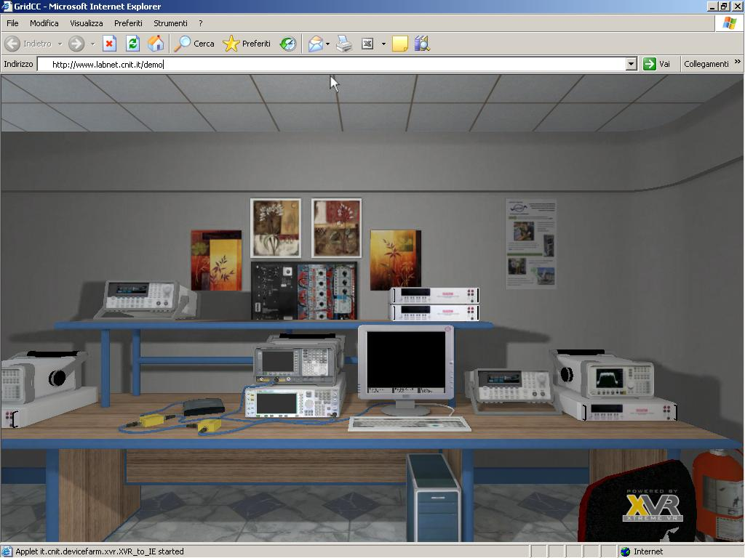
Examples

Slide 12
Functional requirements
User interfaces
  It is important in this application to reproduce (totally or partially) the front panel(s) of the instrument(s) with a certain fidelity. A more realistic user interface can be employed both to display measurement outputs (e.g., in the form of graphics) and to input configuration parameters in a fashion as close as possible to that of the real instrument (i.e., pushing buttons, turning knobs, and moving sliders). 3D is a possible option.
Data collection
  Measurement data can be acquired from the Instrument Elements controlling the various pieces of equipment in (at least) two possible modes:
    continuously polling the IE for new data;
    based on a publish/subscribe paradigm, to allow asynchronous communication between the IEs and the user clients (possibly through a VCR).
  The choice between the two operating modes can be based on performance considerations.

Slide 13
Non-functional requirements
Security considerations
  Each observer must be authenticated to allow video data
  Some authorized users allowed to remotely manage instruments
Performance considerations (incl. real-time properties)
  Polling the IE for instruments' readings (e.g., from the spectrum analyzer) may result in eccessive data transfer delays towards the client stations for waveforms' visualization
  In these cases, the adoption of a publish/subscribe mechanism employing, for instance, JMS for event notification and automatic measurement data transfer is recommended.

Slide 14
Related work
Experience in the field
The CNIT teams at the Universities of Genoa and Bologna, and at the National Laboratory for Multimedia Communications in Naples, Italy, have over 8 years experience in the field. In particular, they have conducted the LABNET project [1], part of the experimental activity of the VICOM project [2], and they have participated in European projects GRIDCC (http://www.gridcc.org), RINGrid (http://www.ringrid.eu), and DORII (http://www.dorii.eu). Participation in the activity of the NoE SatNEx (http://www.satnex.org) has allowed establish a liaison between Remote Instrumentation Services and the usage of satellite links for data transfer (an important aspect when accessing harsh or secluded environments).

Slide 15
References
GridCC Device Farm Demo Video
  http://www.gridcc.org/cms/index.php?option=com_content&task=view&id=17&Itemid=9
[1] F. Davoli, G. Spanò, S. Vignola, S. Zappatore, "LABNET: towards remote laboratories with unified access", IEEE Transactions on Instrumentation and Measurement, vol. 55, no. 5, pp. 1551-1558, Oct. 2006.
[2] L. Berruti, F. Davoli, G. Massei, A. Scarpiello, S. Zappatore, "Remote laboratory experiments in a Virtual Immersive Learning environment", Advances in Multimedia, vol. 2008 (2008), Article ID 426981, 11 pages, doi: 10.1155/2008/426981.
[3] F. Davoli, S. Palazzo, S. Zappatore, Eds., Distributed Cooperative Laboratories: Networking, Instrumentation, and Measurements, Springer, New York, NY, 2006; ISBN 0-387-29811-8.
[4] L. Berruti, L. Caviglione, F. Davoli, M. Polizzi, S. Vignola, S. Zappatore, "On the integration of telecommunication measurement devices within the framework of an instrumentation Grid", in F. Davoli, N. Meyer, R. Pugliese, S. Zappatore, Eds., Grid Enabled Instrumentation and Measurement, Springer, New York, NY, 2008; ISBN 978-0-387-09662-9.
[5] L. Berruti, F. Davoli, S. Vignola, S. Zappatore, "Interconnection of laboratory equipment via satellite and space links: investigating the performance of software platforms for the management of measurement instrumentation", in E. Del Re, M. Ruggieri, Eds., Satellite Communications and Navigation Systems, Springer, New York, NY, 2007, pp. 657-666.

Slide 16
References
[6] L. Berruti, F. Davoli, M. Perrando, S. Vignola, S. Zappatore, "Engineering applications on the eInfrastructure: The case of telecommunication measurement instrumentation ", Computational Methods in Science and Technology, Special Issue on “Instrumentation for e-Science”, vol. 15, no. 1, pp. 41-48, 2009.

Slide 17
Full Copyright Notice
Copyright (C) Open Grid Forum (2008). All Rights Reserved.
This document and translations of it may be copied and furnished to others, and derivative works that comment on or otherwise explain it or assist in its implementation may be prepared, copied, published and distributed, in whole or in part, without restriction of any kind, provided that the above copyright notice and this paragraph are included on all such copies and derivative works.
The limited permissions granted above are perpetual and will not be revoked by the OGF or its successors or assignees.
Notes:
OGF Full Copyright Notice if necessary

