Slide 1


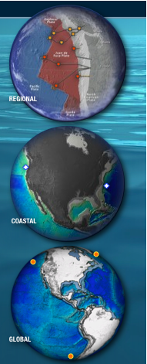
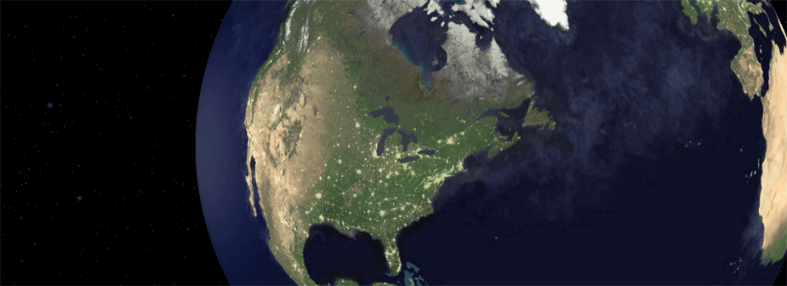
Ocean Observatories Initiative: Cyberinfrastructure (OOI CI)
USE CASES
Duane R Edgington
MBARI (Monterey Bay Aquarium Research Institute)
Moss Landing, California, USA
INGRID2008 Lacco Ameno Ischia April 10 2008

Slide 2
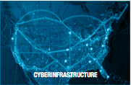
Ocean Observatories Initiative
Cyberinfrastructure Use Cases
Requirements for OOI CI have come primarily from workshops held specifically to gather requirements from ocean scientists.
Two workshops focused on Numerical Ocean Modeling. These modelers use Grid Computing and HPC today.

Slide 3
Case 1: Forecast model
Numerical model describing ocean physics is developed and tuned by extensive research
Archive data from data stores are input to models, selected by location, type, timeframe.
Real time data from observatory instruments are assimilated into the model automatically by script or program.
  Data are selected based on instrument location.
  Data are used for forcing and open boundary conditions.
  Metadata describing the instrument identification, capability, calibration and the data quality are used to filter the data as needed.

Slide 4
Case 1 continued
  An ensemble of (e.g.) 50 model runs are computed with slightly varied start conditions and forcing conditions, and evaluated by the relations of the results (averaging, variation, etc).
Production runs are computed in grid environments with reserved resources.
Output products include:
    3D/4D fields with many variables (temperature, salinity, current) for several times (e.g. every 24h for 14 days) for all e.g. 50 runs of the ensemble.
Visualization is decoupled from model computation, and provided based on availability of resources.

Slide 5
Domain Model Use case 1

Slide 6
Scenario I – “Test the shelf productivity hypothesis” (Numerical model analysis)
Use the CI to find out the relevant variables in the domain and what data products exist?
  Within the OOI, find data from the cabled observatories, gliders…, and other data that is available, and create a time series for the spatial & time domain the PI is interested in.
  Use the CI to find links to external resources (NOAA, NASA satellites)
  The CI shows available resources that potentially require certain authorization or impose certain use policies
  Import and group data into the previously defined model workspace
    For instance, after initial data retrieval, 10GB of data are now in the model workspace

Slide 7
Search for models that provide the desired result. What model outputs are already available in the CI?
  The OOI repository contains several data sets with models run for the selected input data.
  For instance, there is a global model output data set available and a regional-coastal model output with a finer resolution but not exactly with the desired variables.
  Model output size can be in the order of 1 TB

Slide 8
Analyze the found model output
  Use the OOI community toolbox to find suitable data analysis tools
  Finding these tools requires the PI to enter a number of characteristic keywords
  First, the PI performs an interactive analysis process with random (“poke around”) plots, visualizations, tool applications etc. This is not really a defined workflow. The CI supports in doing so, for instance by keeping a history and a stack of the commands used and keeping results and tools in the workspace.
  This interactive analysis occurs iteratively, with refined analysis and searches. It realizes a spiral development cycle. The CI supports iterative analysis.
  The CI also provides data services for statistic analysis and comparison of results and data series. The CI enables the scientist to much faster investigate a region.

Slide 9
Publish own analysis to the CI community
Further subsequent alternative research paths exist:
  Run existing models with different data and parameterization
  Design own observations and use the resulting data with the models

Slide 10
Option 1: Rerun models; create different model output using available models and data
Situation: “I don’t like any model output so far and want to combine a model with existing data “
The PI goes to the data assimilation portal.
  Looks what models and data sets are available.
  Retrieve desired model code and original configuration into the modeling workspace, or get access to the model front-end server.
  Select archived data set as input of the model
  Configure and parameterize the model
  Select from available model extensions and apply them to the given model (similar to an ECMP model component tree)

Slide 11
(Option 1 continued)
Model execution in workspace or externally
  Use the selected model, model extensions, parameterization and input data sets
  Schedule computation for execution on CI infrastructure resources
  The resulting output data could be in the order of 1TB , now in the local workspace
Model output analysis
  As sketched before, using CI analysis and visualization toolbox
  Share selected results by email
  The CI can provide links to results in the workspace
  Create an output report from available resources in the workspace
Cleanup workspace (archive, prune).

Slide 12
Option 2: Schedule observations
Situation: “I decide I will do my own experiment for a month.”
The PI uses the OOI command and control portal
  Evaluate the available instruments in the OOI network
  Define a “virtual model” with its inputs and outputs, properties and constraints as well as potential instrumentation.
  A simulator such as the OSSE (Observing System Simulation Experiment) uses this virtual model and helps to answer the questions:
    “How many gliders are needed, how many resources need to be deployed and where?”
    “Supposed I have data on these points, how would the error be? What is an optimal trade-off of used resources and resulting model output quality”

Slide 13
  Create an observation request
    Depending on the cost, the PI decides on the list of instruments requested
    Defines the observation in terms of resource needs, application area, etc.
    Examples for observation request:
      For gliders, AUV and mobile sensors: Define sampling grids for (“when and where you want the gliders?”)
      For moored sensors: “When cold water coming on the shelf is observed, provide vertical profile 10 times a day instead of once per day”)

Slide 14
Negotiation of the observation request
  The PI files the request through the OOI to the Marine operator who decides the instrument operations
    The request could be “I want the glider to spend more time in this area. Please schedule this experiment in the next month.”
    The CI cannot execute this schedule, but facilitate the communication with the Marine operator
      For instance in this experiment, the scientist requests to use many sensors from the OOI, but is not directly controlling the instruments. There are 30 requests to change where the gliders are flying, so the marine operators must solve the problem.
    Scientist and marine operator negotiate an agreement facilitated by the CI

Slide 15
Execution of the observation request
  The experiment gets executed and new observations are made
  Data from the observations gets available on the CI
Perform data analysis as before
Perform publication of results as before

Slide 16
Transformative changes
Numerical Modeling
  Enable users to determine different configurations for existing models
  Ability to combine very disparate data sets much easier with suitable user interfaces and visualization
  Running large scale models across different locations on the network
  Users should be able to interact with models directly via a simple web interface (on-demand modeling).
  Modeling and data assimilation codes should be as portable and easy to use as Matlab subroutines.

Slide 17
Data retrieval, research
  Availability of “one place to go shopping for everything”, “a sophisticated Google”
  Hooked into everything else (external data sources, computation, storage resources)
  An infrastructure with a uniform and streamlined user interface with homogeneous presentation
  Enable to find all kinds of data in one place (e.g. temperature, salinity, wind, multiple satellite data for one region)

Slide 18
  Ability to ask generic, multi-disciplinary research questions; answer supported by identification (suggestions) of suitable input data, transformations, resources, tools, visualizations
  Transition to a service oriented way of providing information
  Provide students with flexible research capabilities across disciplines, data sources
  Users should have ways to know what model outputs are available in what regions, and download them if needed.
  Datasets available with wiki-style QC and CVS-style revision logs.

Slide 19
Questions?

