Slide 1

OGSA-WG: EGA Reference Model
GGF18 Sept. 12, 4-5:30pm, #159A-B

Slide 2

OGF IPR Policies Apply
“I acknowledge that participation in this meeting is subject to the OGF Intellectual Property Policy.”
Intellectual Property Notices Note Well: All statements related to the activities of the OGF and addressed to the OGF are subject to all provisions of Appendix B of GFD-C.1, which grants to the OGF and its participants certain licenses and rights in such statements. Such statements include verbal statements in OGF meetings, as well as written and electronic communications made at any time or place, which are addressed to:
    the OGF plenary session,
    any OGF working group or portion thereof,
    the OGF Board of Directors, the GFSG, or any member thereof on behalf of the OGF,
    the ADCOM, or any member thereof on behalf of the ADCOM,
    any OGF mailing list, including any group list, or any other list functioning under OGF auspices,
    the OGF Editor or the document authoring and review process
Statements made outside of a OGF meeting, mailing list or other function, that are clearly not intended to be input to an OGF activity, group or function, are not subject to these provisions.
Excerpt from Appendix B of GFD-C.1: ”Where the OGF knows of rights, or claimed rights, the OGF secretariat shall attempt to obtain from the claimant of such rights, a written assurance that upon approval by the GFSG of the relevant OGF document(s), any party will be able to obtain the right to implement, use and distribute the technology or works when implementing, using or distributing technology based upon the specific specification(s) under openly specified, reasonable, non-discriminatory terms. The working group or research group proposing the use of the technology with respect to which the proprietary rights are claimed may assist the OGF secretariat in this effort. The results of this procedure shall not affect advancement of document, except that the GFSG may defer approval where a delay may facilitate the obtaining of such assurances. The results will, however, be recorded by the OGF Secretariat, and made available. The GFSG may also direct that a summary of the results be included in any GFD published containing the specification.”
OGF Intellectual Property Policies are adapted from the IETF Intellectual Property Policies that support the Internet Standards Process.
Notes:
IPR Notices Note Well for OGF meetings

Slide 3
Agenda
Brief high level summary of EGA Ref Model
  Bob Thome and Paul Strong, 20 minutes
Proposals for work
  Glossary comparison
    Jem Treadwell, 15 minutes
    Identify similarities and differences between terminology.
  ERG Ref Model and CDDLM
    Stuart Schaefer, 15 minutes
    Identify similarities and differences between EGA Ref Model's Dependency Graph & Life Cycle of Grid Components and CDDLM-WG's work
Open discussion (40 minutes)
  Work plan (new design team?)

Slide 4
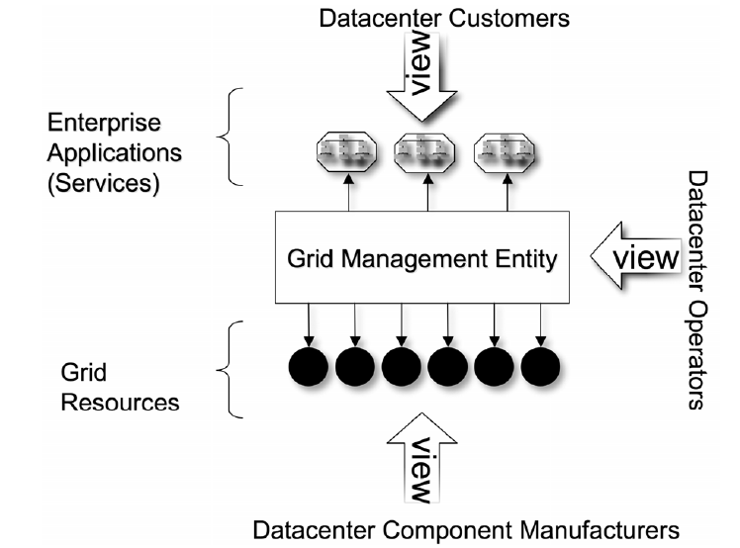
EGA Reference Model
Grid Component (GC)
  IT resources, Services, application
  Relationship graph
  Lifecycle Model
Grid Management Entity (GME)
  GME-GC mapping
  Functional breakdown

Slide 5
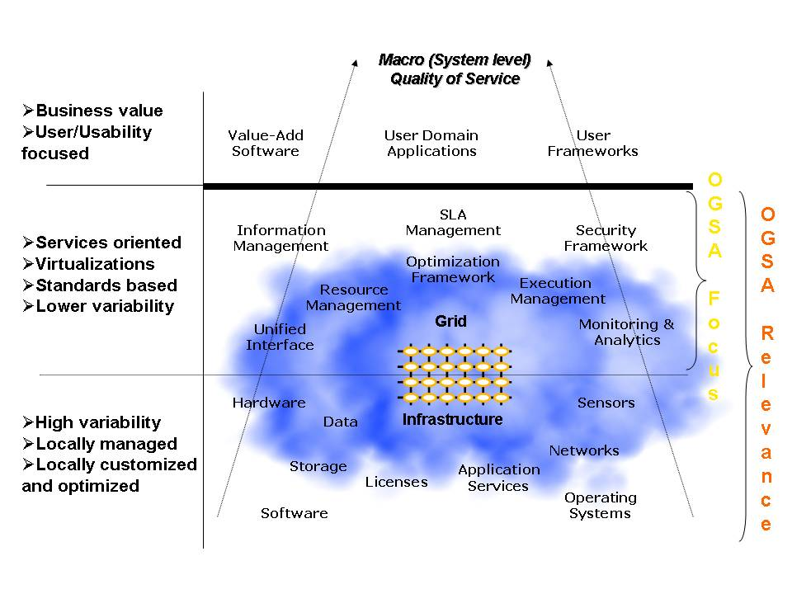
OGSA Conceptual View
GC
GME
GME?

Slide 6
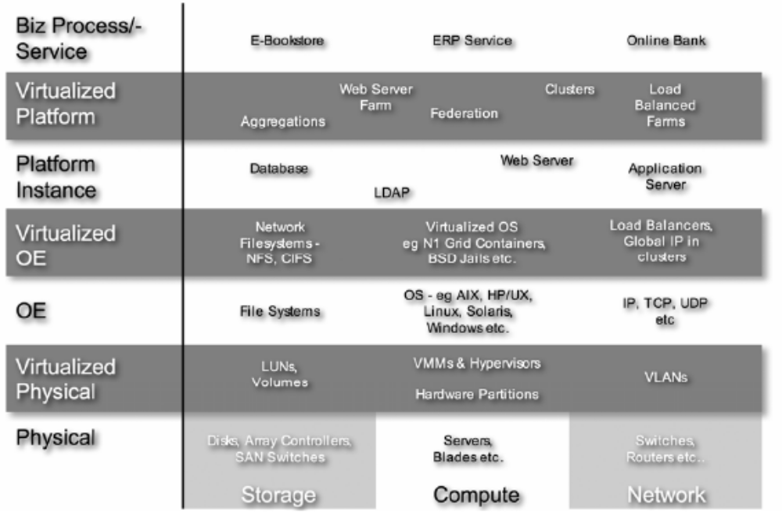
GC - Classes
Are EGA classes normative or just examples?
Should OGSA define these classes normatively?

Slide 7
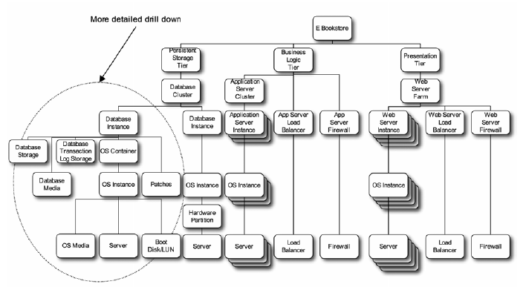
GC – Dependency Graph
CDL document can describe such graph
CDL spec only defines low level syntax

Slide 8
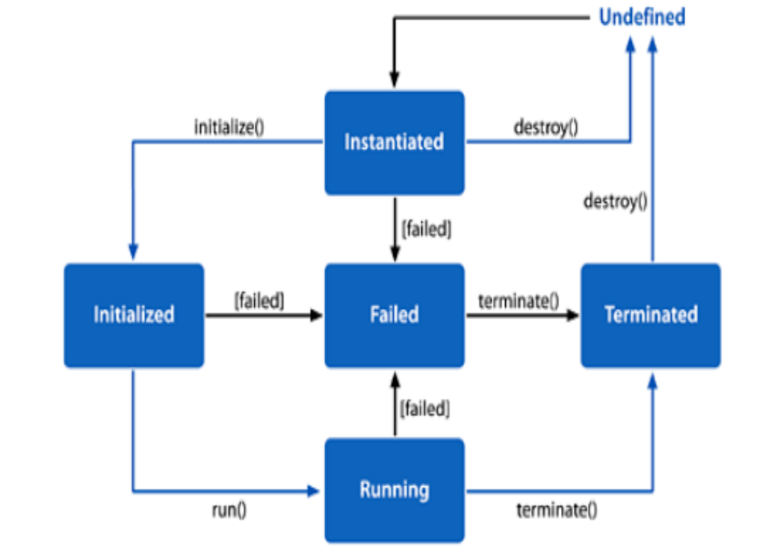
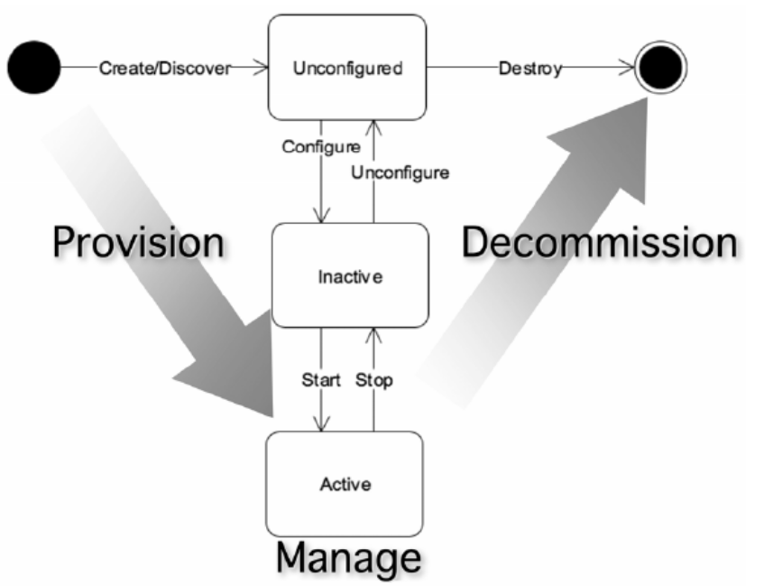
GC - Lifecycle Model
EGA GC
CDDLM component

Slide 9
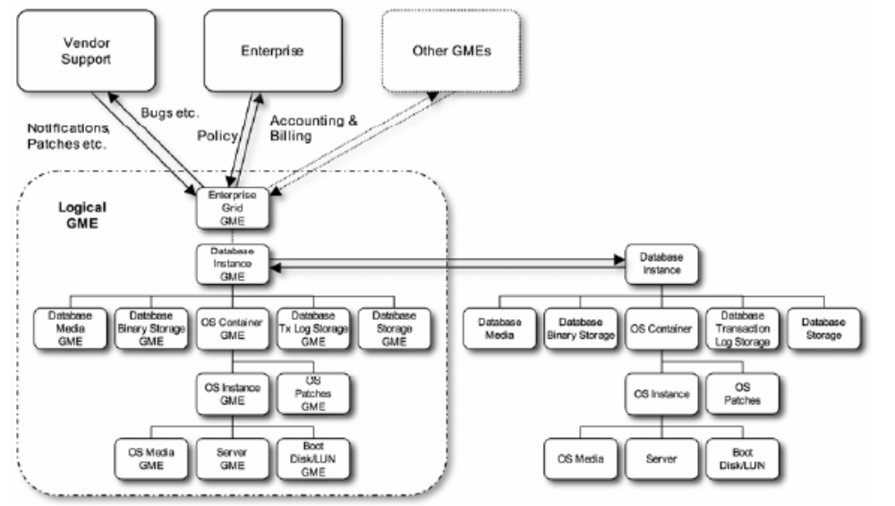
GME-GC mapping
OGSA lacks such mapping

Slide 10
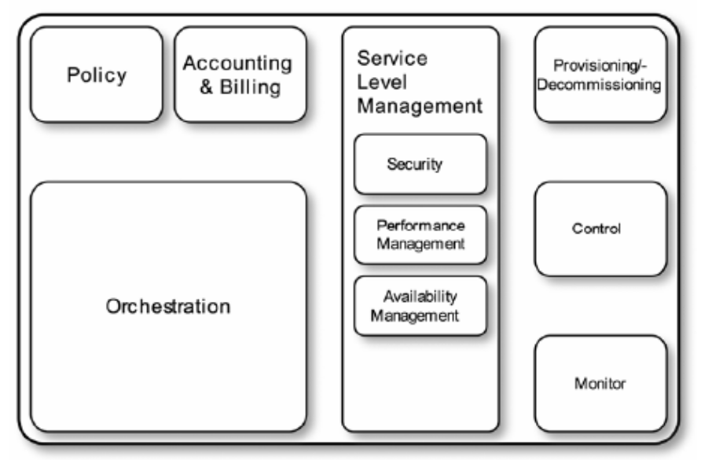
GME – Functional Breakdown
Execution Management
Job description & submission
Scheduling
Resource provisioning
Data Services
Common access facilities
Efficient & reliable transport
Replication services
Resource Management
Discovery
Monitoring
Control
OGSA
Self-Management
Self-configuration
Self-optimization
Self-healing
Information Services
Registry
Notification
Logging/auditing
Security
Cross-organizational users
Trust nobody
Authorized access only
OGSA “profiles”
Web services foundation
EGA GME
OGSA services

Slide 11
Full Copyright Notice
Copyright (C) Open Grid Forum (applicable years). All Rights Reserved.
This document and translations of it may be copied and furnished to others, and derivative works that comment on or otherwise explain it or assist in its implementation may be prepared, copied, published and distributed, in whole or in part, without restriction of any kind, provided that the above copyright notice and this paragraph are included on all such copies and derivative works.
The limited permissions granted above are perpetual and will not be revoked by the OGF or its successors or assignees.
Notes:
OGF Full Copyright Notice if necessary

