Slide 1
OGSA Data Design Team F2F, 15 July 2004
EGEE Architecture Input
(Data)
Gavin McCance
on behalf of
EGEE design team
http://cern.ch/egee-jra1
EGEE is a project funded by the European Union under contract IST-2003-508833

Slide 2
Outline
EGEE strategy
  Overall components
Data components
  Catalogs
  Storage
  Data management == “File replication”

Slide 3
High-level strategy for middleware
EGEE Middleware –
  To re-engineer generic middleware packages
  Incorporating experience from EDG, VDT, LCG, AliEn (product from CERN Alice experiment) and others
  Architected for scale and performance requirements of LCG and other applications
EGEE design team formed early to develop architecture
  Architecture: https://edms.cern.ch/document/476451
Fast prototyping approach
  Short update cycles to give applications the chance to influence and give feedback

Slide 4
Guiding principles
Lightweight (existing) services
  Easily and quickly deployable
  Re-use as much as possible
Interoperability
  Allow for multiple implementations
Resilience and Fault Tolerance
Service oriented approach
  Follow WSRF standardization
  No mature WSRF implementations exist to date, hence: start with plain WS – WSRF compliance is not an immediate goal
  Aim for WS-I compliance
Co-existence with deployed infrastructure
  Co-existence (and convergence) with existing grid infrastructures (e.g. LCG2) are essential for the EGEE Grid service
VDT
EDG
. . .
AliEn
LCG
. . .
EGEE

Slide 5
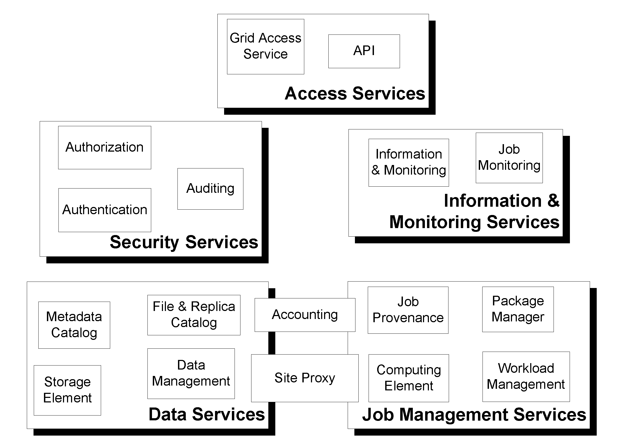
High-level functional decomposition
Starting point was the ARDA roadmap document
  Focus is upon interfaces that can be composed into useful services

Slide 6
EGEE Data functional interfaces
File Catalog
  Management of the logical namespace
Replica Catalog
  Tracking of file replicas
Metadata Catalog
  Application specific metadata
    In particular, metadata used to select logical files
Combined Catalog
  Added functionality by orchestration of the 3 catalogs (providing transaction safety)
Storage Element
  Where the files get stored
  SRM interface (see GGF GSM-WG)
    Manage a Storage Resource
    Space reservation
    Put and retrieve files using various protocols
  Posix-like File I/O
    Most posix-compliant feature support
    Abstraction over existing MSS IO mechanisms
Data Management:
File Transfer Service
  Reliable transfer of files between two sites
File Placement Service
  Transfer and register files
  Orchestrate File Transfer and Data Catalog services
Data Scheduling Service
  Event-based data transfer, using File Placement Service

Slide 7
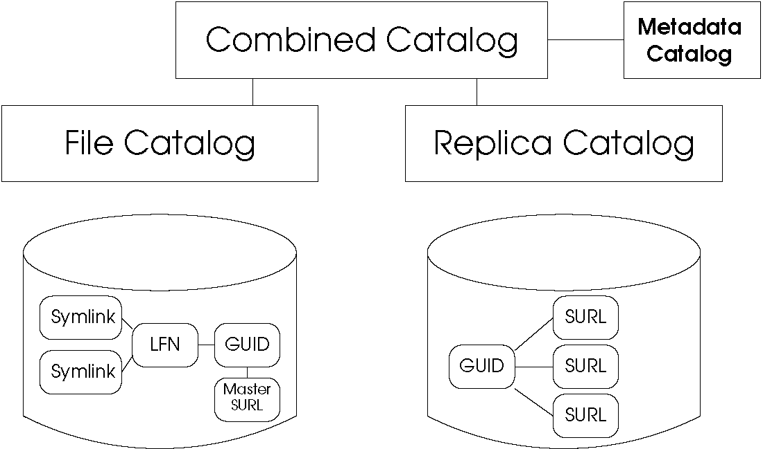
Catalog functions
As in EDG, the catalogs manage at the file level and per VO
Naming:
  Primary logical reference to a file [key] is the GUID [UUID], guaranteed
  unique and immutable. Used by the grid system to refer to files. Stat info and ACLs are on the GUID.
  Human-readable mutable hierarchical namespace [LFN] 0,1:1 LFN:GUID mapping
  LFN namespace supports
  symlinks (with Unix semantics)
  GUID maps to multiple
  SURLs (location dependent
  file identifiers)
  [GSM WG / SRM]

Slide 8
Catalog functions
File catalog interface handles the LFN:GUID mapping
Replica catalog interface handles the GUID:SURL mapping
Very common operation is add/query LFN←→SURL !
  Combined catalog interface
    Providing transaction safety
    Performance
  Most implementations will
  want to have a single
  catalog service exposing
  all 3 catalog interfaces (file,
  replica, combined).

Slide 9
Catalog functions
Why 3 distinct interfaces?
  Each interface has well-defined semantics
  Interoperability: allows alternative implementation of parts of the functionality by other vendors
    Although probably at the expense of performance c.f. a single catalog service implementation
  Comments on this approach?

Slide 10
Catalog functions - metadata
File-specific metadata functionality
  For metadata that have the GUID as one of their primary keys
  Query on application-specific metadata to select a set of GUIDs
    query( theQuery ) : GUID[ ]
  Permits e.g. virtual directories in the LFN namespace where the contents
  are described by a metadata query.
  Permits collection
  services where a versioned
  ‘data collection’ is defined as
  a set of snapshots of a given
  metadata query.
  Any existing application’s
  metadata catalog (that keys on
  logical files) can expose this
  interface to allow it to plumb
  onto this catalog system

Slide 11
Storage Element QoS issues
Two classes of storage element:
‘Strategic’ Storage Element
  High QoS
  Usually tied to an MSS
  Reliable, safe
    Place to keep important data
    SRM ‘permanent’ storage [GSM WG]
  Heavyweight – larger commitment
  from site
‘Tactical’ Storage Element
  Volatile, ‘lightweight’ space
    Easy to install and manage
    Allows a site without MSS to have managed space
      Plan to use for SRM ‘volatile’ space management [GSM WG]
      Local file cache management for job scratch space
  Best-effort QoS
strategic
QoS
tactical
Portability

Slide 12
Storage Functionality
Two access methods:
SRM interface
  File copying and replication
  File management and control
  Using SRM standards [GSM WG]
  (with possible evolution)
Posix-like file I/O
  Direct file access
  Open, read, write
Control
POSIXAPI
File I/O
SRM interface
User
rfio
dcap
chirp
aio
Castor
dCache
NeST
Disk

Slide 13
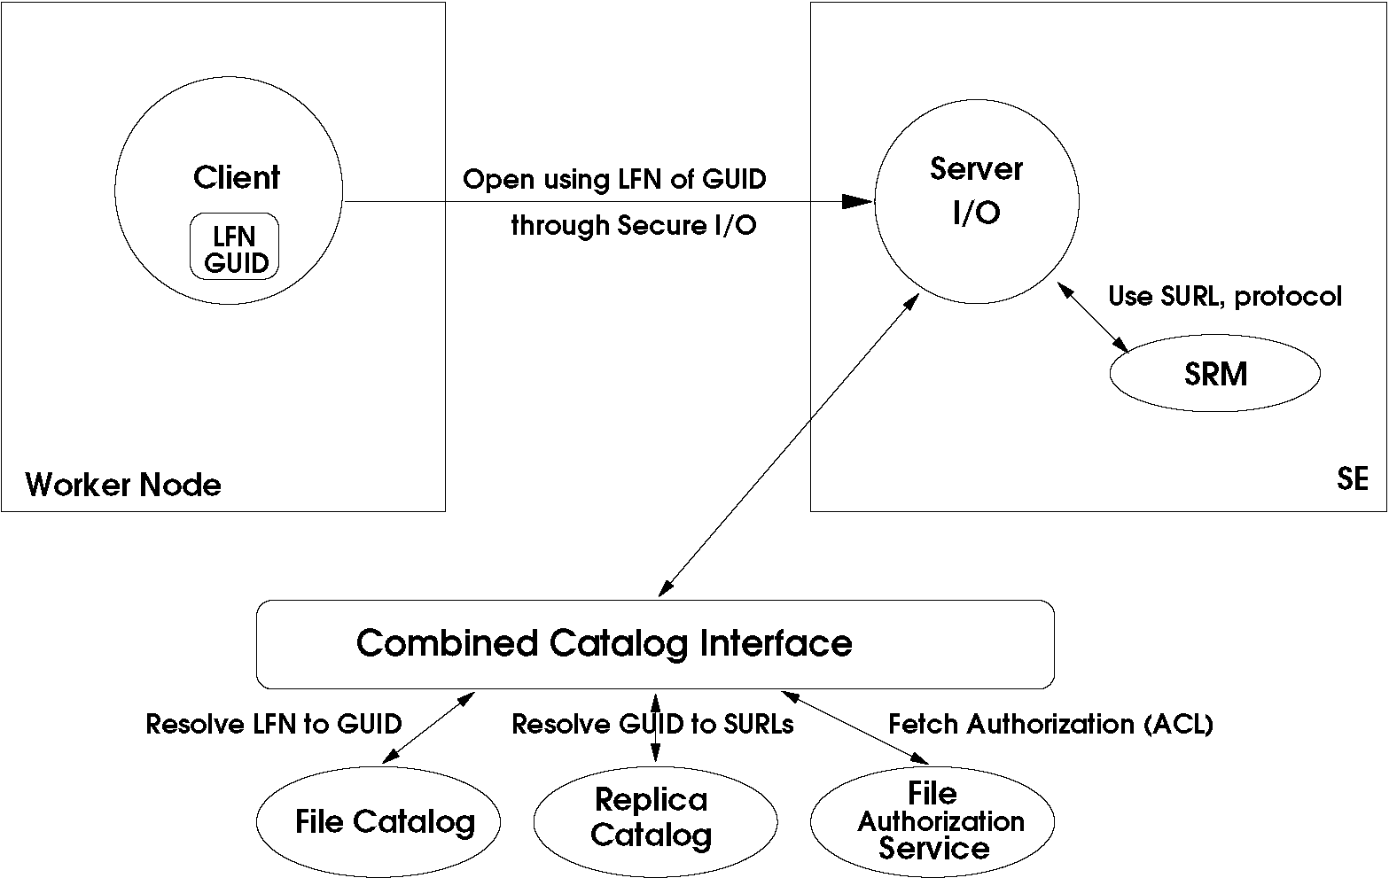
Posix with LFN or GUID
Posix file access – open(…) with LFN or GUID

Slide 14
Posix with LFN or GUID: example issue
Posix file access – open(…) with LFN or GUID
Security impacts on architecture…
Question of site (administrative) boundary w.r.t. catalogs
  The catalogs hold the (master) ACL for a logical GUID
  Are you happy to have the authorization decision made off-site?
Catalogs off-site
  Push master ACL down to
  SRM for local authorization
  (few of them support that!)
Catalogs on-site
  Authz made locally
  Suggests a particular catalog
  partitioning or distribution
  model since there is
  always a site-local catalog

Slide 15
Catalog topology
Catalog topology
  Partitioned or replicated
  catalogs:
  Better availability (limits
  network dependence)
  Consistency and
  scalability issues
    Acceptable latencies?
  Mastering strategies
    Multi-master?
    Collision handling

Slide 16
Posix with LFN or GUID
Posix file access – open with LFN or GUID
In case of LFN/GUID being non-local, it’s a policy:
  fail (assume somebody pre-staged or replicated all files)
  block and transfer locally using “data management” tools
  try to proxy a WAN remote I/O through the SE
  All should be supported by the middleware, but only the application knows what it wants
  Requirement:
  We assume no external
  network connectivity for the
  Worker Node.

Slide 17
Data management (file replication)
We want a user, VO admin or the workload management system to be able to schedule file replication from one site to another
The system must:
  Reliably deliver the files
    Handle failures
  Update replica catalogs in the transaction
  Control file transfers according to a site’s network bandwidth
  Queue file transfers according the site’s and VO’s policies

Slide 18
File Transfer Service
File Transfer service per site
  Reliably moves files (in pull mode) from there to here
  Maintains persistent queue of pending file transfers
    Enforces the site policy on transfer queues, and then the VO policy.
  Communicates with local and remote SRM to arrange file staging (and potentially local space allocation)
  Communicates with catalogs to determine ACL permissions
  Communicates with network monitoring to learn about the site’s bandwidth usage and enforce the site’s network policies

Slide 19
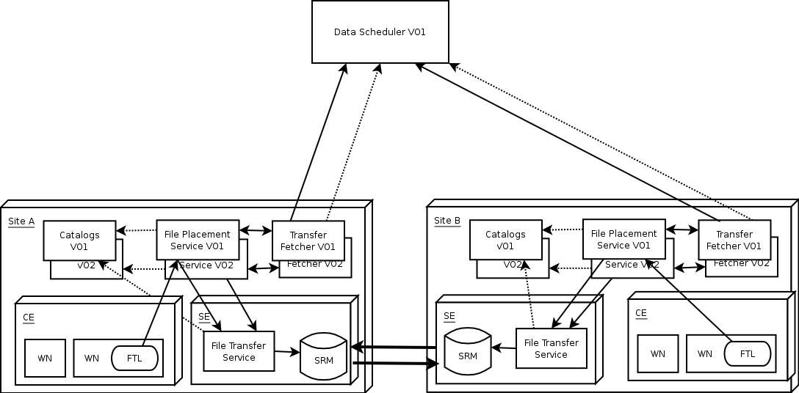
Data management (file replication)
Current model:
Scheduled data transfers
(like jobs)
SRM based storage
Reliable file transfer
dotted line = query
full line = request
single box = service per site
double box = service per VO

