Slide 1
Performance Update
Eric L. Boyd
Director of Performance Architecture and Technologies
Internet2

Slide 2
Vision: Performance Information is …
Available
  People can find it (Discovery)
  “Community of trust” allows access across administrative domain boundaries (AA)
Ubiquitous
  Widely deployed (Paths of interest covered)
  Reliable (Consistently configured correctly)
Valuable
  Actionable (Analysis suggests course of action)
  Automatable (Applications act on data)

Slide 3
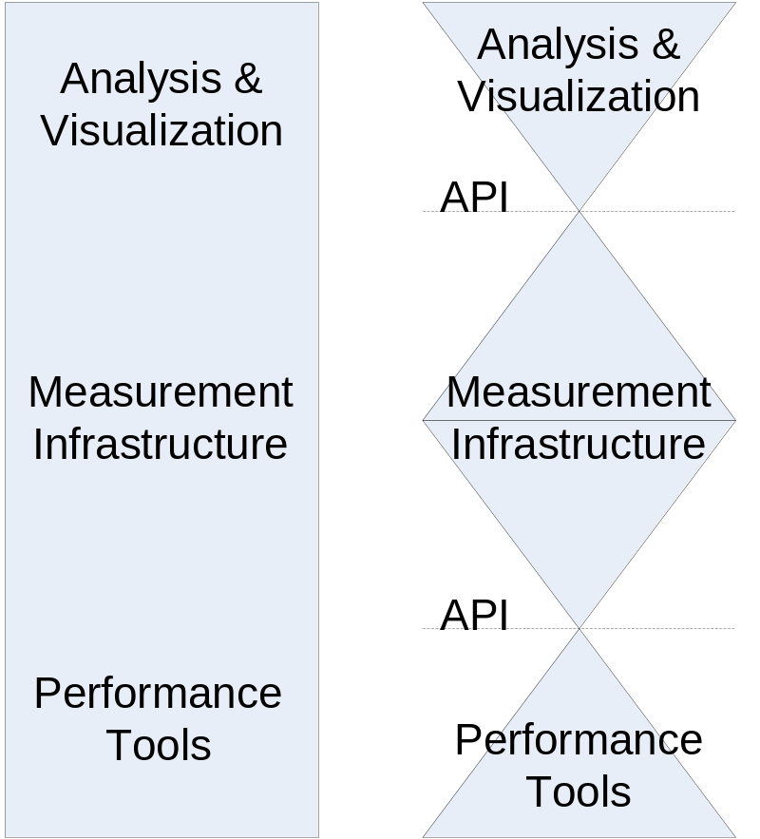
Getting There: Build & Empower the Community
Decouple the Problem Space:
Analysis and Visualization
Performance Data Sharing
Performance Data Generation
Grow the Footprint:
Clean APIs and protocols between each layer
Widespread deployment of measurement infrastructure
Widespread deployment of common performance measurement tools
Notes:
This is our ‘strategic’ look at the problem

Slide 4
Result: No more mystery …
Increase network awareness
  Set user expectations accurately
Reduce diagnostic costs
  Performance problems noticed early
  Performance problems addressed efficiently
  Network engineers can see & act outside their turf
Transform application design
  Incorporate network intuition into application behavior

Slide 5
Immediate Game-plan
Internet2 is leveraged to help provide diagnostic information for “backbone” portion of problem
  Create *some* diagnostic tools
  Make Abilene data as public as is reasonable
Work on efforts to more widely make performance data available (perfSONAR)
  Contribute to ‘base’ development
  Integrate ‘our’ diagnostic tools as ‘good’ example MP/MA services

Slide 6
Thrulay Overview
Network capacity and delay tester
Same class of tools as iperf, netperf, nettest, nuttcp, ttcp, etc.
Unique features not found in other tools:
  TCP: measures round-trip delay along with goodput
  UDP: measures:
    One-way delay, with quantiles
    Packet loss
    Packet duplication
    Reordering
  UDP: ability to send precisely positioned true Poisson streams (microsecond errors in sending times)
  Human and machine-readable (ready to be fed to gnuplot)

Slide 7
BWCTL (Bandwidth Controller)
What is it?
  A resource allocation and scheduling daemon for arbitration of throughput tests
    Iperf (current, NLANR/DAST)
Typical Solution
  Run “iperf” or similar tool on two endpoints and hosts on intermediate paths
Typical road blocks
  Need permissions on all systems involved
  Need to coordinate testing with others
  Need to run software on both sides with specified test parameters
New ‘testers’ supported soon
  Thrulay (Internet2)
  Nuttcp (Naval Research Lab)

Slide 8
OWAMP: One-Way Active Measurement Protocol
What is it?
  Measures one-way latency: 1-way ping
  Control connection used to broker test request based upon policy restrictions and available resources. (Bandwidth/disk limits)
Specification
  http://tools.ietf.org/wg/ippm/draft-ietf-ippm-owdp/draft-ietf-ippm-owdp-14.txt
  IETF formal specification due out soon
  IANA port assigned
  Version of OWAMP implementation updated to formal specification soon

Slide 9
NDT: Network Diagnostic Tool
Web100 enhanced server handles testing and diagnostic services
Java based and command line clients allows testing from any client (local or remote)
Performance and configuration faults reported back to client
Drill-down functions provide more details & error reporting capabilities
Grant from NIH/NLM to explore duplex mismatch detection

Slide 10
Everything we work on is available
Tools are open source, supported, well-documented
BWCTL/Iperf, OWAMP, NDT are deployed across Abilene backbone and at many partners
You can:
  See ongoing measurement results at the Abilene Observatory (http://abilene.internet2.edu/observatory)
  Test to/from the Abilene backbone

Slide 11
Network Performance Measurement Workshops
  Example Course Materials:
    http://e2epi.internet2.edu/npw/presentations.html
Goals:
  Grow installed base of BWCTL/Iperf, OWAMP, and NDT at GigaPoP and regional campuses.
    http://e2epi.internet2.edu/pipes/pmp/pmp-dir.html
  Begin integration into IT support processes.
  Create an installed base for perfSONAR deployment.
  Give each participant tool-specific cookbooks.

Slide 12
perfSONAR Overview
PerfSONAR is performance middleware
  Modular
  Web services-based
  Decentralized
  Locally controlled
Integrates:
  Network measurement tools
  Network measurement archives
  Discovery
  Authentication and authorization
  Data manipulation
  Resource protection
  Topology

Slide 13
perfSONAR Credits
perfSONAR is a joint effort:
  ESnet
  Fermilab
  GÉANT2 JRA1
  Internet2
  RNP
Internet2 includes:
  University of Delaware
  Georgia Tech
  Internet2 staff
GÉANT2 JRA1 includes:
  Arnes
  Belnet
  Carnet
  Cesnet
  DANTE
  DFN
  FCCN
  GRNet
  GARR
  ISTF
  PSNC
  Nordunet (Uninett)
  Renater
  RedIRIS
  Surfnet
  SWITCH

Slide 14
perfSONAR: Project Activity Meter
Interactions
  1-2 conf calls/week
  1 new service/month (accelerating)
  3-4 development workshops/year
  3-4 paper submissions/year
Recruitment
  RNP and GaTech have joined the effort
  Outreach to LHC community

Slide 15
perfSONAR: Services (1)
Measurement Point Service
  Enables the initiation of performance tests
Measurement Archive Service
  Stores performance monitoring results
Lookup Service
  Allows the client to discover the existing services and other LS services.
  Dynamic: services registration themselves to the LS and mention their capabilities, they can also leave or be removed if a service gets down.
Authentication Service
  Internet2 MAT, GN2-JRA5
  Authentication functionality for the framework
  Users can have several roles, the authorisation is done based on the user role.
  Trust relationship between networks
Notes:
The services register themselves to the LS and mention their capabilities. They can also leave or be removed from a LS if a service gets down (keepalives).

Slide 16
perfSONAR Services (2)
Transformation Service
  Transform the data (aggregation, concatenation, correlation, translation, etc).
Topology Service
  Make the network topology information available to the framework.
  Find the closest MP, provide topology information for visualisation tools
Resource protector
  Arbitrate the consumption of limited resources.

Slide 17
Types of perfSONAR Services
Core Services
  Set released by perfSONAR Team
    e.g. LS, AA, 3 MPs, 2 MAs, RP, Tos, TS
  Tested for interoperability
  Serve as examples for affiliated developers
  Targeted at next generation network needs (e.g. GÉANT2, Internet2 New Network, etc.)
Affiliated Services
  Released by perfSONAR partners, lag Core
  May share development infrastructure (Bugzilla, Website, Mailing Lists)
  Candidates for migration to Core Services
Unaffiliated Services

Slide 18
perfSONAR: Core Status Update
V1.0 perfSONAR core released
Core services include:
  Single domain LS solution
  RRD MA
Affiliate services and client applications supporting this version will soon follow:
  BWCTL MP (DFN)
  perfSONAR UI (ISTF)
Ongoing work
  AA Design (Internet2 – Middleware & Performance, G2 JRA1, G2 JRA5)
  Multi-LS (PSNC, RNP, UDel)
  ToS (DFN, UDel)

Slide 19
perfSONAR Process Status Update
We have processes … ;-)
Release management process implemented (Internet2, RedIRIS, UDel)
Bugzilla up and running (Internet2, UDel)
Migrated from CVS to SVN (Internet2)
Functional testing under construction (Greece)
Monitoring deployed services (ISTF)
Installation process eased significantly (DANTE, PSNC, UDel)
www.perfsonar.net under development (Internet2, Renater)
  Development information will stay on the Wiki
  Adopter information will migrate to website

Slide 20
perfSONAR: Affiliate Status Update
Upcoming Core Services
  Command Line Interface MP (Ping, OWAMP, Traceroute) (RNP)
  L2-specific MA (DANTE)
  SQL MA (PSNC)
Affiliated Services
  BWCTL MP (DFN, released)
  SSH MP (Looking Glass) (Belnet, released)
  ABW MP (bandwidth packet capture cards) (Cesnet)
  NMS MP (SDH status) (DANTE)
  Hades MA (OWD, Jitter, OWPL) (DFN)
  Flow Replicator MA (Surfnet, Carnet)
  NeTraMet / SNMP MA (RNP)
User Interfaces
  CNM (DFN)
  perfSONAR UI (ISTF)
  Visual PerfSONAR (Carnet)
  Looking Glass (Belnet)
  ICE (RNP)

Slide 21
RRD MA features
Wrapper around RRD.
Request/reply interface.
Write into RRD.
LS registration.
Installation scripts.
Test configuration files available.
Notes:
Test configuration file – to allow a NREN to test the service alone before installing it.

Slide 22
Lookup Service Features
Centralized LS (Creating a distributed LS is ongoing development)
Service Registration (including updates) functionality
Service deregistration functionality
Lookup/query functionality (XQuery/XPath)
Services keep-alives
  including database cleanup, scheduled functionality
Registration component for a service available.
Configuration scripts
  Input: cricket config (other rrd tools coming)
  Output: automatically generated perfSONAR config

Slide 23
perfSONAR Deployments
Prototype
  Abilene
  ESnet
  GÉANT
  Various European NRENs
  RNP
Planned
  RedCLARA
  Inca / TeraGrid
US Rollout
  Build on Network Performance Workshops
  perfSONAR Workshops in ’07
  Target application communities (LHC)
  Target regional networks and universities

Slide 24
PerfSONAR Next steps
Upgrade existing user base (currently using prototype)
Data exchange policy (measurement peering agreement)
Consistent offering of services.
  What services package to suggest to networks.
L2 status monitoring.

Slide 25


