Slide 1
ESnet Issues for Firewall IG BoF
Michael Helm
helm@es.net
ATF project ESnet/LBNL
14 March 2005

Slide 2
Three Snapshots
Fusion Grid Use Case
  Re-run of use case shown at GGF-12 OpSec workshop
  Multiple sites with independent infra
Host-based Firewall
  Alternative to proprietary services?
OSCARS
  MPLS VPN’s: Firewall alternative?

Slide 3
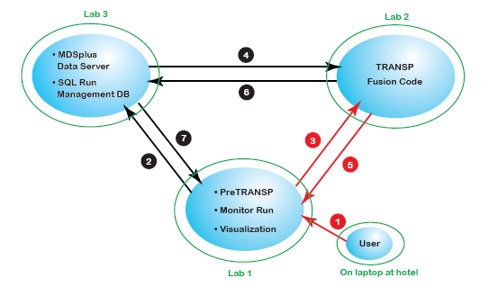
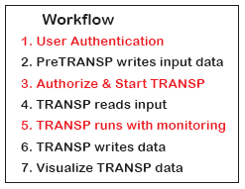
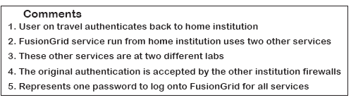
FusionGrid Use Case
Firewall: Each site has unique firewall

Slide 4
Fusion Grid Comments
Each site is protected by a firewall
Different firewall technology
OTP is probably a feature
Need single sign-on, delegation, autonomous processes….

Slide 5
Fusion Grid Conclusion
Use case comes from Dave Schissel, GA
Evolved from discussion of OTP
  2 of 3 labs in FusionGrid already have an RSA SecurID infrastructure, another complication
Need direct support
  Currently, ad hoc solutions, personal interactions with firewall managers (like old fashioned telephone operator), and clumsy interactions with provisioning solutions (CISCO ACS)
Need to identify path to solution: dynamic provisioning?

Slide 6
PNNL Network Enclaves

Slide 7
PNNL Network Enclaves
Pacific Northwest National Laboratory
  US DOE National Lab
Complex laboratory – multiple missions
“Enclaves”: tailor cybersecurity to specific needs of these missions
EMSL Enclave – Environment Molecular Sciences Laboratory
Enclave design goals
  Scale to support multiple enclaves
  Avoid replication of services
  Every enclave should have critical resources needed to operate
  Backup and shared services in a common area
  Provide mechanisms for secure access to applications between enclaves

Slide 8
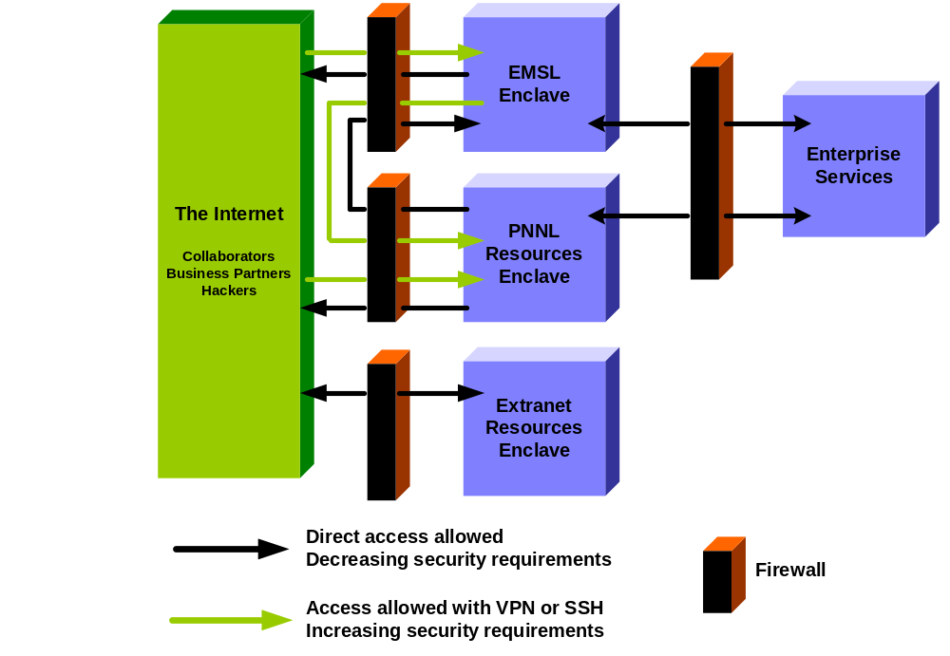
PNNL Enclave Diagram
Notes:
This diagram nicely illustrates how our enclaves are configured. Not listed here is the new Collaboration Enclave that we will see on the next slide. The idea is to separate the enclaves while providing access to standard resources including authentication such as Kerberos, ACE, Active Directory, email and printing. The list of services that live in the Enterprise enclave changes as the needs arise. For example, email services were at one time only in the PNNL enclave and if you were in the EMSL enclave, you needed to use VPN to access the PNNL enclave and get your email. We now have an email server in the Enterprise enclave to which you can securely connect to from the EMSL enclave.
In all cases, you’ll will not the firewall complex on the left side of the diagram. This is our current choke point for bandwidth

Slide 9

PNNL Collaboration Network Enclave
Collaboration
Enclave
I
n
t
e
r
n
e
t
I
n
t
e
r
n
e
t
2
E
S
N
E
T
PNWGP
e
t
t
l
E
x
P
N
N
L
t
r
a
n
e
t
Enterprise
Services
M
S
C
F
R
a
d
i
o
l
a
n
P
N
N
L
E
M
S
L
Notes:
The traditional approach to network security has been to put a firewall at the network perimeter or an organization boundary. In our case both at the perimeter and “Enclave” level.
Network bandwidth and the ability of firewalls to keep up with the bandwidth are continually leapfrogging each other. Just when firewall technology can keep up to line speeds, the line speed increases.
The firewall becomes a bottleneck….like an four lane freeway under construction were two lanes are close for a few miles. The traffic it moving along just fine until the construction choke point, then everything slows down, once passed everything speeds up again.
Can we move from various perimeter based firewall approach to a host based firewall approach?
Will this result in a bandwidth increase? Can we maintain security in such a configuration?
The main firewall complex at PNNL is based on Linux machines running iptables. We’re using the same technology on the host based firewalls. The advantage we gain is that we don’t have to forward traffic between two interfaces on a single host. This is where our central firewall complex becomes the choke point. When you have to forward traffic from one interface to another, you take a big performance hit.

Slide 10
PNNL Collaboration Network Enclave
Layered Security Components
Host-based security
  Host-based firewall (iptables) – controlled by PNNL Firewall team
  Intrusion Prevention System (PSAD)
  File integrity checking (Tripwire)
Configuration Control/Auditing
  Centralized configuration control (cfengine and Redhat Satellite)
  Active vulnerability scanning (Nessus)
  Centralized system logging (Syslog)
  Center for Internet Security (CIS) benchmarks
  Big Brother
Notes:
Having just a firewall on a machine is not a complete answer to security. You need to be able to do some type of intrusion detection and prevention. On the host machines, we will use PSAD to detect port scans/attacks. PSAD can then insert rules into the iptables firewall rules to drop connections from the host doing the scan. While the main firewall rule set is under the control of the PNNL firewall team, we will allow PSAD to insert more DROP rules as it deems necessary. The idea being that is better to err on the conservative side.
Tripwire: Check for any files changed on a machine and send alerts if things have changed
Cfengine: We currently use cfengine to maintain various configuration files on Linux machines that we manage. Cfengine also acts as a compliment to tripwire. If configuration files are changed, either cfengine or tripwire will notify us of these changes
BigBrother: Our standard process monitoring tool. Used to monitor a number of things including network connectivity, service processes, file system health.
CIS benchmark: Another layer. Run the benchmark daily to make sure that the system is configured as expected.
Redhat Satellite service: Remote management of software stack on machine. Machines run “up2date” on a daily basis.

Slide 11
PNNL Enclave Conclusion
Principal Investigators
  John McCoy (Program Director)
  Shaun O’Leary (Team Lead)
  Tim Carlson (tim@pnl.gov) (UNIX systems manager)
Important points:
  Firewalls are a regulatory issue in DOE Labs
    We must meet regulatory provisions as well as real needs
  Similar program in place at LANL
  Host – based tools
  Open source or “widely available” tools
  Component – based architecture
  Firewall Grid service?

Slide 12
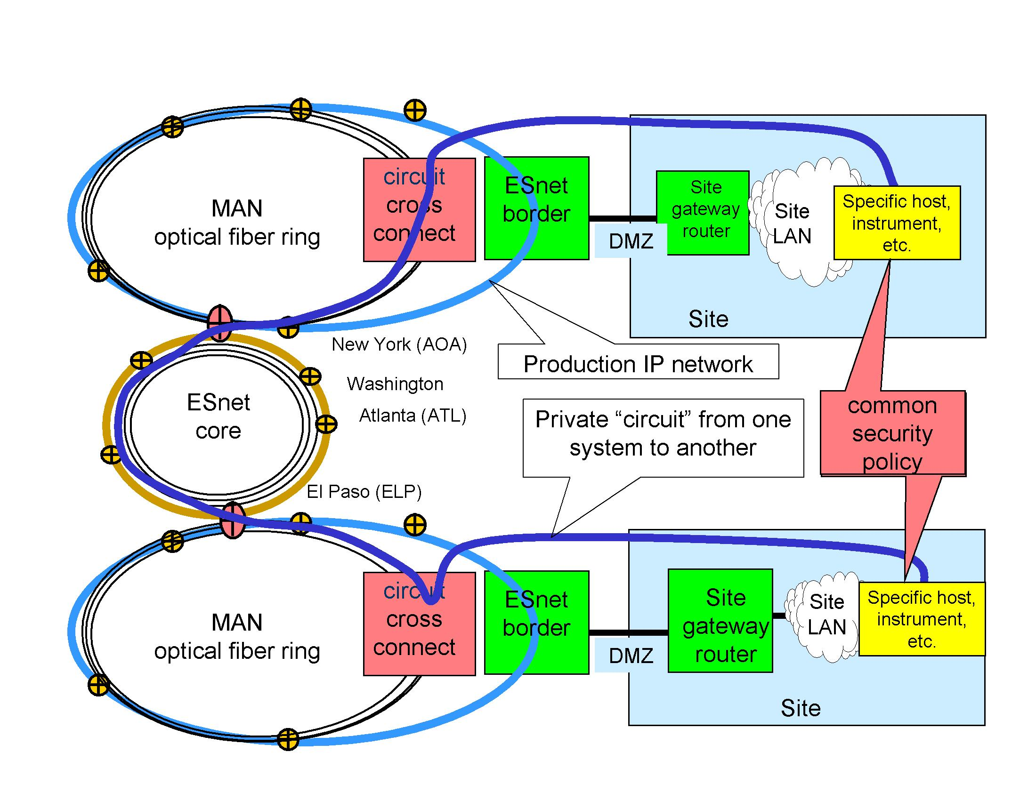
Dynamic Provisioning of Private End-To-End Circuits
The Dream: The circuits are secure and end-to-end, so if the sites trust each other, and if they have compatible security policies, they should be able to establish direct connections by going around site firewalls to connect specific systems. (emph: mwh)

Slide 13
Dynamic Provisioning of Private End-To-End Circuits
Domain of
OSCARS
Project
The current state of the art: ESnet OSCARS project: Quality of Service for “Labeled Switched Paths” (MPLS): Interior of ESnet; similar projects underway in I2 and elsewhere.

Slide 14
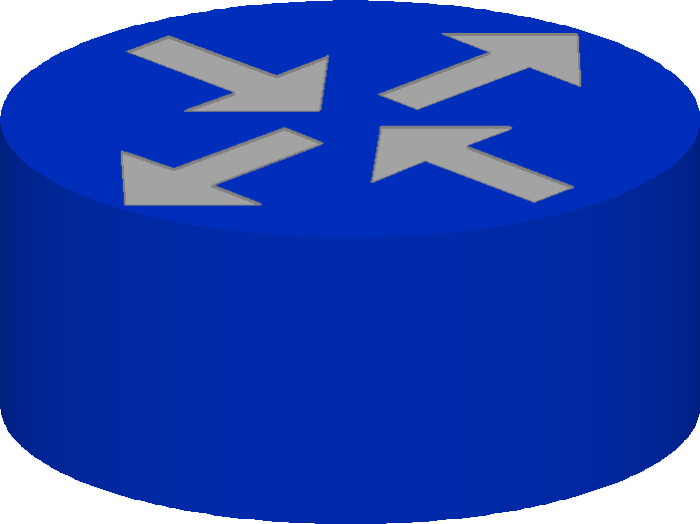
OSCARS Implementation
ESnet On-Demand Secure Circuits and Advance Reservation System
LSP between ESnet border routers
Source
Sink
RSVP, MPLS
enabled on
internal interfaces
MPLS labels are attached onto packets from Source and
placed in separate queue to ensure guaranteed bandwidth.
Interface queues
Regular production traffic queue.
Multi-Protocol Label Switching (MPLS) and Resource Reservation Protocol (RSVP) is used to create a Label Switched Path (LSP)
Quality-of-Service (QoS) level is assign to the LSP to guarantee bandwidth.
LSPs are bounded within the ESnet domain.

Slide 15
OSCARS Project
OSCARS project references
  Principal Investigator: Chin Guok, ESnet: chin@es.net
  http://www.es.net/oscars
Some related comments…
David Farmer, U of Minn (farmer@umn.edu)h
  Adopt similar architecture inside campus? – I2 Joint Techs presentation: “Gopher GigaNet - A Next Generation Campus Network”
  http://www.internet2.edu/presentations/jtsaltlake/20050214-Gopher-Farmer.ppt
  5000 virtual firewalls on U of M campus
  “Firewall off” VO services – issues with integration into/conflict with these WAN circuits (private comm)
Conclusion:
  Sites drawn into this discussion to maintain security?
  Firewalls outdated?

