Slide 1
T-Infrastructure in EGEE and ICEAGE
Gergely Sipos
EGEE NA3 deputy manager & ICEAGE NA4 participant
MTA SZTAKI
Hungarian Academy of Sciences
Credits to Roberto Barbera for many of these slides…

Slide 2
t-Infrastructure concepts
“Definition: t-Infrastructure is support for the teaching mission in ICEAGE (grid schools, one-day courses, one-semester courses).
Course audiences can vary from system administrators through application users to application developers.” [D1.F1, p. 11].
Technology independent, summer schools
EGEE t-Infrastructure covers any specific support infrastructure required by training, for example infrastructures which mimic the production infrastructure to allow realistic hands-on training although with simplified certification, flexibility in software configuration, a protected environment to allow for errors, etc.
gLite specific, induction courses; app. developer courses, system admin courses, summer schools

Slide 3
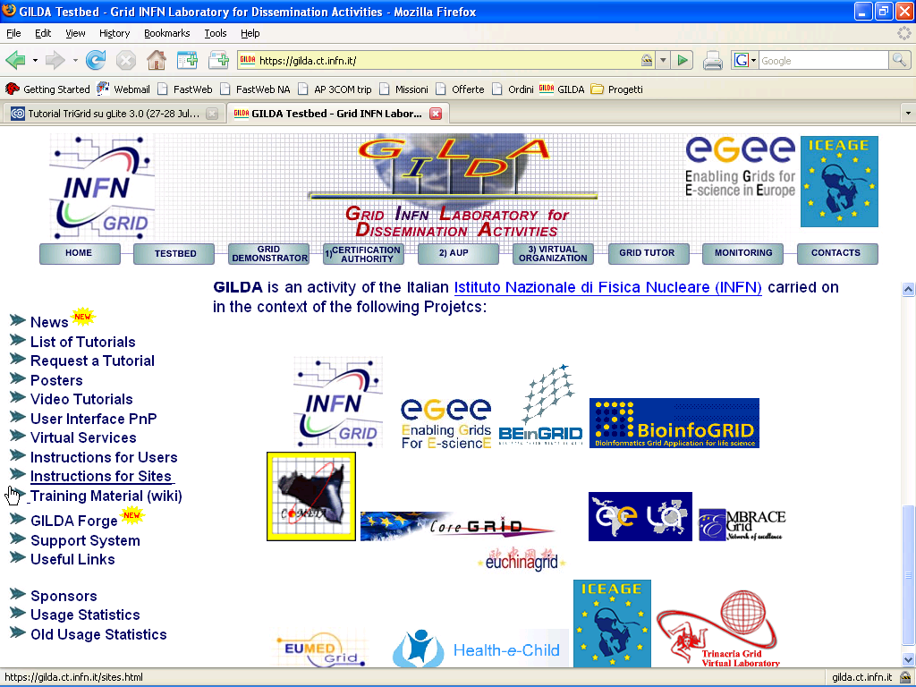
GILDA…and the Projects using it
GILDA is really serving EU FP6 grid projects.

Slide 4
What is coming
ICEAGE:
Multiple middleware versions on GILDA
  gLite
  Globus Toolkit 4
  OMII
Integrated monitoring, booking and ticket management systems
“Cloneable” t-Infrastructure solution: t-Infrastructure at universities, companies, …
EGEE:
T-infrastructure is a separate work package in EGEE-III (SA4)
Stronger links between EGEE and business → training with third party tools
Application porting support in NA4 → GILDA for training, a new VO for application prototyping

Slide 5





Middleware co-existence
....
gLite Resource Broker
glite-rb3.ct.infn.it
iceage-ce-01.ct.infn.it
GT 2.4 GRAM
GT 2.4 GRAM
GT 4.0 GRAM
GT 4.0 GRAM
OMII Integrated
Services
OMII Integrated
Services
PBS(Torque + MAUI)
User Interface
bonnie.trigrid.it
Notes:
An important study on different middleware coexistence has been done, and it has led to a prototype “super-infrastructure” where three middleware shares both client machine and computing farm. The “super user interface” : has got clients for the three middlewares and it’s able to send jobs to the machine iceage-ce-01, where have been installed the three middlewares interface standing over a single local resource manager.

Slide 6
Discussion

