Slide 1
EUGridPMA
CAOPS-WG and IGTF Issues
March 2013
Charlottesville, VA, USA
David Groep, Nikhef, EUGridPMA, and EGI

Slide 2
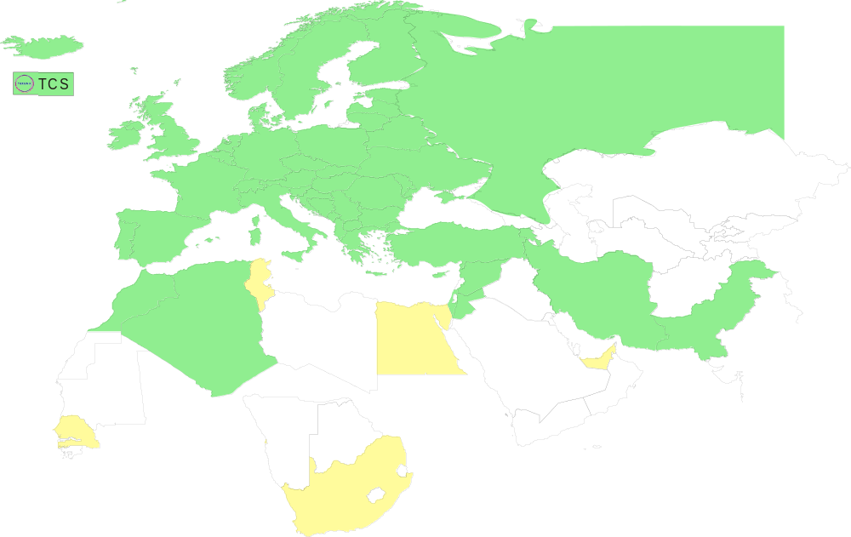
Geographical coverage of the EUGridPMA
25 of 27 EU member states (all except LU, MT)
+ AM, CH, DZ, HR, IL, IR, IS, JO, MA, MD, ME, MK, NO, PK, RO,
RS, RU, SY, TR, UA, CERN (int), DoEGrids(US)* + TCS (EU)
Pending or in progress
ZA, SN, TN, EG, AE

Slide 3
Rome meeting results and issues
https://www.eugridpma.org/meetings/2013-01/
SHA-2 time line (sunset date is now October 2014)
CA readiness for SHA-2 and 2048+ bit keys
OCSP support
MICS Profile and Kantara LoA-2
Towards an LoA 1.x "light-weight" AP
Security Token Service profile
Private Key Protection Guidelines
IGTF Test Suite
On on-line CAs and FIPS 140-2 level3 HSMs
Public Relations
IPv6 readiness
Risk Assessment Team

Slide 4
SHA-2 readiness
For SHA-2 there are still a few CAs not ready:
a few can do either SHA-2 OR SHA-1 but not both
  so they need to wait for software to be SHA-2-ready
  and then change everything at once
A select few can do SHA-2 but their time line is not driven solely by us (i.e. the commercials).
  Their time line is driven by the largest customer base
  All can so SHA-2 (since non-grid customers do request SHA-2-only PKIs)
  it is because of these that RPs have to be ready, because when directives come from CABforum they will change, and do it irrespective of our time table!
It should be kept in mind that old Alladin eTokens (32k) do not support SHA-2.

Slide 5
End of MD5
Some software stacks (NSS 3.14+, in RHEL6.4) are now disabling MD5!
Will create a nice mess, with several large CA roots still MD5

Slide 6
OCSP support
Two documents to guide its introduction
profile and guidance of RFC5019 light-weight OCSP for CAs
  CAs already deploying full RFC 2560 are not the audience
  https://wiki.eugridpma.org/Main/OCSPProfileForIGTFCAs
'best practices' guide for RPs and their software developers in using OCSP information
  https://wiki.eugridpma.org/Main/OCSPDeploymentGuidelines
Trade-off between pre-computation or on-demand signing depends on number of certs issues and number of requests (choice it not trivial ;-)

Slide 7
MICS and Kantara LoA2
"A primary authentication system that complies with the Kantara Identity Assurance Accreditation and Approval Program at at least assurance level 2 as defined in the Kantara IAF-1400-Service Assessment Criteria qualifies as adequate for the identity vetting requirements of this Authentication Profile.“
This clarifies the "should" mentioned several times in the second line of paragraph 3.1, as we have now interpreted it several times in this particular way (TCS eScience Personal, CILogon Silver).

Slide 8
PKP Guidelines v1.2
New text is now available at
  https://wiki.eugridpma.org/Main/PrivateKeyProtectionLifeCycle
  https://wiki.eugridpma.org/Main/PrivateKeyProtectionRevised
structure is different, but the currently allowed use cases are covered by the new text
companion document on how to secure key stores (be they run by NGIs, CAs, home organisations, or anyone) should also be written.
We expect the key stores to be run securely!

Slide 9
IGTF Test Suite
Actions decided
each CA to send a URL to or a sample of end-entity certs, at least personal cert and server cert, and depending on the CA also a robot cert and/or a 'service' ("blah/") cert
each CA to indicate some edge cases for their CA (use of colons, dashes, weird characters) and parameter space of the subject naming
known troublesome certs should be included
developed on the Wiki
  https://wiki.eugridpma.org/Main/IGTFTestSuite
  now has some samples and conditions

Slide 10
HSMs at level 3 for on-line CAs
“Inspired by the idea of NIIF for buidling an on-line CA based on a low-power Raspberry Pi and a level-3 HSM in USB format, a discussion emerged on whether it is possible to have enough compensatory controls around a level-2 HSM to make the risk comparable to the current off-line CA or level-3. It is not entirely clear which elements of level-3 improve the risk resilience when compared to an off-line classic CA.”
We think it is worthwhile doing the risk analysis compared to the off-line classic CA, and if the risk is comparable allow the use of L2 HSM or eTokens in conjunction with compensatory controls like a safe. We propose to discuss this with the TAGPMA and APGridPMA and have a discussion at the IGTF All Hands in La Plata (October 2013).

Slide 11
PR!
For the world at large our work and progress are not necessarily clear. The article in ResearchMedia is not enough. In particular the wider scope and new direction should be emphasized.
Papers (academic and PR) are encouraged so that we more clearly demonstrate usefulness and relevance -- and thus may get fewer questions on this issue!

Slide 12
IGTF RAT
Ursula will be coordinating the communications challenges to the CAs and the internal (encrypted) mailing list

Slide 13
Live AP
Dedicated discussion!

Slide 14
Agenda
28th PMA meeting
Kyiv, UA, 13-15 May 2013
29th PMA meeting
Bucharest, RO, 9-11 Sept 2013

