Slide 1
FermiGrid, OSG and GIN
Keith Chadwick
Fermilab
Work supported by the U.S. Department of Energy under contract No. DE-AC02-07CH11359.

Slide 2
Personnel
Eileen Berman, Fermilab, Batavia, IL 60510 berman@fnal.gov
Philippe Canal, Fermilab, Batavia, IL 60510 pcanal@fnal.gov
Keith Chadwick, Fermilab, Batavia, IL 60510 chadwick@fnal.gov *
David Dykstra, Fermilab, Batavia, IL 60510 dwd@fnal.gov
Ted Hesselroth, Fermilab, Batavia, IL, 60510 tdh@fnal.gov
Gabriele Garzoglio, Fermilab, Batavia, IL 60510 garzogli@fnal.gov
Chris Green, Fermilab, Batavia, IL 60510 greenc@fnal.gov
Tanya Levshina, Fermilab, Batavia, IL 60510 tlevshin@fnal.gov
Don Petravick, Fermilab, Batavia, IL 60510 petravick@fnal.gov
Ruth Pordes, Fermilab, Batavia, IL 60510 ruth@fnal.gov
Valery Sergeev, Fermilab, Batavia, IL 60510 sergeev@fnal.gov *
Igor Sfiligoi, Fermilab, Batavia, IL 60510 sfiligoi@fnal.gov
Neha Sharma Batavia, IL 60510 neha@fnal.gov *
Steven Timm, Fermilab, Batavia, IL 60510 timm@fnal.gov *
D.R. Yocum, Fermilab, Batavia, IL 60510 yocum@fnal.gov *

Slide 3
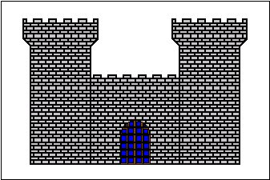
FermiGrid - Current Architecture
VOMS
Server
Periodic
Synchronization
Step 1 - user issues voms-proxy-init
user receives voms signed credentials
GUMS
Server
Step 4 – Gateway requests GUMS
Mapping based on VO & Role
Site Wide
Gateway
Step 2 – user submits their grid job via
globus-job-run, globus-job-submit, or condor-g
Step 3 – Gateway checks against
Site Authorization Service
clusters send ClassAds
via CEMon
to the site wide gateway
SAZ
Server
BlueArc
Step 5 - Grid job is forwarded
to target cluster
Exterior
Interior
CMS
WC1
CDF
OSG1
CDF
OSG2
D0
CAB1
D0
CAB2
GP
Farm

Slide 4
VOs hosted at FermiGrid
VO Focus Area URL
fermilab Fermilab Experimental Program http://www.fnal.gov/faw/experimentsprojects/index.html
  accelerator, astro, cdms, hypercp, ktev, miniboone, minos, mipp, nova, numi, patriot, test, theory
des Dark Energy Survey https://www.darkenergysurvey.org/
dzero D0 experiment http://www-d0.fnal.gov
I2u2 Interactions in Understanding The Universe http://ed.fnal.gov/uueo/i2u2.html
ilc International Linear Collider http://ilc.fnal.gov
lqcd Lattice QCD computations http://lqcd.fnal.gov
nanohub Nanotechnology http://www.nanohub.org
gadu Bioinformatics http://compbio.mcs.anl.gov/gaduvo/gaduvo.cgi
sdss Sloan Digital Sky Survey http://www.sdss.org
osg OSG individual researchers or small groups VO http://www.opensciencegrid.org/

Slide 5
Computing Clusters
Fermilab operates clusters for four major clients:
  General Purpose Grid Cluster:
    Used by smaller groups and experiments.
    Currently - 388 VM's on the grid, 240 more coming soon.
  CDF Clusters:
    Currently - 2 production grid clusters (520 WN / 2600 VM’s), 2 analysis/production (non-grid) clusters (~600 WN / ~3000 VM’s) and 1 test/integration cluster (8 WN / 40 VM’s).
    Future - 3 production grid clusters (~1200 WN / ~6000 VM’s) and 1 test/integration cluster (8 WN / 40 VM’s).
  D0 Clusters:
    Currently - 2 production grid clusters (860 WN / 3440 VM’s) and 1 farm/analysis cluster (360 WN / 1440 VM’s).
    Future - 3 production grid clusters (~1200 WN / ~4800 VM’s).
  CMS.
    Operated by the CMS Computing Facilities Department.
    Currently more than 1900 VM's on the grid.

Slide 6
FermiGrid - Storage
BlueArc NFS Shared File Systems:
  Purchased 24 Tbytes (raw) = 14 Tbytes (formatted RAID 6)
  Currently mounted on (most) FermiGrid clusters.
  blue2:/fermigrid-home /grid/home 1 TByte
  blue2:fermigrid-login /grid/login 1 TByte
  blue2:/fermigrid-app /grid/app 2 TByte
  blue2:/fermigrid-data /grid/data 7 TBytes
  blue2:/fermigrid-state /grid/state 1 TByte
Public dcache (FNAL_FERMIGRID_SE):
  7 TBytes of storage.

Slide 7
Software Stack
Baseline:
  SL 3.0.x, SL 4.x, SL 5.0 (just released)
  OSG 0.6.0 (VDT 1.6.1, GT 4, WS-Gram, Pre-WS Gram)
Additional Components:
  VOMS (VO Management Service)
  VOMRS (VO Membership Registration Service)
  GUMS (Grid User Mapping Service)
  SAZ (Site AuthoriZation Service)
  jobmanager-cemon (job forwarding job manager)
  MyProxy (credential storage)
  Squid (web proxy cache)
  syslog-ng (auditing)
  Gratia (accounting)
  Xen (virtualization)
  Linux-HA (high availability)

Slide 8
Authorization & Authentication
DOEgrids Certificate Authority:
  Long lived (1 year) certificates.
  Heavy weight process (from the perspective of the typical user…).
Fermilab Kerberos Certificate Authority:
  Service run on Fermilab Kerberos Domain Controllers.
  Most Fermilab personnel already have Kerberos accounts for single sign on.
    Lighter weight process than DOEgrids (from the users perspective).
  Short lived (1-7 day) certificates:
    kinit -n -r7d -l26h
    kx509
    kxlist -p
    voms-proxy-init -noregen -voms fermilab:/fermilab -valid 168:0
    submit grid job
  Support cron jobs through kcroninit:
    /usr/krb5/bin/kcron <script>
    /DC=gov/DC=fnal/O=Fermilab/OU=Robots/CN=cron/CN=Keith Chadwick/UID=chadwick
TAGPMA + IGTF

Slide 9
glexec
Joint development by NIKHEF (David Groep / Gerben Venekamp / Oscar Koeroo) and Fermilab (Dan Yocum / Igor Sfiligoi).
glexec allows a site to implement the same level of authentication, authorization and accounting for glide-in jobs on the WN as for jobs which are presented to the globus gatekeeper of the CE.
Integrated (via “plugins”) with LCAS / LCMAPS infrastructure (for LCG) and GUMS / SAZ infrastructure (for OSG).
glexec is currently deployed on several clusters at Fermilab.
Will be included in Condor 6.9.x.

Slide 10
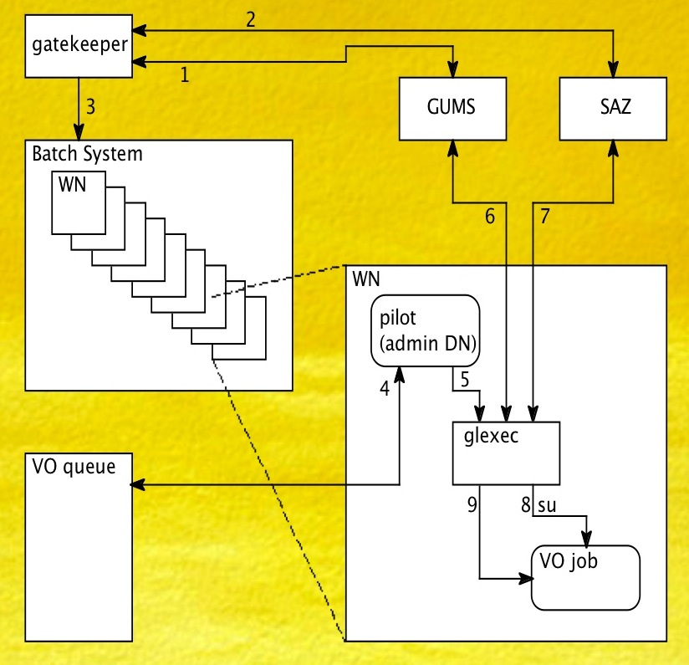
glexec block diagram

Slide 11
User Experience on FermiGrid/OSG
VOs at Fermilab using other OSG resources:
  Our experience is not very good.
    SDSS VO - ~82 OSG sites, ~41 claim to “support”, but only 5 sites can actually run the SDSS application.
    Fermilab VO - ~82 OSG sites, ~42 claim to “support”, but only 30 sites pass the minimal acceptance tests.
      Authenticate, run already existing programs, copy file to site, copy file from site.
    The situation is slowly improving, but sites are not very responsive to problem tickets.
VOs on OSG using Fermilab resources:
  Fermilab operates as a “universal donor” of opportunistic cycles to OSG VOs.
    In April - 18 unique OSG VOs ran on FermiGrid and used 3.9M CPU hours.
  Gratia accounting data show that ~10% of the Grid systems at Fermilab are being used opportunistically.
    But there are VOs which run into problems with our job forwarding site gateway and handling the heterogeneous cluster and sub-cluster configurations (CPU chipset - Intel vs. AMD, OS, 32 vs. 64 bit, memory, local disk and mounted filesystems).
    There are also VOs which desire significant amounts of resources beyond what we are able to opportunistically contribute.
      Hey buddy can you spare 7 terabytes of disk? We only need it for the next year…
VOs from other Grids using OSG/Fermilab resources:
  We participate in the GIN efforts.
  Most recently - Individuals from PRAGMA, Fermilab and OSG have demonstrated successful interoperability of PRAGMA, OSG and FermiGrid.
    Cindy Zheng, Tsutomu Ikegami, Yoshio Tanaka, Neha Sharma and Shaowen Wang
    http://fermigrid.fnal.gov/gin/pragma/osg-pragma-interoperability.html

Slide 12
fermilab VO Acceptance on OSG

Slide 13
Unique VOs on FermiGrid by Month

Slide 14
Unique VOs on OSG by Month

Slide 15
CPU Time by Organization on FermiGrid per month

Slide 16
CPU Time by Organization on FermiGrid per month (stacked)

Slide 17
CPU Time by Organization on OSG per month (stacked)

Slide 18
New Initiative - OSG User Support Campaign
OSG has just started a campaign to address problems with grid site job submissions:
https://twiki.grid.iu.edu/twiki/bin/view/Troubleshooting/CampaignUserRunning
http://vdt.cs.wisc.edu/tmp/contact.pl

Slide 19
fin
Any Questions?

