Slide 1

Connecting across Firewalls on the Grid
Jeff Tan, David Abramson and Colin Enticott
(Monash University, Australia)
Firewalls restrict the level of collaboration possible on the Grid, while middleware and applications are often not built to handle such restrictions. We present an architecture that facilitates communication across firewalls that is designed to neither compromise security nor require heavy customization of existing software. We call it REMUS.
n_{A}
n_{B}
ρ_{A}
ρ_{B}
c_{A}
c_{B}
Notes:
These slides will be used at GGF-18. There is no specific paper associated with this presentation. The previous Grid Workshop paper does not cover Globus. It is more appropriate to refer to the newer paper that we are hoping to be a journal publication, but it is not yet finished.

Slide 2
What’s a Firewall?
“a piece of hardware and/or software which functions in a networked environment to prevent some communications forbidden by the security policy.” (Wikipedia)
Good for you.
Bad for you.

Slide 3
Motivation: Grid Enabling Legacy Software (GriddLeS) Workflows
Late bound decision
read()
Local
File
write()
seek()
Remote
File
close()
open()
Legacy Application
GriddLeS FileMultiplexer
Cache
Remote
Application
Process
GRS
replicas
Firewalls restrict non-local data transfers.

Slide 4
GriddLeS Redirected I/O via Web Services
FIREWALL
Domain 1
Domain 2
Execution nodes can only access the front node.
Front node cannot access the Internet, but can access the local public web server.
Public web servers are mutually accessible.
Assumes that public web servers are available.
Exec node
Exec node
Exec node
Exec node
Exec node
Exec node
Writer
G
G
Reader
Front node
Front node
GriddLeS
Redirection
service
GriddLeS
Redirection
service
Public Web Server
Public Web Server
GriddLeS
buffer service
GriddLeS
buffer service
Notes:
This worked quite well, but the problem remains that we make two assumptions: public web servers exist and they will allow GriddLeS web services.

Slide 5

Motivation: Nimrod Parameter Sweeps
Nimrod manages the execution of parametric studies across distributed computers.
A high-level environment for parameter sweep applications (PSAs).
A push and pull model for experiment processing using agents.
Grid-enabled with Nimrod/G.

Slide 6
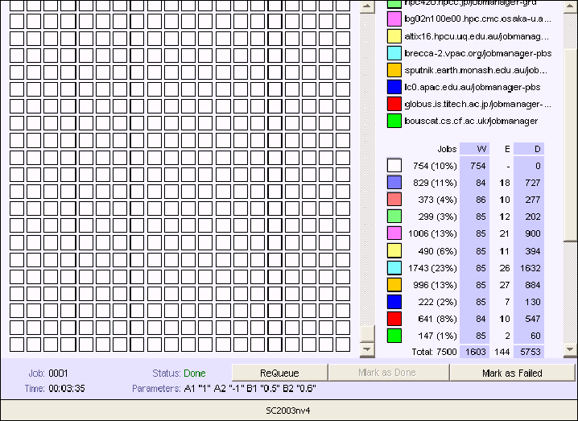
SC2003
Notes:
The Job Viewer shows the utilization of resources for the GAMESS experiment just shown. It reminds us of that point in time when we could have added several other resources into the testbed, but were stopped by firewall issues.

Slide 7
Nimrod Applications
Air pollution studies
Laser physics
Ecology
Discrete Optimization and Meta-Heuristics
CAD Digital Simulation
Etc..
And they all rely on the interconnection of Nimrod components over the network:
access to more resources
overall application performance

Slide 8
The Networked Components of Nimrod/G
Nimrod
Nimrod server components: the file and database servers, and the actuator.
FS
DBS
experiment
management
Actuator
Agents process experiments on computational resources.
resource management
Agents pull job inputs in and push results out.
computational
resources
Firewalls can block agents communicating with FS and DBS.
running agent
Notes:
The Nimrod Inter-Component Communication Model. This is a simplified diagram of the components of Nimrod/G that use the network. Experiments are processed on computational resources at one or more remote sites. The Actuator component of Nimrod deploy agents which run on the compute nodes as jobs through resource management suites like Globus. The agents communicate with two key Nimrod components for the duration of an experiment: the file server (FS) handles file transfers and the database server (DBS) manages control data. It is likely that the resource manager will be accessible for the Actuator to start agents. The firewall gets in the way when the agents attempt to connect back to Nimrod. If this is unsuccessful, then the agents will time out and terminate without accomplishing anything.

Slide 9
Abstract Model of Rerouting
LEGEND:
ρ_{i} : Remus rerouters
C_{j} : communicating components
: some open port
n_{A}
n_{B}
ρ_{A}
ρ_{B}
c_{A}
c_{B}
An authorized channel must be open.
We can tunnel multiple connections through.
We should avoid reprogramming.
We can use off-the-shelf means
Notes:
Grid applications are not expected to be able to adjust to different firewall situations. Likewise, firewalls cannot be expected to readily adjust to different Grid applications. We proposed and developed a middle layer solution that accommodates both while minimizing the need to customize them. We call this solution REMUS – a Rerouting and Multiplexing System.

Slide 10
Accessible Ports
LEGEND:
ρ_{i} : Remus rerouters
C_{j} : communicating components
: some open port
: blocked port
: rerouted local port
n_{A}
n_{B}
n_{B}
ρ_{A}
ρ_{B}
n_{A}
ρ_{A}
ρ_{B}
d_{B}
=
D
c_{A}
c_{B}
c_{A}
c_{B}
Vacant Port
Non-Vacant Port
Rerouters at unused and accessible ports.
However, secure networks will usually open useful ports only, i.e., running services like HTTP.
Use daemon to run rerouters as servlets, web services, etc.
But daemons have different capabilities.
Notes:
If we find an open port to use at the remote site, it may either be vacant or bound to some existing service. If vacant, we can probably bind it to our own rerouter component, unless we are not running as root (superuser) and the available port is between 1 and 1023, since these are privileged ports. This is already being done for Nimrod using a Nimrod Proxy, specifically designed to reroute connections from Nimrod agents back to the Nimrod server. If the open port is not vacant, then it depends on what daemon (a server, in UNIX parlance) is currently using that port. We can use that daemon if it has extensibility or plug-in features, e.g., we can implement rerouting through web services or CGI. We have tried this in a fashion using HTTP proxy tunneling with an SSH tunnel above it and SOCKS at the top to reroute connections across. This assumes that the HTTP proxy server will agree to bridge the SSH connection to the SSH server port, usually at 22/tcp.

Slide 11
No Direct Access, Use Proxies
n_{A}
ρ_{A}
n_{B}
ρ₁
ρ₂
ρ_{f}
ρ_{B}
c_{A}
c_{B}
Use mutually accessible proxy host, or several in a chain.
Proxy host is usually a low-risk host that does not run critical applications.
Proxy host can be hardened and with full logging.
Notes:
Sometimes, direct access between component A and component B is impossible, e.g., component B is running from a host that sits behind a firewall. We can then proxy our connections through a mutually accessible proxy host: component A can access the proxy host, and the proxy host can access component B, and back again. If necessary, we can use a proxy chain.

Slide 12
Globus (GT2)
Client site
Gatekeeper Site
Gatekeeper
Open ports may be too few, or impossible, in secure environments.
Designated ephemeral ports must be open, even in GT4.
Nexus Proxy involves rebuild.
Proxy router is specific to Globus.
job-run
create
Globus Client
status
Job manager
GridFTP server
url-copy
create
ftp-data
FTP server process
Notes:
This is a snapshot of the interaction between a Globus client and either the Gatekeeper or the GridFTP server. There are cases when new TCP streams are initiated by the job manager. There is therefore a need to reroute connections in both directions. While Globus provides the port range setting to make use of the open channels, those may be too few, if not non-existent, as they must be vacant ports. The Nexus Proxy requires rebuilding the Grid applications.

Slide 13
Test Case 1: Globus
SSH tunnel
SSH port
Forwards back to X₂
SITE 2 DMZ
DMZ host
sshd
protected network
SITE 1
s
rX₂
gatekeeper
globus client host
socks wrapper ρ_{B}
accepts SOCKS
accepts SOCKS
ssh, SOCKS proxy
gatekeeper
local SOCKS
proxy
jobmgr
X₂
X₁
socks wrapper ρ_{A}
globusrun
open, unrestricted port
local port
Use SSH port forwarding and SOCKS.
Use a SOCKS wrapper.
Transparent, no rebuild.
Notes:
Recent experiments have allowed us to use a proxy solution that facilitates Globus job transactions using the SOCKS proxy protocol that is facilitated by SSH. We must first build a tunnel (big green arrow) using the SSH client at client host and the SSH daemon at the proxy host (the DMZ host). This SSH client is also a SOCKS proxy that proxies connections from the client (via port X₁) to the daemon. It also establishes a reverse forwarding port (rX₂ at the DMZ host) that points to a second SOCKS proxy running on the same client host. This second SOCKS proxy accepts connections via port X₂ through port rX₂ on the DMZ host. The result is that globusrun (client) and the gatekeeper+jobmanager (server) are able to initiate connections in both directions via SOCKS through the SOCKS port X₁ on the client host and port rX₂ on the DMZ host (which is accessible from the gatekeeper host). To top it off, a clever SOCKS wrapper (open source dante) can “socksify” both client and server components simply by preloading the SOCKS library for network calls. SOCKS network calls are programmable via a simple configuration file so as to redirect specific connections via some specified SOCKS proxy server, based on the intended destination of the connection to be initiated. Hence, the same gatekeeper can be used to serve other clients from other sites without inappropriately going through SOCKS.

Slide 14
Test Case 2: Nimrod/G + Globus
SSH tunnel
Forwards back to X₂
Nimrod/G using Globus resources.
Same setup as Case 1.
Transparent, no rebuilding Nimrod/G.
SITE 1
SITE 2 DMZ
Nimrod/G Host
DMZ host
sshd
rX₂
s
accepts SOCKS
ssh, SOCKS proxy
local SOCKS
proxy
SSH port
protected network
gatekeeper
X₂
socks wrapper ρ_{B}
X₁
Nimrod Agent
socks wrapper ρ_{A}
Nimrod/G
FS
DBS
gatekeeper
globusrun
jobmgr
open, unrestricted port
local port
Notes:
In addition to “socksifying” Globus components via dante, Nimrod/G components are likewise ‘tricked’ via preloaded SOCKS library references on a shared object module. All it takes is to set LD_LIBRARY_PATH and LD_PRELOAD to the proper values before invoking the components that are to be socksified. The Nimrod Master invokes GRAM via SOCKS (Globus-bound direction), and the Globus job manager may be configured to pass these values along to the Nimrod agents and Proxies invoked, so that they inherit the “socksified” environment, using the same path (Nimrod-bound direction) through rX₂ on the DMZ host to connect via the local SOCKS proxy on the Nimrod/G host.

Slide 15
Issues
Performance: slower -- but connected.
Reliability: requires further work, but relies on mature technology, e.g., SSH, SOCKS.
Security: relies on proven technology, trusted, and certain features mitigate risks, e.g., firewall-like configurability and logging.
Portability: applies to Grid applications in general.

Slide 16
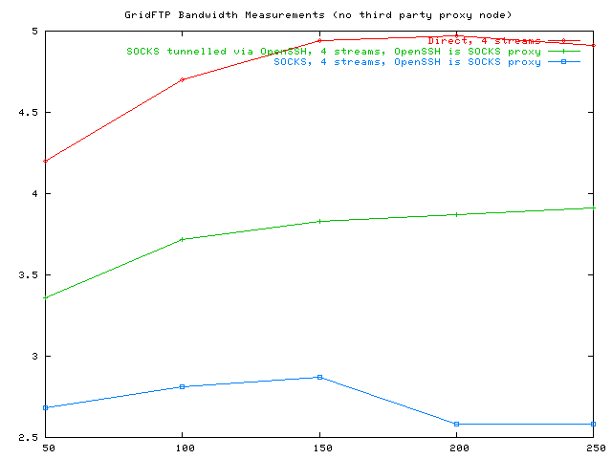
Performance Impact
FTP Throughput (MB/sec)
FTP file size (MB)
Notes:
We take a quick look at the performance impact of rerouting via REMUS by measuring the network performance of GridFTP when it is direct and when it is rerouted in two different ways. The best performance is still by direct GridFTP. This is followed by GridFTP+REMUS when we use the built-in SOCKS proxy support in OpenSSH, so that the SSH session and the SOCKS capabilities run from the same processes, i.e., the SSH client and server. The worst performance is GridFTP+REMUS when we make un-encrypted SOCKS connections, i.e., SOCKS provides the rerouting without the benefit of SSH tunneling. The dismal performance is probably due to the lack of compression which OpenSSH provides in SSH tunneling, as well as the need to create multiple raw TCP streams, which can saturate the link quickly since SOCKS adds its own headers around the actual GridFTP transmissions. When tunneled under SSH, the 4 GridFTP streams would be implemented as 4 channels within the same SSH session, which is compressed.

Slide 17
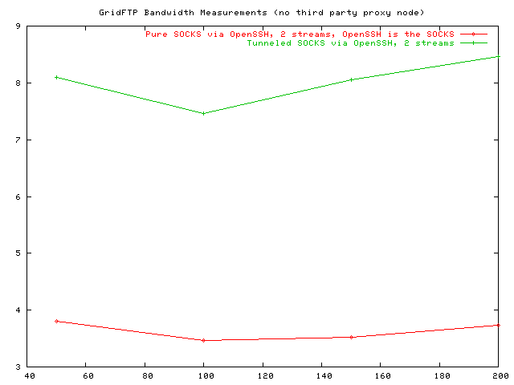
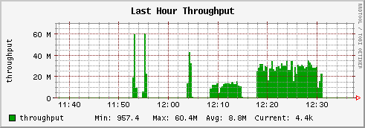
Tunneling Impact
FTP Throughput (MB/sec)
(raw IP):
FTP file size (MB)
Notes:
Note that the raw IP throughput reaches higher peaks when performing pure SOCKS, compared to that for tunneled SOCKS. This is probably due to the delay involved when OpenSSH has to encrypt and compress data streams before sending them across. However, transfer turnaround times for tunneled SOCKS are about half of those for pure SOCKS, which may be evidence that OpenSSH encryption can be very efficient, hence requiring less raw data to move across.

Slide 18
Future Directions
Work on installation (package).
Work on multiple mechanisms.
Work on fault tolerance.
Load balancing.
SOCKS wrapper
SOCKS wrapper r_{B}
tunnel 1
Px
globusrun
gatekeeper
tunnel 2
jobmgr
Px
GR
GK
JM
GR
GK
JM

Slide 19

Conclusions
Security and resource sharing are inherently at odds with each other.
Grid applications can work with firewalls with a reasonable degree of accessibility.
Grid applications and firewalls can leave accessibility mechanisms to middleware.
Acknowledgment
Australian Partnership for Advanced Computing:

Slide 20
References
Sudholt, W., Baldridge, K., Abramson, D., Enticott, C. and Garic, S. “Parameter Scan of an Effective Group Difference Pseudopotential Using Grid Computing”, New Generation Computing 22 (2004) 125-135. (http://www.csse.monash.edu.au/~davida/papers/gamess.pdf)
Tan, J, Abramson, D. and Enticott, C. “Bridging Organizational Network Boundaries on the Grid”, IEEE Grid 2005, Seattle, Nov 2005. (http://www.csse.monash.edu.au/~davida/papers/Grid2005.pdf)
Kommineni, J and Abramson, D. “Building Virtual Applications for the GRID with Legacy Components”, in “Advances in Grid Computing - EGC 2005, European Grid Conference”, Springer Lecture Notes in Computer Science (LNCS 3470), Amsterdam, The Netherlands, February 14-16, 2005. pp 961 – 971. Edited by P.M.A. Sloot, A.G. Hoekstra, T. Priol, A. Reinefeld, M. Bubak.
Websites:
http://www.csse.monash.edu.au/~davida/griddles/index.htm
http://www.csse.monash.edu.au/~davida/nimrod/
http://www.csse.monash.edu.au/~davida/publications.html

Slide 21
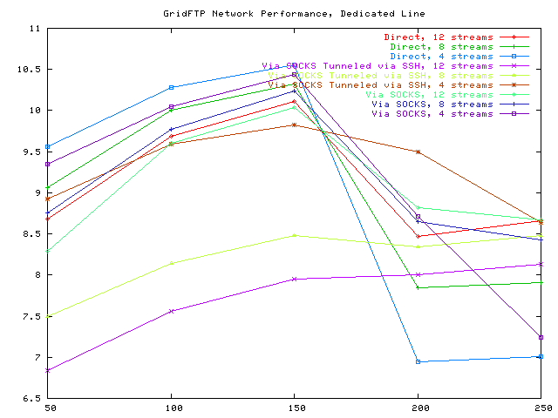
Throttling?
FTP Throughput (MB/sec)
FTP file size (MB)
Notes:
Throttling seems to affect direct FTP the worst because its raw IP throughput is highest – there is no preprocessing, so data is quickly released into the network. Is there any benefit therefore in a slower transfer, in terms of raw IP, where the performance may be more predictable, as it is not subject to throttling?

