Slide 1




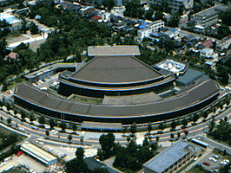

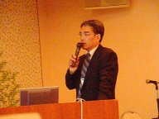
Activity Reports
Date: 2004/5/31-6/1
Venue: Kanazawa Japan
Participations: 60
Submission: 20 paper submitted. 12 oral presentations accepted.
Program Chair Akihiko Konagaya
Program:
  Keynote: Hideaki Sugawara, Professor, DDBJ, National Institute of Genetics "Gene Trek in Procaryote Space powered by a GRID environment"
  Invite lectures: 4
  Poster: 4
  Demonstration exhibition:10
Area:
  The scope of this workshop focuses on life science applications of grid systems especially for bionetwork research and systems biology.
TOPICS
  Grid architectures for life science
  Life science applications on grid systems
  Computation pipelines and workflows for life science data integration
  Ontologies and semantic web approaches for life sciences
  Mathematical modeling and simulation systems for life sciences
  High performance architectures and systems for life sciences

Slide 2
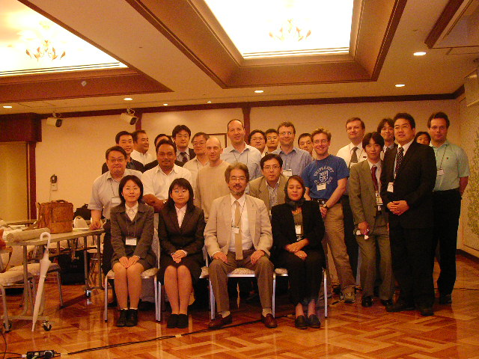
Sessions
GRID Infrastructure for Life Sciences (Chair Rahmah Mohamed) , 2 spekers
Systems Biology (Chair Richard Sinnott), 2 spekers
Massive Data Processing (Chair Suhaimi Napis), 2 spekers
Databases and Data Grid (Chair Kenji Sato), 2 spekers
Grid Portal and Pipeline for Functional Annotation (chair Tin Wee Tan), 3 spekers
Parallel and Distributed Applications (Chair Yutaka Akiyama), 2 spekers
Life Science Grid Projects (Chair Simon See)
LSGRID2004 Program Committee Members
Akiyama, Yutaka (AIST CBRC, Japan)
Ang, Larry (BII, Singapore)
Angulo, David (Depaul Univ., US)
Arzberger, Peter (UCSD, US)
Bala, Piotr N. (Copernicus Univ., Poland)
Goble, Carole (Univ. of Manchester, UK)
Farazdel, Abbas (IBM, US)
Fukuda, Ken'ichiro (AIST CBRC, Japan)
Himeno, Ryutaro (RIKEN ACCC, Japan)
Hong, Gilnam (POSTECH, Korea)
Kao, Cheng-Yao (NTU, Taiwan)
Konagaya, Akihiko (RIKEN GSC, Japan)
Konishi, Fumikazu (RIKEN GSC, Japan)
Lin, Fang-Pang (NCHPC, Taiwan)
Luo, Jingchu (CBI, Peking University, China)
Miyazaki, Satoru (NIG, Japan)
Nakamura, Haruki (Osaka Univ., Japan)
Matsuda, Hideo (Osaka Univ., Japan)
Matsuoka, Satoshi (TITECH, Japan)
Mohamed, Rahmah (UKM, Malaysia)
Napis, Suhaimi (UPM, Malaysia)
Ono, Isao (Tokushima Univ., Japan)
Palittapongarnpim, Prasit (BIOTEC, Thailand)
Rodrigo, Allen (Auckland, New Zealand)
Satou, Kenji (JAIST, Japan)
See, Simon (SUN, Singapore)
Sekiguchi, Satoshi (AIST GTRC, Japan)
Shimojo, Shinji (Osaka Univ., Japan)
Stevens, Rick (ANL, US)
Tan, Tin Wee (NUS, Singapore)

Slide 3
Discussion about the Life Science Grid activities
The current state of other projects was discussed. The summary is far from complete because there are so many projects that it is impossible to be exhaustive. The coordinators of some of the projects mentioned below were presented in LSGRID2004.
- Biogrid Kansai
- OBIGrid
- Apbionet
- NC biogrid
- BIRN,EOL
- UK e-science Project/health grid
- GCE/Life science grid working group
- PRAGMA, Apgrid

Slide 4
What about a bigger conference to cover all of these activities?
LSGRID2005 in Singapore
Date: Under coordination of schedules
Venue: Under coordination of space
Program Chair Akihiko Konagaya
Local Host Prof.Lee Hing Yan
Collaborate Projects: Kansai Bio Grid, OBIGRID, AP-BioGRID, UK e-science

