Slide 1
Activity Reports LSGRID2004
RIKEN Genomic Science Center
Fumikazu KONISHI

Slide 2




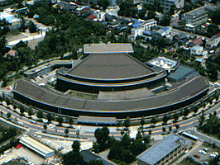

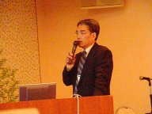
Activity Reports
Period: 2004/5/31-6/1
Venue: Kanazawa Japan
# of participants : 60
# of Paper Submission: 20
# of Acceptance. 12
Program Chair Akihiko Konagaya
Presentations:
  Keynote: Hideaki Sugawara, Professor, DDBJ, National Institute of Genetics "Gene Trek in Procaryote Space powered by a GRID environment"
  Invited Talks: 4
  Technical Talks:12
  Poster: 4
  Demonstration Exhibitions:10
Area:
  The scope of this workshop focuses on life science applications of grid systems especially for bionetwork research and systems biology.
TOPICS
  Grid architectures for life science
  Life science applications on grid systems
  Computation pipelines and workflows for life science data integration
  Ontology and semantic web approaches for life sciences
  Mathematical modeling and simulation systems for life sciences
  High performance architectures and systems for life sciences
http://big.gsc.riken.jp/big/LSGRID2004/

Slide 3
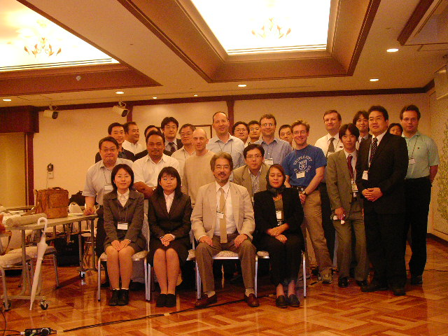
Program Sessions
GRID Infrastructure for Life Sciences (Chair Rahmah Mohamed) , 2 talks
Systems Biology (Chair Richard Sinnott), 2 talks
Massive Data Processing (Chair Suhaimi Napis), 2 talks
Databases and Data Grid (Chair Kenji Sato), 2 talks
Grid Portal and Pipeline for Functional Annotation (chair Tin Wee Tan), 3 talks
Parallel and Distributed Applications (Chair Yutaka Akiyama), 2 talks
Life Science Grid Projects (Chair Simon See) 4 talks
LSGRID2004 Program Committee Members
Akiyama, Yutaka (AIST CBRC, Japan)
Ang, Larry (BII, Singapore)
Angulo, David (Depaul Univ., US)
Arzberger, Peter (UCSD, US)
Bala, Piotr N. (Copernicus Univ., Poland)
Goble, Carole (Univ. of Manchester, UK)
Farazdel, Abbas (IBM, US)
Fukuda, Ken'ichiro (AIST CBRC, Japan)
Himeno, Ryutaro (RIKEN ACCC, Japan)
Hong, Gilnam (POSTECH, Korea)
Kao, Cheng-Yao (NTU, Taiwan)
Konagaya, Akihiko (RIKEN GSC, Japan)
Konishi, Fumikazu (RIKEN GSC, Japan)
Lin, Fang-Pang (NCHPC, Taiwan)
Luo, Jingchu (CBI, Peking University, China)
Miyazaki, Satoru (NIG, Japan)
Nakamura, Haruki (Osaka Univ., Japan)
Matsuda, Hideo (Osaka Univ., Japan)
Matsuoka, Satoshi (TITECH, Japan)
Mohamed, Rahmah (UKM, Malaysia)
Napis, Suhaimi (UPM, Malaysia)
Ono, Isao (Tokushima Univ., Japan)
Palittapongarnpim, Prasit (BIOTEC, Thailand)
Rodrigo, Allen (Auckland, New Zealand)
Satou, Kenji (JAIST, Japan)
See, Simon (SUN, Singapore)
Sekiguchi, Satoshi (AIST GTRC, Japan)
Shimojo, Shinji (Osaka Univ., Japan)
Stevens, Rick (ANL, US)
Tan, Tin Wee (NUS, Singapore)
http://big.gsc.riken.jp/big/LSGRID2004/

Slide 4
Discussion about the next Life Science Grid Workshop
The current state of other projects was discussed. The summary is far from complete because there are so many projects that it is impossible to be exhaustive. The coordinators of some of the projects mentioned below were presented in LSGRID2004.
- Biogrid Kansai
- OBIGrid
- AP-Bionet
- NC biogrid
- BIRN,EOL
- UK e-science Project/health grid
- GCE/Life science grid working group
- PRAGMA, Apgrid

Slide 5
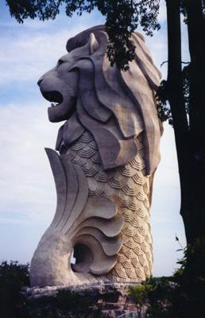
LSGRID2005 in Singapore
Date: Under consideration
Venue: Under consideration
Program Chair Akihiko Konagaya
Local Host Prof. Lee Hing Yan
In collaboration with: Kansai Bio Grid, OBIGRID, AP-BioGRID, UK e-science
What about a bigger conference to cover all of world-wide Life Science Grid activities?

Slide 6
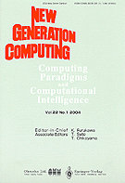
J. New Generation Computing Special Issue
Call for Paper March, 2003
Paper Submission June, 2003
Notification Sep. , 2003
Camera Ready Nov. , 2003
Published vol. 22 no.2 in Feb, 2004
Long Preface
Survey of LSG
Six Technical Papers
Three Short Papers
Contents available at
http://www.ohmsha.co.jp/ngc/ngc2202.htm

