Slide 1
GNS-WSI3
Grid Network Service -
Web Services Interface, version 3
G-lambda project
http://www.g-lambda.net/
National Institute of Advanced Industrial Science and Technology (AIST)
KDDI R&D Laboratories,
NTT Network Innovation Laboratories,
National Institute of Information and Communications Technology (NICT)

Slide 2
G- lambda project overview
Joint project of KDDI R&D labs., NTT, NICT and AIST.
G-lambda project has been started in December 2004.
The goal of this project is to establish a common web services interface (GNS-WSI) between Grid resource manager and network resource manager.
Draft specification of GNS-WSI3 is available at:
  http://www.g-lambda.net/

Slide 3
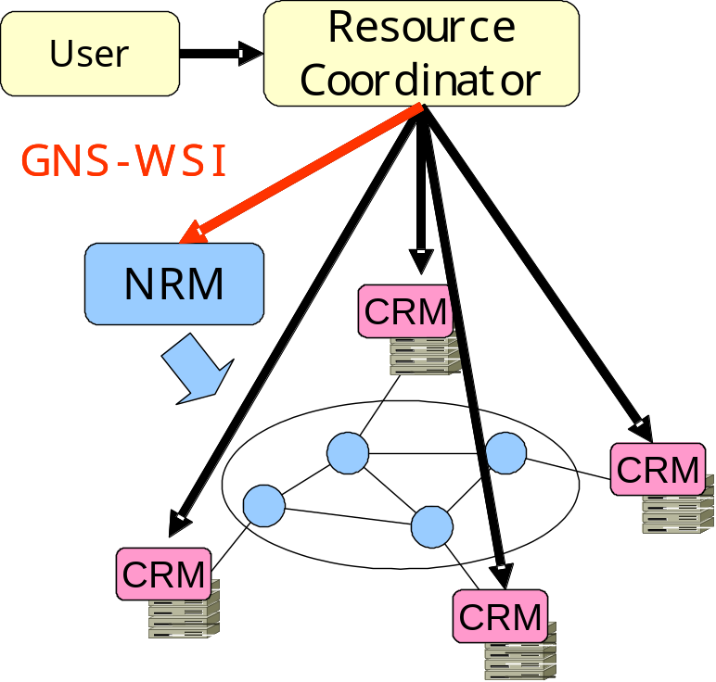
GNS-WSI
Grid Network Service - Web Services Interface
Interface to enable advance reservation of bandwidth from Grid applications and middleware
Based on the Web Services interface technology
Polling-based non-blocking
operations
  Advance reservation of a path
  between end points
  Modification of reservation
  (i.e. reservation time or duration)
  Query of reservation status
  Cancellation of reservation
Will support notification

Slide 4
GNS-WSI
GNS-WSI ver. 1 (released in 2005)
  Provides simple Web services based interface
  1-phase commit
  Used for the intra-domain demo at iPOP2005
GNS-WSI2 (GNS-WSI ver. 2) (released in 2006)
  Based on WSRF (Web Services Resource Framework)
  Supports 2-phase commit protocol
  Used for the inter-domain demo at GLIF2006, SC2006, GLIF2007
GNS-WSI3 (released in 2008)
  Co-allocation function of multiple resources including compute resources
  Specification of network parameters including SLA parameters
  Both WSRF-based and non-WSRF-based implementations
  Current specification based on WSRF

Slide 5
GNS-WSI3 Services
ReservationFactoryService
  Creates ReservationResource instance in ReservationService
  Provides network resource information
ReservationService
  Provides general reservation operations
    reservation, modification, release
  Creates ReservationCommandResource instance in ReservationCommandService
ReservationCommandService
  Enables 2 phase commit and non-blocking operation
(xxxResource is a service instance for each user request)

Slide 6
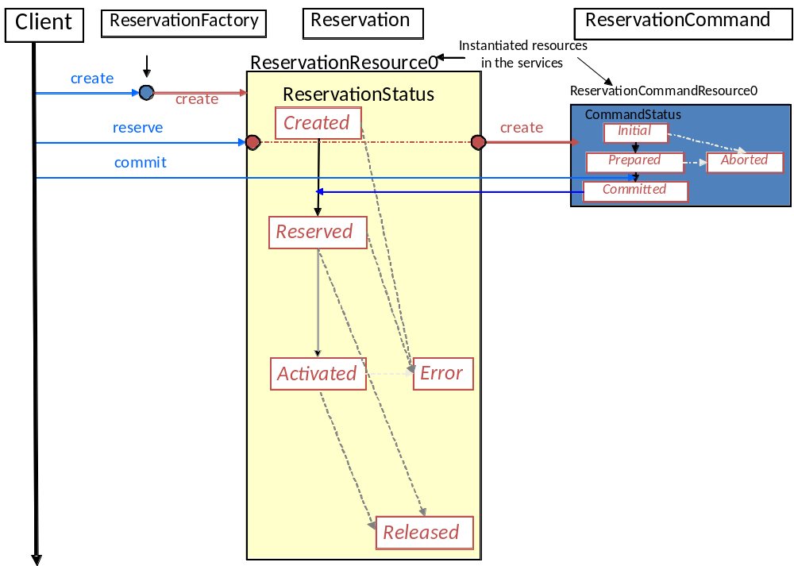
Services in a reserve operation

Slide 7
ReservationStatus Transition Process (Reservation)
A property of ReservationResource
Represents current "Reservation"
status for each requested path
ReservationStatus:
  Created
  Reserved
  Activated
  Released
  Error
createReservationResource
netResourceReservation
cmd aborted
Created
internal
error
netResourceReservation cmd committed
internal
error
netResourceModification
cmd committed/aborted
netResourceRelease
cmd aborted
Reserved
Error
activate
internal
error
netResourceModification
cmd committed/aborted
netResourceRelease cmd aborted
Activated
netResourceRelease
cmd committed
release
netResourceRelease cmd committed
Released

Slide 8
CommandStatus Transition Process (ReservationCommand)
A property of ReservationCommandResource created by reservation commands (e.g. netResourceReservation)
Represents current
requested operation status
CommandStatus:
  Initial
  Prepared
  Committed
  Aborted
Initial
pre-command
succeeded
pre-command
failed
abort request
timeout
Prepared
Aborted
commit request
Committed

Slide 9
Summary of port-types and operations
ReservationFactory Port-Type
create | Creates reservation resource
getAvailableResources | Discovery of available resources
checkResourceAvailability | Checks availability of specified resources
Reservation Port-Type
reserve | Makes advance reservation
modify | Modifies specified reservation resources
modifyAll | Modifies reservation time of all the reserved resources
release | Releases specified reservation resources
releaseAll | Releases all the reserved resources
getReservationStatus | Returns the reservation status
getResourceProperty | Returns specified ReservationResource property
ReservationCommand Port-Type
commit | Commits the request
abort | Aborts the request
getCommandStatus | Returns the command status
getResourceProperty | Returns specified ReservationResource property
Availability check
Reservation related
2PC

Slide 10
Reservation related operations
reserve
modify/modifyAll
release/releaseAll
getRservationStatus
getResourceProperty

Slide 11
Reserve

Slide 12
Reserve (cont.)
Client
(E.g. GRS,
Resource
Coordinator)
Create reservation request instance for WSRF
NRM
RI : Reference of the instance
Booking request (reserve(
RI, Site IDs, Reservation Time, Bandwidth(, availability, latency))
(Example: Site A-B, 15:00-18:00, 1Gbps)
CID : Reference of the requested reservation
Get command status (getCommandStatus(CID))
"Prepared"
Non-blocking
operations
to avoid deadlock
Commit the requested reservation (commit(CID))
Get reservation status (getReservationStatus(RI))
"Reserved"

Slide 13
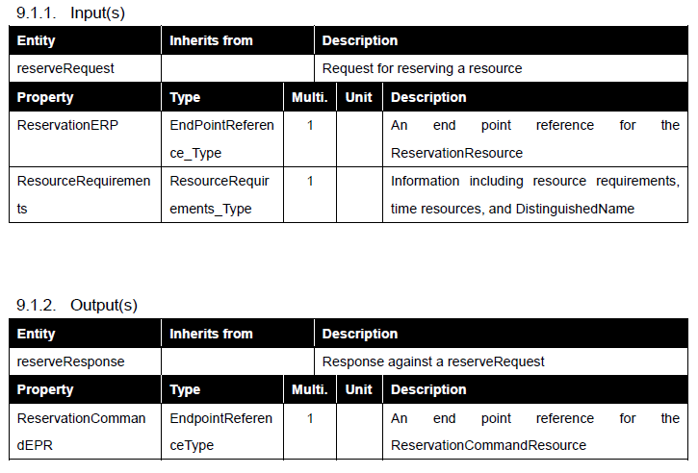
Reserve (cont.)

Slide 14
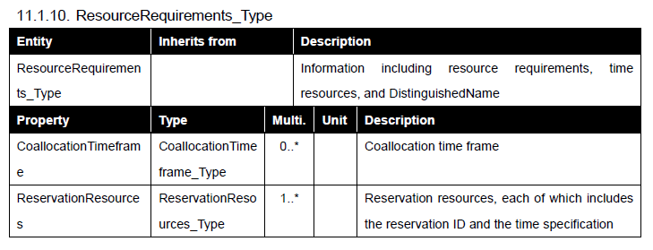
Reserve (cont.)
Supports request of multiple resources

Slide 15
Reservation of multiple hetero. resources
Client
Request multiple heterogeneous
Resources simultaneously
(e.g. compute and network)
Coordinator
Compute
Resource
Network
Resource

Slide 16
Requesting multiple resources
<ResourceRequirements>
<ReservationResources type="ns3:ComputeResources_Type">
<TimeSpecification xsi:type="ExactTimeframe_Type">
<StartTime>2009-12-14T15:18:51.764Z</StartTime>
<EndTime>2009-12-14T15:23:51.764Z</EndTime>
</TimeSpecification>
<ns3:Site>D1A</ns3:Site>
<ns4:TotalCPUCount>1.0</ns4:TotalCPUCount>
</ReservationResources>
<ReservationResources type="ns3:ComputeResources_Type">
<TimeSpecification/>
<ns3:Site>D1B</ns3:Site>
<ns4:TotalCPUCount>2.0</ns4:TotalCPUCount>
</ReservationResources>
<ReservationResources type="ns3:ComputeResources_Type">
<TimeSpecification/>
<ns3:Site>D2C</ns3:Site>
<ns4:TotalCPUCount>1.0</ns4:TotalCPUCount>
</ReservationResources>
<ReservationResources type="ns5:NetworkResources_Type">
<TimeSpecification/>
<ns5:Path>
<ns5:APoint>D2C</ns5:APoint>
<ns5:ZPoint>D1A</ns5:ZPoint>
<ns5:Bandwidth>
<ns5:GuaranteedBW>
<ns5:Rate>1000000</ns5:Rate>
<ns5:BWUnit>kbps</ns5:BWUnit>
</ns5:GuaranteedBW>
</ns5:Bandwidth>
Sub Paths of Path 1
<Route>
<SubPath>
<ns5:APoint>D2C</ns5:APoint>
<ns5:ZPoint>IX4</ns5:ZPoint>
</SubPath>
<SubPath>
<ns5:APoint>IX4</ns5:APoint>
<ns5:ZPoint>D1A</ns5:ZPoint>
</SubPath>
</Route>
</ns5:Path>
</ReservationResources>
<ReservationResources type="ns5:NetworkResources_Type">
<TimeSpecification/>
<ns5:Path>
<ns5:APoint>D1A</ns5:APoint>
<ns5:ZPoint>D1B</ns5:ZPoint>
<ns5:Bandwidth>
<ns5:GuaranteedBW>
<ns5:Rate>1000000</ns5:Rate>
<ns5:BWUnit>kbps</ns5:BWUnit>
</ns5:GuaranteedBW>
</ns5:Bandwidth>
</ns5:Path>
</ReservationResources>
</ResourceRequirements>
CPU resources
Path 2
Path 1

Slide 17
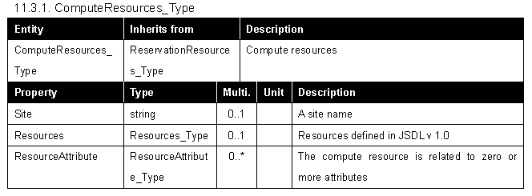
Support of compute resource (11.3.1)

Slide 18
modify and modifyAll operations
modify #1
Resource 3
Resource 3
Resource 2
Resource 2
modify #2
Resource 1
Time
Resource 1
Time
modifyAll
Resource 3
Resource 3
Resource 2
Resource 2
Resource 1
Time
Resource 1
Time

Slide 19
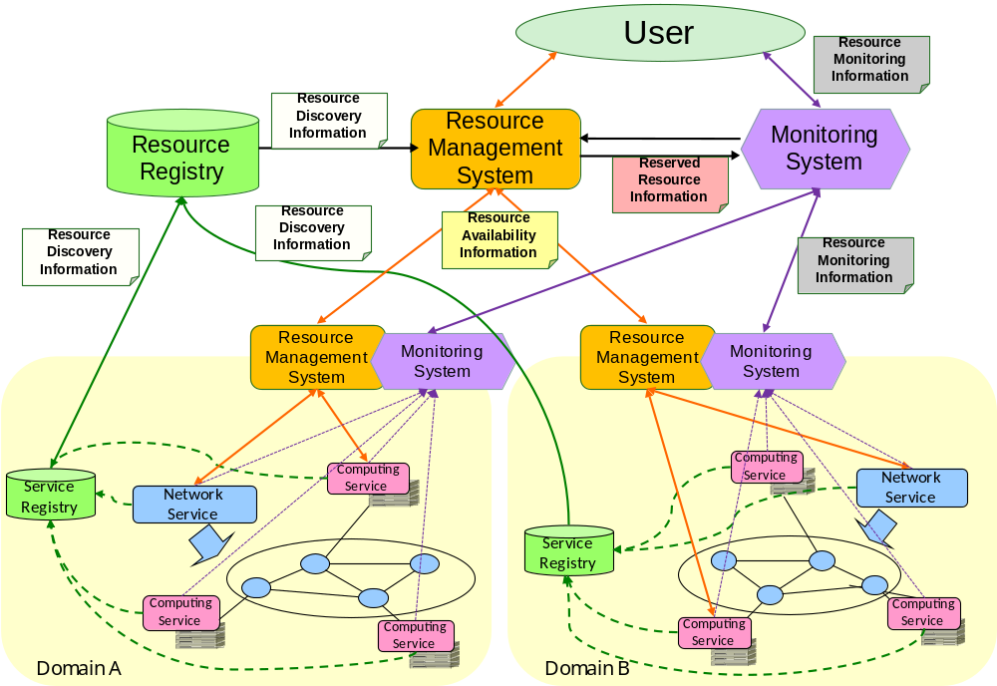
Path finding and monitoring
Path finding and monitoring are out of scope of GNS-WSI
The following architecture is used in AIST implementation

Slide 20
Appendix: A sample XML of intermediate paths specification
<ReservationResources xmlns:xsi="http://www.w3.org/2001/XMLSchema-instance" xsi
:type="ns:NetworkResources_Type">
..
<ns:Path>
<ns:APoint>
<ns:DomainName>D1N</ns:DomainName>
<ns:TerminationPoint>
<ns:TerminationPointName>D1A</ns:TerminationPointName>
</ns:TerminationPoint>
</ns:APoint>
<ns:ZPoint>
<ns:DomainName>D2N</ns:DomainName>
<ns:TerminationPoint>
<ns:TerminationPointName>D2C</ns:TerminationPointName>
</ns:TerminationPoint>
</ns:ZPoint>
<ns:Route>
<ns:SubPath>
<ns:APoint>
<ns:DomainName>D1N</ns:DomainName>
<ns:TerminationPoint>
<ns:TerminationPointName>D1A</ns:TerminationPointName>
</ns:TerminationPoint>
</ns:APoint>
<ns:ZPoint>
<ns:DomainName>D1N</ns:DomainName>
<ns:TerminationPoint>
<ns:TerminationPointName>IX1</ns:TerminationPointName>
</ns:TerminationPoint>
</ns:ZPoint>
<ns:NRM>
<ns:NrmName>NRM1</ns:NrmName>
<ns:NrmUrl>http://nrm1...</ns:NrmUrl>
</ns:NRM>
</ns:SubPath>
<ns:SubPath>
<ns:APoint>
<ns:DomainName>D1N</ns:DomainName>
<ns:TerminationPoint>
<ns:TerminationPointName>IX1</ns:TerminationPointName>
</ns:TerminationPoint>
</ns:APoint>
<ns:ZPoint>
<ns:DomainName>D2N</ns:DomainName>
<ns:TerminationPoint>
<ns:TerminationPointName>D2C</ns:TerminationPointName>
</ns:TerminationPoint>
</ns:ZPoint>
<ns:NRM>
<ns:NrmName>NRM2</ns:NrmName>
<ns:NrmUrl>http://nrm2...</ns:NrmUrl>
</ns:NRM>
</ns:SubPath>
</ns:Route>
</ns:Path>
..
</ReservationResources>

