Slide 1
www.ggf.org
GESA-WG
Grid Economic Services Architecture
Working Group
Summary of Activities for the OGSA-WG
Program Execution Area Discussion
GGF9
Chicago, IL
October, 2003

Slide 2
Outline
Requirements
Key concepts/functionality
Architecture/Model (if any)
Services/portTypes (if any)
Relation with invited groups

Slide 3
Requirements
We require negotiation!
  We have defined in the current specification a Request Pricing/Accept Pricing scheme...
  ...but recognise its limitations.
  We are looking closely at WS-Agreement to see if this will satisfy our requirements.
  We are currently putting together use cases, and identifying negotiation patterns.
  We’ll feed these to GRAAP-WG
We require more security!
  simple delegated credential will not suffice where
  money is an issue!

Slide 4
Motivation and Approach
The problem we want to address is how to enable charging for Grid Services.
Four step approach:
  Put Accounting information into standard format – this is handled by the Usage Record Working Group
  Record the Usage information in a service – this is handled by the Resource Usage Working Group
  Provide a mechanism for a service to specify pricing schemes, publish this, etc. – Chargeable Grid Service or CGS wrapper
  Provide access to payment systems to complete the transaction – Grid Payment System

Slide 5
Key Concepts
Chargeable Grid Service or CGS
  A wrapper for existing Grid service
  Defines extra SDEs to publish “economic” data
  Provides portType to allow charging and limited price negotiation
Grid Payment System or GPS
  A service which provides access to an underlying payment system, e.g. credit card, or purchase order/invoice

Slide 6
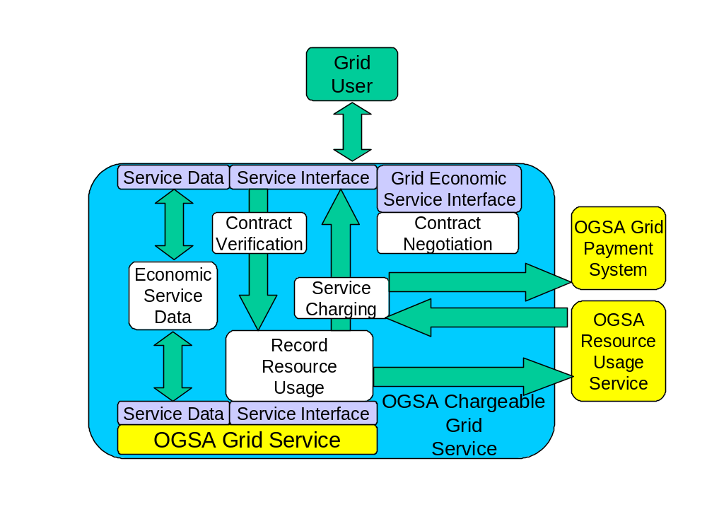
Architecture/Model

Slide 7
Proposed Services/portTypes
Chargeable Grid Service.
  Wrapper for existing services. Expressed as a portType
Grid Payment System.
  Interface to existing payment system. Again, a portType
GPSHold.
  Service representing a chunk of money.
Grid CurrencyExchange
  PortType for currency exchange

Slide 8
Relationship with Invited Groups
Strong relationship with GRAAP-WG
Are evaluating WS-Agreement for use as method for negotiating cost
Observing progress of JSDL from an architect’s perspective, as this is a complementary activity, which should be compatible
Other important groups are RUS-WG and UR-WG

