Slide 1
A Language for Grid File System
and/or Grid Naming System
Arun swaran Jagatheesan
arun@sdsc.edu
San Diego Supercomputer Center (SDSC)
University of California, San Diego

Slide 2
Standard Disclaimer
All statements and comments are the author’s opinion and need not represent the views or policies of UCSD or SDSC or University of Florida or any Federal Agency that supports our research and development activities
Trademarks, copyrights etc. of any products mentioned remain the property of their owners

Slide 3
IP & ©
Intellectual Property Statement
The GGF takes no position regarding the validity or scope of any intellectual property or other rights that might be claimed to pertain to the implementation or use of the technology described in this document or the extent to which any license under such rights might or might not be available; neither does it represent that it has made any effort to identify any such rights. Copies of claims of rights made available for publication and any assurances of licenses to be made available, or the result of an attempt made to obtain a general license or permission for the use of such proprietary rights by implementers or users of this specification can be obtained from the GGF Secretariat.
The GGF invites any interested party to bring to its attention any copyrights, patents or patent applications, or other proprietary rights which may cover technology that may be required to practice this recommendation. Please address the information to the GGF Executive Director.
Copyright (C) Global Grid Forum (2004). All Rights Reserved.
This document and translations of it may be copied and furnished to others, and derivative works that comment on or otherwise explain it or assist in its implementation may be prepared, copied, published and distributed, in whole or in part, without restriction of any kind, provided that the above copyright notice and this paragraph are included on all such copies and derivative works However, this document itself may not be modified in any way, such as by removing the copyright notice or references to the GGF or other organizations, except as needed for the purpose of developing Grid Recommendations in which case the procedures for copyrights defined in the GGF Document process must be followed, or as required to translate it into languages other than English.
The limited permissions granted above are perpetual and will not be revoked by the GGF or its successors or assigns.
This document and the information contained herein is provided on an "AS IS" basis and THE GLOBAL GRID FORUM DISCLAIMS ALL WARRANTIES, EXPRESS OR IMPLIED, INCLUDING BUT NOT LIMITED TO ANY WARRANTY THAT THE USE OF THE INFORMATION HEREIN WILL NOT INFRINGE ANY RIGHTS OR ANY IMPLIED WARRANTIES OF MERCHANTABILITY OR FITNESS FOR A PARTICULAR PURPOSE."

Slide 4
Talk Outline
Use case
Need for standard description language
Requirements of the language
Subset of Data Grid Language (DGL)
Components of Data Grid Language
Relation to the “Architecture of the Grid File System Services” document (Next steps)
Summary

Slide 5
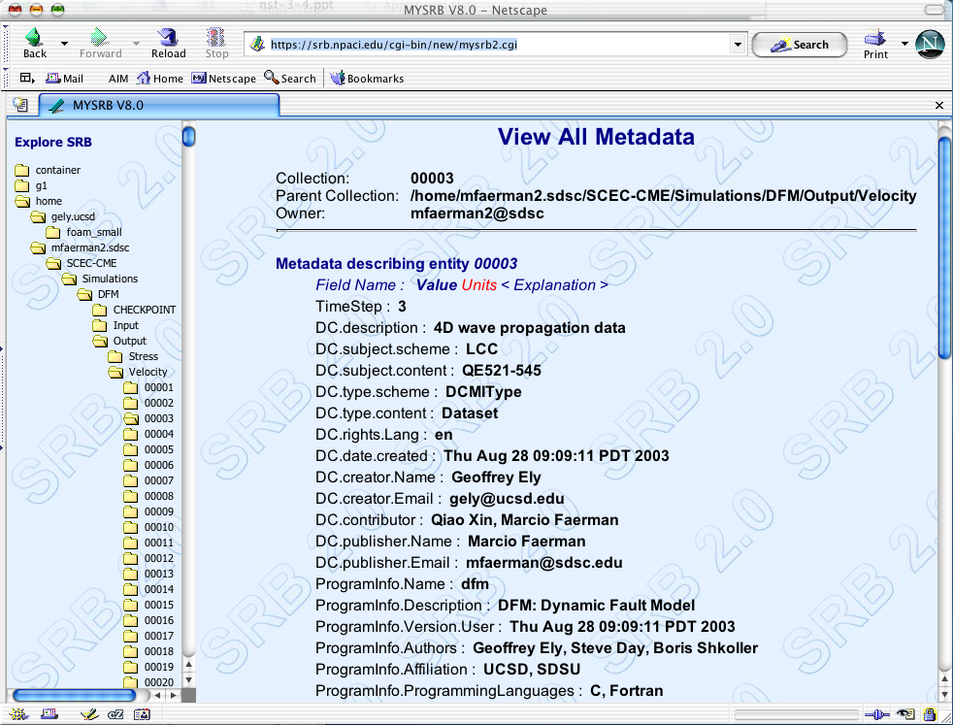
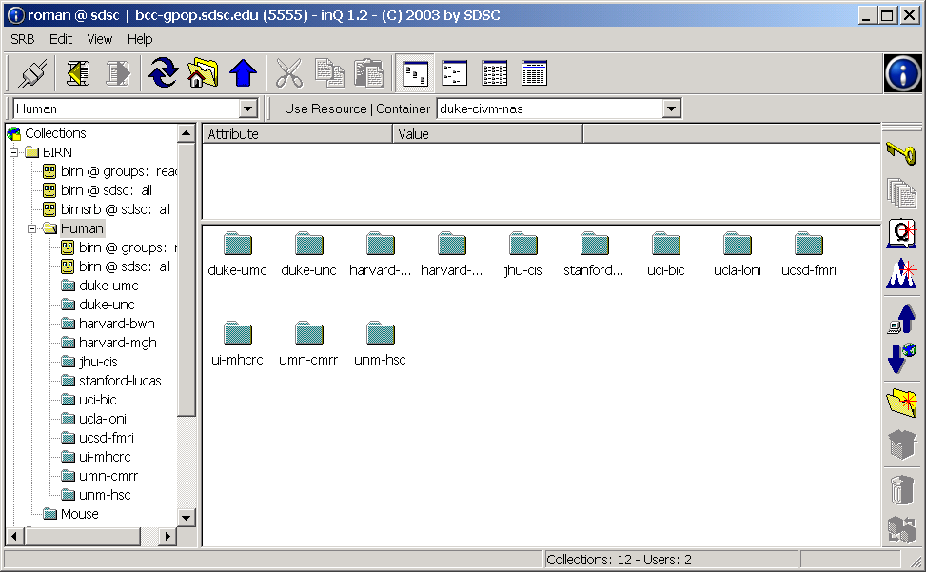
Use Case
Logical Namespace Organization of data and storage (Logical view – need not be same as physical view of data sources )
/home/arun.sdsc
/home/arun.sdsc/text1.txt
/home/arun.sdsc/text2.txt
/home/arun.sdsc/text3.txt
Heterogeneous Storage Resource provisioning (plug and play on demand)
/…/text1.txt
/…//text2.txt
/txt3.txt

Slide 6
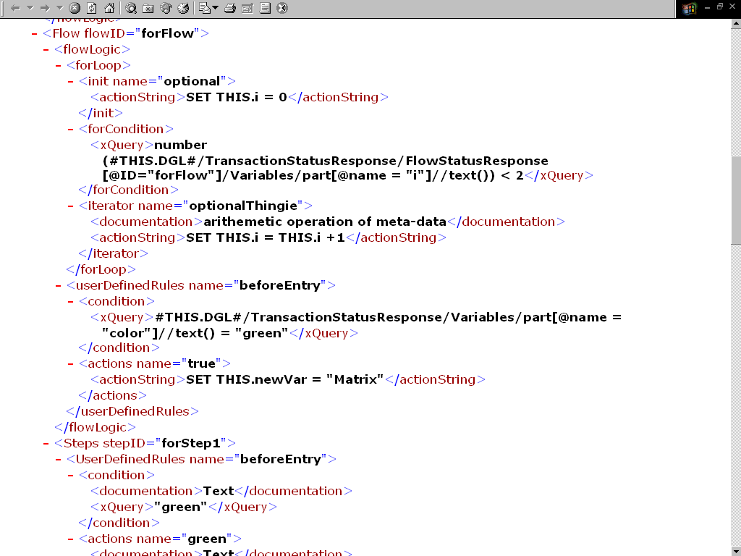
Use Case
Services (SOAP-based) to manage and operate on the logical namespace of data and storage resources

Slide 7
Need for Description Language
Description or XML Schema of data entities
  Describe virtual directories, data sets, ACL, listing, …
Description of Logical Resources
  Even though storage pools or storage virtualization is achieved, individual storage resources need to be logically visible to applications
Description of Operations (function calls)
  Standard description of operations and their input/output parameters

Slide 8
Language Requirements
Simple yet flexible
  Flexible to describe more complex requirements
Aggregation of Operations
  Single call over the network to invoke multiple operations
Asynchronous execution
  For long-run requests
Promote using existing standards
  XQuery
Can easily be extended
  Evolves over time

Slide 9
Data Grid Language (DGL)
DGL is just a language specification
Can be used in any commercial or academic data grid software
DGL (subset) describes data types for GFS Schema
  Virtual Directories (as collections)
  Files (as Data Sets)
  Storage resources (Logical resources)
  Virtual Organizations and Users
  And more …

Slide 10
Existing GFS Operations in DGL
Copy directories/files
Change Permissions (Chmod)
Create directory/file/archive
Delete directory/file/archive
Ingest URl or any data source
Download URI
Replicate, Rename, List
SeekNWrite, SeekNRead
Ingest, Query Any type of Metadata
… (Also bulk operations)

Slide 11
Components of DGL
DGL document is either a request or a response
Data Grid Request
  Could be a Flow (aggregation of operations)
  Or could be a Status Query
Data Grid Response
  Could be a Flow Acknowledgement
  Or could be a Status Response
Can be made Synchronous or Asynchronous
  Flexibility for any type of Implementation

Slide 12
Relation to Standard Documents

Slide 13
Community Input

Slide 14
Summary
A standard description language is Needed
Requirements of the language
Data Grid Language (DGL) and its subset of GFS
Components of Data Grid Language
Relation to the “Architecture of the Grid File System Services” document (Next steps)

