Slide 1
CDDLM-WG discussions with OGSA-WG
July 6, 2005

Slide 2
Outline
Introduction
CDL
Component Model
Deployment APIs

Slide 3
Introduction
Configuration Description, Deployment and Lifecycle Management
Started from expertise gained from HP’s SmartFrog
Added experience from NEC and Softricity
Very aggressive in schedule
Tight relationship to OASIS WSDM
Loose one to DMTF CIM

Slide 4
History
Started at GGF9 in Chicago
Submitted foundation document and SF-based language specs
Recently submitted XML-based language spec
Component model and Deployment APIs
spec on the last call
Had continuous interactions (at the discussion level) with other SRM WGs
Intentional low key wrt OGSA

Slide 5
Where we are
All specs version 1 complete
Do (again) demos at GGF14
Getting ready to work on reference implementations (three in-house, one external)
WSDM compliant (cause some scars)
Started to think about interop
Right time to discuss how do we fit with OGSA

Slide 6
What do we want from OGSA
Closer discussion at GGF14
Fit onto the roadmaps
Plan subsequent versions
Fit into the bigger pictures
(other standards and standard bodies)
How do we fit into an overall architecture
(and what do you need from us to do so)

Slide 7
Where we are going
Complete the process with version 1 (submitted specs, refer. implementations on the way)
Relationship to OASIS SDD
Integration/relationship with ACS
Do we refactor? What do we keep in GGF?
When do we meet at GGF?

Slide 8
CDL Introduction
Jun Tatemura
NEC Laboratories America

Slide 9
Use of CDL in Deployment
Example: Three-tier web applications
provides
Application
Wrapper
Provider (developer)
User (who deploys)
refers to
CDL
Template
CDL
Template
CDL
Template
provides
CDL Template
For 3tier app
(schema, default values,…)
(application structure,…)
Component provider
refers to
Web
server
Component
object
Web
server
CDL
For a specific
deployment
request
Web
server
submit
Deployment API
Component
object
App
server
App
server
App
server
discovered resources
agreed values
DB
server
Component
object
DB
server
discovery and
agreement
Resource
Broker
DB
server

Slide 10
CDDLM XML-based CDL
Configuration: Property Lists
  <webserver>
  <hostname>example.com</hostname>
  <port>80</port>
  </webserver>
CDL Notations
  @cdl:extends – inheritance of prototype
  @cdl:ref – value reference
  @cdl:type – data type annotation
  @cdl:lazy – lazy (runtime) value resolution

Slide 11
CDL Document
cdl
import
types
configuration
system
<cdl:cdl targetNameSpace=xsd:AnyURI?>
<cdl:documentation …/>?
<cdl:import …/>*
<cdl:types>?
<cdl:documentation …/>?
<-- schema definition -->*
<-- extensibility element -->*
</cdl:types>
<cdl:configuration>?
<cdl:documentation …/>?
<-- PropertyList -->*
</cdl:configuration>
<cdl:system>?
<cdl:documentation …/>?
<-- PropertyList -->*
</cdl:system>
<-- extensibility element -->*
</cdl:cdl>

Slide 12
CDL: Appendix

Slide 13
Prototype References
@cdl:extends=xsd:QName
<cdl:configuration
xmlns:tmpl="urn:tmp-uri1">
<Tomcat cdl:extends="tmpl:Tomcat">
<hostname>myweb.com</hostname>
</Tomcat>
</cdl:configuration>
<cdl:cdl
targetNamespace="urn:tmp-uri1">
<cdl:configuration>
<WebServer>
<hostname />
<port>80</port>
</WebServer>
<Tomcat cdl:extends="WebServer">
<port>8080</port>
<maxThreads>200</maxThreads>
</Tomcat>
</cdl:configuration>
</cdl:cdl>
<Tomcat>
<hostname>myweb.com</hostname>
<port>8080</port>
<maxThreads>200</maxThreads>
</Tomcat>

Slide 14
Value References
@cdl:ref=cdl:pathType
<WebApp>
<application/>
<applicationPath/>
<dbname/>
<data/>
<dbuser/>
<dbpassword/>
<DB cdl:extends="DBServer">
<data cdl:ref="/data"/>
<username cdl:ref="/dbuser"/>
<password
cdl:ref="/dbpassword"/>
</DB>
<Web cdl:extends="WebServer">
<application cdl:ref="/application"/>
<applicationPath cdl:ref="/applicationPath"/>
<dbconnection cdl:extends="DBConnection">
<JNDIName cdl:ref="/dbname"/>
<hostname cdl:ref="/DB/hostname"/>
<port cdl:ref="/DB/port"/>
<username cdl:ref="/DB/username"/>
<password cdl:ref="/DB/password"/>
</dbconnection>
</Web>
</WebApp>

Slide 15
Schema Annotations
@cdl:type
@cdl:use
<WebServer>
<hostname cdl:type="xsd:string" cdl:use="optional"/>
<port cdl:type="xsd:positiveInteger" cdl:use="required">80</port>
</WebServer>

Slide 16
Laziness Annotation
@cdl:lazy=“xsd:boolean”
Lazy Property
(provide side annotation)
Lazy Reference
(consumer side annotation)
<server>
<port cdl:lazy="true"/>
</server>
<app>
<p cdl:ref="…" cdl:lazy="true"/>
</app>

Slide 17
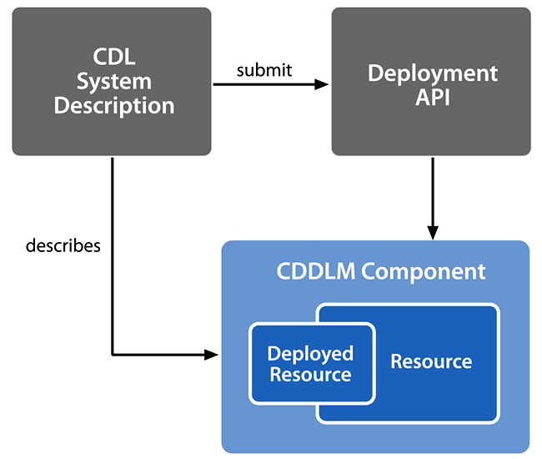
CDDLM Foundations
A Component Description Language (CDL) document describes a deployment
It is submitted to a node implementing the Deployment API
This node is then responsible for the deployment lifecycle of the Components described in the CDL document

Slide 18
Component Model
The Component Model provides semantics for how to use the CDL language to describe a deployment
Provides a mapping between the definitions in CDL and Components able to deploy described Resources
Describes the implementation requirements of a CDDLM compliant Component
Describes the interaction of Components with the CDDLM Deployment API
Defines the normative lifecycle of a deployment

Slide 19
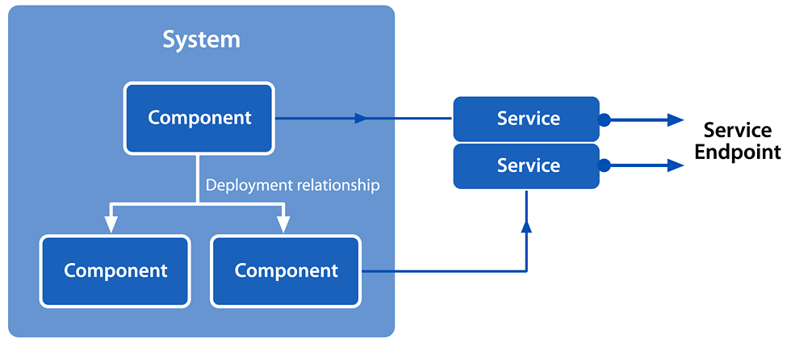
CDDLM System
A System is a group of 1…n Components that each contain 0…n Services
Services are defined as WS-I or WS-RF compliant, but must have at least one valid WS-Addressing Endpoint Reference.

Slide 20
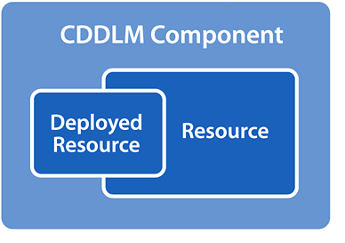
Components
Deploy and manage Resources
  May or may not contain Services
Manage the lifecycle of the Resource
Provide a WS Resource for interaction
  With the Deployment API
  With other Manageability Providers
Provide a WSDM Manageability Endpoint
Provide properties and interfaces for:
  Configuration
  Lifecycle Management
  Maintenance

Slide 21
Deploying A System
The Deployment API is responsible for creation of a WSRF resource to represent the System
  The System EPR will aggregate lifecycle operations and state for the components of the System.
Once created, the System EPR will instantiate each Deployment Component
Each Deployment Component is created as a WSRF resource with a Component EPR
From this point, operations on the System EPR will translate to aggregated operations on Component EPRs
For more detail on this process, come to tomorrow’s presentation on the Deployment API

Slide 22
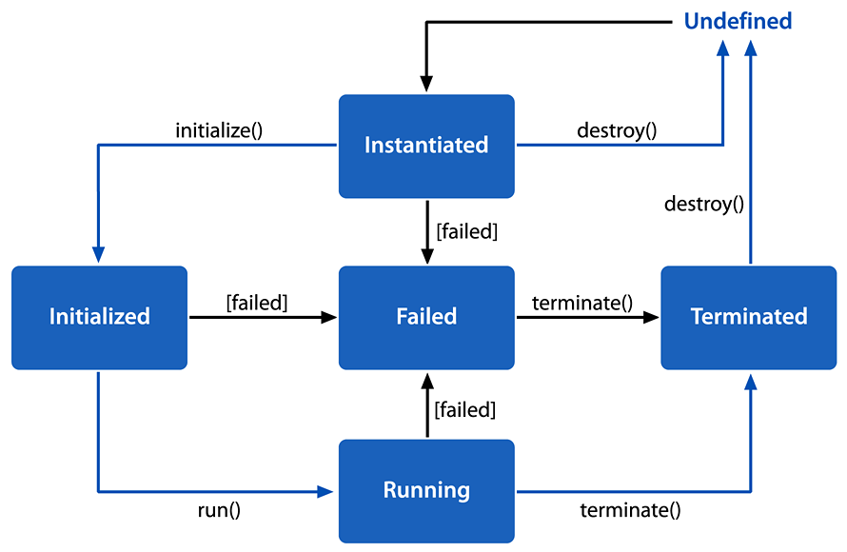
Component Lifecycle Model
Each deployment component must implement the CDDLM lifecycle state machine
Each state represents the state of the underlying managed resource, not the component itself
A component SHOULD NOT report its state as a new state until the transition is complete.
Each Component EPR and the System EPR expose WSDM State Capabilities
  These require state and state transition properties
WSDM also allows sub-states to augment the core state model

Slide 23
Goals
Widely usable deployment API
Public face of CDDLM
Integrate with portal, resource manager
Supports both CDL and SmartFrog languages
Use WS-RF for properties,
WS-N for notification
WSDM for manageability.
Be extensible
Notes:
This is a rework of the deploy API of last GGF. It adds WSRF, WSDM and WS-Notification. It’s very different, even if some of the XML elements are the same.

Slide 24
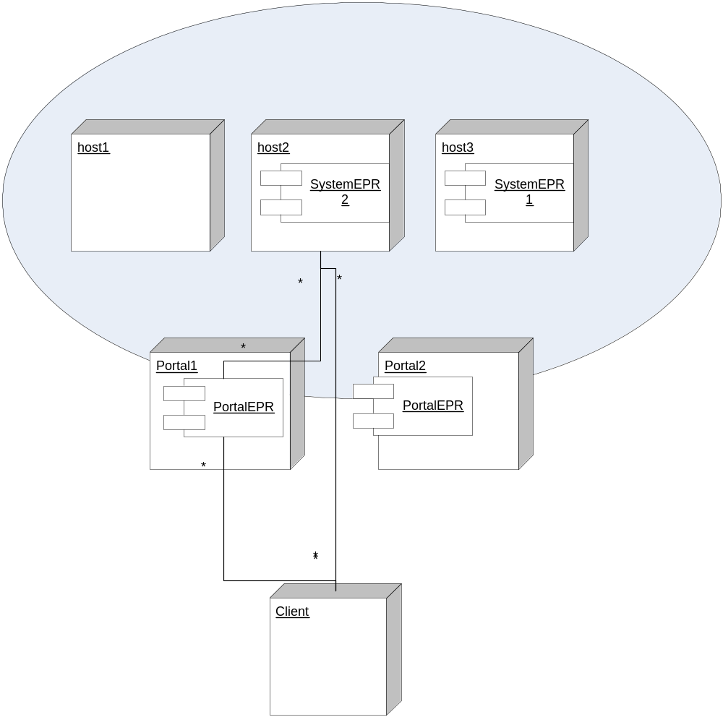
Deployment infrastructure
Portals know about deployed systems on the nodes they manage
Systems are what clients deploy
Both are WSRF Resources
For fault tolerance, may have >1 portal managing a set of nodes.
Notes:
This is the conceptual model. Clients talk to a portal which gives them a new/existing system EPR, with which they communicate.

Slide 25
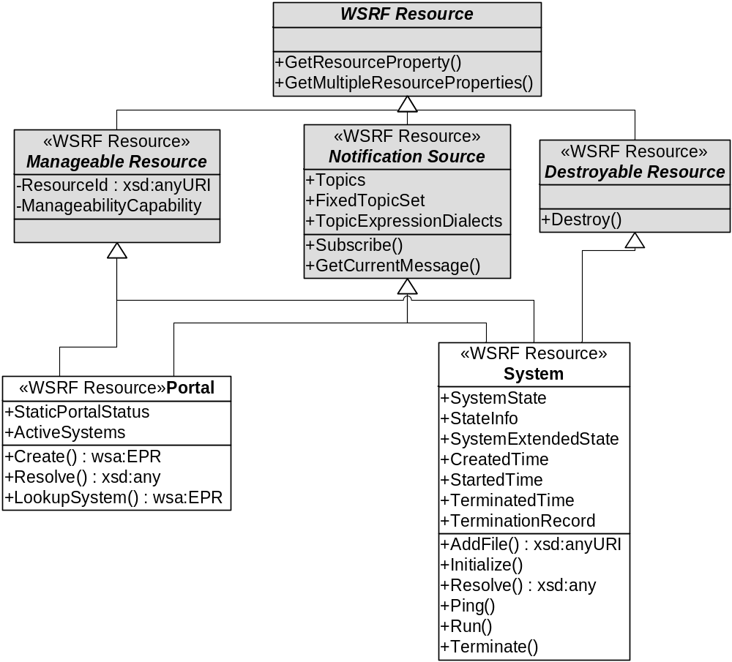
Two resource types: portal and system
Notes:
Stuff in grey is from other specs.
Remember there is no real notion of inheritance in WSDL, it is all done by hand.
Remember, the resource pattern does not imply 1:1 mapping with object instances in an OO language.

Slide 26
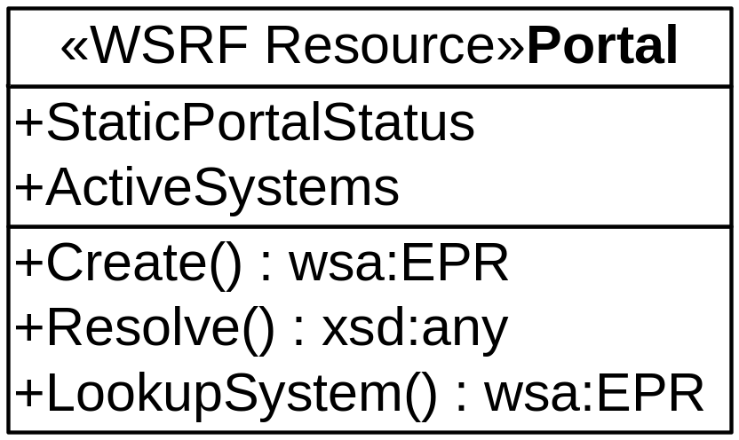
The Portal is the front end
Create a new system
Lookup an existing system
Lookup an existing system & resolve a path
Subscribe to Creation events
Notes:
We don’t cover how these things are found, or security.

Slide 27
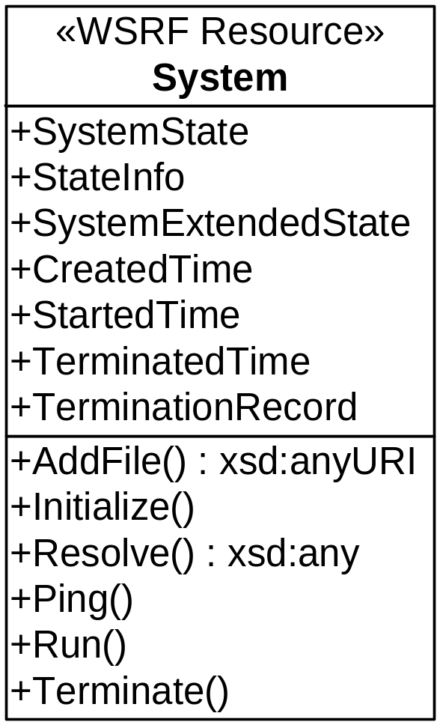
A System represents a deployment
<AddFile> to upload files
Move through component lifecycle with <Initialize>, <Run>, <Terminate>
<Ping> for health
<Resolve> requests
<Subscribe> to events
<Destroy> it to remove it completely
Notes:
This is where most of the complexity is hidden. A system is the top of a graph of deployment nodes, it is the thing that is created.

Slide 28
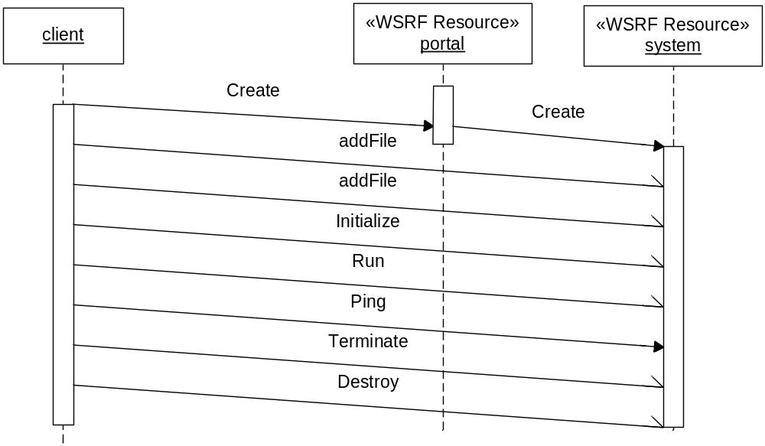
Sequence: create to destroy
Portal creates a system, returns EPR
Clients upload files, then initialize and run the system
Terminate stops the system, destroy kills the EPR
Notes:
Use case of basic create/configure/run/destroy cycle
If a client disconnects without terminate/destroy operations, the system remains running.

Slide 29
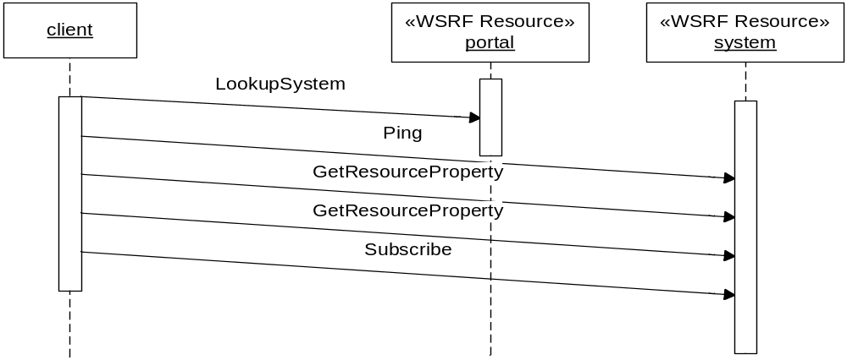
Sequence: lookup and subscribe
Portal provides lookup of ResourceID to EPR
Clients must not destroy the system EPR unless they want to terminate the system.
Notes:
Any authenticated client can use the portal to lookup an existing system, from which they can make requests, such as to subscribe to lifecycle events
The returned EPR is not a view; it is the system itself.

Slide 30
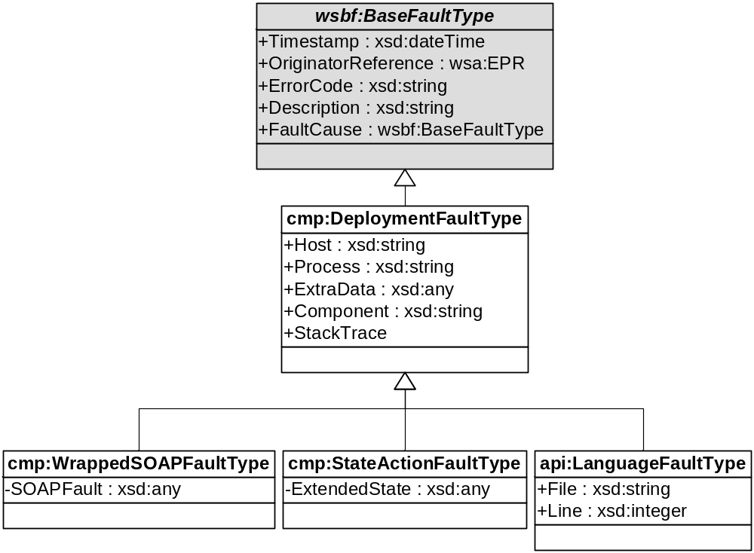
Faults
CDDLM operations declare faults of cmp:DeploymentFaultType
Everything extends this.
Contains much diagnostics, all of which is optional
Secure systems should filter out stack trace, use pseudonym for host names, etc.
Notes:
First issue of controversy.
I like some aspects of WS-BaseFault: chaining model, explicit inclusion of address.
But it is like Java exceptions: you need to declare everything you can possibly throw. This is too restrictive for a generic interface.
The sole workaround is to declare a 'generic' extensible type and stick everything inside, but if you do that, why not stick with the broadly interoperable SOAPFaults. Which is what we did.

