Slide 1
Describing “Arbitrary” Data Using XML
Binary Format Description (BFD)
Alan Chappell (PNNL)

Slide 2
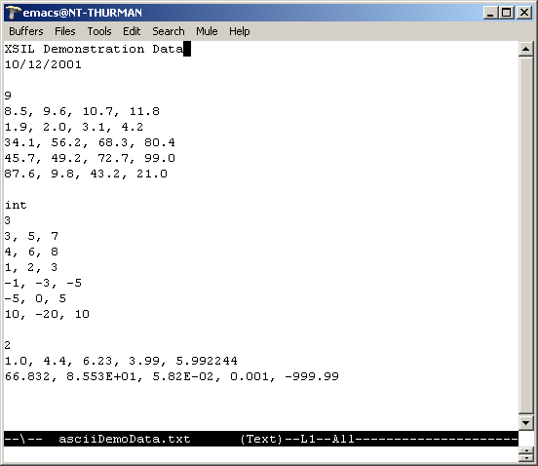
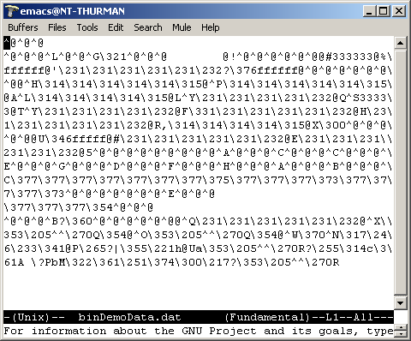
Example Data Files

Slide 3
Simple Example
<XSIL>
<Param Name=“numAtoms” Type=“Integer”/>
<Array Name=“orbitData” Type=“Double”>
<Dim>2</Dim>
<Dim>4</Dim>
</Array>
<Stream Type=“remote”>
Data File
</Stream>
</XSIL>
Data File
12
8.5, 9.6, 10.7, 3.4
18.2, 5.3, 3.1, 0.6

Slide 4
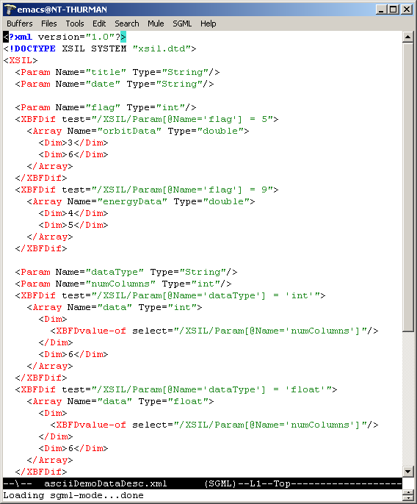
BDF Data Description

Slide 5
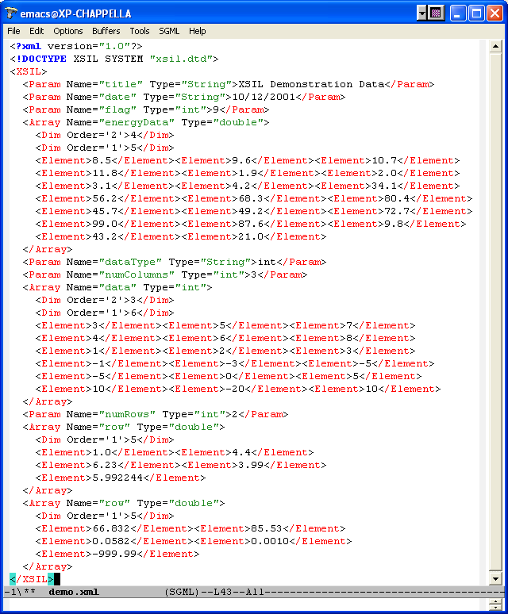
Data Parsed to XML

