Slide 1

Application Contents Service (ACS)
OGF19 January 29 - February 2, 2007@ Chapel Hill, North Carolina
ACS-WG session, Tuesday, January 30 4:00 pm - 5:30 pm (Windflower)

Slide 2

OGF IPR Policies Apply
“I acknowledge that participation in this meeting is subject to the OGF Intellectual Property Policy.”
Intellectual Property Notices Note Well: All statements related to the activities of the OGF and addressed to the OGF are subject to all provisions of Appendix B of GFD-C.1, which grants to the OGF and its participants certain licenses and rights in such statements. Such statements include verbal statements in OGF meetings, as well as written and electronic communications made at any time or place, which are addressed to:
    the OGF plenary session,
    any OGF working group or portion thereof,
    the OGF Board of Directors, the GFSG, or any member thereof on behalf of the OGF,
    the ADCOM, or any member thereof on behalf of the ADCOM,
    any OGF mailing list, including any group list, or any other list functioning under OGF auspices,
    the OGF Editor or the document authoring and review process
Statements made outside of a OGF meeting, mailing list or other function, that are clearly not intended to be input to an OGF activity, group or function, are not subject to these provisions.
Excerpt from Appendix B of GFD-C.1: ”Where the OGF knows of rights, or claimed rights, the OGF secretariat shall attempt to obtain from the claimant of such rights, a written assurance that upon approval by the GFSG of the relevant OGF document(s), any party will be able to obtain the right to implement, use and distribute the technology or works when implementing, using or distributing technology based upon the specific specification(s) under openly specified, reasonable, non-discriminatory terms. The working group or research group proposing the use of the technology with respect to which the proprietary rights are claimed may assist the OGF secretariat in this effort. The results of this procedure shall not affect advancement of document, except that the GFSG may defer approval where a delay may facilitate the obtaining of such assurances. The results will, however, be recorded by the OGF Secretariat, and made available. The GFSG may also direct that a summary of the results be included in any GFD published containing the specification.”
OGF Intellectual Property Policies are adapted from the IETF Intellectual Property Policies that support the Internet Standards Process.

Slide 3
Common procedure
Introduction
Note taker & time keeper
Agenda bashing
Presentations and discussions …

Slide 4
Agenda bashing
Overall status - where are we? what we do?
ACS Specification
Status report of the NAREGI PSE
  Prof. Usami of NII will present slides and demo
ACS part of the EMS Scenario
How we can promote the ACS (brainstorm)

Slide 5
Where were we?
GGF12 ACS-BOF: September 2004, Brussels
Approved as WG: January 2005
GGF13 first WG meeting: March 2005, Seoul, Korea
  Participation to CDDLM-WG discussions
Interim F2F: May 2005, Washington DC
  NAREGI PSE
GGF14 second WG meeting: June 2005, Chicago, IL
  Concepts, Glossary items
  Joint discussion with CDDLM-WG
Interim F2F: August 2005, RTP, NC
  Refinement of the concepts
GGF15 final WG review: October 2005, Boston, MA
ACS spec. to GGF editor: November 2005

Slide 6
Where are we?
Public Comments started: February 2006
Final spec submitted to GGF editor: May 2006
  Improvements are included to the spec.
Published on September 4, 2006
  http://www.ggf.org/gf/docs/?final
GGF18 @ Washington DC September 2006
  Reviewed status of the projects

Slide 7
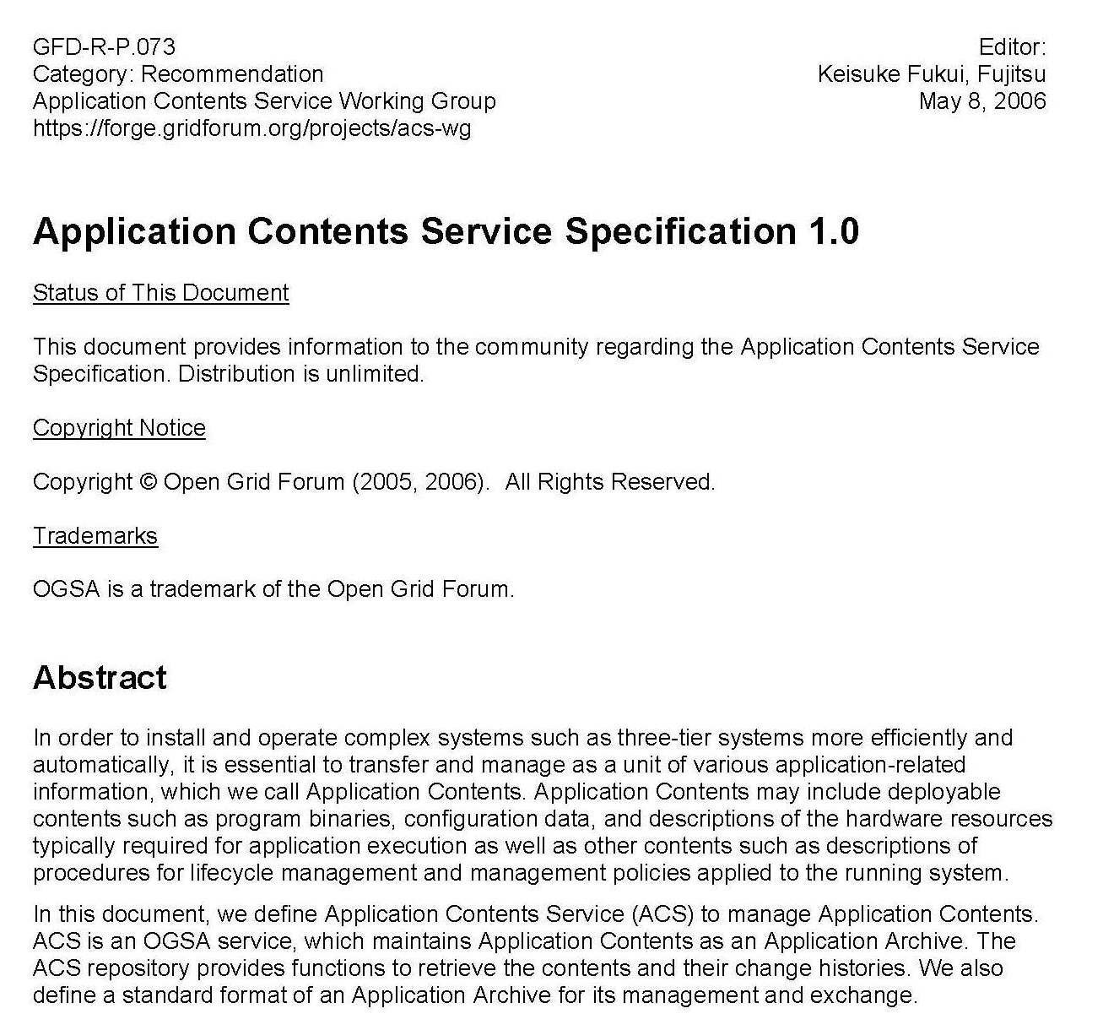
ACS Specification 1.0
81 pages in total
  Normative specification and non-normative text description
  Normative XML Schema for Archive Format and Repository I/F
Cover page looks like this->
Now you can see the specification as GFD-R-P.073 on the GGF Document Series page:
  http://www.ogf.org/gf/docs/?final

Slide 8
What is ACS?
Specification for the ACS repository.
  ACS: Application Contents Service
Application Contents Repository Interface (ARI)
  WSRF interface for ACS repository to create, retrieve, update and delete archives in the repository
Application Contents Archive transport Format (AAF)
  Transport format for contents in an archive. Information for lifecycle operations can be included in contents in a archive.
  Not a schema for internal format in a repository.
Deployment, data staging, workflow, etc.
Application
Archive
Subscribe
requests
Notify
response
contents
Application
Producer
Application
Repository
Application
Consumer

Slide 9
ACS specification 1.0

Slide 10
NAREGI PSE presentation
presented by Prof. Usami

Slide 11
ACS part of the EMS Scenario

Slide 12
Promote the ACS!

Slide 13
How we can promote the ACS
Ideas
  Contribution / collaboration with major projects
    Globus, Apache, etc.
  Demonstration of the reference/implementation of ACS
    Evaluation
  Proposal for adoption
    More use cases, business plans

