Slide 1
ACS sample implementation
Business Grid Computing Project
GGF18 September 11-14, 2006
Washington DC, USA
Notice:
All of the information included in this presentation is subject to change.

Slide 2
Intellectual Property Policy
I acknowledge that participation in GGF18 is subject to the GGF Intellectual Property Policy.
Intellectual Property Notices Note Well: All statements related to the activities of the GGF and addressed to the GGF are subject to all provisions of Section 17 of GFD-C.1 (.pdf), which grants to the GGF and its participants certain licenses and rights in such statements. Such statements include verbal statements in GGF meetings, as well as written and electronic communications made at any time or place, which are addressed to: the GGF plenary session,
any GGF working group or portion thereof,
the GFSG, or any member thereof on behalf of the GFSG,
the GFAC, or any member thereof on behalf of the GFAC,
any GGF mailing list, including any working group or research group list, or any other list functioning under GGF auspices,
the GFD Editor or the GWD process
Statements made outside of a GGF meeting, mailing list or other function, that are clearly not intended to be input to an GGF activity, group or function, are not subject to these provisions.
Excerpt from Section 17 of GFD-C.1 Where the GFSG knows of rights, or claimed rights, the GGF secretariat shall attempt to obtain from the claimant of such rights, a written assurance that upon approval by the GFSG of the relevant GGF document(s), any party will be able to obtain the right to implement, use and distribute the technology or works when implementing, using or distributing technology based upon the specific specification(s) under openly specified, reasonable, non-discriminatory terms. The working group or research group proposing the use of the technology with respect to which the proprietary rights are claimed may assist the GGF secretariat in this effort. The results of this procedure shall not affect advancement of document, except that the GFSG may defer approval where a delay may facilitate the obtaining of such assurances. The results will, however, be recorded by the GGF Secretariat, and made available. The GFSG may also direct that a summary of the results be included in any GFD published containing the specification.
GGF Intellectual Property Policies are adapted from the IETF Intellectual Property Policies that support the Internet Standards Process.

Slide 3
ACS sample implementation
Features of ACS sample implementation
  The client program and ACS repository code
  Developed in Java language using Java WS Core*
  Compact code that implements an essential part of the ARI operations
  Based on the ACS specification 1.0 (Public Comment Draft)
    Business Grid Project
      Japanese Business Grid Consortium developed a Grid middleware based on GGF OGSA, which is leveraged by many GGF WG specifications, inspiring the Application Contents Service.
      Sponsored by the Ministry of Economy, Trade, and Industry of Japan and participating companies.
      Collaborative with the Grid Technology Research Center of AIST
      Industry members include Fujitsu, Hitachi, and NEC
      Target project completion by March 2006.
* Java WS Core is provided with Globus Toolkit 4.0.x

Slide 4
Additional Information
Code steps
  Client program: 300
  ACS Repository: 2500
  Misc. code: 700
Released for public 2006 3Q.
  http://businessgrid.ipa.go.jp/acsri/download.html
  * Pages are only in Japanese and you need to agree the conditions described there before downloading.

Slide 5
Basic Structure
Both ACS Client and Repository are implemented over the GT4 Container.
Application Repository Interface
File System
SOAP / HTTP
ACS Client
ACMS
( Application Contents
Manager Service )
AA
ACM
( Application Contents Manager )
ACS Repository

Slide 6
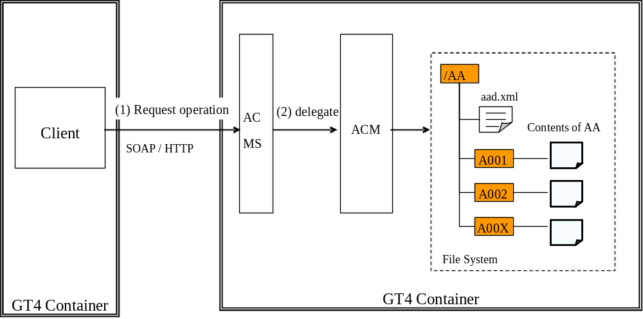
Structure of modules

Slide 7
Demo System
RHEL4 AS Update 3
Globus Toolkit Java WS Core 4.0.2
J2EE(Java EE SDK 5.0 FCS)
Apache Ant 1.6.5
Apache XMLBeans 2.1.0
ACS sample implementation 1.0.0 (2006/04/10) + patch
ACS 1.0 (2006/05/08) schemas + patch

Slide 8
Demo
Starting the GT4 containers
acs-Create
acs-LookupArchives
acs-getArchive
wsrf-get-property
wsrf-destroy

Slide 9
Structure of sample.aa
/
/
AA
AA
aad.xml
Contents in AA
A001
A001
A002
A002
A00X
A00X
File system

Slide 10
aad.xml in sample.aa
<?xml version="1.0" encoding="UTF-8"?>
<!--
All Rights Reserved, Copyright (c) 2006 FUJITSU LIMITED, Hitachi, Ltd. and NEC Corporation
-->
<aaf:AAD xsi:schemaLocation="http://schemas.ggf.org/acs/2006/04/aaf AAD.xsd"
xmlns:aaf="http://schemas.ggf.org/acs/2006/04/aaf"
xmlns:xsi="http://www.w3.org/2001/XMLSchema-instance">
<aaf:AAID>
<aaf:Name>http://www.bizgrid.org/sample2-application</aaf:Name>
<aaf:Version>1.0.0</aaf:Version>
</aaf:AAID>
<aaf:Author>
<aaf:Name>FUJITSU LIMITED, Hitachi, Ltd. and NEC Corporation.</aaf:Name>
<aaf:Description xml:lang="en">Business Grid Computing Development Project</aaf:Description>
<aaf:Location>
<aaf:Country>Japan</aaf:Country>
</aaf:Location>
</aaf:Author>
<aaf:Descriptions>
<aaf:Description>sample AA for BG-ACS</aaf:Description>
</aaf:Descriptions>
<aaf:Contents>
<aaf:Content>
<aaf:Pathname>deploy/dd.xml</aaf:Pathname>
</aaf:Content>
<aaf:Content>
<aaf:Pathname>doc/ReadMe.txt</aaf:Pathname>
</aaf:Content>
</aaf:Contents>
</aaf:AAD>

Slide 11
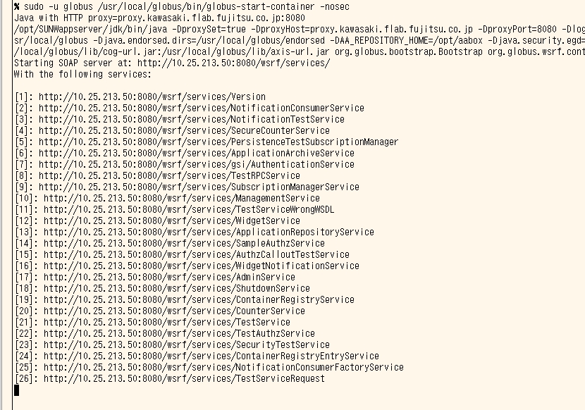
Starting the GT4 containers

Slide 12
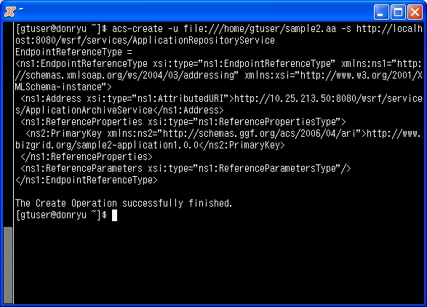
acs-Create

Slide 13
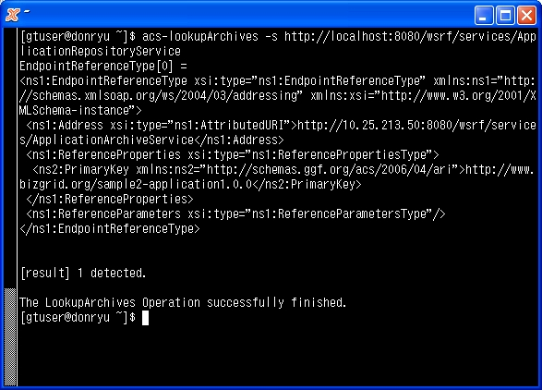
acs-LookupArchives

Slide 14
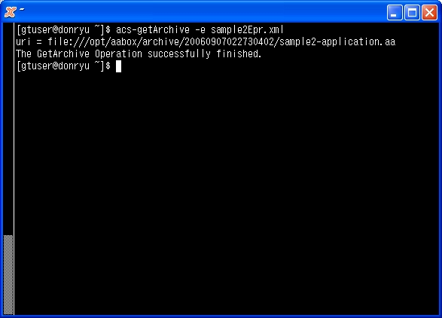
acs-getArchive

Slide 15
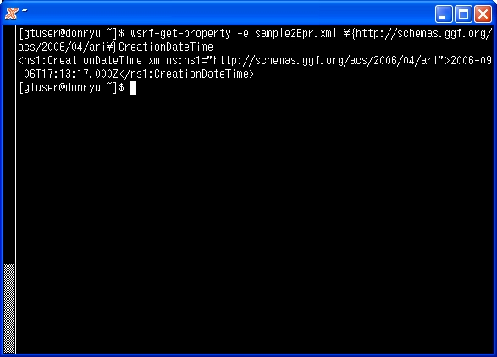
wsrf-get-property

Slide 16
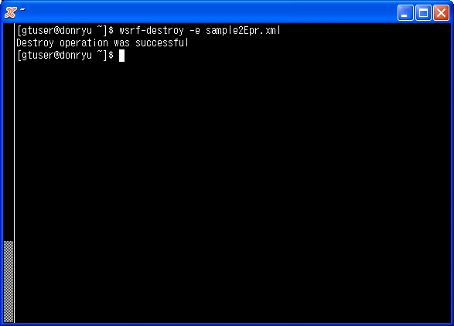
wsrf-destroy

Slide 17
Supported ARI Operations in the impl.
Supported operations on ApplicationRepository:
  Create
  LookupArchives
Supported operations on ApplicationArchive:
  GetArchive
  Operations defined in the below portTypes:
    wsrp:GetResourceProperty (wsrf-get-property), wsrl:ImmediateResourceTermination (wsrf-destroy)
Difference from ACS specifications
  Only the pathname transport is supported for TransferType and TransferMethod defined in ACS. The pathname transport is a possible extension allowed in the ACS specification 1.0.

Slide 18
Remarks on the implementation
Command line interface to demonstrate functioning.
Major operations on ApplicationRepository and Application Archive with proper error handlings.
Leverage by external project output
  GT4 Java WS Core and Apache XMLBeans

Slide 19
Rest of the work
Synchronization to the up-to-date WSRF/WS-Addressing schema
  Current GT4.0.3 implementation make use of older versions of them
Supporting more TransportedDataType
  Only “ReferenceURI” is supported.
Catching up to the final ACS specification GDR-R-P.073
  Years in copyright notice in schema
  Naming convention change for the complextType in schema
  Change of the name from “Binary” to “Embedded” in TransportedDataType
  Addtion of AAInstanceStateType

Slide 20
Thank you!

