Slide 1
Progress report on implementations
Steven Lynden
University of Manchester

Slide 2
Plan of this report
DAIS implementation overview
  Optional features defined in the specifications
  Implementation requirements
Current WS-DAIR implementation
  Design, implementation, evaluation
Work-in-progress WS-DAIX implementation
  Design decisions, progress report
Future plans
  Plans for current WS-DAIR implementation
  Testing & ensuring interoperability
Conclusions

Slide 3
Requirements
WS-DAI
Two interoperable implementations now required for each realisation
1st WS-DAIR implemented
Work on the 1st WS-DAIX has started
WS-DAIR
WS-DAIX
The specifications define:
Generic operations which can be extended
Optional port types, operations and behaviours
A means of interacting with heterogeneous resources which have various properties that must be exposed by the DAIS interfaces
Therefore it is open to interpretation what constitutes a valid implementation

Slide 4
Optional features of WS-DAI
WSRF data resource
Requires implementation of the WSRFDR port type:
  GetResourceProperty
  GetMultipleResourceProperties
  QueryResourceProperties
  Destroy
  SetTerminationTime
Resource List
The resource list maintains the abstract names and addresses of all data resources accessible through a data service.
Accessed by CoreResourceList::GetDataResourceList
CoreResourceList::Resolve translates a data resource abstract name into a list of data resource addresses

Slide 5
Optional features of WS-DAI
PreferredTargetService parameter of factory port type operations
Allows the specification of the service which should expose a resource created by a factory operation
Defined in the specification as a “hint” to the implementation which may be ignored for any implementation specific reason.
PortTypeQName parameter of factory port types
Allows the optional specification of the port type through which a created resource will be accessed.
If this is not specified, the first port type specified by the ConfigurationMap property is assumed.
ConfigurationDocument parameter of factory port types
Allows the specification of initial property values of a created data resource.

Slide 6
Optional features of WS-DAI
CoreDataAccess:GenericQuery
A message which allows general query messages to be passed to the underlying data resource.
Contains an optional input element, DatasetFormatURI, which allows a URI to be specified to define the format of the response.
A GenericExpression element may contain a URI defining the language used to construct the expression.
Transactions
The TransactionInitiation property describes how transactions are initiated.
The TransactionIsolation property describes how transactions are initiated and behave.
It is expected that WS-AtomicTransaction will be used alongside DAIS.

Slide 7
Optional features of WS-DAI
Sensitivity
The ChildSensitiveToParent property describes the sensitivity of a child data resource with respect to changes in a parent.
Concurrency
The ConcurrentAccess property indicates whether the service is able to successfully process messages concurrently.

Slide 8
Additional considerations for WS-DAIX
Assuming from the outset that access to XML collections and support for XQuery/XPath through direct and indirect access mechanisms will be implemented.
Hierarchical collections
The SupportsCollectionNesting property indicates whether the nesting of collections is supported.
The specification provides optional message parameters in various operations to manipulate nested collections.
XML Schema support
The SupportsSchemas property indicates whether XML Schema documents are used to describe the structure of any documents held in a repository.

Slide 9
Implementation requirements
The implementation of the WSRF data resource may require deployment using GT4.
Do open operations, e.g. CoreDataAccess:GenericQuery need to be implemented?
Are two implementations interoperable if one of them ignores the PreferredTargetService parameter and the other doesn’t?
Do operations need to be tested with and without their optional parameters? (e.g. PortTypeQName of factory operations)
The DAIS transactions, concurrency and sensitivity related properties expose properties of the underlying data resource. Do we need to implement & test with resources that have such properties?
Similarly for the WS-DAIX support for hierarchical collections and XML schema – do we need to implement & test with resources supporting these properties.

Slide 10
WS-DAIR implementation
A Java implementation of WS-DAIR has been developed by David Vyvyan at IBM Hursley.
A previous implementation using the OGSA-DAI engine was aborted.
The current software was developed using Apache Axis and some code-reuse from OGSA-DAI.
There are 6593 lines of code (not including code autogenerated by Axis).
Some extra features outside the specifications e.g. persistence
Brief diary:
July 19th 2005 – August 26th 2005
20 days: requirements analysis + consolidation with notes from implementation in 2004.
September 19th 2005 – November 21st 2005
30 days: basic working implementation
November 22nd 2005 – December 15th 2005
15 days: client toolkit and documentation
Delivery to OGSA-DAI CVS

Slide 11
WSDL & XSD specification conformance
All Java types were built from the WSDL messages and XSD types using the wsdl2java tool.
Some minor manual changes made to the generated Java to resolve deployment conflicts:
  e.g. AttributedURIType needed to have field names: _value and language changed manually as these names have special meaning in Axis.
There is an issue with substitution groups, whereby Java extensions of base types (mapping to WSDL substitutions) were not permitted by Axis.
  As a result of this the WSDL was altered.

Slide 12
High-level design of WS-DAIR architecture
RDB Target1
Derby
Resources
RDBConnection: externally managed, exposed by the SQLAccess service.
SQLResponse: internally managed, exposed by the SQLResponse service.
SQLRowset: internally managed, exposed by the SQLRowset service.
RDB Target2
Persistent store
RDBConnection
SQLResponse
SQLRowset
In-memory ResourcesMap (maps IDs to Resources)
SQLAccess
SQLResponse
SQLRowset
PT-A
PT-F
PT-A
PT-F
PT-A
PT-F
1
*
PT-A represents the access port type and PT-F represents the factory port type.
Additional WS-DAI port types (not illustrated) exist alongside each PT-A.

Slide 13
Resources
Each RDBConnection contains configuration information elements: name, vendor, version, JDBC URI, driver, user, password, credential.
These are specified by a properties file which is read when the service is deployed.
For example:
dai.resource.id=dair:mysql1
dai.product.vendor=MySQL
dai.product.version=4.0
dai.data.resource.uri=jdbc:mysql://localhost:3306/ogsadai
dai.driver.class=com.mysql.jdbc.Driver
dai.user.name=ogsadai
dai.password=ogsadai
The resource abstract name is assigned the resource ID.
Resource IDs are assigned by a ResourcesMap object shared by the 3 services. The ResourcesMap ensures uniqueness and recycles IDs.

Slide 14
Resources, persistence & result set caching
A SQLResponse and SQLRowSet objects can be persisted by describing it as a ‘Persisted Resource’ in the data resource description parameter of the factory configuration document.
Persistence is achieved using Apache Derby.
Sensitivity may be broken if a persisted result set is reconstructed.
Sensitivity may also be broken if the ResultSet is cached when:
  The result set was created from a parent SQLResponse resource
  The number of rows were counted (NoOfRows property queried)
  The DBMS does not support multiple open result sets from stored procedures
Caching is achieved by [ result set -> WebRowSet -> result set ] conversion using OGSA-DAI code.

Slide 15
Resource properties
TransactionInitiation and TransactionIsolation apply directly to the DBMS settings set on the JDBC Connection wrapped by the RDBConnection resource.
Concurrency works for all resource types.
The DatasetMap maps every response message QName to a dataset format URI. The only supported format is currently WebRowSet.
If a child resource is created with initial insensitive sensitivity and its parent is sensitive, then all its internal result sets will be cached to be made independent.
The NoOfRows property is only set when queried because setting it involves parsing the result set and counting its rows.

Slide 16
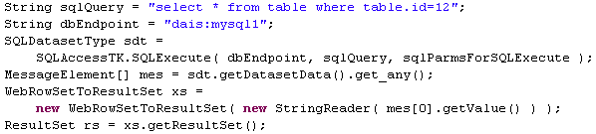
Client toolkit
Provides a Java API for WS-DAIR.
Handles the construction of requests and the extraction of data from output messages.
Example direct access SQL query:

Slide 17
WS-DAIR Evaluation
Optional Feature |  | Supported by WS-DAIR
 | WSRF data resource | NO
 | Resource List | YES
 | PreferredTargetService parameter | NO
 | PortTypeQName parameter | YES
 | ConfigurationDocument parameter | YES
 | CoreDataAccess::GenericQuery | NO
 | Transactions | YES
 | Sensitivity | YES (with constraints)
 | Concurrency | YES
Testing strategy needed, faults need to be implemented

Slide 18
WS-DAIX – options for implementation
The attempt to implement WS-DAIR using OGSA-DAI (release 5) was aborted because:
  There was no support for modelling state in activities
  The implementation required multiple output streams from single activities
The new OGSA-DAI (release 7) allows resources to be dynamically deployed:
  This allows new resources to be created in-line with the DAIS approach
  It means that (1) and (2) are no longer required
This makes building WS-DAIX on top of OGSA-DAI feasible.

Slide 19
Option 1 : Implement WS-DAIX without using the OGSA-DAI engine.
XML
Data service
XML DB
WS-DAIX port types
Pros
Possible to use the WS-DAI specifications without heavyweight OGSA-DAI installation.
Probable performance improvement over any implementation using OGSA-DAI.
Code reuse from the WS-DAIR implementation
will be possible.
Cons
Distinct code-bases to maintain. Could be costly to maintain as a result.

Slide 20
Option 2: Integrate with OGSA-DAI
The OGSA-DAI data service is extended to implement WS-DAIX
OGSA-DAI accepts perform documents which are parsed and translated into Request objects encapsulating activity DAGs.
The WS-DAIX implementation methods submit Request objects to perform the WS-DAIX operations using OGSA-DAI activities:
xPathStatement | Run an XPath statement against an XML database.
xUpdateStatement | Run an XUpdate statement against an XML database.
xmlCollectionManagement | Create or remove collections within an XML database.
xmlResourceManagement | Create or remove resources within an XML database.

Slide 21
Pros and cons of the integrated approach
Pros
Some insulation from platforms, drivers etc. will be provided by the OGSA-DAI layer.
Provides an alternative interface to existing OGSA-DAI users. For example, an optional “provide DAIS interface” feature which deploys OGSA-DAI with the DAIS operations.
Cons
WS-DAIX will be implemented using a different approach than the WS-DAIR implementation. If WS-DAIX is integrated with OGSA-DAI,
will WS-DAIR follow?
Performance …
OGSA-DAI data service
WS-DAIX port types
impl
OGSA-DAI port types
impl
XML DB

Slide 22
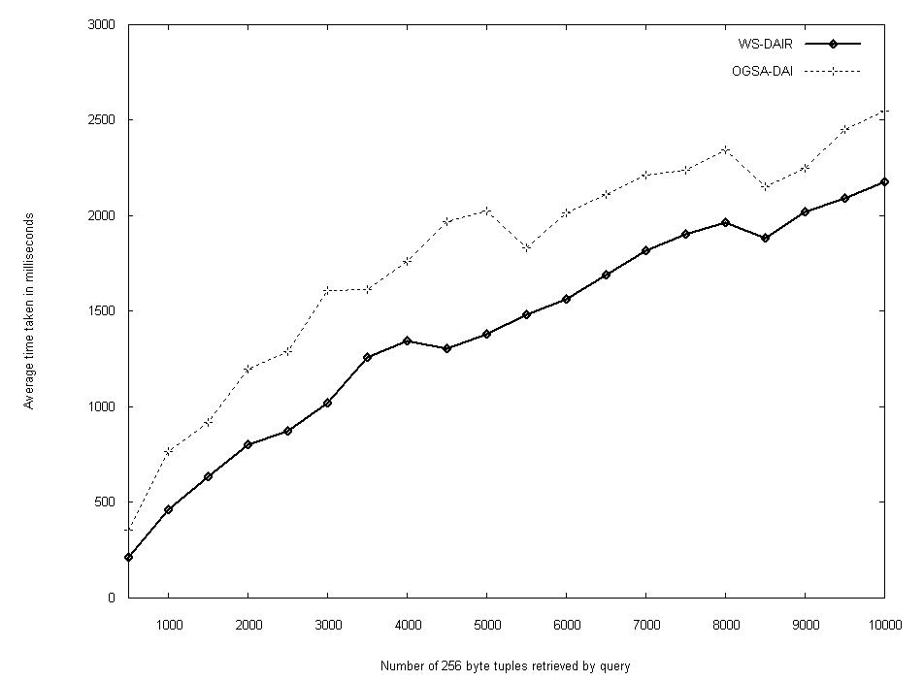
IBM WS-DAIR vs OGSA-DAI release 7 (WSI 2.1)

Slide 23
Current status
Following the integrated approach.
Taking advantages of new OGSA-DAI functionality for release 8:
  Lightweight dynamic data resource deployment
  Support for eXist DB
  XQuery activity
This work is currently in the early stages of development – adding the WSDL and starting to implement the operations …

Slide 24
Future plans
Release WS-DAIX-OGSA-DAI as a tech preview.
The existing WS-DAIR standalone implementation will also be made available.
If WS-DAIX is integrated with OGSA-DAI then WS-DAIR will become simpler as we will then have a template for WS-DAIR.
When the WS-DAIX implementation is ready, the WS-DAIR implementations will be modified to follow the same approach.
Eventually, WS-DAIX / WS-DAIR will become part of the OGSA-DAI release.

Slide 25
Testing
There are no unit or system tests for the WS-DAIR implementation.
OGSA-DAI has thorough unit tests, so the activities etc. used by the integrated approach will have unit tests.
System tests for WS-DAIX & WS-DAIR required.
They will test WS-DAI functionality, but it is impossible to test WS-DAI on its own.

Slide 26
Interoperability
To define DAIS interoperability, we need to do the following for WS-DAIX and WS-DAIR:
  Define a plausible scenario that can be used for the basis of interoperability testing.
  Come up with a sequence of operations and property queries which adequately test the [(WS-DAIR or WS-DAIX) + WS-DAI] under that scenario
  For each request/response in this sequence, define the correct:
    The XML input
    The XML output
  Execute the sequence of requests, checking that the correct response is received in each case.

Slide 27
Strategy for system testing & interoperability testing
The plan is to compose a GGF Informational document describing test scenarios for WS-DAIX & WS-DAIR, detailing:
  Starting conditions e.g. the resources, data, configuration properties
  The service interfaces and message sequences
  The XML of the SOAP envelopes of each input/output
The document forms the basis of deciding whether two implementations are interoperable.
A set of system tests will be constructed for WS-DAIX and WS-DAIR using Junit.
The system tests can be executed to test interoperability across multiple implementations.

Slide 28
Conclusions
Two implementations have been presented:
  WS-DAIR implementation based on Axis
  Work-in-progress WS-DAIX implementation based on OGSA-DAI
When WS-DAIR is moved over to OGSA-DAI some of the extra features e.g. persistence will be lost.
Decisions still need to be made about the support for optional features such as the WSRF data resource
A strategy for testing has been presented, which will be used to:
  System test the individual implementations
  To ensure that the subsequent implementations are interoperable

