Slide 1

Database Access and Integration Services (DAIS) Working Group
OGF28
Chairs: Mario Antonioletti (EPCC), Isao Kojima (AIST)

Slide 2
OGF IPR Policies Apply
“I acknowledge that participation in this meeting is subject to the OGF Intellectual Property Policy.”
Intellectual Property Notices Note Well: All statements related to the activities of the OGF and addressed to the OGF are subject to all provisions of Appendix B of GFD-C.1, which grants to the OGF and its participants certain licenses and rights in such statements. Such statements include verbal statements in OGF meetings, as well as written and electronic communications made at any time or place, which are addressed to:
    the OGF plenary session,
    any OGF working group or portion thereof,
    the OGF Board of Directors, the GFSG, or any member thereof on behalf of the OGF,
    the ADCOM, or any member thereof on behalf of the ADCOM,
    any OGF mailing list, including any group list, or any other list functioning under OGF auspices,
    the OGF Editor or the document authoring and review process
Statements made outside of a OGF meeting, mailing list or other function, that are clearly not intended to be input to an OGF activity, group or function, are not subject to these provisions.
Excerpt from Appendix B of GFD-C.1: ”Where the OGF knows of rights, or claimed rights, the OGF secretariat shall attempt to obtain from the claimant of such rights, a written assurance that upon approval by the GFSG of the relevant OGF document(s), any party will be able to obtain the right to implement, use and distribute the technology or works when implementing, using or distributing technology based upon the specific specification(s) under openly specified, reasonable, non-discriminatory terms. The working group or research group proposing the use of the technology with respect to which the proprietary rights are claimed may assist the OGF secretariat in this effort. The results of this procedure shall not affect advancement of document, except that the GFSG may defer approval where a delay may facilitate the obtaining of such assurances. The results will, however, be recorded by the OGF Secretariat, and made available. The GFSG may also direct that a summary of the results be included in any GFD published containing the specification.”
OGF Intellectual Property Policies are adapted from the IETF Intellectual Property Policies that support the Internet Standards Process.
Notes:
IPR Notices Note Well for OGF meetings

Slide 3

Outline
Background
Brief overview of DAIS
Documents
Documents in preparation
Implementations
Next Steps
More information on the WS-RDF specs
Discussion

Slide 4
Background
Database Access & Integration Services Working Group
  Been around since GGF4 (BoF Session)
Aim:
  Provide consistent WS-based access methods to databases
Achieve through a:
  Generic (Core) specification
  Extend (Realise) for other data models
Realisations thus far:
  Relational
  XML
  RDF
  …

Slide 5
Interface types
Three main types of interface:
  Data Description
    provide information about a service/data resource accessed through a service.
  Data Access
    provide access to data through a service interface.
  Data Factory
    provide indirect access to data through a client specified interface.
Can be combined

Slide 6
Access Patterns
Direct Access
Request
Consumer
Data Service
Response
Indirect Access (Factory)
Request
Consumer
Data Service
EPR
Derived
data
Data Service
Direct
Access

Slide 7
A DAIR Example
Data Service
Data Description
SQLAccess
SQL AccessFactory
Data Service
Data Description
Result Set
SQLResponseAccess
SQLResponseFactory
Data Service
Data Description
SQLRow Set
SQLRowSetAccess

Slide 8
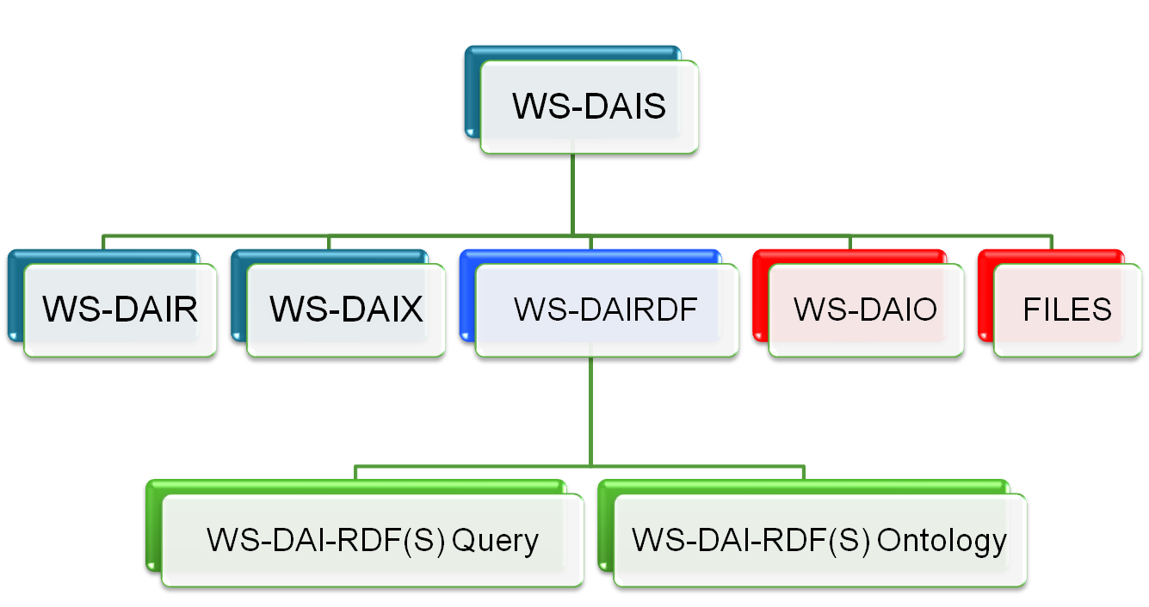
Document Hierarchy
Notes:
Blue – is already in the informational/recommendation track
Green – in progress
Red - dead

Slide 9
Documents
Recommendation Track:
  Web Services Data Access and Integration – The Core (WS-DAI) Specification, Version 1.0
    http://www.ogf.org/documents/GFD.74.pdf
  Web Services Data Access and Integration – The Relational Realisation (WS-DAIR) Specification, Version 1.0
    http://www.ogf.org/documents/GFD.76.pdf
  Web Services Data Access and Integration – The XML Realization
    http://www.ogf.org/documents/GFD.75.pdf
Informational:
  Interoperability Testing for DAIS Working Group Specifications
    http://www.ogf.org/documents/GFD.77.pdf
Experimental
  WS-DAI and WS-DAIR Implementations - Experimental Document
    http://www.ogf.org/documents/GFD.160.pdf

Slide 10
Documents in preparation
In Preparation (available from Grid Forge)
  WS-DAI-RDF(S) query specification
    http://forge.gridforum.org/sf/go/doc14074?nav=1
  WS-RDF(S) ontology specification, profile 0
    http://forge.gridforum.org/sf/go/doc15613?nav=1

Slide 11
Where are we?
Draft
WS-RDF(S)-*
Proposed
Recommendation
WS-DAIX
Editor /
GFSG Review
Interoperability
Testing
Public Comment
Interop doc
Experimental
Document
Author
Revision
WS-DAI
WS-DAIR
Elaborate Formal
Review Process
Editor /
GFSG Review

Slide 12
Implementations
WS-DAIR Interop (requires WS-DAI)
  OGSA-DAI & AMGA implementations
  Result:
    17 changes/clarifications for WS-DAI
    32 changes/clarifications for WS-DAIR
Current status:
  Waiting for OGF report to take to recomm. status
  Need to implement the changes

Slide 13
Next Stages
Take WS-DAI & WS-DAIR to recommendation status
  Mario Antonioletti to stand down as DAIS chair
  Oscar Corcho willing to take over
    Needs to be approved by the working group
WS-DAI recommendation
  WS-DAI-RDF(S) query →public comment
  Interop between AIST & UPM
  Experimental document
WS-DAIX needs another implementation
WS-DAI-RDF(S) needs to be progressed

Slide 14
Becoming involved
Join the mailing list
  Details on the DAIS-WG project page
Attend telcons
In the near future hope to:
  Do WS-DAIX interoperability
  Do WS-DAI-RDF(S) Query interoperability
Help complete the WS-DAIRDF specs
Implement one or more of the specs

Slide 15
Full Copyright Notice
Copyright (C) Open Grid Forum (2010). All Rights Reserved.
This document and translations of it may be copied and furnished to others, and derivative works that comment on or otherwise explain it or assist in its implementation may be prepared, copied, published and distributed, in whole or in part, without restriction of any kind, provided that the above copyright notice and this paragraph are included on all such copies and derivative works.
The limited permissions granted above are perpetual and will not be revoked by the OGF or its successors or assignees.
Notes:
OGF Full Copyright Notice if necessary

