Slide 1

Data Design Team
Dave Berry
10th Dec 2004

Slide 2


Status
Active, weekly telcons
Wins:
  Engaging WGs
  Naming discussion ⇨ Naming design team
  Scenarios for metadata
Issue: Architecture strawman

Slide 3


Candidate Specs
WS-DAI
  No conflicts
GFS RNS
  Closer integration with OGSA
  ⇨ Naming
BasicFile
  POSIX-style IO
  via GSF WG?
  c.f. XIO?
SRM?
  with GSM WG
GridFTP

Slide 4
Soliciting interested WGs
DAIS, GFS & InfoD fully engaged
GSM
  We talked to GSM at GGF12 (& before)
  SRM seems to be well advanced
CGS (CIM Grid Schema)
  Aware of their activity
GridFTP not engaged
  GridFTP spec already submitted
OREP
  Inactive
DFDL
  Not engaged

Slide 5
Soliciting interested projects & vendors
EGEE
  Implementation of WS-based file replication etc.
NextGrid
  Input via NeSC
SRB
  Not engaged
  May be a source of expertise
Vendors
  IBM, Oracle, Avaki, …

Slide 6
Links to EMS
Access to input/output data
  Staging files or dedicated network bandwidth
Status of long-running operations
  SQL is Turing complete
  Mobile code (e.g. stored procedures)
Derived data products
  May be generated by computations

Slide 7
Some Metadata Stories
Delivery - Sue
  move data (e.g. a file) from one service to another
  third-party delivery
  triggered data movement
Access – Simon/Mario
  access a remote file
  query a (non-stream) resource with a synchronous reply (1.2)
  query a (non-stream) resource with a asynchronous reply
  submit a query to a stream resource
Management - ?
  add, rename, delete files at a remote location (i.e. directory services)
  add, rename, delete database content at a remote location
Replication/Cache - Dave
  maintain a replica of a file at a different location (for availability)
  maintain a replica of an RDBMS at a different location (for availability)
  maintain a replica of a file at a different location (for performance)
  maintain a replica of an RDBMS at a different location (for performance)
  create a local cache of remote data
  maintain a user's personal distributed data area
Composition – Kostas/Malcolm
  connect output from one service to input of another
  setting up process & data pipelines
  batching a set of tasks over data.
Federation - Allen
  federate several data resources
  query a federated resource
Discovery - ?
  discover data
  register data
Grid constants/vocabularies/ontologies – Scott, Stephen
  Find me all the services that can convert one data type to another (must understand the types)
  Find all the services that allow write to a given data source (common understanding of write)
Notes:
These are data atories that we brainstormed as candidates for exploring with regard to metadata needs. This list is not canonical. Red ones have some work done
1.1 = 5.1
2.1 = 2.2

Slide 8
Some architecture issues
The next few slides are some thoughts on architectural issues
  Not agreed by design team as a whole
Connecting services
  Virtualise connections
  Streaming
  Move into base profile?
EGEE architecture
  Base for straw man?
  Problem: doesn’t handle updates
  Need DAIS work on top.

Slide 9
5.1 Connect S1’s output to S2’s input
Service 1
MetaDataQuery
MetaDataUpdate
Data service
metadata
MetaDataDelete
MetaDataAugment
MetaDataSubscribe
ControlTransport
DTM
Client
Service 2
DTM
Data
ControlTransport
MetaDataQuery
MetaDataUpdate
Data service
metadata
MetaDataDelete
MetaDataAugment
MetaDataSubscribe

Slide 10

Connection/Delivery Metadata
Data Source
  data interfaces/selection
    All, head, tail, select
  data formats
    Application (FITS), generic (rowset), described (DFDL)
  data bindings
    HTTP, FTP, MPI, file, in memory
  data transformation
    From what to what
  data treatment
    encryption, compression
  data constraints
    Expected size, Maximum size
    Maximum rate
    Timeouts
    stream, bulk, block
  Logging
    What, where, when
  Notification
    What, where, when
  QoS
    Transactions etc.
  Security
    Who, what, privacy
Data Target
  data interfaces/selection
    All
  data formats
    Application (FITS), generic (rowset), described (DFDL)
  data bindings
    HTTP, FTP, MPI, file, in memory
  data transformation
    From what to what
  data treatment
    de-encryption, de-compression
  data constraints
    Expected size, Maximum size
    Maximum rate
    Timeouts
    stream, bulk, block
  Logging
    What, where, when
  Notification
    What, where, when
  QoS
    Transactions etc.
  Security
    Who, what, privacy
Notes:
Two points of view:
An endpoint taking part in the data transfer
A consumer who is specifying the data transfer

Slide 11
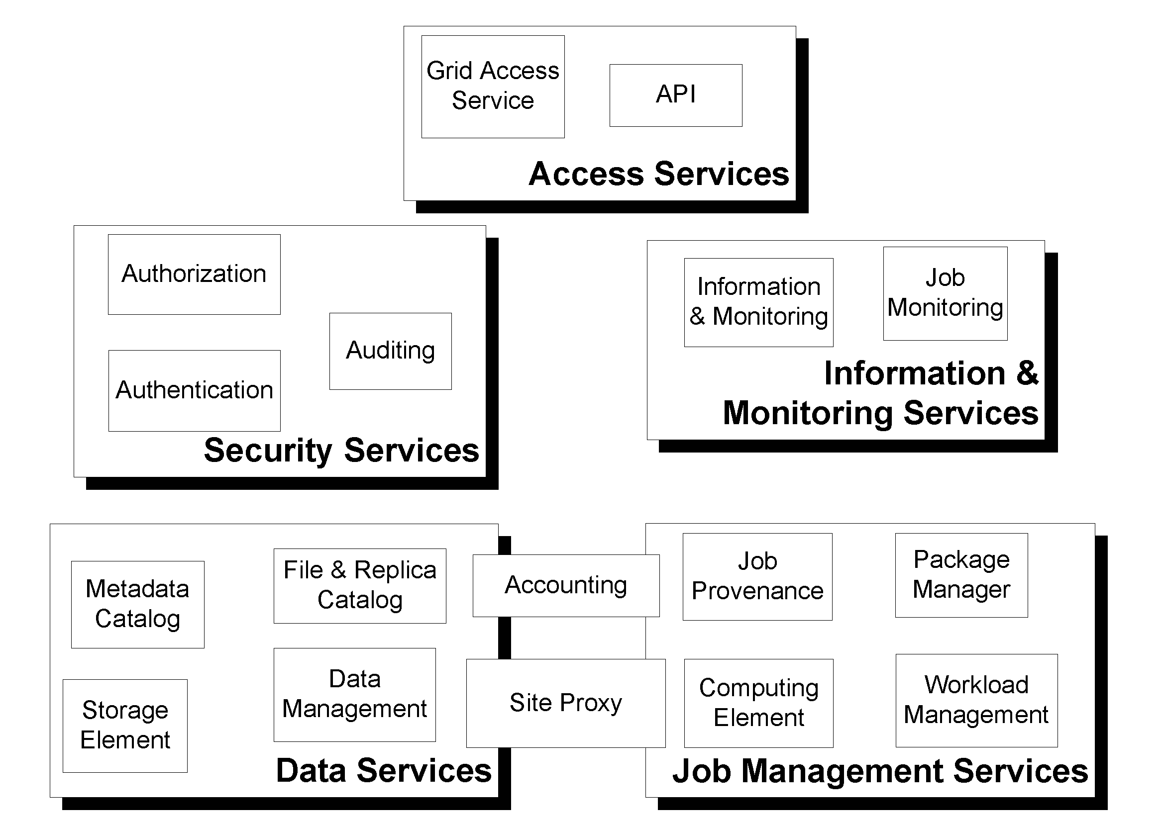
GLite: Web Services for EGEE
Focus is upon interfaces that can be composed into useful services
Notes:
File Catalog
Management of the logical namespace
Replica Catalog
Tracking of file replicas
Metadata Catalog
Application specific metadata
In particular, metadata used to select logical files
Combined Catalog
Added functionality by orchestration of the 3 catalogs (providing transaction safety)
Storage Element
Where the files get stored
SRM interface (see GGF Grid Storage Manager WG)
Manage a Storage Resource
Space reservation
Put and retrieve files using various protocols
Not to be consfused with the SRB system, which is completely different.
Posix-like File I/O
Most posix-compliant feature support
Abstraction over existing MSS IO mechanisms
Data Management:
File Transfer Service
Reliable transfer of files between two sites
File Placement Service
Transfer and register files
Orchestrate File Transfer and Data Catalog services
Data Scheduling Service
Event-based data transfer, using File Placement Service

Slide 12
EGEE Storage Functionality
Storage Resource Manager interface
  File copying and replication
  File management and control
  Using SRM standards [GSM WG]
  (with possible evolution)
Posix-like file I/O
  Direct file access
  Open, read, write
Control
POSIXAPI
File I/O
SRM interface
User
rfio
dcap
chirp
aio
Castor
dCache
NeST
Disk
Notes:
SRM = Storage Resource Manager, a common API for accessing mass storage systems. This is not to be confused with SRB, the Storage Resource Broker.

Slide 13
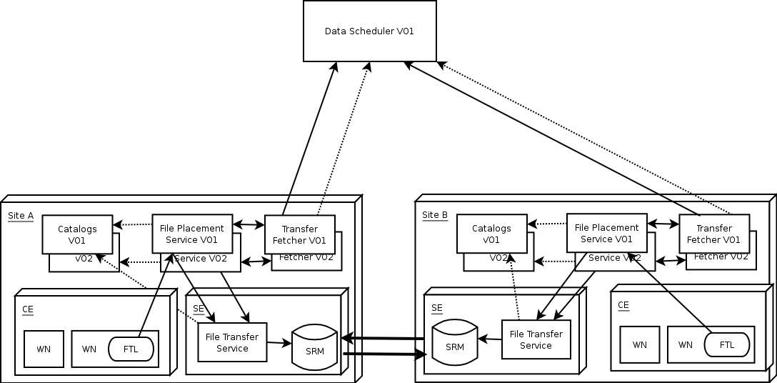
Data management
(file replication)
Scheduled data transfers
(like jobs)
SRM based storage
Reliable file transfer
Current model:
dotted line = query
full line = request
single box = service per site
double box = service per VO

Slide 14
More metadata stories
The remaining slides show some of the metadata stories
Show the services involved
Answer four questions
  What metadata is needed?
  Does a spec exist?
  Where can it be retrieved from?
  What is the authoritative source?
Identify possible gaps for specification work

Slide 15
4.1, 4.3 Maintain a replica of a file at a different location
Consumer
Add/Remove
Storage
Element
Access/Update
MetaData…
Replica
Catalog
Notify Update
Send/Receive
Data
Transfer
MetaData…
Move
Query Location
MetaData…
Management
Send/Receive
Storage
Element
Add/Remove
MetaData…
Access/Update

Slide 16
4.1, 4.3 Maintain a replica of a file at a different location
What metadata | Does a spec exist | Where retrieved from | Authoritative source
File ‘stat’ data (creation time, ACL, etc). | ? | Resource properties of data service or replica catalogue | Data service lookup operations(?)
File locations | ? (It’s a simple map) | Replica catalogue. | Replica Catalogue lookup operations
Replication policies | Probably not. | Replica catalogue | Replica Catalogue WSDL

Slide 17
4.1, 4.3 Maintain a replica of a database at a different location
Consumer
Manage
Storage
Element
Query/Update
MetaData…
Replica
Catalog
Notify Update
Send/Receive
Data
Transfer
MetaData…
Move
Query Location
MetaData…
Management
Send/Receive
Storage
Element
Manage
MetaData…
Query/Update

Slide 18
4.1, 4.3 Maintain a replica of a database at a different location
What metadata | Does a spec exist | Where retrieved from | Authoritative source
Data model & schemas | CIM? | Data service (or catalogue?) | Data service management operations
Database locations | ? (It’s a list) | Replica catalogue. | Replica Catalogue lookup operations
Replication policies | Probably not. | Replica catalogue | Replica Catalogue WSDL

Slide 19
4.5 Create a local cache
Consumer
Cache
Storage
Element
MetaData…
Access/Update
Notify Update
MetaData…
Access/Update
Send/Receive
Management

Slide 20
4.5 Create A Local Cache
What metadata | Does a spec exist | Where retrieved from | Authoritative source
Data service metadata | <as appropriate to the data service> | Cache | Data service metadata
Cache status | Probably not | Cache | Cache WSDL
Caching policies | Probably not. | Cache | Cache WSDL

Slide 21
6.1 Creation of a federating data service
Data Resource 2
(DR2)
Data Service
Data resource
metadata
Sources:
LN1: DR2
DR1
Data
LN1: DR2, DR3, DR4
Creating Application
Data Service Factory
Create (DR1, LN, <output schema>)
Data Source MetaData
Query
Data Resource 1
(DR1)
Data resource
metadata
Data
Notes:
The story: Some application requests creation of a data service from a suitable factory. The creation oepration specifies a concrete data source (DR1) and a logical name for data, LN1 (e.g., “Customer data”). (We could extend this picture to include access to a second repository of metadata that allows the application to find the factory. We do not do this due to lack of space.)
The factory will find a repository which knows about data sources (and, yes, another opportunity for a metadata search). It will send a query to that repository asking for repositories that can supply data denoted by LN1. Back comes a list of sources (DR2, DR3 and DR4). The factory chooses to use DR2.
The factory now sends a query to DR1 and DR2 asking for metadata about the data contained in the data source. Back will come back, for instance in the relational case, table names, column names and column types of the data in the database.
The factory uses this metadata to create a data service that uses DR1 and DR2 as data sources. It is beyond the scope of this scenario to discuss how the data from DR1 and DR2 are used to provide the data requested of the data service.

Slide 22
6.1 – Creation of a federating data service
What metadata | Does a spec exist | Where retrieved from | Authoritative source
Data structure, DB Schema XML Schema Binary structure | CIM XSD DFDL | Resource properties of data service | Data resource which may be a data service ?
Descriptive information about data sources | None (?) | Repository of metadata about data sources | Data service or data resource

Slide 23
6.2 Dynamic access to an alternative data resource
Data Resource 2
(DR2)
Data Service
Data resource
metadata
Sources:
LN1: DR2 DR3
DR1
Broken or poor QoS
Query
Data
Query: LN1?
LN1: DR3
Application
Data Source MetaData
Data Resource 1
(DR1)
Data Resource 3
(DR3)
Data resource
metadata
Data resource
metadata
Data
Data
Notes:
The story: the data service receives a query from the application. The query requires access to both of the underlying data sources behind the data service. The data service determines that DR2 is no longer a suitable source of data. It may be down at the moment or it may not be providing the required QoS. As a result, the data service must find an alternative way to satisfy that part of the query that refers to LN1. To do that, the data service consults a repository of data sources looking for one whoe regsitered metadata indicates that it has the data denoted by LN1. The repository returns “DR3”. The data service now proceeds as in the creation case to query DR3 for the metadata needed by the data service to satisfy queries against LN1. Once that is obtained, the approppriate part of the query is passed to DR3, results returned and combined with results from DR1 and the final result returned to the application.

Slide 24
6.2 – Query of a federating data service
What metadata | Does a spec exist | Where retrieved from | Authoritative source
Data structure, DB Schema XML Schema Binary structure | CIM XSD DFDL | Resource properties of data service | Data resource which may be a data service ?
Descriptive information about data sources | None (?) | Repository of metadata about data sources | Data service or data resource

Slide 25
7.2 Discover data
Data Resource
Metadata Service/Registry
(Data Service)
MetaDataQuery
Data resource
metadata
MetaDataUpdate
Data service
metadata
MetaDataDelete
MetaDataAugment
Entries (Data)
MetaDataSubscribe
Additional
metadata
Ref
Query
Classify
Service/resource
metadata
Publish
Consumer
Data Service
Data dictionary /
Ontology?
MetaDataQuery
MetaDataUpdate
Data service
metadata
MetaDataDelete
MetaDataAugment
Data Resource
MetaDataSubscribe
Data resource
metadata
Query
Data

Slide 26
7.2 Discover data
What metadata | Does a spec exist | Where retrieved from | Authoritative source
Data structure, DB Schema XML Schema Binary structure | CIM XSD DFDL | Registry | Data resource or data service ?
Query structure SQL XQuery | SQL99 etc XQuery, XQueryX | Registry | Data service WSDL
Result structure Rowset | WebRowset | Registry | Data service WSDL

Slide 27
What next?
Contact other groups
  GSM, DFDL

