Slide 1
DMTF and Cisco Profile overview/comparison
August 17, 2005

Slide 2
What Is a Profile?
A Profile is a specification that defines the subset of the CIM Schema and associated behavior for a management domain
The management domain is a set of related management tasks
DMTF is currently planning on a document based specification for Profiles
  Cisco working towards an XML based specification from which a document can be generated.

Slide 3
DMTF Profile definition 1of 5
Synopsis
  Profile name
  Version
  Organization
  CIM Schema version (on which the profile is based)
  Specializes <org><name><version>
  Cisco: Experimental, Final, Deprecated
  One paragraph summary that may be used in other documents to describe the profile

Slide 4
DMTF Profile definition 2 of 5
Description (management domain & model overview)
Implementation Requirements/Guidelines (informative)
Methods
  Class Methods
    1 to 2 paragraph description
    Table specifying the return values and parameters
    Table specifying standard messages
  Intrinsic Methods (3 different table options)
    Mandatory, Optional, Unspecified
Cisco: Included in the CIM Elements section

Slide 5
DMTF Profile definition 3 of 5
Related Profiles and Conditional Behavior
  Table format with the following columns
    Profile name
    Organization
    Version
    Requirement (Optional, Conditional, Mandatory)
    Description
  Conditional behavior subclauses
Cisco: Constraints specified by OCL

Slide 6
DMTF Profile definition 4 of 5
Use Cases
  Defines the steps required to accomplish some goal and the affects to the model
  Different starting conditions and ending conditions
  All class methods included in the use cases (instance/object and sequence diagrams)
Cisco: Various instance/sequence diagrams that also illustrate “conditional” CIM elements
Cisco: Included in the method definition in the CIM Elements section

Slide 7
DMTF Profile definition 5 of 5
CIM Elements
  Overview table has rows for Classes and Indications. Columns for:
    Element name (class or filter)
    Requirement
    Description
  Each class has a separate subclause
    Description (relationship of class to underlying implementation)
    Subclause Table has rows for properties and methods. Columns for:
      Element name
      Requirement
      Description (reference to Method section, values)
Cisco: Properties, Methods, & Associations

Slide 8
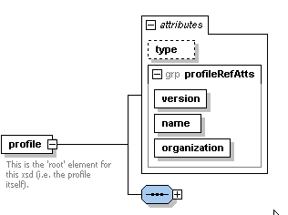
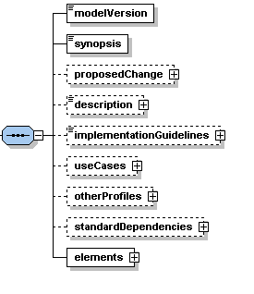
Cisco Parts of a Profile
Enumeration: Exp, Final, Dep
strings
CR tracking

Slide 9
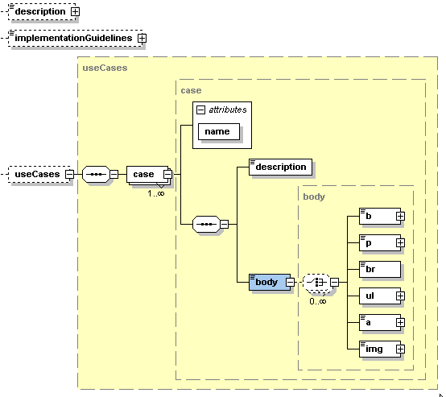
Cisco Parts of a Profile - details 1 of 3
of type “body”
of type “body”

Slide 10
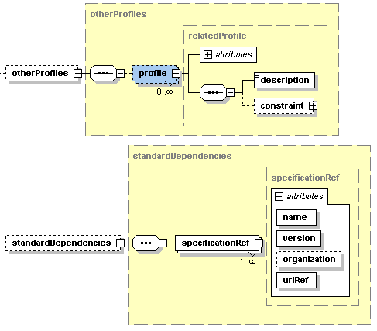
Cisco Parts of a Profile - details 2 of 3
Name, Organization, Version, RequirementsLevel
Language, Constraint, Description

Slide 11
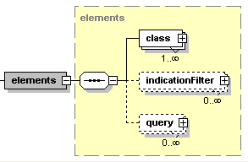
Cisco Parts of a Profile - details 3 of 3

Slide 12
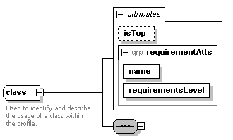
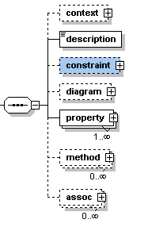
Cisco Parts of a Profile - class
Constraint describing how to distinguish “context”
string
Language, Constraint, Description
WORK in PROGRESS for auto-gen of model diagrams

Slide 13
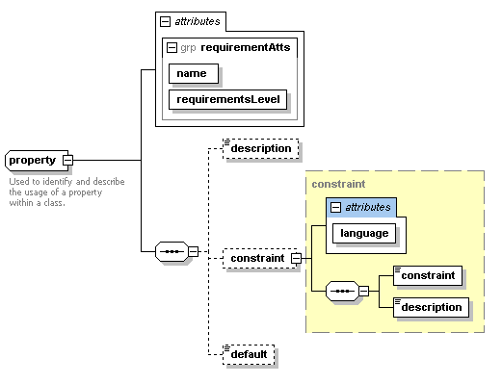
Cisco Parts of a Profile – class: property
Enumeration
body
Value(s) or Pattern

Slide 14
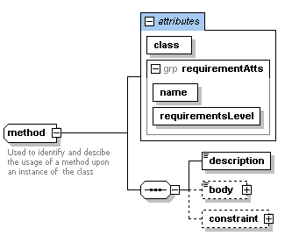
Cisco Parts of a Profile – class:method
string
Text, State, and/or sequence diagrams
Language, Constraint, Description

Slide 15
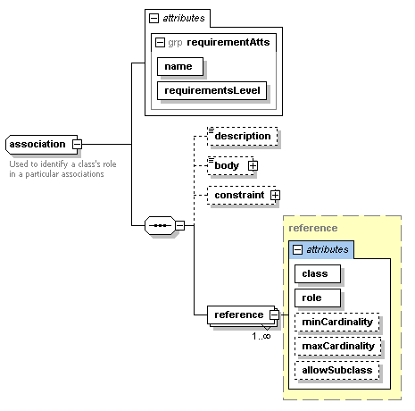
Cisco Parts of a Profile – class:assoc
string
Language, Constraint, Description
Other participant(s) in the association
“MODEL” | #
boolean

Slide 16
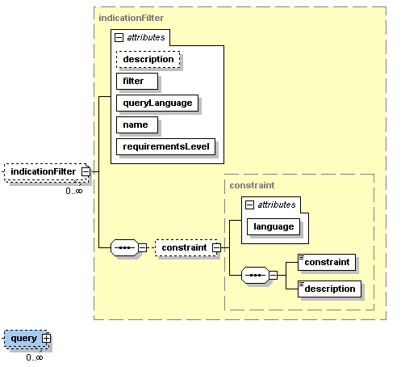
Cisco Parts of a Profile – Filters

Slide 17
Example

