Slide 1
Building Federations: Honest Experiences From Contrail and EUDAT
Jens Jensen,
STFC RAL
Contrail and EUDAT projects
FEDSEC-WG, OGF 39, Madrid

Slide 2








Federation
abstraction of providers
selection and deployment by description, providing unified approach
single authentication/authorisation framework covering all resources
Federation
contrail-project.eu
Notes:
Here comes the Federation. Federation is our answer to current diversity and division of cloud solutions. What exactly is federation?
Federation is an abstraction of providers. The abstraction gives us interoperability, where we have a unified approach to description of the applications as well as unified way of deploying it to different providers, automatically, if requested. The user experience remains the same regardless of the provider.

Slide 3
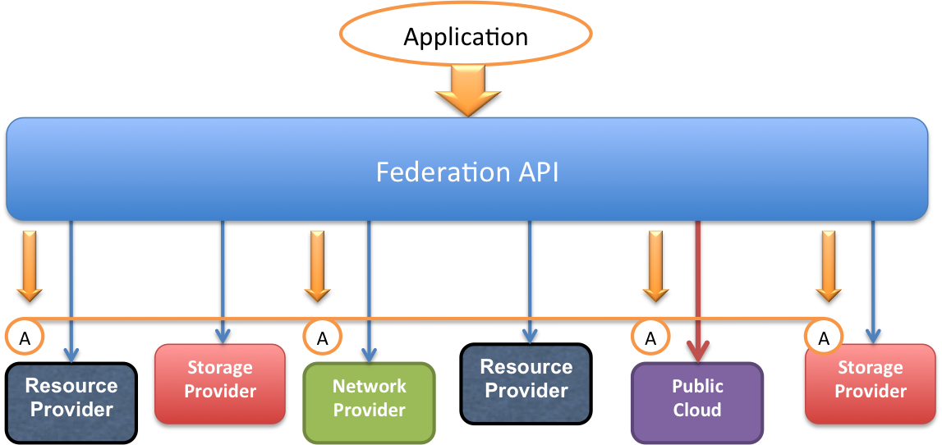
Contrail Objectives: Elastic PaaS Services over a Federation of IaaS Clouds
Cloud Federation
ConPaaS Elastic Services
Web applications
Bag of Tasks
MapReduce
SQL & NoSQL
Interoperability
Advanced SLA
Security
Scalability

Slide 4
Static Services (non-elastic)
Essential to establish trust in the infrastructure
Required to use IGTF or commercial
Can industry always get IGTF (nearest RA?, community)
Commercial for browser-facing services
Testing and integration always use ad-hoc

Slide 5
Recent Progress
Google
Yahoo
IdP
Bridge
Auz Svr
Umbrella
Account creation
LoA set
Attribute update (eg email)
WAYF
DB
IdP

Slide 6
Authentication workflow
CA
WEB
FAPI
Core
Contrail
IdP
AS
External
IdP

Slide 7
Use of Certificates
OAuth only for delegating the credential
Non-Web stuff
Carries identity information
Carries authorisation information (extensions)

Slide 8

Authorisation and Access Control
PEP
Resource
Federated Id
OK
X reject
+ suspend
PIP
PDP
DB
Subscr.
Federation core
Policies
PAP
=attributes (SAML)

Slide 9
Plan: Community Authorisation
“Standard XACML infrastructure”
Community
Infrastructure
Resource/site
Policy ctrl / adm
Policies
PEP
Access
PIP / attrs
PDP

Slide 10
Portal view – Plan B2
User Home Portal
IdP
EUDAT Home Portal
Different identities with ePTID
Home problem: identity changes if home IdP changes (ePPN
Persistent identifier (Australia, new eduPerson revision)

Slide 11
Portal view – GO Integration
Globus Online
EUDAT Home Portal
MyProxy
Different identities with ePTID
Home problem: identity changes if home IdP changes (ePPN)
Persistent identifier (Australia, new eduPerson revision), Umbrella

Slide 12
File access
MyProxy
Globus
Online
GridFTP(?)
GridFTP
iRODS
Portal
GridFTP(?)
HTTP(S)
GridFTP
PRACE
Browser

Slide 13
Sum of Experiences
Maturity of software – most featureful is less mature
However, development is currently ahead of integration
Evaluated other stuff – the case for the dofer
And the future – eg Moonshot
Aim to work with what communities do today
Need community effort for integration
Some communities not ready
Sustainability needed for reuse
Fairly sophisticated sustainability plan

Slide 14
Integrate with Everything™: EUDAT
Federated Services
Invenio…
“SimpleStore”
REMS…
GridFTP (for data transfers), GO (via MyProxy?)
iRODS
Communities
CLARIN
ENES
EPOS
VPH
LifeWatch
…

Slide 15



http://contrail-project.eu
contrail is co-funded by the
EC 7th Framework Programme
Funded under: FP7 (Seventh Framework Programme)
Area: Internet of Services, Software & Virtualization (ICT-2009.1.2)
Project reference: FP7-IST-257438
Total cost: 11,29 million euro
EU contribution: 8,3 million euro
Execution: From 2010-10-01 till 2013-09-30
Duration: 36 months
Contract type: Collaborative project (generic)
contrail-project.eu

